Slide 1
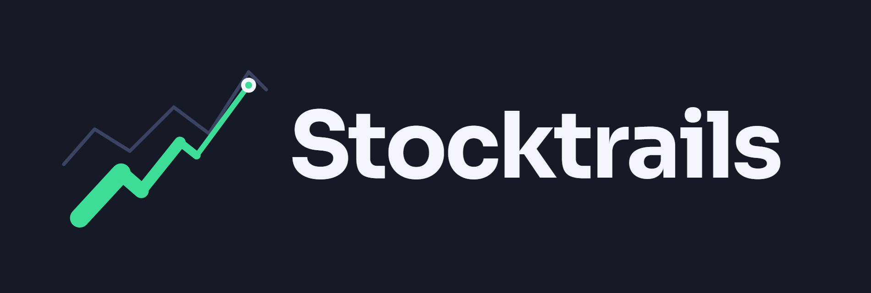
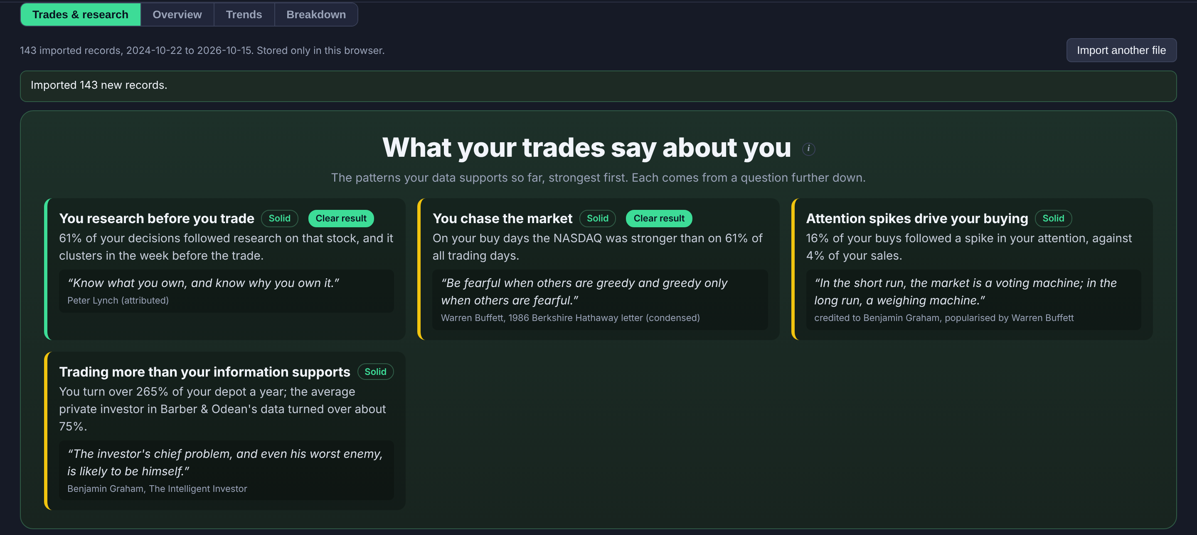
Your trades already know your biases.
We prove which habits to change, before your next buy.
FinTechathon 2026 · International Track
Topic A: Personal Finance Assistant
Notes:
[0:20] Good morning. We are Stocktrails. Every investor leaves a trail: the stocks they research and the trades they make. We turn that trail into evidence: which of your habits cost you money, and which rule would have fixed it. Proven on trades the rule had never seen, before we recommend it.

Slide 2



Meet Alex: 140 buys and one expensive habit
THE STORY
A stock is up 12%
22:40, first look
Buys within the hour
in the last 20 days. Everyone is talking about it.
Alex opens it on a finance portal after work.
No second look, no plan, size above the usual.
-7 pts
Alex never sees the pattern.
Each trade feels like a fresh decision. Only the full trail shows that following run-up before a buy costs dearly the following month.
vs the NASDAQ, one month later
Notes:
[0:35] Meet Alex, one of the investor profiles in our test lab. A stock has run up 12%. Alex looks at it late in the evening and buys within the hour. A month later it lags the market by seven points. Then it happens again. Alex never sees the pattern, because each trade feels like a fresh decision. Only the full trail shows that following a run-up before a buy costs dearly the following month.

Slide 3
Every tool tells you what to buy. None checks how you buy
THE GAP
What investors get today
What is missing: evidence about you
Screeners and stock signals
Price targets and news feeds
Robo-advice and chatbots
Opinions about the market
What you researched, and for how long
When and how you actually bought
Which habit cost you, measured
Whether a fix works, before you rely on it
“The investor’s chief problem, and even his worst enemy, is likely to be himself.”
Benjamin Graham, The Intelligent Investor
Notes:
[0:30] The market is full of tools that tell you what to buy. Screeners, signals, targets, and now chatbots. They all give opinions about the market. Nobody looks at the one thing the investor controls: their own behaviour. Benjamin Graham said it 75 years ago: the investor's worst enemy is likely to be himself. That is the gap we fill.

Slide 4





Four ideas that make Stocktrails different
WHAT IS NEW
Attention becomes data
Every stock you research on 15+ finance portals is captured automatically and joined to the trades you import.
Proof on unseen trades
A rule is fitted on your past and must hold up on later trades it never saw before we recommend it.
Statistics find, AI decides
Statistics prove which habits are real. Then an AI agent decides every live moment next to you, saved once and judged by time.
Private by construction
Broker trades never leave your device. The AI sees aliases, ratios and months, never amounts or names.
And it closes the loop: find the bias → adopt a rule → track that you keep it → check the next buy
Notes:
[0:45] Four ideas make this new. One: attention becomes data. We capture what you research, automatically, and join it to your broker trades. Two: proof on unseen trades. Every rule is fitted on your past and must hold up on later trades it never saw. Three: the statistics find the biases, and then the AI decides. An AI agent makes its own call at every live moment, in parallel with the investor, saved once, and time tells who was right. Four: privacy by construction. Your trades never leave your device. And together they close the loop, from finding a bias to checking your next buy.

Slide 5
The product
01
Four screens, one loop: capture, understand, change, compare
Notes:
[0:05] Let me show you the product first, then how it works underneath.

Slide 6
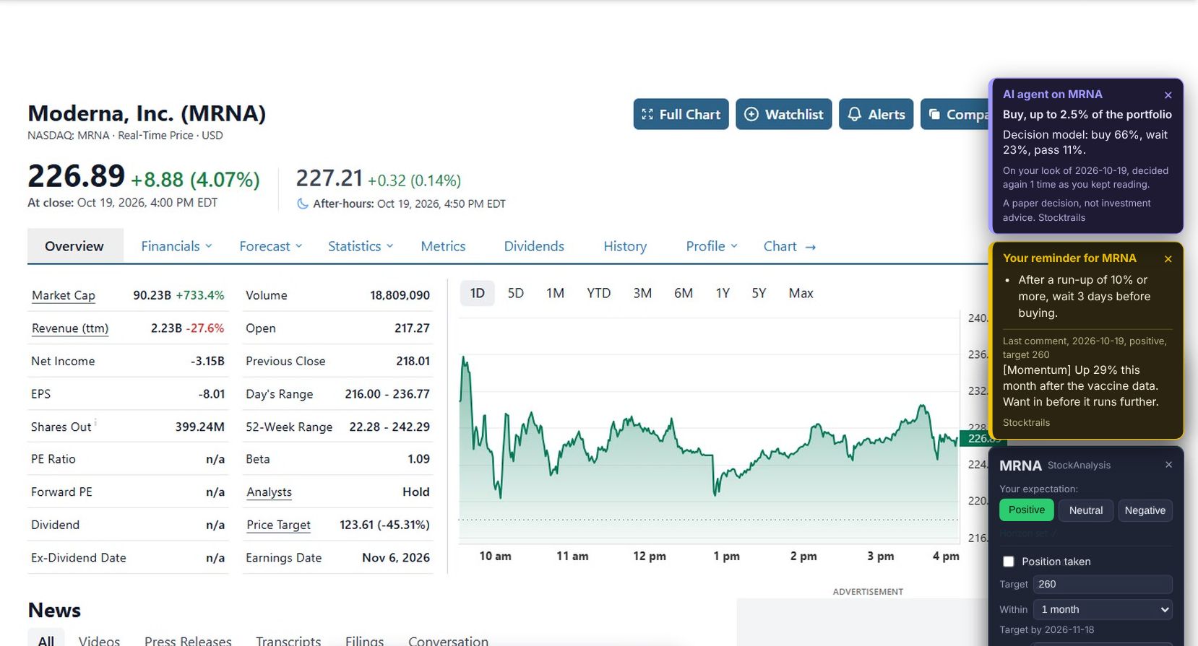



It starts while you browse
01 · THE PRODUCT · POP-UPS
Captured automatically
Opening a stock page logs the stock, time, active reading time and portal. No click needed.
Label your expectation
The pop-up card records Positive, Neutral or Negative, a target, a horizon and a short note why.
Your rules and the AI speak up
A reminder from your own rule appears on the stock page. The AI agent's paper decision waits until you ask.
Notes:
[0:30] It starts in the browser. When you open a stock on Yahoo Finance, TradingView or any of 15 portals, Stocktrails records it automatically. A small pop-up lets you label your expectation, positive or negative, with a target, a horizon and a note on why. Every call is later followed to its deadline. The same page can show a reminder from one of your own rules, and the AI agent's paper decision, which stays hidden until you ask for it.

Slide 7
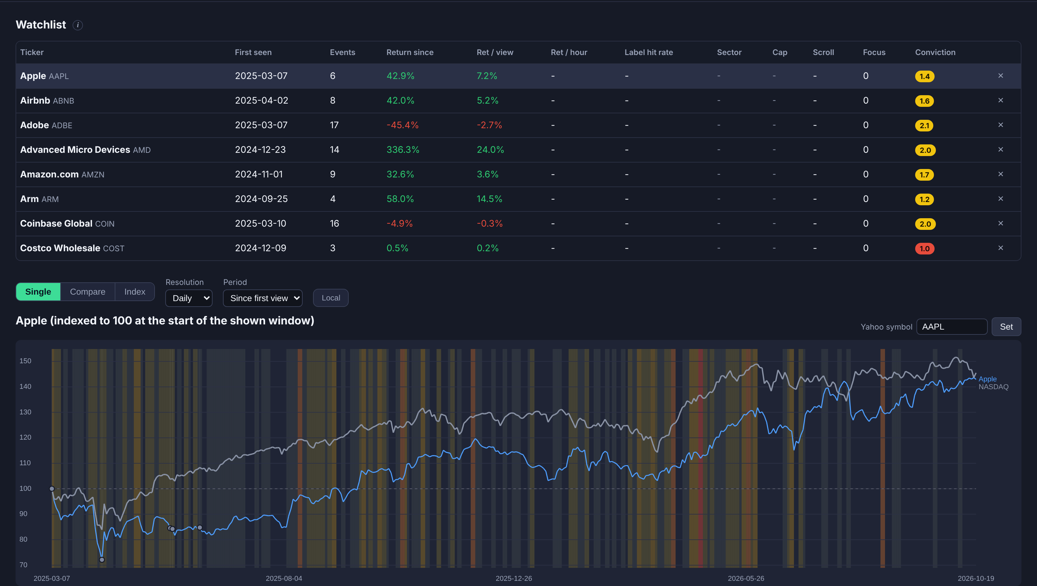

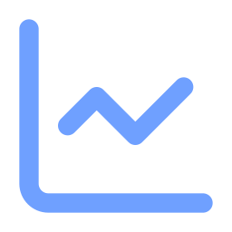

My Stocks: what happened after you looked
01 · THE PRODUCT · MY STOCKS
Watchlist built from attention
Return since first look, return per view and per hour of research, label hit rate, conviction.
Your attention on the chart
Every view is a dot, sized by views and coloured by your label, against the NASDAQ rebased.
An index of your attention
A no-leverage portfolio built from what you looked at, compared with the market.
Notes:
[0:30] My Stocks answers a simple question: what happened after you looked? The watchlist builds itself from your attention: return since your first look, return per hour of research, how often your labels were right. On the chart every dot is a visit, sized by how often you looked and coloured by your label, against the NASDAQ.

Slide 8



Trades & research: what your trades say about you
01 · THE PRODUCT · TRADES & RESEARCH
Import a broker file
CSV or XML from 10+ brokers, read and kept in the browser.
Joined to your research
Each buy and sell is linked to what you looked at before it.
Graded findings
Each pattern is marked solid, indicative or not enough data.
Research habits, chasing rises, herding, the disposition effect, overconfidence, timing and more, each with its evidence.
Notes:
[0:35] Trades and research is the heart of the app. You import the export file from your broker; it is read in the browser and never uploaded. Every trade is joined to the research before it. The result opens with what your trades say about you: the patterns your data supports, strongest first, each graded solid, indicative or not enough data.

Slide 9
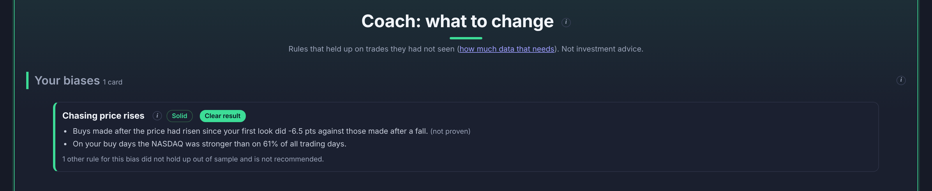
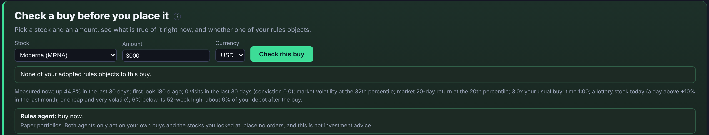
From a bias to a rule, and a check before the next buy
01 · THE PRODUCT · TRADES & RESEARCH
1
Bias found
Buys made after a run-up did worse than buys made after a fall.
2
A rule that held up
Fitted on earlier trades, tested on later ones it never saw.
3
Adopt with one click
The rule joins your personal playbook.
4
Check a buy
Before you place it: which of your rules object, right now, and why.
Paper portfolios and checks only: Stocktrails never places an order, and nothing here is investment advice.
Notes:
[0:40] Now the coach turns findings into action. Here it found that buys made after a run-up did worse than buys made after a fall. A rule is only proposed when it held up on trades it had not seen, and the app says so when it did not. One click adopts it. And before the next buy, Check a buy measures the stock and the market right now and tells you which of your rules object. No order is ever placed by us.

Slide 10

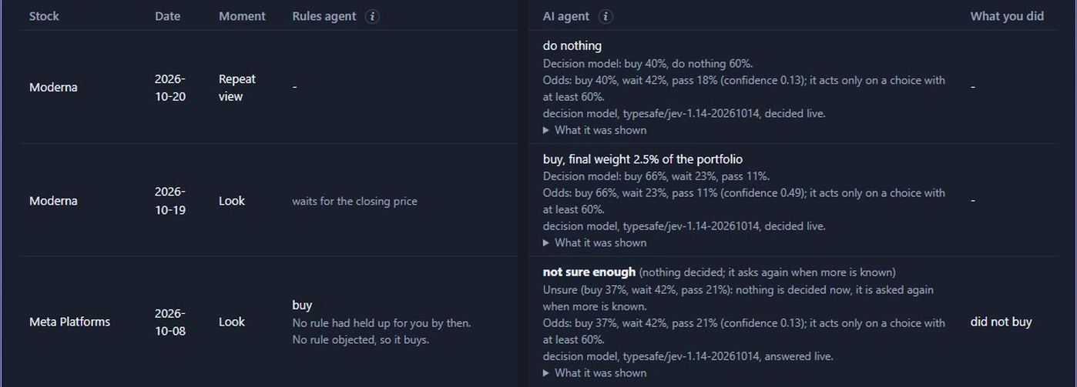

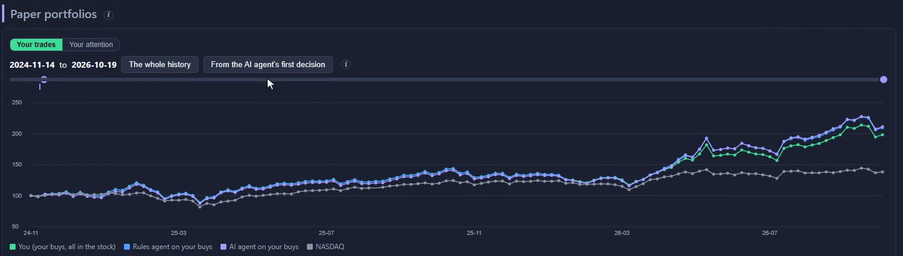
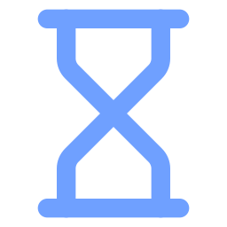
AI and investor decide in parallel. Time tells the result.
01 · THE PRODUCT · AI AGENT
Statistics find the biases
Tests on your own trail show which habits are real. Pure maths, on your device.
Then the AI decides
At each live moment the AI agent weighs the same facts you have: buy, wait or pass, with odds. It acts only on a choice of 60% or more, otherwise it asks again later.
Saved once, never revised
Every decision is stamped with its time. Live moments only: no backfilling, no hindsight. Hidden until you ask, so it never sways your call.
Time tells the result
Its paper portfolio runs next to yours and the rules agent's, against the NASDAQ.
Notes:
[0:40] This is the new part. First the statistics identify your biases and prove which rules hold up. Then the AI decides. At every live moment, a rules agent and an AI agent each make a call next to you: buy, wait or pass, with odds, and the AI acts only when its confidence is high enough, otherwise it says not sure enough and asks again later. Each decision is saved once with its time. It is never revised and never backfilled, and its verdict stays hidden until you ask, so it does not sway your own view. Then time tells the result: the paper portfolio of the AI agent runs next to yours, the rules agent's, and the NASDAQ. Paper decisions only, not investment advice.

Slide 11

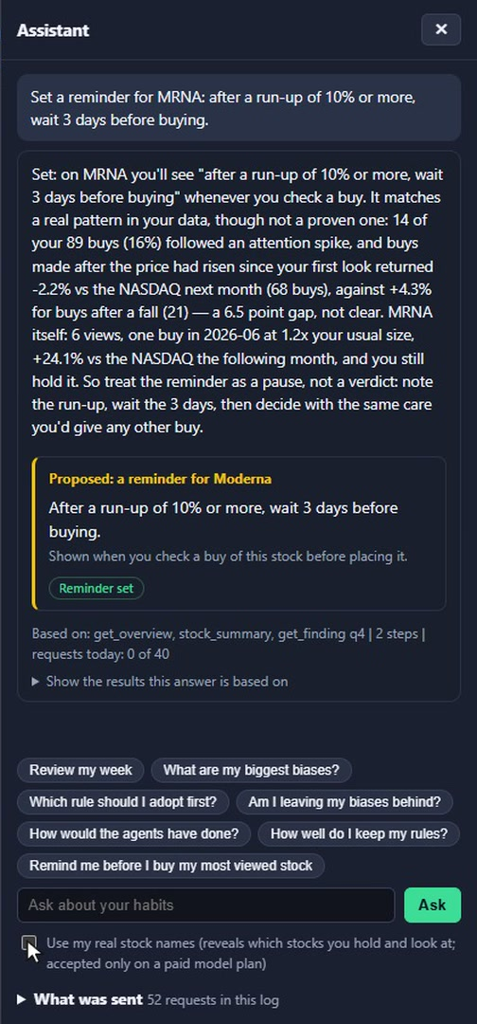



Ask your data: an assistant that shows its work
01 · THE PRODUCT · ASSISTANT
You ask in your own words
“Which rule should I adopt first?”
It reads your results on the device
Read-only tools such as get_biases and get_rule; up to five steps of digging.
Every number is checked
Numbers in the answer are matched against the results; the evidence is one click away.
It proposes, you decide
Adopt, retune or retire a rule as a card. Nothing changes without your click.
Notes:
[0:35] The assistant lets you ask your data in your own words. It does not guess: it reads the results already computed on your device with read-only tools, can dig up to five steps deep, and every number in its answer is checked against those results. When it suggests something, adopting a rule for example, it appears as a card. Nothing happens until you click.

Slide 12
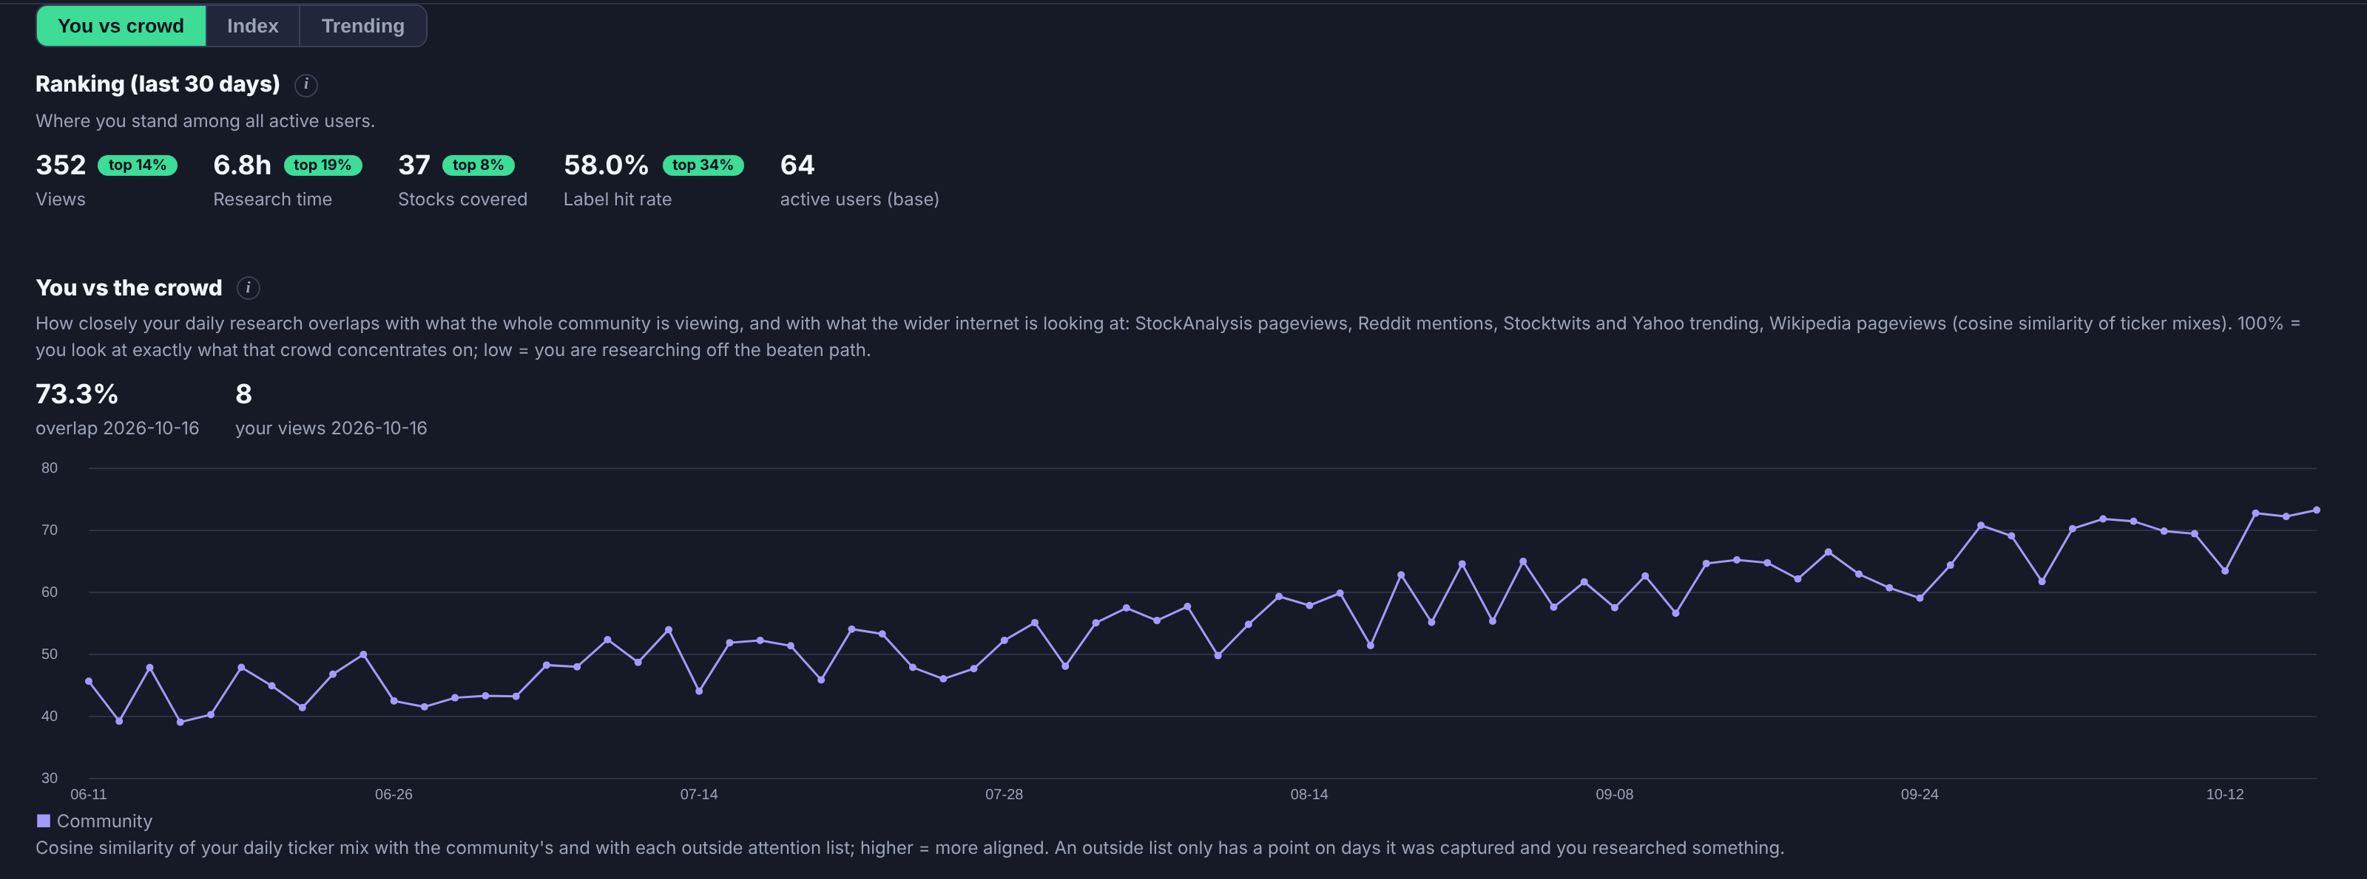
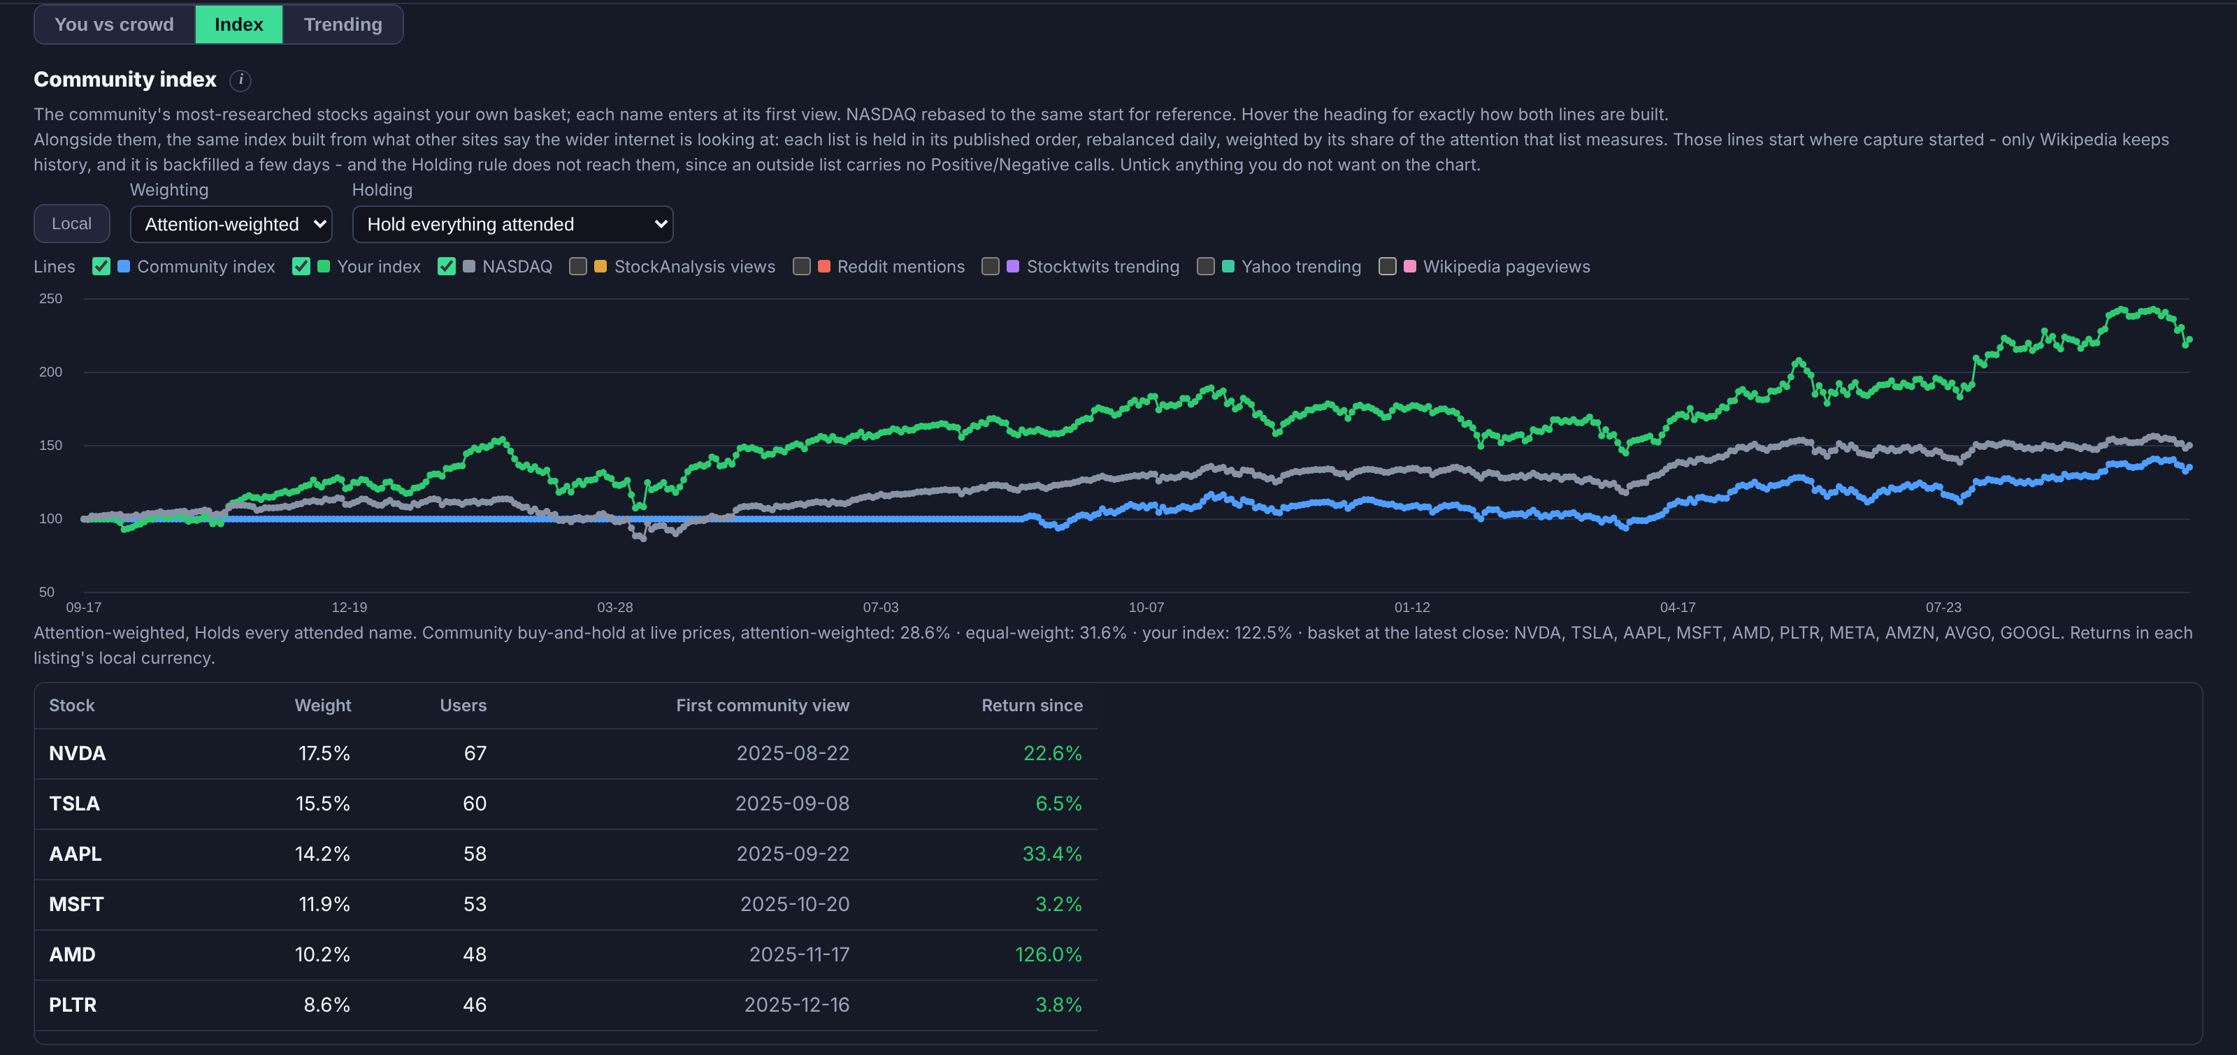



Community: you against the crowd
01 · THE PRODUCT · COMMUNITY
Where you stand
Your research time, coverage and hit rate ranked among all active users.
Crowd overlap
How close your research is to the community and to Reddit, Stocktwits, Yahoo and Wikipedia attention.
Anonymous by design
Only aggregates with minimum group sizes are shown.
Notes:
[0:30] Community puts you next to the crowd. Where you rank in research time and hit rate, how closely your research follows what everyone else, and the wider internet, is looking at, and an index built from the community's attention. It also feeds a bias: buying what the crowd is piling into. Everything here is anonymous aggregates with minimum group sizes.

Slide 13
System architecture
02
Heavy lifting on the device; the cloud only sees what it must
Notes:
[0:05] How is it built?

Slide 14
The device does the thinking; only de-identified results leave
02 · SYSTEM ARCHITECTURE
ON YOUR DEVICE · Chrome extension · web app · Android app
Capture
15+ portals, views, labels
Attention store
local, offline-first
Analytics core
decisions, bias tests, rules, agents. Pure code, no model.
Dashboard
coach, check a buy
Broker import
CSV / XML, 10+ brokers
Trade ledger
never synced
AI client + privacy filter
aliases, ratios, months
own attention rows (optional sync)
de-identified results only
CLOUD · Supabase, EU region · JWT on every call · row-level security
Sign-in
Google OAuth
Postgres
your attention, isolated per user
Community
aggregates with group-size floors
Edge functions
AI coach · prices · trending
Notes:
[0:40] The architecture follows one principle: the device does the thinking. Capture, the trade ledger and the whole analytics core run in the browser or the app. The analytics core is plain, tested code with no language model in it. The broker ledger, outlined in red, is never synced anywhere. Only two things can reach the cloud: your own attention rows if you choose to sync, and de-identified results when you use the assistant. The cloud is Supabase in the EU, with JWT checks and row-level security on every call.

Slide 15
Core algorithms
03
Statistics find the biases and prove the rules, in code that never guesses
Notes:
[0:05] Now the core: how a habit becomes a verdict.

Slide 16

From raw trades to a verdict in five steps
03 · CORE ALGORITHMS · PIPELINE
1
2
3
4
5
Decisions
Context
Bias tests
Rules
Verdict
All fills of one stock, one side, one day form one decision. Outcome: return against the NASDAQ one and three months later.
What was true before the buy: recent rise, market turbulence, time of day, research done, size against your usual buy.
Eleven questions. A calendar-shift test asks: could chance alone produce this pattern?
Each bias becomes a concrete rule with a setting, fitted only on outcomes known at the time.
Supported, indicative, unclear or untested, with the range shown to the user.
Adopt
one click by you
Adherence
kept vs broken, results of each
Pre-trade check
your next buy against your rules
Notes:
[0:40] Five steps. First, trades are grouped into decisions and each gets an outcome: how it did against the NASDAQ a month and three months later. Second, context: what was true before the buy, measured only from data available that day. Third, eleven bias tests, each checked against what chance alone would give. Fourth, every bias becomes a concrete rule. Fifth, a verdict. Then the loop: you adopt it, we track whether you keep it, and we check your next buy.

Slide 17
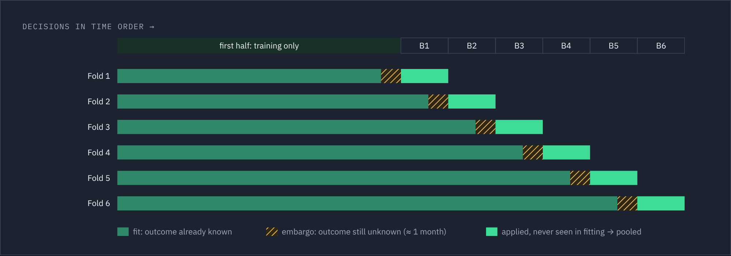
A rule must work on trades it has never seen
03 · CORE ALGORITHMS · VALIDATION
0 of 216
rules recommended in simulated markets with no real effect
48 of 50
planted habits found: 5 investor profiles × 10 random seeds
Walk-forward with an embargo. The rule is fitted on the past, applied to the next block, and the window moves on. Trades whose outcome was still unknown are held back, so the future never leaks into the fit.
+16.3 pts
Shift test against chance. Your buying pattern is slid along the calendar to see what luck alone would produce, keeping calm and turbulent market stretches intact.
per flagged buy, out of sample, for “Wait after a run-up”
Notes:
[0:40] This is what makes the advice trustworthy. A rule is fitted on the first part of your history and judged only on later trades it never saw, block by block, with an embargo so nothing from the future leaks in. A second test slides your buying pattern along the calendar to see what chance alone would give. In simulated markets with no real effect, zero of 216 rules were recommended. Across five investor profiles and ten seeds, the planted habit was found 48 times out of 50. For our demo investor, waiting after a run-up was worth 16 points per flagged buy, out of sample.

Slide 18
Security design
04
Private by construction, not by promise
Notes:
[0:05] Finally, security, which is built into the design rather than added on.

Slide 19



Your trades stay home. Only anonymous facts may leave
04 · SECURITY DESIGN · DATA MINIMISATION
Never leaves your device
May leave, only with your consent
Imported broker files and the trade ledger
Amounts, quantities and prices paid
ISINs, broker and account details
Real stock names (unless you opt in)
Your notes, until you preview and approve
Counts, shares and results as plain facts
Aliases: “Stock 3” instead of a ticker
Ratios: “2.2× your usual buy”
Months instead of exact dates
Redacted notes, classified once and cached
Checked twice, tested always: a privacy filter in the browser, a second check on the server that refuses private data, and a test that scans every request.
Notes:
[0:35] Data minimisation is enforced in code. On the left, what never leaves: broker files, amounts, prices paid, ISINs, account details. On the right, what may leave, and only after consent: plain facts with stock aliases, ratios instead of amounts, months instead of dates. Every result passes a privacy filter in the browser, the server checks again and refuses anything that looks private, and our test suite scans every request the system sends.

Slide 20





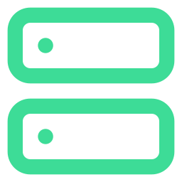


Three permission tiers, and the agent can never trade
04 · SECURITY DESIGN · PERMISSIONS
T0
T1
T2
Read only
You decide
Not offered
Names tools from a fixed catalogue that read results on your device. Every argument is checked.
Proposes an action: adopt, retune or retire a rule, a reminder, a note. Applied only on your click and logged.
Placing orders, broker credentials, uploading trades. No tool, endpoint or code path exists.
Consent, off by default
Deny-by-default access, JWT
Daily cap per user
Prompt-injection guards
“What was sent” log
No content kept on the server
Kill switch
GDPR principles, no advice
Notes:
[0:30] Permissions come in three tiers. T0: the agent can only read results computed on your device. T1: it can propose an action, but nothing is written until you click. T2, placing orders, holding broker credentials or uploading trades, does not exist: there is no tool, endpoint or code path for it. Around that: consent off by default, deny-by-default access, a daily cap, prompt-injection guards, a log showing exactly what was sent, nothing stored on the server, and a kill switch.

Slide 21



Where Stocktrails goes next
OUTLOOK
Community rankings
Richer rankings of research discipline and habit improvement, anonymous and with minimum group sizes.
World view by country
Attention data from individual countries: how investors in each market research, and where they look.
Attention meets fundamentals
Combine what people look at with fundamental data, to tell attention that leads to informed buys from attention that chases noise.
Broker partnerships
Work with brokers for comprehensive attention capture, beyond the portals we see today, with the same privacy design.
Notes:
[0:20] Where we go next. Richer community rankings. A world view with attention data from individual countries. Attention combined with fundamental data. And partnerships with brokers, so attention can be captured comprehensively, not only on the portals we see today.

Slide 22
Know your trail. Change your habits.
Notes:
[0:15] Know your trail. Change your habits. Thank you.

