Slide 1

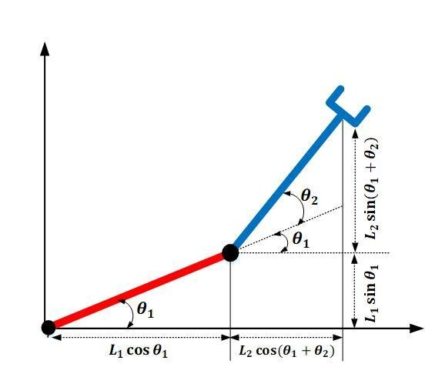
MODELLING THE INVERSE KINEMATICS OF 2 LINK MANIPULATOR USING DEEP NEURAL NETWORK
TEAM MEMBERS MENTORS
ADITYA RAJ (ECE) TUSAR SAHU
RAJIB DAS (EPH ) APURBA PRASAD PADHY

