Slide 1
JIRA Classic and Agile

Slide 2
Course Objectives
JIRA Overview
Why JIRA
Audience in JIRA
JIRA Menus
Access to JIRA
Project , Workflow , Issue
Working With an Issue
Searching for Issues
Generating Reports
Browsing a Project
Customizing the Dashboard
JIRA Agile

Slide 3
JIRA Overview
JIRA is a Issue Tracking / Project management tool by Atlassian, Inc.,
It provides bug tracking, issue tracking, and project management.
JIRA is been used by 25,000 + customers in 122 countries around the globe.
JIRA is truncation of Gojira, the Japanese name for Godzilla

Slide 4
Why JIRA?
JIRA is more internally customizable.
Single Source of truth with all info centralized.
All Changes are automatically audited
Dashboard make up-to-minute status reports a breeze.
Extensible Platform
Flexible Planning
Runs Anywhere (Web Browser)

Slide 5
Who Uses JIRA?
Business Analyst
Business/Product Owner
Project Manager
Development Group
Quality Assurance Group
Support team
BRE Team(Deployment)

Slide 6
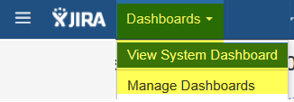
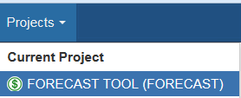
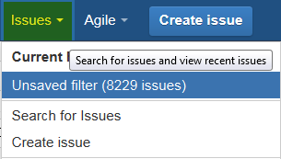
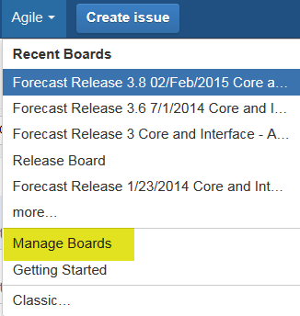
JIRA Menus

Slide 7
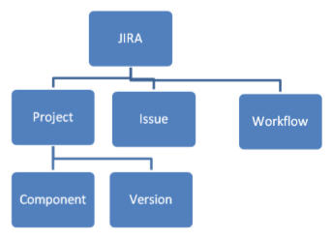
Structure of JIRA

Slide 8
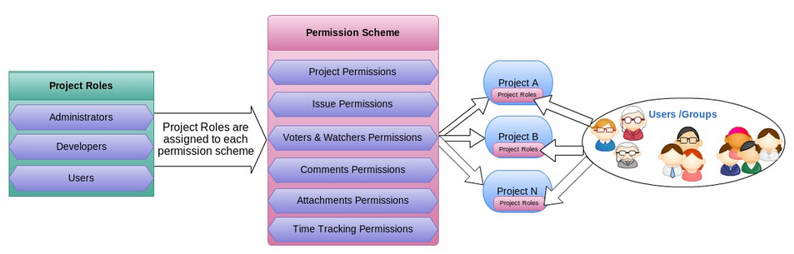
Access to JIRA

Slide 9
Project in JIRA
A JIRA project is a collection of issues, and is defined according to your organization's requirements. For example, a JIRA project could be:
a software development project
a marketing campaign
a helpdesk system
a leave request management system
a website enhancement request system

Slide 10
What is a Component?
A project component is a logical grouping of issues within a project. Each project may consist of various components (or none), depending on your organization's needs.
For example, a software development project could consist of components called 'Documentation', 'Backend', 'Email Subsystem', 'GUI'. A website enhancement request system might consist of components called 'Products', 'Contact Us', etc.,

Slide 11
What is a Version?
For some types of projects, particularly software development, it is useful to be able to associate an issue with a particular project version (e.g. 1.0 beta, 1.0, 1.2, 2.0).
Issues have two fields that relate to versions:
Affects Version(s) — this is the version(s) in which the issue is manifesting. For instance, a software bug might affect versions 1.1 and 1.2.
Fix Version(s) — this is the version(s) in which the issue was (or will be) fixed. For instance, the bug affecting versions 1.1 and 1.2 might be fixed in version 2.0. Note that issues which do not have a Fix Version are classified as Unscheduled.
Versions can be in one of three states: Released, Unreleased or Archived. Versions can also have a Release Date, and will automatically be highlighted as 'overdue' if the version is Unreleased when this date passes.

Slide 12
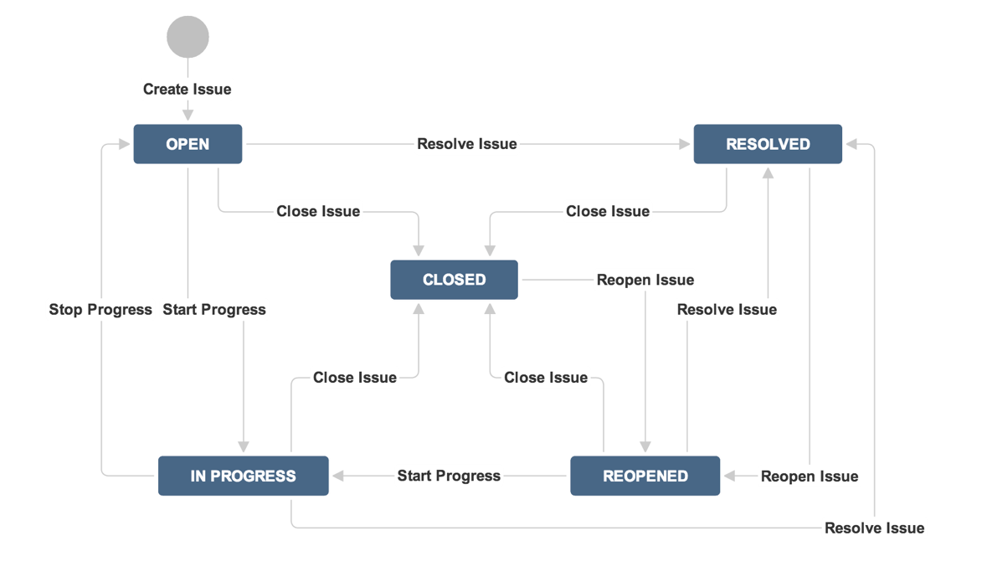
Workflow

Slide 13
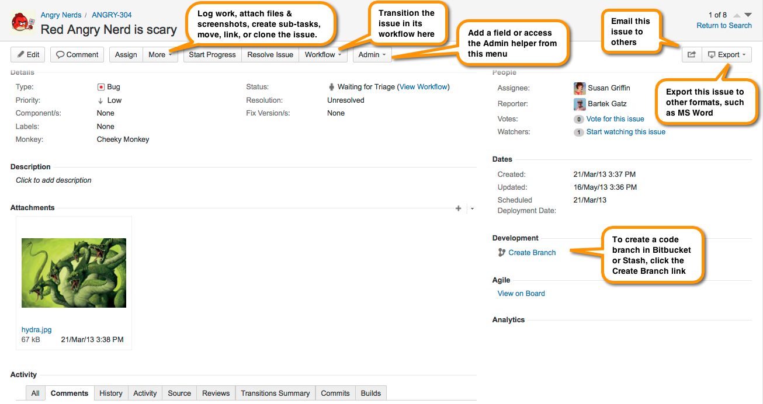
What is an Issue?

Slide 14
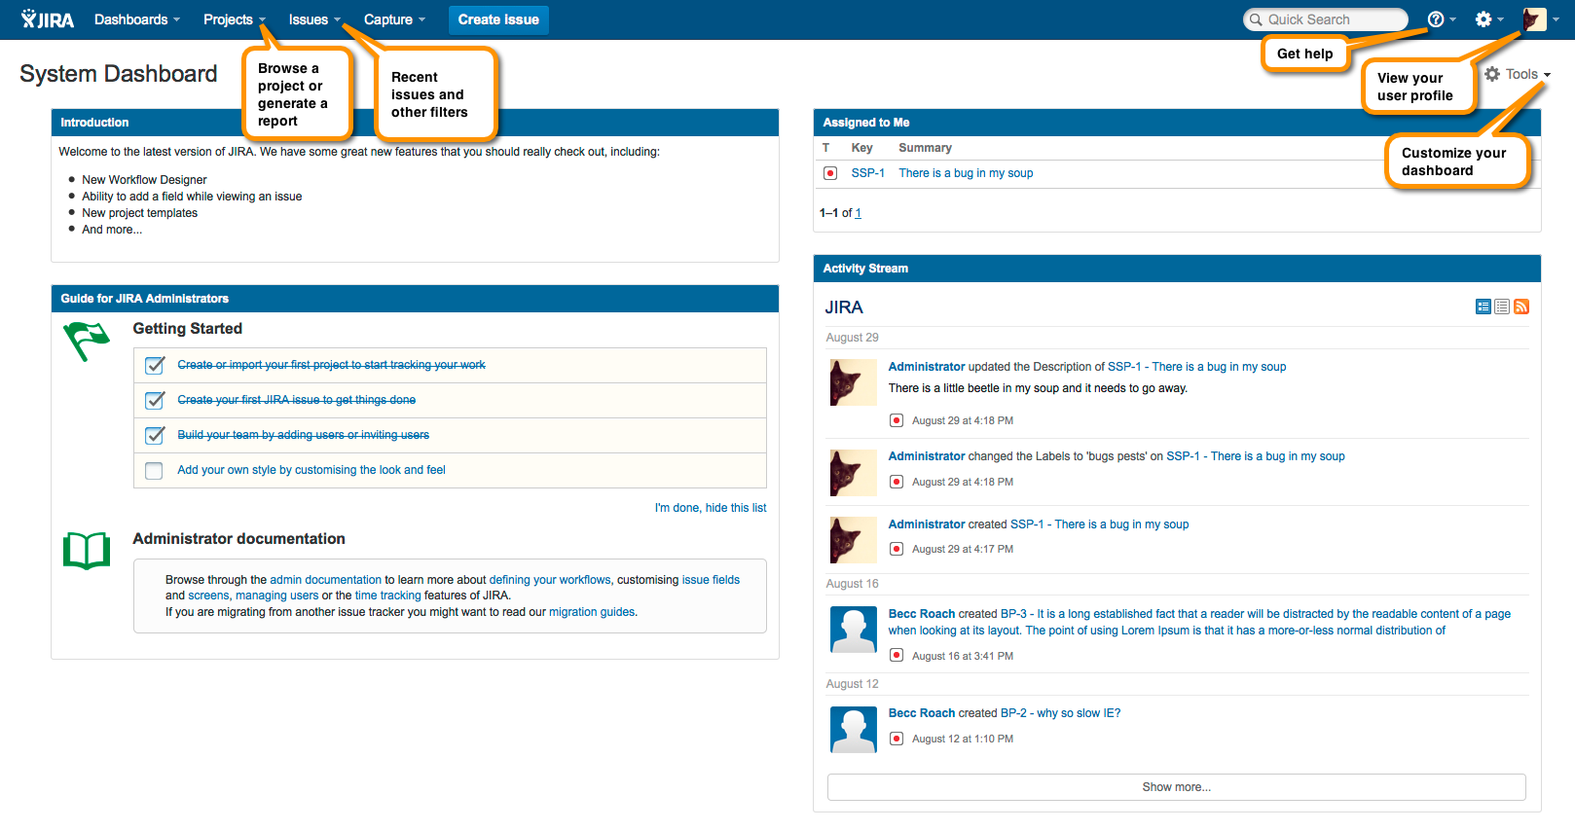
Dashboard in JIRA

Slide 15
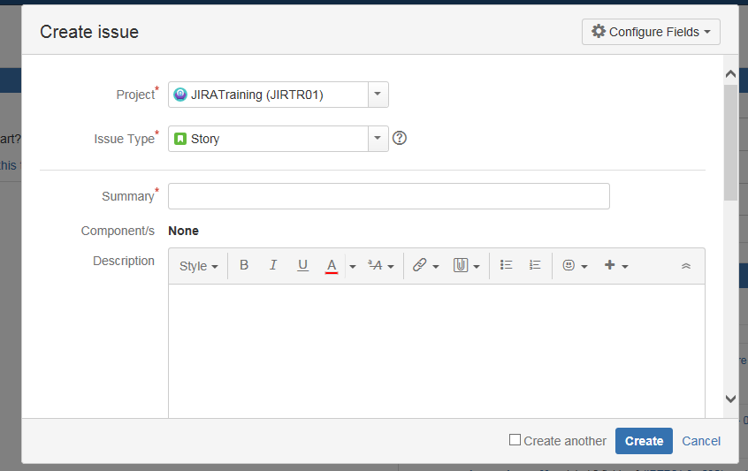
Working with an Issue
Create Issue
Click to create and issue
Select the Project
Select the Issue type
Give the crisp complete detail about the issue
Select Components
Detailed description of the Issue here

Slide 16
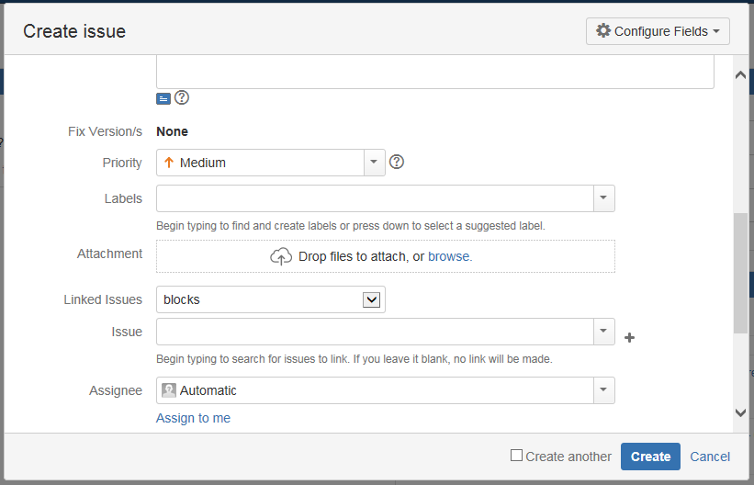
Working with an Issue
Create Issue…
Fix version of the issue
Select Priority of the issue
Check this to Clone the issue

Slide 17
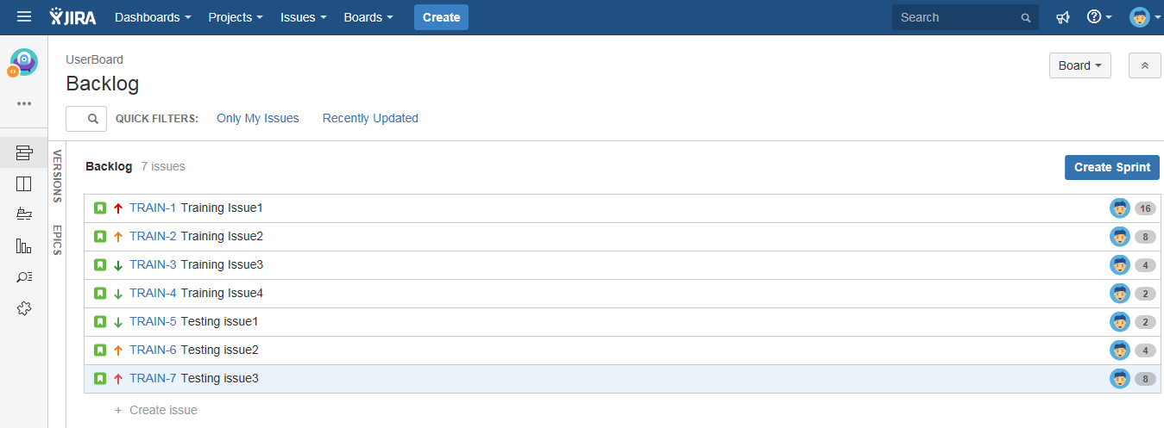
Working with an Issue
Issues Created

Slide 18
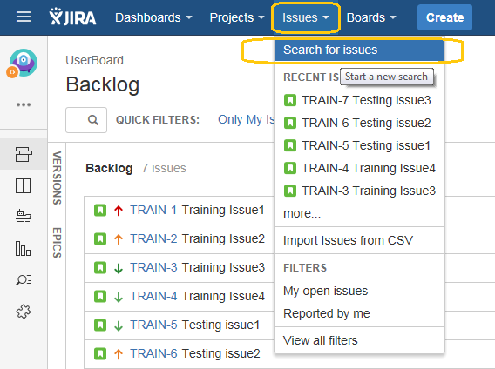
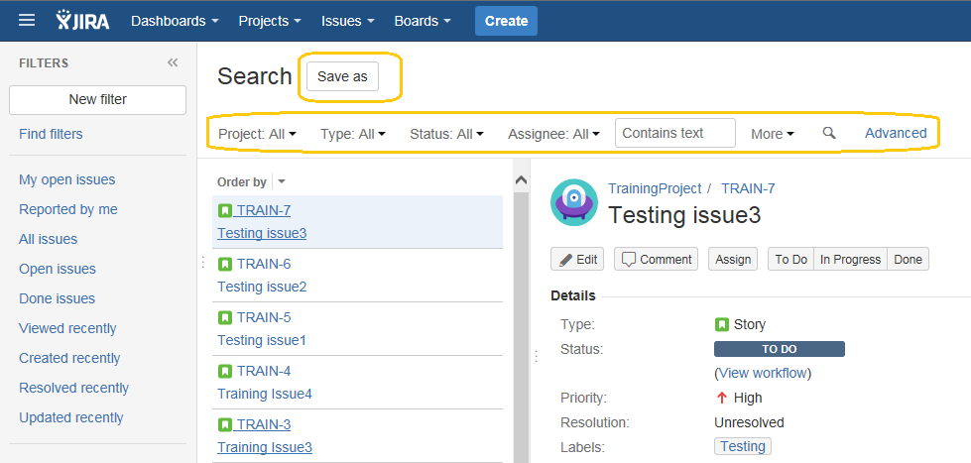
Working with an Issue
Search Issues – Basic Search
You can define your search criteria in three different ways: quick search, basic search or advanced search.

Slide 19
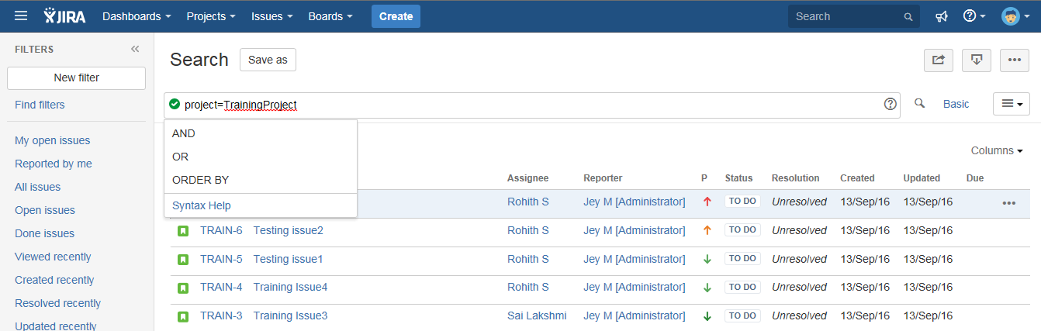
Working with an Issue
Search Issues – Advanced Search

Slide 20
Creating Sub task
Creating a sub-task
Working with sub-tasks
Searching for sub-tasks
Converting a standard issue to a sub-task
Converting a sub-task to a standard issue
To create a sub-task:
Navigate to the issue you would like to be the parent issue of the sub-task you are about to create.
Select More > Create Sub-Task. You will see the Create Subtask screen.
Fill in the details as needed, and then click Create at the bottom of the page.

Slide 21
Viewing an Issue's Change History
An issue's change history is a record of changes made to an issue, including:
creator of the issue (this may be the same as the reporter, but can be distinct)
changes to an issue field
attachment of a file
deletion of a comment
deletion of a work log
creation or deletion of an issue link
For each change, the following is recorded:
the person who made the change
the time at which the change was made
if an issue field was changed, the new and old values of the field

Slide 22
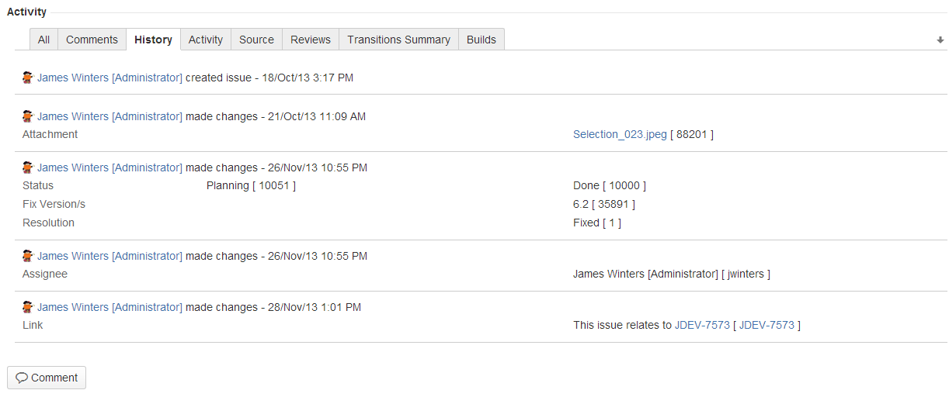
Viewing an Issue's Change History…

Slide 23
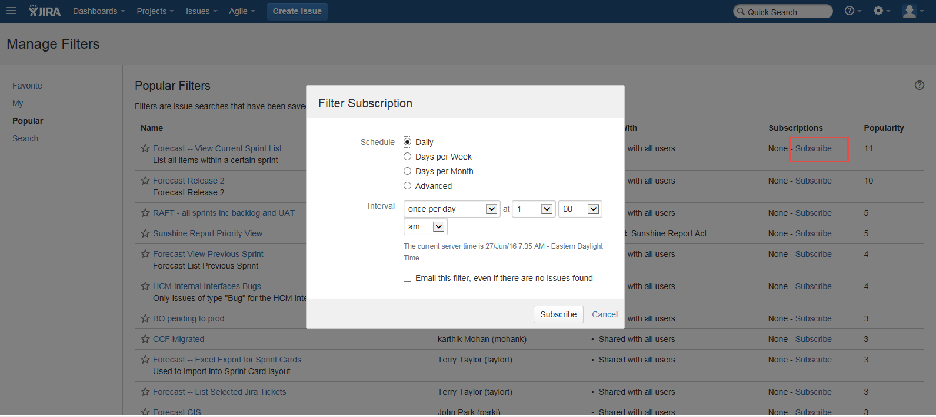
Subscribing to a Filter
Choose Issues > Manage Filters.
A list of available filters is displayed
Locate the filter you are interested in and click on its Subscribe link.

Slide 24
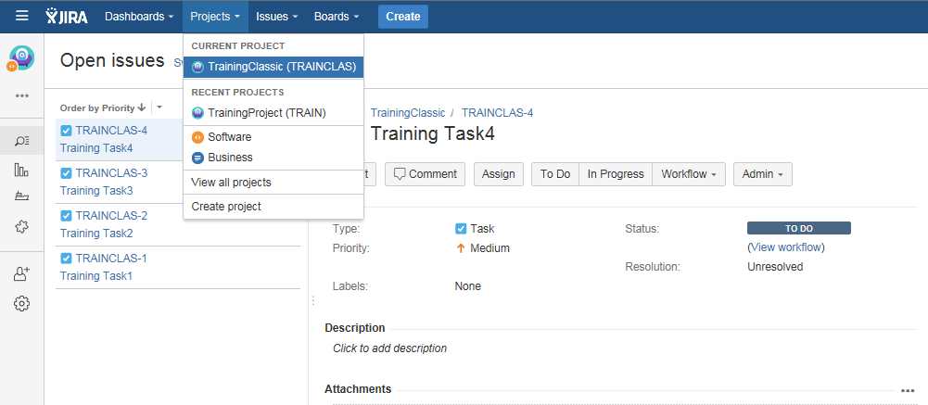
Browsing a Project

Slide 25
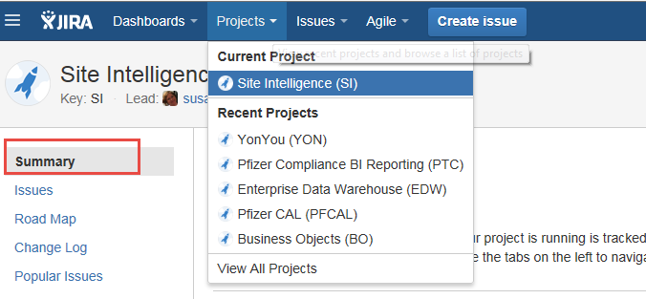
Generating Reports

Slide 26
Generating Reports…
Average Age Report
Created vs Resolved Issues Report
Pie Chart Report
Resolution Time Report
Recently Created Issues Report
Single Level Group By Report
Time Since Issues Report
Time Tracking Report
User Workload Report
Version Time Tracking Report
Version Workload Report
Workload Pie Chart Report

Slide 27
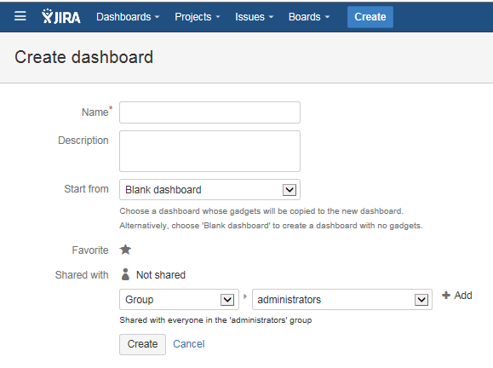
Create New Dashboard

Slide 28
Customizing the Dashboard
The JIRA Dashboards is the first screen you see when you log in to JIRA. It can be configured to display many different types of information, depending on your areas of interest.
The information boxes on the dashboard are called Gadgets.
To create your own dashboard:
At the top right of the Dashboard, click the 'Tools' menu.
Select either 'Create Dashboard' to create a blank dashboard, or 'Copy Dashboard' to create a copy of the dashboard you are currently viewing.

Slide 29
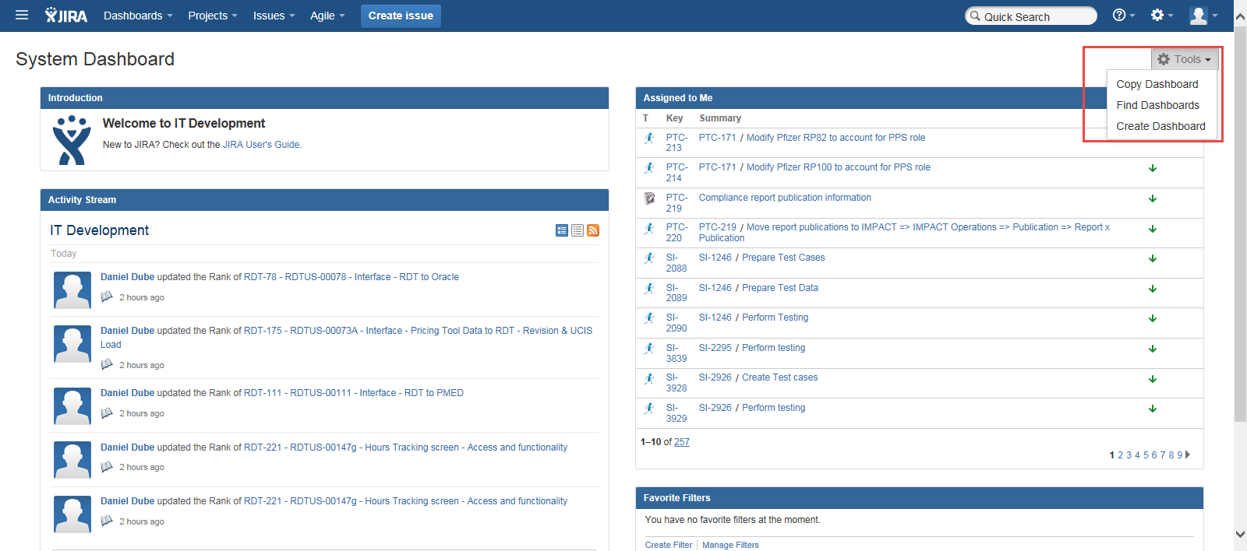
Customizing the Dashboard…

Slide 30

JIRA Agile

Slide 31
Agile
Agile:
is a time boxed, iterative approach to software delivery that builds software incrementally from the start of the project, instead of trying to deliver it all at once near the end.
Sprint:
is a set period of time during which specific work has to be completed and made ready for review. sprints used to be 30 days long, but today we advise one-week or two-week sprints.
User Story:
is a very high-level definition of a requirement, containing just enough information so that the developers can produce a reasonable estimate of the effort to implement it.
Epic:
is essentially a large user story that can be broken down into a number of smaller stories. It may take several sprints to complete an epic.
Velocity:
is a metric that predicts how much work an Agile software development team can successfully complete within a specified time.

Slide 32
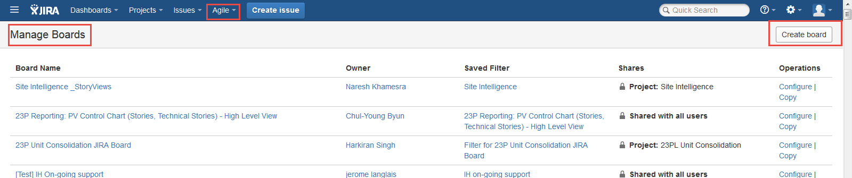
JIRA Agile - Creating a Board
There are two types of boards:
Scrum boards
Kanban boards
JIRA 'Create Shared Objects' global permission access should be available. If you don't have this permission you can still create a board, but it will not be visible to other people as its filter will not be shared.

Slide 33
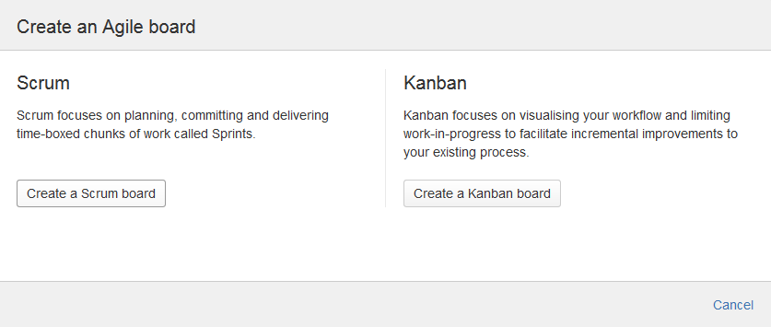
JIRA Agile - Creating a Board…

Slide 34
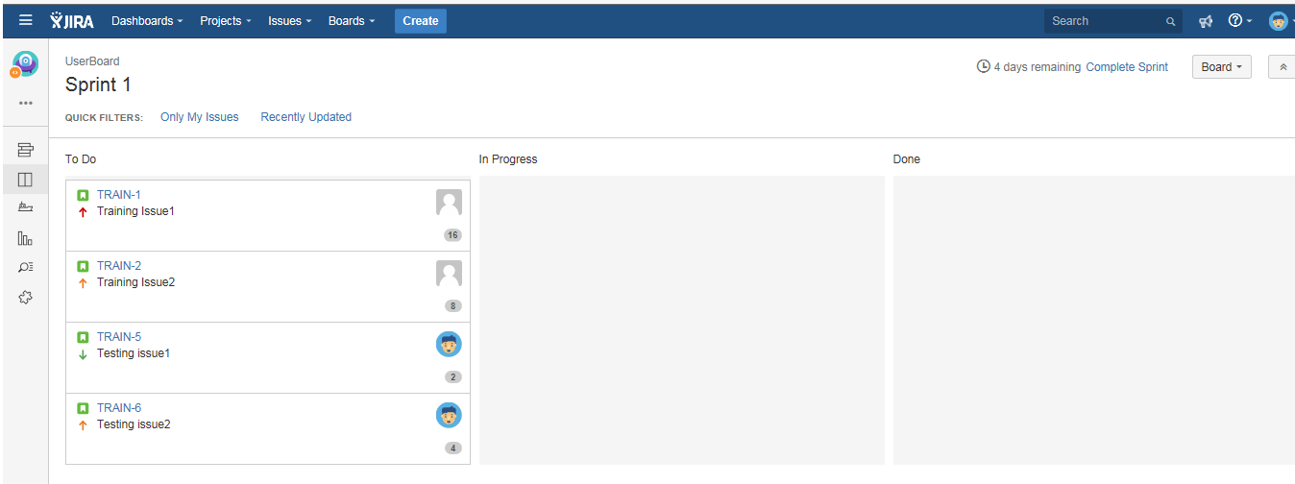
Scrum Board
The Scrum board is usually divided into columns. An example that some teams use is:
Stories – this column contains a list of all the user stories in the current sprint backlog
Not started – this column contains sub tasks of the stories that work has not started on
In progress – all the tasks on which work has already begun
Done – all the tasks which have been completed

Slide 35
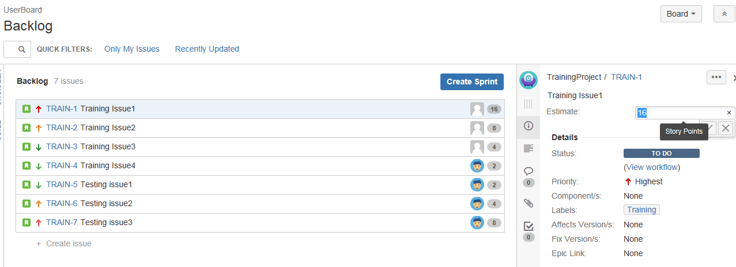
Story Estimation
The user stories can be estimated based on the Story points, Original time, Account and Issue count on the Board. This is based on your administrator’s setting for the project.
Estimate your story

