Slide 1
Jenkins

Slide 2
Executive Summary
Continuous integration systems are a vital part of any Agile team because they help enforce the ideals of Agile development
Jenkins, a continuous build tool, enables teams to focus on their work by automating the build, artifact management, and deployment processes
Jenkins’ core functionality and flexibility allow it to fit in a variety of environments and can help streamline the development process for all stakeholders involved

Slide 3
Session Plan
Continuous Integration
- What is it?
- What are the benefits?
- Continuous build system
Jenkins
- What is it?
- Where does it fit in?
- Why should I use it?
- What can it do?
- How does it work?
- Where is it used?
- How can I get started?
Putting it all together
Conclusion
References

Slide 4
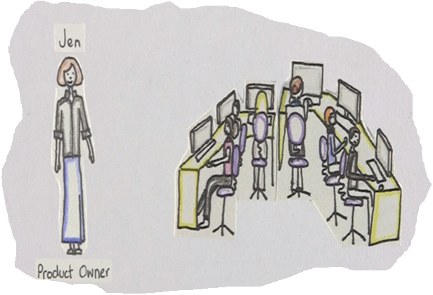
Continuous Integration (CI)
“Continuous Integration is a software development practice where members of a team integrate their work frequently, usually each person integrates at least daily - leading to multiple integrations per day. Each integration is verified by an automated build (including test) to detect integration errors as quickly as possible”
– Martin Fowler
For better understanding:
- https://www.youtube.com/watch?v=h8mDVFp6UjU

Slide 5
CI- What does it really mean?
At a regular frequency (ideally at every commit), the system is:
Integrated
Built
Tested
Archived
Deployed
All changes up until that point are combined into the project
The code is compiled into an executable or package
Automated test suites are run
Versioned and stored so it can be distributed as is, if desired
Loaded onto a system where the developers can interact with it

Slide 6
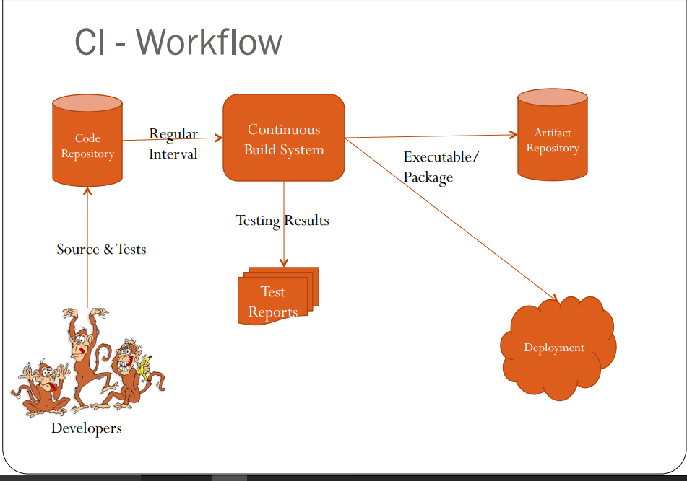

Slide 7
CI - Benefits
Immediate bug detection
No integration step in the lifecycle
A deployable system at any given point
Record of evolution of the project

Slide 8
CI – The tools
Code Repositories
SVN, Mercurial, Git
Continuous Build Systems
Jenkins, Bamboo, Cruise Control
Test Framework
jUnit, Cucumber,CppUnit
Artifact Repositories
Nexus, Artifactory, Archiva

Slide 9

Jenkins
Branched from Hudson
Java based Continuous Build System
Runs in servlet container
Glassfish, Tomcat
Supported by over 400 plugins
SCM, Testing, Notifications, Reporting, Artifact Saving, Triggers, External Integration
Under development since 2005
http://jenkins-ci.org/
Notes:
Kohsuke Kawaguchi, founder of Hudson project which then forked into currenlty known as Jenkins, fonldy calls it a butler which can get your task done according to your order[1]. Hudson as well as Jenkins are very British sounding names where butler services originated and still are pretty popular. I guess that is the motivation which Kohsuke also time to time KK casually mentions in his talks

Slide 10
Jenkins History
2005 - Hudson was first release by Kohsuke Kawaguchi of Sun Microsystems
2010 – Oracle bought Sun Microsystems
Due to a naming dispute, Hudson was renamed to Jenkins
Oracle continued development of Hudson (as a branch of the original)

Slide 11
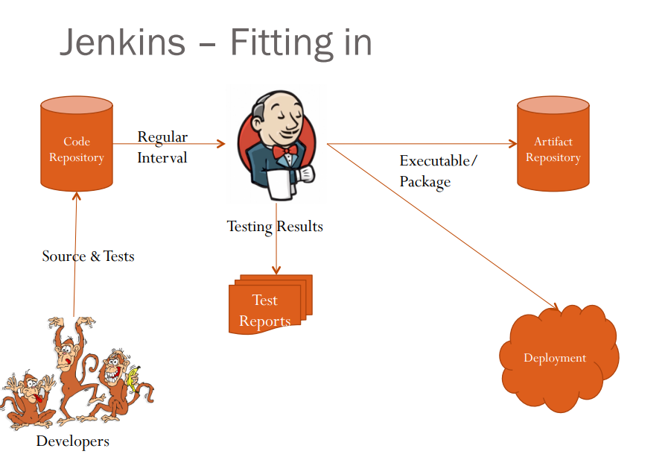


Slide 12
Why Jenkins? Flexibility!
Jenkins is a highly configurable system by itself
The additional community developed plugins provide even more flexibility
By combining Jenkins with Ant, Gradle, or other Build Automation tools, the possibilities are limitless

Slide 13
What can Jenkins do?
Generate test reports
Integrate with many different Version Control Systems
Push to various artifact repositories
Deploys directly to production or test environments
Notify stakeholders of build status
…and much more

Slide 14
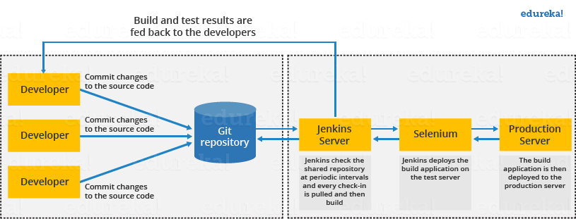
Jenkins Architecture

Slide 15
How Jenkins works - Setup
When setting up a project in Jenkins, out of the box you have the following general options:
Associating with a version control server
Triggering builds
Polling, Periodic, Building based on other projects
Execution of shell scripts, bash scripts, Ant targets, and Maven targets
Artifact archival
Publish JUnit test results and Javadocs
Email notifications
As stated earlier, plugins expand the functionality even further.

Slide 16
How Jenkins works - Building
Once a project is successfully created in Jenkins, all future builds are automatic.
Building
Jenkins executes the build in an executer
By default, Jenkins gives one executer per core on the build server
Jenkins also has the concept of slave build servers
Useful for building on different architectures
Distribution of load

Slide 17
How Jenkins works - Reporting
Jenkins comes with basic reporting features
Keeping track of build status
Last success and failure
“Weather” – Build trend
These can be greatly enhanced with the use of pre-build plugins
Unit test coverage
Test result trending
Findbugs, Checkstyle, PMD

Slide 18
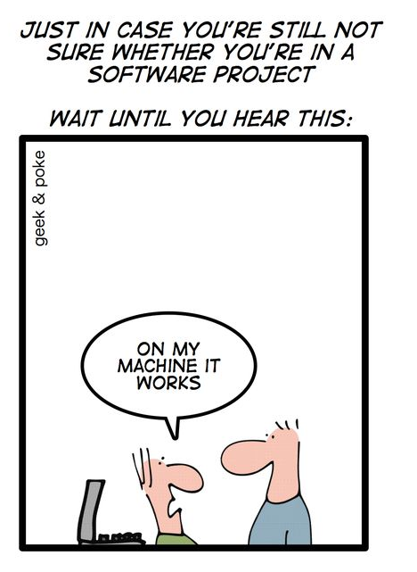
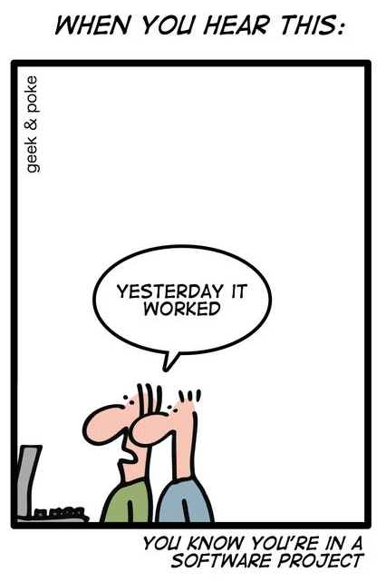
The problem

Slide 19
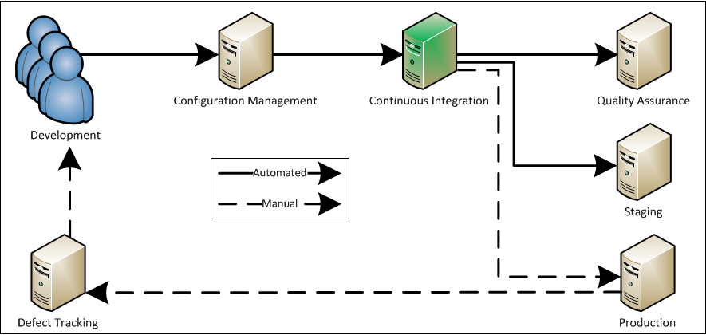
Continuous integration server
Source:
http://www.appfoundation.com/ci/
Notes:
Continuous Integration is used in the following process:
1. Check-In: Developers check-in code to SCM
2. Wait for changes: The CI server polls SCM at some interval, looking for code changes
3. Build and test: When the CI Server detects a code change, it runs the system unit tests and then the build
4. Deploy to QA: On the pass of unit tests and the build, the CI server deploys the system to the QA environment
5. Integration and Acceptance test: The QA environment is now capable of running integration and acceptance tests pending an automated database refresh
6. Deploy to Staging: On the pass of integration and acceptance tests, the CI server deploys the system to the Staging environment
7. Verify Staging: On manual acceptance of the state of the system in the Staging environment, the system is ready to be deployed to production
8. Deploy to Production: A CI Task can then be manually run by pressing a button that deploys the system to production
9. Issues and Features: Production issues and feature requests can then be entered into the defect tracking system (or at any point in the process), to later be assigned to be worked

Slide 20
Continuous integration server
Benefits
Costs
Automation (build, test, deployment)
Integration with SCM
Easy access to daily deliverables
Time trigger/change polling
Build history
Writing/maintenance of CI automated scripts
Team resources
Server setup
Server maintenance
Individual job setup
Team communication

Slide 21
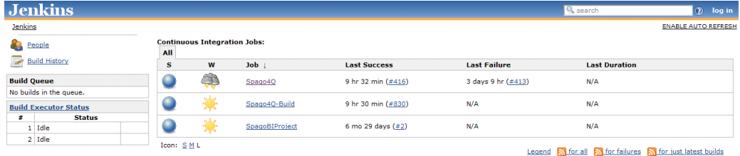
Jenkins by example – Main Page
The main page provides a summary of the projects
Build Executor Status(both idle”)
What’s building (“No builds in the queue”)
Status of the projects

Slide 22
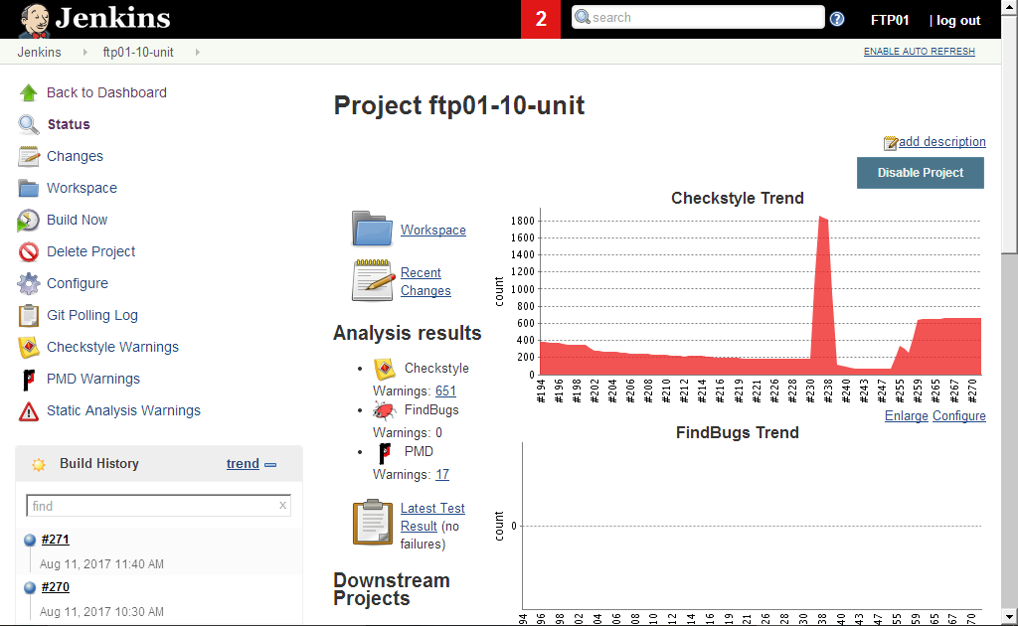
Jenkins By Example – Project Status

Slide 23
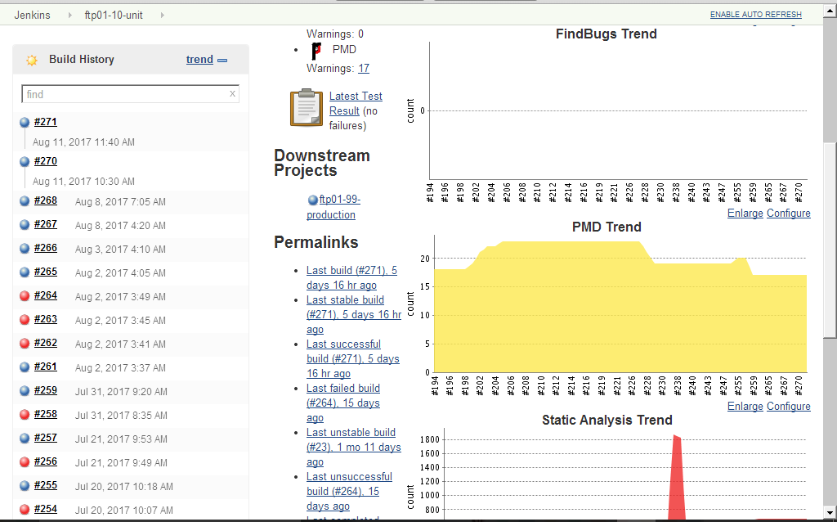
Jenkins By Example – Build History
Charting (depending on plugins)
Status of last several builds

Slide 24
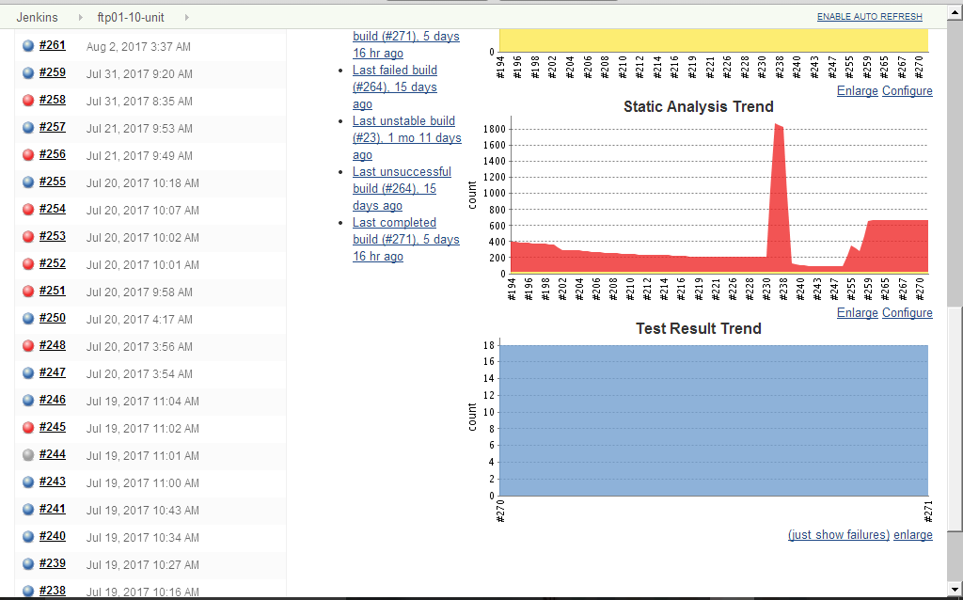
Jenkins By Example – Build History (cont..)
Charting (depending on plugins)

Slide 25
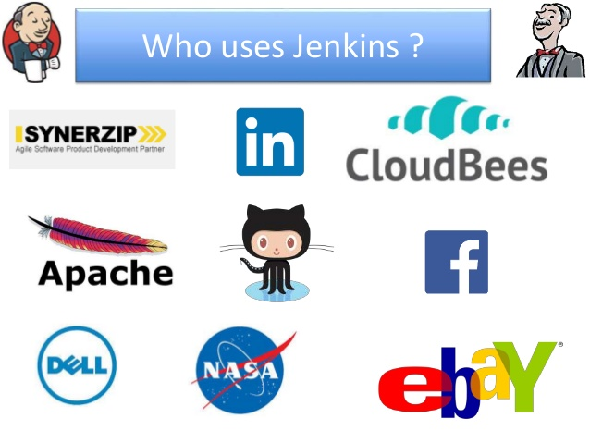
Who uses Jenkins

Slide 26
Tying it into Agile
For an Agile team, Jenkins provides everything needed for a robust continuous build system
Jenkins supports Agile principles by constantly providing access to working copies of software
Jenkins’ extensibility allows the system to adapt to many different pre-existing environments

Slide 27
References
Continuous Integration – Martin Fowler
http://www.martinfowler.com/articles/continuousIntegration.html
Jenkins
https://wiki.jenkins-ci.org
http://jenkins-ci.org/

Slide 28
Summary
Continuous integration is a necessity on complex projects due to the benefits it provides regarding early detection of problems
A good continuous build system should be flexible enough to fit into pre-existing development environments and provide all the features a team expects from such a system
Jenkins, a continuous build system, can be an integral part of any continuous integration system due to it’s core feature set and extensibility through a plugin system

