Slide 1
MAVEN

Slide 2
Course Objective
To understand and execute Maven build tool
- Maven Overview
- POM

Slide 3
Reference Link
Web Link
https://maven.apache.org

Slide 4
MAVEN Overview

Slide 5

Maven - Introduction
Apache Maven is a software project management and comprehension tool.
It is based on the concept of a project object model (POM)
Maven can manage a project's build, reporting and documentation from a central piece of information.
In Yiddish, the word maven means "accumulator of knowledge"

Slide 6

Maven Objective
Making the build process easy
Providing a uniform build system
Providing quality project information
Providing guidelines for best practices development
Allowing transparent migration to new features

Slide 7
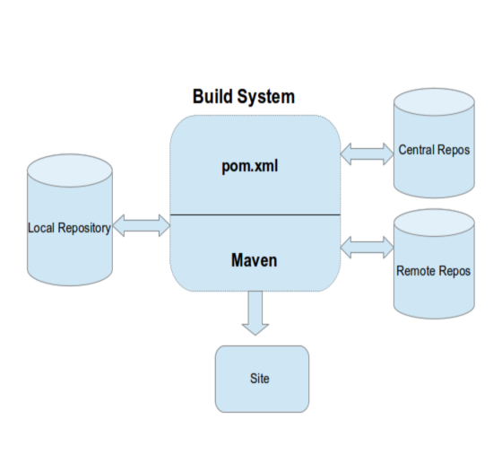
Maven - Architecture
Every Maven project contains a POM file that defines the project essentials. Maven uses the POM details to decide upon different actions and artifact generation. The dependencies specified are first searched for in the local repository and then in the central repository and later in Remote repository.

Slide 8
POM
A Project Object Model (POM) provides all the configuration for a single project.
General configuration covers the project's name, its owner and its dependencies on other projects.
Individual phases of the build process can also be configured, they are implemented as plugins.
Example: Configure the compiler-plugin to use Java version 1.8 for compilation

Slide 9
Maven - Configuration
Configuration that can be specified in the POM
project dependencies
plugins
goals
build profiles
project version
developers
mailing list

Slide 10
Maven – Configuration Cont…
<project xmlns = "http://maven.apache.org/POM/4.0.0" xmlns:xsi = "http://www.w3.org/2001/XMLSchema-instance" xsi:schemaLocation = "http://maven.apache.org/POM/4.0.0 http://maven.apache.org/xsd/maven-4.0.0.xsd"> <modelVersion>4.0.0</modelVersion> <groupId>com.companyname.project-group</groupId> <artifactId>project</artifactId> <version>1.0</version> </project>

Slide 11
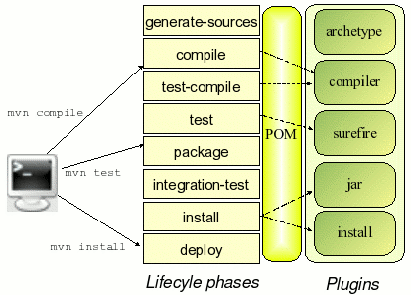
Maven - Build lifecycle Cont…
Build lifecycle is a list of named phases that can be used to give order to goal execution.

Slide 12
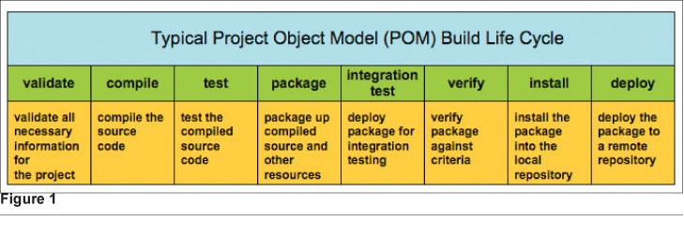
Maven - Build lifecycle
Maven has the following three standard lifecycles −
clean
default(or build)
site

Slide 13
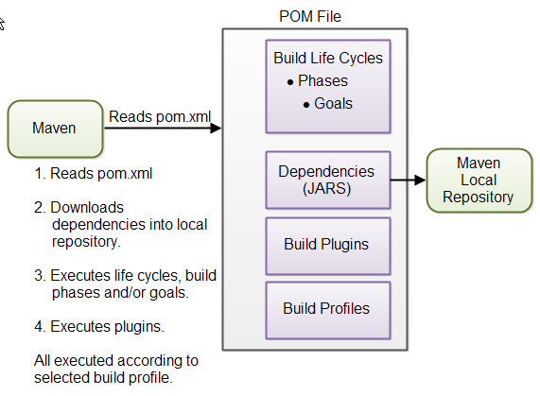
Maven - Overview

Slide 14
POM

Slide 15
POM - Basic Cont…
This is generally unique amongst an organization or a project.
<!-- The Basics --> <groupId>...</groupId> <artifactId>...</artifactId> <version>...</version> <packaging>...</packaging> <dependencies>...</dependencies> <parent>...</parent> <dependencyManagement>... </dependencyManagement> <modules>...</modules> <properties>...</properties>
The artifactId is generally the name of the project
Along with the groupId, It is used within an artifact's repository to separate versions from each other.

Slide 16
POM – Dependeny Management Cont…
<dependencyManagement> <dependencies> <dependency> <groupId>org.glassfish.jersey</groupId> <artifactId>jersey-bom</artifactId> <version>${jersey.version}</version> <type>pom</type> <scope>import</scope> </dependency> </dependencies> </dependencyManagement>
The dependency management section is a mechanism for centralizing dependency information.
When a set of projects inherits a common parent it's possible to put all information about the dependency in the common POM and have simpler references to the artifacts in the child POMs.
Notes:
Using the dependencyManagement element in a pom.xml allows you to reference a dependency in a child project without having to explicitly list the version. Maven will walk up the parent-child hierarchy until it finds a project with a dependencyManagement element, it will then use the version specified in this dependencyManagementelement.

Slide 17
POM – Dependency Management
<dependency> <groupId>org.glassfish.jersey</groupId> <artifactId>jersey-bom</artifactId> <version>${jersey.version}</version> <type>pom</type> <scope>import</scope> </dependency>
${jersey.version} is a placeholder, configure its actual value in <properties> block
<properties> <project.build.sourceEncoding>UTF-8</project.build.sourceEncoding> <jersey.version>2.25</jersey.version> <build.number>SNAPSHOT</build.number> </properties>

Slide 18
POM - Dependencies
<dependencies> <dependency> <groupId>org.glassfish.jersey.containers</groupId> <artifactId>jersey-container-servlet-core</artifactId> </dependency> <dependency> <groupId>org.glassfish.jersey.media</groupId> <artifactId>jersey-media-json-jackson</artifactId> </dependency> </dependencies>

Slide 19
Maven Plugins Cont…
Maven is a plugin execution framework
Build plugins will be executed during the build and it should be configured in the <build/> element from the POM.
Reporting plugins will be executed during the site generation and it should be configured in the <reporting/> element from the POM.
Note: All plugins should have minimal required informations: groupId, artifactId,version.

Slide 20
Maven Plugins Cont…
Maven Plugins are generally used to −
create jar file
create war file
compile code files
unit testing of code
create project documentation
create project reports
Notes:
Core Plugins: Plugins corresponding to default core phases (ie. clean, compile).
Packaging types/tools: These plugins relate to packaging respective artifact types(eg: jar,war)
Reporting plugins: Plugins which generate reports, are configured as reports in the POM and run under the site generation lifecycle(eg:checkstyle, sure-fire report).

Slide 21
Maven - Plugins
<build> <pluginManagement> <plugins> <plugin> <groupId>org.apache.maven.plugins</groupId> <artifactId>maven-compiler-plugin</artifactId> <version>3.5.1</version> </plugin> <plugin> <groupId>org.apache.maven.plugins</groupId> <artifactId>maven-checkstyle-plugin</artifactId> <version>2.17</version> </plugin> </plugins> </pluginManagement> </build>

Slide 22
Sample Application

Slide 23
Sample Application 1 Cont…
Command to set path for Maven
Set java path in JAVA_HOME
Set java path in MAVEN_HOME
Set java path in M2_HOME
Set the class path

Slide 24
Sample Application 1 Cont…
Steps to create the application:
1. Create a Java project
2. Convert the Java project into Maven project
Right click the project -> Configure -> Convert to Maven Project
3. Finish
4.Create a Java class with a simple print statement

Slide 25
Sample Application 1
Steps to Execute the application:
1. $ mvn install
2. $ mvn clean
3. $ mvn compile
4. $ mvn package
5. $ mvn exec:java -Dexec.mainClass="com.hexa.Sample.Welcome"

Slide 26
Standard Project Structure Cont…
To create the standard project structure:
mvn archetype:generate
This creates src/main/java directory which contains the project source code, the src/test/java directory contains the test source, and the pom.xml file is the project's Project Object Model, or POM.

Slide 27
Standard Project Structure
my-app
|-- pom.xml
`-- src
|-- main
| `-- java
| `-- com
| `-- mycompany
| `-- app
| `-- App.java
`-- test
`-- java
`-- com
`-- mycompany
`-- app
`-- AppTest.java

Slide 28
Sample Application 2 Cont…
Steps to create application:
STEP 1:
-mvn archetype:generate
STEP 2:
-Search for “Sample Maven Project”
Choose a number or apply filter (format: [groupId:]artifactId, case sensitive contains): 1055: 1055
Choose org.apache.maven.archetypes:maven-archetype-quickstart version:6
Define value for property 'groupId': com.Hexa

Slide 29
Sample Application 2 Cont…
Define value for property 'artifactId': Maven-Sample
Define value for property 'version' 1.0-SNAPSHOT: : 1.0-SNAPSHOT
Define value for property 'package' com.Hexa: : com.Hexa.Testing
Confirm properties configuration:
groupId: com.Hexa
artifactId: Maven-Sample
version: 1.0-SNAPSHOT
package: com.Hexa.Testing
Y: : Y

Slide 30
Sample Application 2 Cont…
STEP 3:
Open the project from the workspace
STEP 4:
Create a test method in the AppTest.java
STEP 5:
Add dependencies in the POM.XML
STEP 6:
Execute the application using Maven commands.

Slide 31
Sample Application 2 Cont…
Sample Maven application with Junit testing

