Slide 1
Selenium

Slide 2
Session Plan
Automation Testing
Selenium
Selenium Component
Selenium Integrated Development Environment (IDE)
Selenium Remote Control (RC)
WebDriver
Selenium Grid
Working with TestNG
TestNG Annotations

Slide 3
Automation Testing
Automation testing is creating individual tests using test tool to execute the test without direct tester intervention
Automation testing is used to
Control the execution of test
Comparison of actual outcomes to predicted outcomes
Setting up of test preconditions and test reporting functions

Slide 4
Why Automate Testing?
Is it necessary to repeat the sequence of actions many times?
Do you need to run the same tests on multiple hardware configurations?
Need to test with several concurrent users?
Exercise multiple options, components, and configurations
Save time and money

Slide 5
Automation Testing
Disadvantages of Manual Testing
Time consuming
Low reliability
High Cost
Inconsistent Results

Slide 6
Automation Testing
Advantages of Automation Testing
Speed
Regression
Programming capabilities
Reliability and reusability

Slide 7
Selenium

Slide 8
What is Selenium?
Selenium is a free (open source) automated testing suite for web applications across different browsers and platforms.
History of Selenium: Selenium was developed by Jason Huggins in 2004 at ThoughtWorks in Chicago. It is open-source software, released under the Apache 2.0 license. He developed a Javascript library that could drive interactions with the page. That library eventually became Selenium Core, which underlies all the functionality of Selenium Remote Control (RC) and Selenium IDE.
While Selenium was a tremendous tool, it wasn’t without its drawbacks. In 2006 Simon Stewart at Google started working on WebDriver. The WebDriver project began with the aim to solve the Selenium’ pain-points.

Slide 9





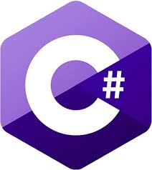








Platform Supported by Selenium
Languages are used with Selenium
Browser Supported By Selenium

Slide 10
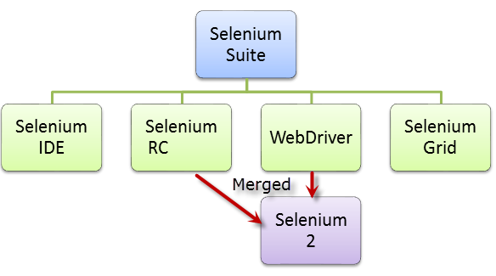
Selenium Components
Selenium is not just a single tool but a suite of softwares, each catering to different testing needs of an organization.
It has four components.
Selenium Integrated Development
Environment (IDE)
Selenium Remote Control (RC)
WebDriver
Selenium Grid

Slide 11
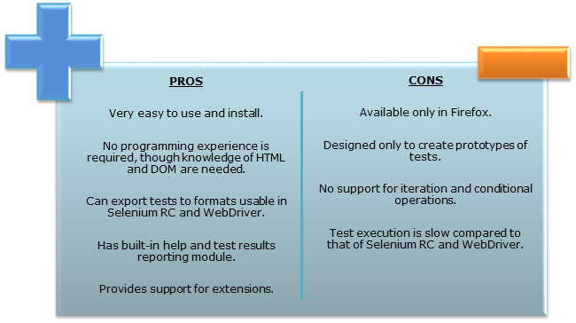
Selenium IDE
Selenium IDE is a complete integrated development environment (IDE) for Selenium tests. It is implemented as a Firefox extension, and allows recording, editing, and debugging tests. It was previously known as Selenium Recorder. Selenium-IDE was originally created by Shinya Kasatani and donated to the Selenium project in 2006.

Slide 12
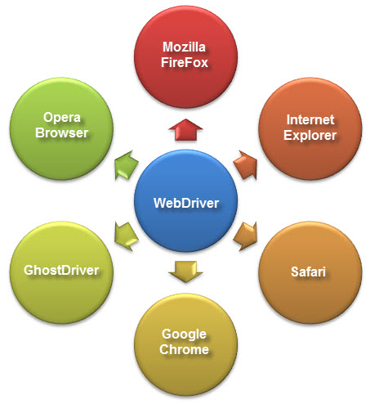
Selenium WebDriver
WebDriver is a web automation framework that allows you to execute your tests against different browsers, not just Firefox (unlike Selenium IDE).
WebDriver also enables you to use a programming language in creating your test scripts(not possible in Selenium IDE).
Following programming languages are supported by WebDriver
Java
.Net
PHP
Python
Perl
Ruby

Slide 13
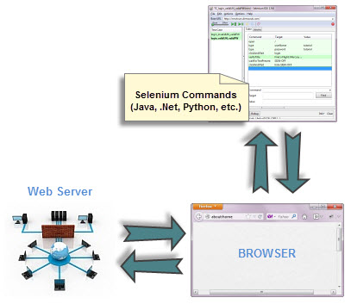
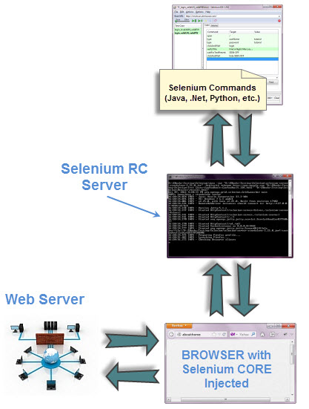
WebDriver Vs. Selenium RC
WebDriver’s architecture is simpler than Selenium RC’s.
WebDriver
RC

Slide 14


WebDriver Vs. Selenium RC
Speed
WebDriver is faster than Selenium RC since it speaks directly to the browser uses the browser’s own engine to control it.
Selenium RC is slower since it uses a Javascript program called Selenium Core. This Selenium Core is the one that directly controls the browser, not you.

Slide 15
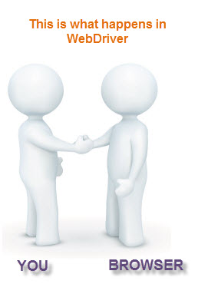
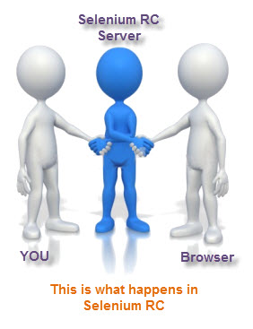
WebDriver Vs. Selenium RC
Real-life Interaction
WebDriver interacts with page elements in a more realistic way. For example, if you have a disabled text box on a page you were testing, WebDriver really cannot enter any value in it just as how a real person cannot.
Selenium Core, just like other Javascript codes, can access disabled elements .In the past, Selenium testers complain that Selenium Core was able to enter values to a disabled text box in their tests.Differences in API

Slide 16
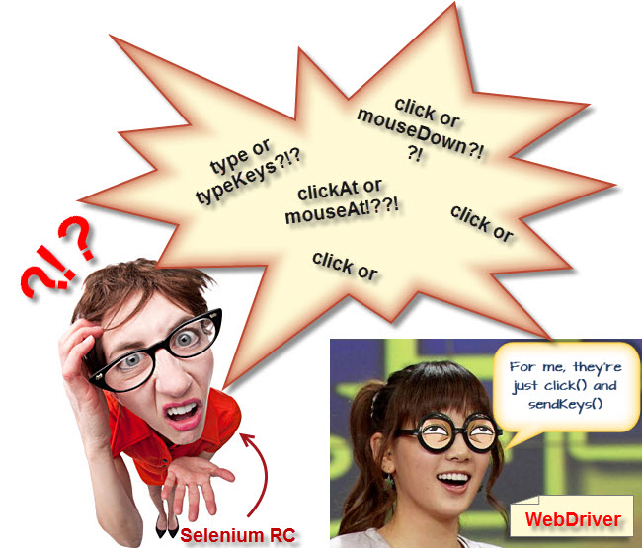
WebDriver Vs. Selenium RC
API
Selenium RC’s API is more matured but contains redundancies and often confusing commands. For example, most of the time, testers are confused whether to use type or typeKeys; or whether to use click, mouseDown, or mouseDownAt. Worse, different browsers interpret each of these commands in different ways too!
WebDriver’s API is simpler than Selenium RC’s. It does not contain redundant and confusing commands.

Slide 17
WebDriver Vs. Selenium RC
Limitations of WebDriver
Selenium RC automatically generates an HTML file for test results. The format of the report was pre-set by RC itself.
WebDriver has no built-in command that automatically generates a Test Results File. You would have to rely on your IDE’s output window, or design the report yourself using the capabilities of your programming language and store it as text, html, etc.
WebDriver Cannot Readily Support New Browsers

Slide 18
WebDriver Vs. Selenium RC
Limitations of WebDriver
Selenium RC automatically generates an HTML file of test results. The format of the report was pre-set by RC itself. Take a look at an example of this report below.
WebDriver has no built-in command that automatically generates a Test Results File. You would have to rely on your IDE’s output window, or design the report yourself using the capabilities of your programming language and store it as text, html, etc.
WebDriver Cannot Readily Support New Browsers

Slide 19
Installing Selenium WebDriver
WebDriver Setup
Step 1 – Install Java on your computer
Step 2 – Install Eclipse IDE
Step 3 – Download the Selenium Java Client Driver
Step 4 - Configure Eclipse IDE with WebDriver

Slide 20
WebDriver
Different Drivers
Browser | Name of Driver Server | Remarks
HTMLUnit | (none) | WebDriver can drive HTMLUnit without the need of a driver server
Firefox | (none) | WebDriver can drive Firefox without the need of a driver server
Internet Explorer | Internet Explorer Driver Server | Available in 32 and 64-bit versions. Use the version that corresponds to the architecture of your IE
Chrome | ChromeDriver | Though its name is just “ChromeDriver”, it is in fact a Driver Server, not just a driver. The current version can support versions higher than Chrome v.21
Opera | OperaDriver | Though its name is just “OperaDriver”, it is in fact a Driver Server, not just a driver.
PhantomJS | GhostDriver | PhantomJS is another headless browser just like HTMLUnit.
Safari | SafariDriver | Though its name is just “SafariDriver”, it is in fact a Driver Server, not just a driver.

Slide 21

Scripting with WebDriver
Common Commands
Instantiating Web Elements
Clicking on an Element

Slide 22
Scripting with WebDriver
Get Commands
get() Sample usage: | It automatically opens a new browser window and fetches the page that you specify inside its parentheses. It is the counterpart of Selenium IDE’s “open” command. The parameter must be a String object.
getTitle() Sample usage: | Needs no parameters Fetches the title of the current page Leading and trailing white spaces are trimmed Returns a null string if the page has no title
getPageSource() Sample usage: | Needs no parameters Returns the source code of the page as a String value
getCurrentUrl() Sample usage: | Needs no parameters Fetches the string representing the current URL that the browser is looking at
getText() Sample usage: | Fetches the inner text of the element that you specify

Slide 23
Scripting with WebDriver
Navigate commands
navigate().to() Sample usage: | It automatically opens a new browser window and fetches the page that you specify inside its parentheses. It does exactly the same thing as the get() method.
navigate().refresh() Sample usage: | Needs no parameters. It refreshes the current page.
navigate().back() Sample usage: | Needs no parameters Takes you back by one page on the browser’s history.
navigate().forward() Sample usage: | Needs no parameters Takes you forward by one page on the browser’s history.

Slide 24
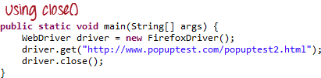
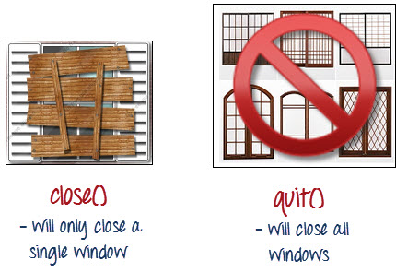
Scripting with WebDriver
Closing and Quitting Browser Windows

Slide 25
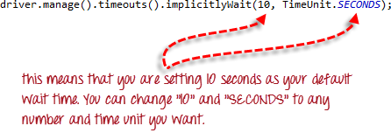
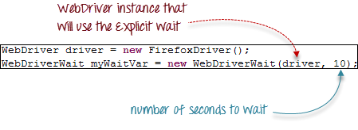
Scripting with WebDriver
Waits
There are two kinds of waits.
Implicit wait – used to set the default waiting time throughout the program
Explicit wait – used to set the waiting time for a particular instance only
Implicit Wait
Explicit Wait

Slide 26
Scripting with WebDriver
commands to access each type of element
Element | Command | Description
Input Box | sendKeys() | used to enter values onto text boxes
 | clear() | used to clear text boxes of its current value
Check Box, Radio Button, | click() | used to toggle the element on/off
Links | click() | used to click on the link and wait for page load to complete before proceeding to the next command.
Drop-Down Box | selectByVisibleText()/ deselectByVisibleText() | selects/deselects an option by its displayed text
 | selectByValue()/ deselectByValue() | selects/deselects an option by the value of its “value” attribute
 | selectByIndex()/ deselectByIndex() | selects/deselects an option by its index
 | isMultiple() | returns TRUE if the drop-down element allows multiple selection at a time; FALSE if otherwise
 | deselectAll() | deselects all previously selected options
Submit Button | submit()

Slide 27
Scripting with WebDriver
Handling special keyboard and mouse events
Method | Description
clickAndHold() | Clicks (without releasing) at the current mouse location.
contextClick() | Performs a context-click at the current mouse location.
doubleClick() | Performs a double-click at the current mouse location.
dragAndDrop(source, target) | Performs click-and-hold at the location of the source element, moves to the location of the target element, then releases the mouse. Parameters: source- element to emulate button down at. target- element to move to and release the mouse at.
dragAndDropBy(source, x-offset, y-offset) | Performs click-and-hold at the location of the source element, moves by a given offset, then releases the mouse. Parameters: source- element to emulate button down at. xOffset- horizontal move offset. yOffset- vertical move offset.
keyDown(modifier_key) | Performs a modifier key press. Does not release the modifier key - subsequent interactions may assume it's kept pressed. Parameters: modifier_key – any of the modifier keys (Keys.ALT, Keys.SHIFT, or Keys.CONTROL)
keyUp(modifier _key) | Performs a key release. Parameters: modifier_key – any of the modifier keys (Keys.ALT, Keys.SHIFT, or Keys.CONTROL)
moveByOffset(x-offset, y-offset) | Moves the mouse from its current position (or 0,0) by the given offset. Parameters: x-offset- horizontal offset. A negative value means moving the mouse left. y-offset- vertical offset. A negative value means moving the mouse up.
moveToElement(toElement) | Moves the mouse to the middle of the element. Parameters: toElement- element to move to.
release() | Releases the depressed left mouse button at the current mouse location
sendKeys(onElement, charsequence) | Sends a series of keystrokes onto the element. Parameters: onElement - element that will receive the keystrokes, usually a text field charsequence – any string value representing the sequence of keystrokes to be sent

Slide 28
TestNG Framework

Slide 29
TestNG
What is TestNG
TestNG is a testing framework inspired from JUnit and NUnit but introducing some new functionalities in order to make it more powerful and easier to use.
Advantages of TestNG over Junit
Annotations are easier to understand
Test cases can be grouped more easily
Parallel testing is possible

Slide 30
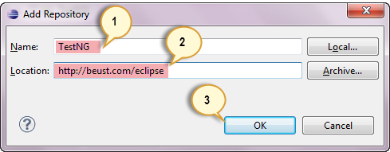
TestNG Installation
Installing TestNG in Eclipse
Step 1
Launch Eclipse.
On the menu bar, click Help.
Choose the “Install New Software…” option.
Step 2
In the Install dialog box, click the Add button
Step 3
In “Name”, type TestNG.
In “Location”, type http://beust.com/eclipse.
Click OK

Slide 31
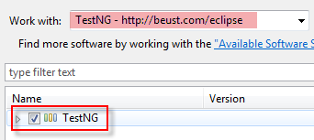
TestNG Installation
Installing TestNG in Eclipse…
Step 4
Notice that “TestNG - http://beust.com/eclipse” was populated onto the “Work with:” textbox.
Check the “TestNG” check box as shown below, then click Next.
Step 5
Click Next again on the succeeding dialog box until you reach the License Agreement dialog.
Click “I accept the terms of the license agreement” then click Finish.

Slide 32
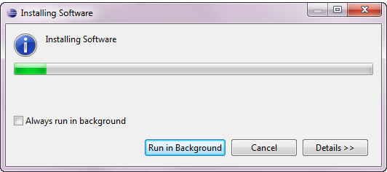
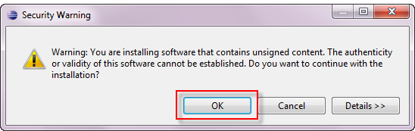
TestNG Installation
Installing TestNG in Eclipse…
Step 6
Wait for the installation to finish
If you encounter a Security warning, just click OK

Slide 33
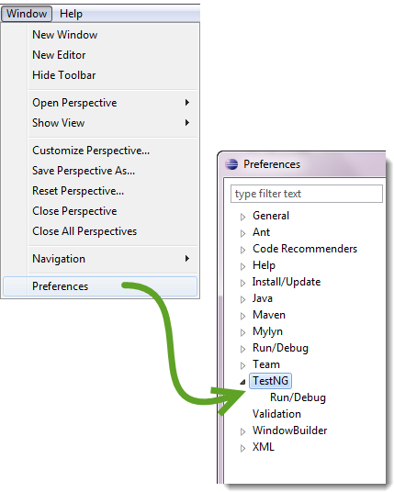
TestNG Installation
Installing TestNG in Eclipse…
Step 8
After restart, verify if TestNG was indeed successfully installed. Click Window > Preferences and see if TestNG is included on the Preferences list.

Slide 34
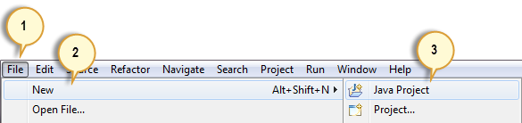
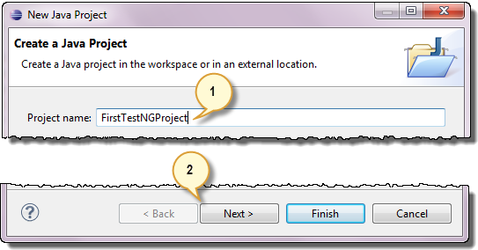
TestNG Project Setup
Setting up a new TestNG Project
Step 1
Click File > New > Java Project
Step 2
Type “FirstTestNGProject” as the Project Name then click Next.

Slide 35
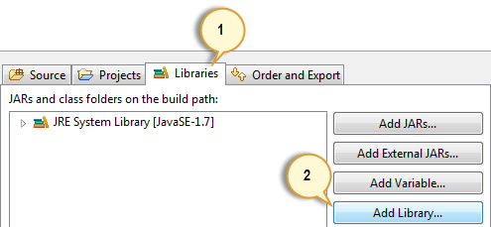
TestNG Project Setup
Setting up a new TestNG Project…
Step 3
We will now start to import the TestNG Libraries onto our project. Click on the “Libraries” tab, and then “Add Library…”
Step 4
On the Add Library dialog, choose “TestNG” and click Next.
Step 5
Click Finish.
You should notice that TestNG is included on the Libraries list.

Slide 36
Working with TestNG
Notice the following.
TestNG does not require you to have a main() method.
Methods need not be static.
We used the @Test annotation. @Test is used to tell that the method under it is a test case.
Since we use annotations in TestNG, we needed to import the package org.testng.annotations.*.
We used the Assert class. The Assert class is used to conduct verification operations in TestNG. To use it, we need to import the org.testng.Assert package.

Slide 37
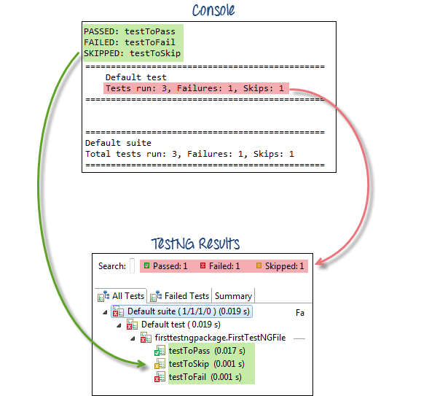
Working with TestNG
Checking reports created by TestNG
The Console window in Eclipse gives a text-based report of our test case results while the TestNG Results window gives us a graphical one.

Slide 38
TestNG Annotations
Summary of TestNG Annotations
@BeforeSuite: The annotated method will be run before all tests in this suite have run.
@AfterSuite: The annotated method will be run after all tests in this suite have run.
@BeforeTest: The annotated method will be run before any test method belonging to the classes inside the tag is run.
@AfterTest: The annotated method will be run after all the test methods belonging to the classes inside the tag have run.
@BeforeGroups: The list of groups that this configuration method will run before. This method is guaranteed to run shortly before the first test method that belongs to any of these groups is invoked.

Slide 39
TestNG Summary
Summary of TestNG Annotations
@AfterGroups: The list of groups that this configuration method will run after. This method is guaranteed to run shortly after the last test method that belongs to any of these groups is invoked.
@BeforeClass: The annotated method will be run before the first test method in the current class is invoked.
@AfterClass: The annotated method will be run after all the test methods in the current class have been run.
@BeforeMethod: The annotated method will be run before each test method.
@AfterMethod: The annotated method will be run after each test method.
@Test: The annotated method is a part of a test case

Slide 40
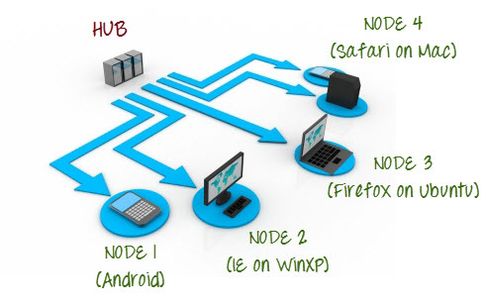
Selenium Grid
What is Selenium Grid?
Selenium Grid is a part of the Selenium Suite that specializes on running multiple tests across different browsers, operating systems, and machines in parallel.

Slide 41
Selenium Grid
What is a Hub and Node?
The Hub
The hub is the central point where you load your tests into.
There should only be one hub in a grid.
The hub is launched only on a single machine, say, a computer whose OS is Windows 7 and whose browser is IE.
The machine containing the hub is where the tests will be run, but you will see the browser being automated on the node.
The Nodes
Nodes are the Selenium instances that will execute the tests that you loaded on the hub.
There can be one or more nodes in a grid.
Nodes can be launched on multiple machines with different platforms and browsers.
The machines running the nodes need not be the same platform as that of the hub.

Slide 42
Demo

Slide 43


