Slide 1
Trello

Slide 2
Course Objective
To learn and understand the Trello project management tool.
With Trello, How to
- Build the project
- Assign the task to different users
- Assign each task
- due date etc..

Slide 3
Reference Link
http://www.trello.com
https://trello.com/guide
https://help.trello.com/article/899-getting-started-video-demo

Slide 4
Trello Overview

Slide 5
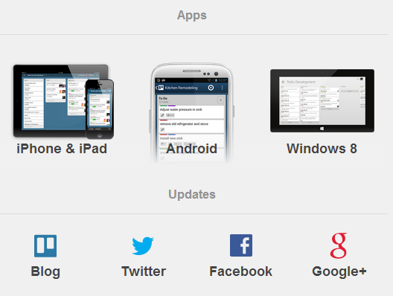
Trello - Introduction
Trello is a collaboration tool that organizes the project into boards .
It is a free web-based project management application.
It uses a paradigm for managing projects known as kanban.
It can also be used on Android, iPhone, iPad & Windows 8 Tablet.

Slide 6
Features of Trello
Assign tasks to different Team members
Assign tasks to Multiple Team members
Track task progress
Link and upload Asset to
Instant team collaboration
Global access

Slide 7
Working with Trello
Project represented as Boards.
Each board contain Lists. Each list contains Cards.
Cards are progressed from one list to the next using drag and drop.
Board
- Used to assign activities to different individuals and track it.
List
- A specific area of the project that units specific activities.
Card
- An exact activity do be executed.

Slide 8
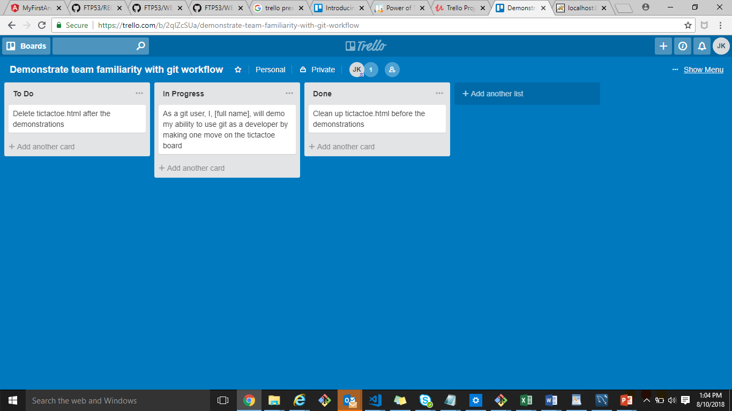
Working with Trello (cont..)
Card
List
Board

Slide 9
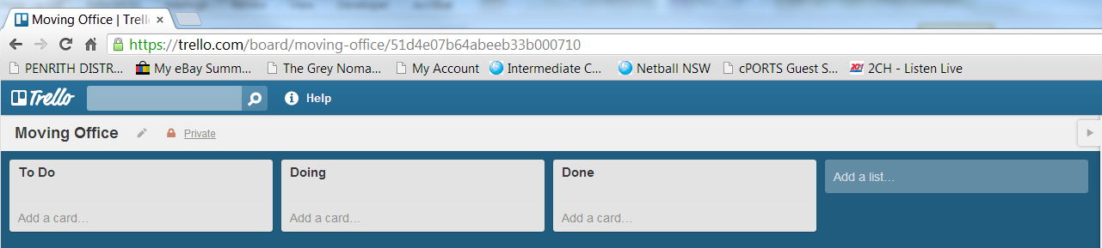
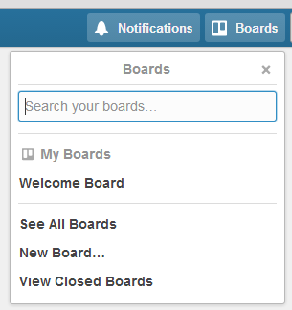
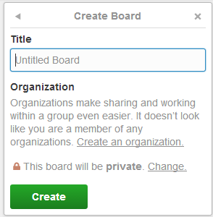
Getting started
Open Trello
Login or sign up
Create a Board:
From the Boards tab. Choose New Board.
In Title, type project name e.g. Moving office. This becomes the Board name.
Click create.

Slide 10
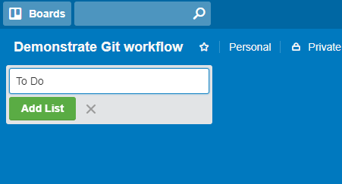
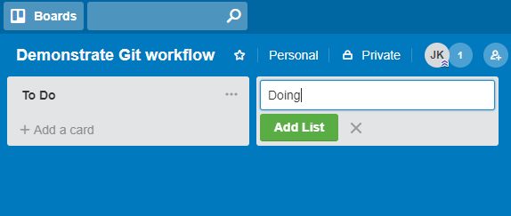
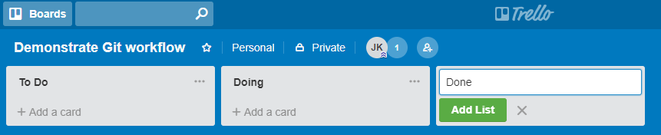
Creating Lists
From the List tab, Add a title eg: To Do and click Add List button.
Similarly add other list eg: Doing, Done
There is a To Do, Doing & Done. You can delete any of these and/or add new lists.

Slide 11
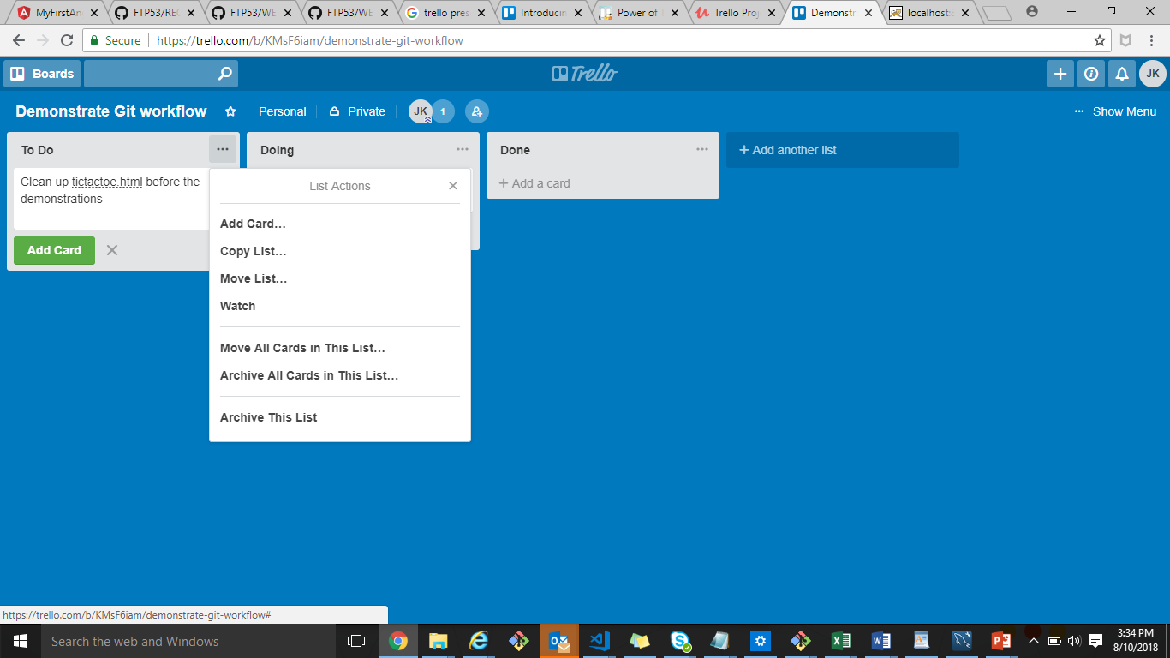
List Actions
Click on the arrow to the right of your list name and view several different ways of managing your lists.
List Actions :
Add Card
Adding new card in right.
Copy List
Copy a list with its cards (if desired) to
somewhere else on the board or a
different board entirely
Move List
Move a list wherever you want and
bring the cards with you
- Move All Cards in This List…
- Archive All Cards in This List… - keep the lists and archive the cards. - Archive This List - can't delete lists but you can archive them and find it another day

Slide 12
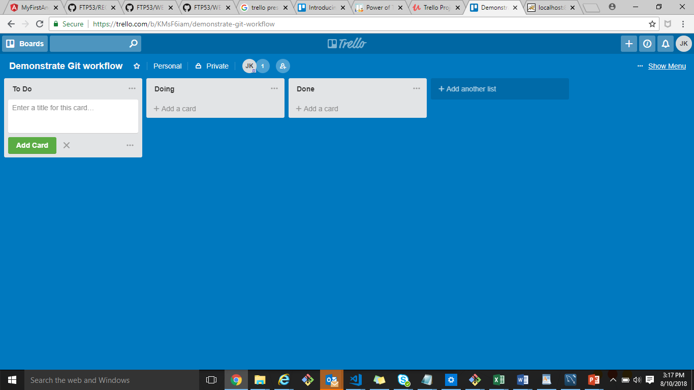
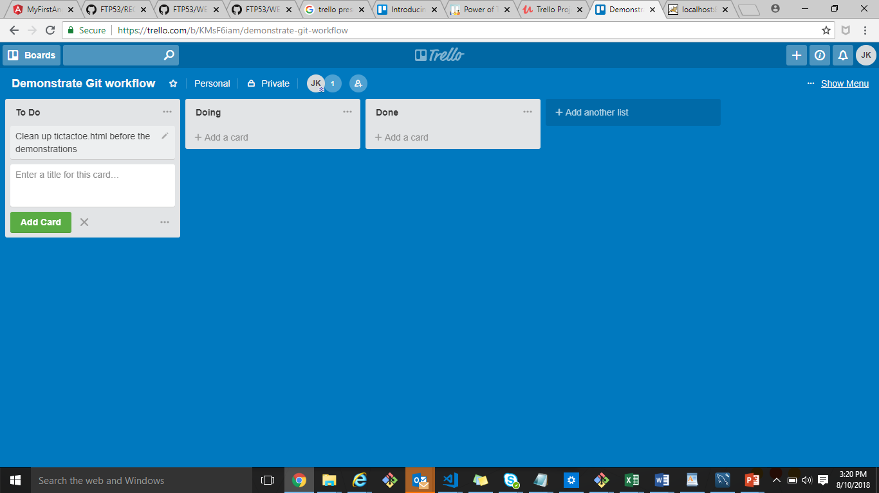
Adding Cards in List
In the To Do list, click the Add a Card link.
Type a task. E.g. Clean up file
Click Add to create the card.
A name box appears to add another Card
Type a task. E.g. Delete file
Click Add to create the card.
When you have finished, click away from the list.

Slide 13
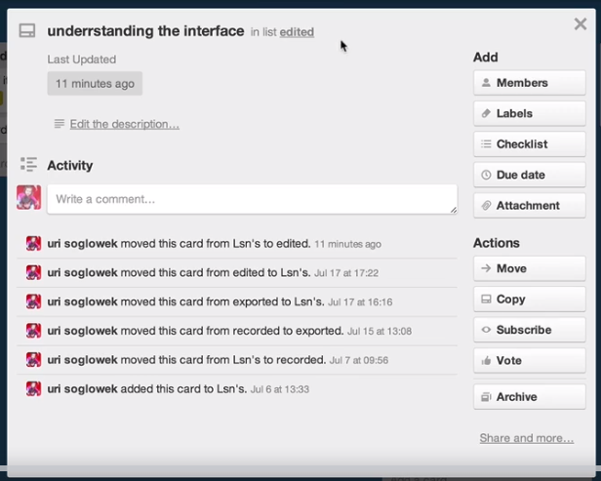
Card Actions – Assign members
To add an individual to a card,
click the card to open it, then
choose "Members" from the
right side of the card.

Slide 14
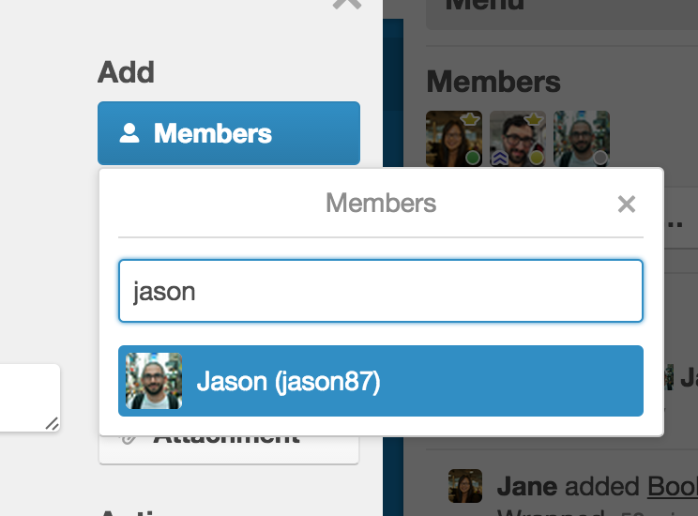
Card Actions – Assign members (cont..)
Type the member's name or click on their avatar.
You can also add a member to a card by opening
the card's quick edit menu (hover mouse over card
and click the pencil icon) and selecting
"Change Members " from the drop down.
Drag and Drop Members to Cards
While viewing the "Members" area in the menu on the right side of a Trello board, you can drag and drop a user's avatar directly onto a card.
Or you can drag and drop a member's avatar on to a card from the board's menu.

Slide 15
Card Actions – Adding due dates
A badge with the due date will appear on the card.
A light grey badge means the card is due more than 24 hours in the future
Yellow badge means it's within 24 hours of being due
Red badge means the card is due and it will remain red for 24 hours
Light pink badge means it's past due,
And green badge means it's complete.

Slide 16
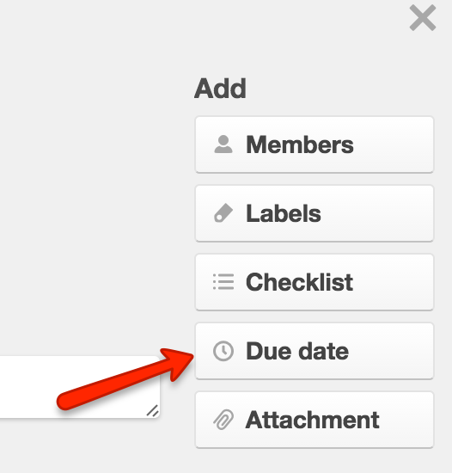
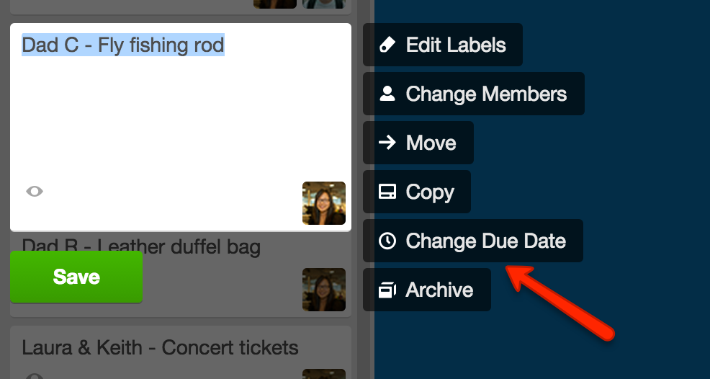
Card Actions – Adding due dates (Cont..)
Add a due date via the card back under "Add" in the card's sidebar.
Also add dates via the card menu on the front of the card or by hovering your mouse over a card

Slide 17
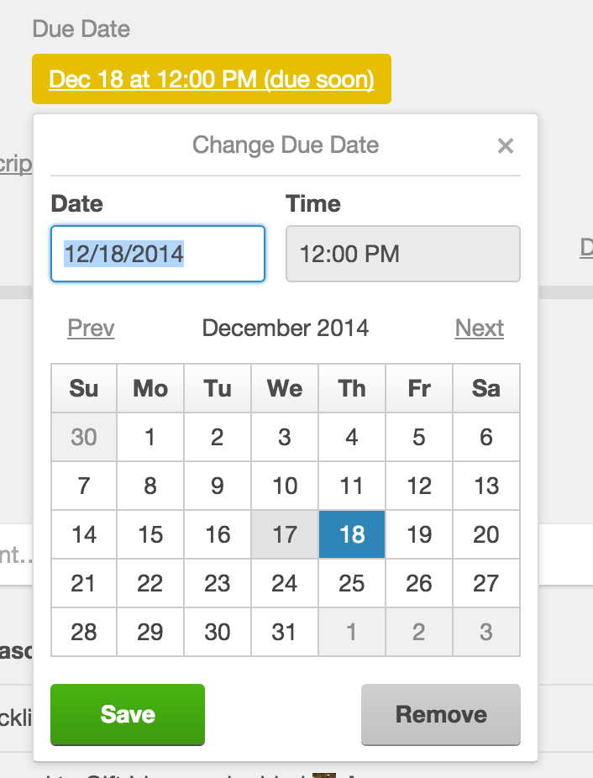
Card Actions – Adding due dates (Cont..)
Editing
Edit a due date by clicking the due date
on the card back and selecting a new date or time.

Slide 18
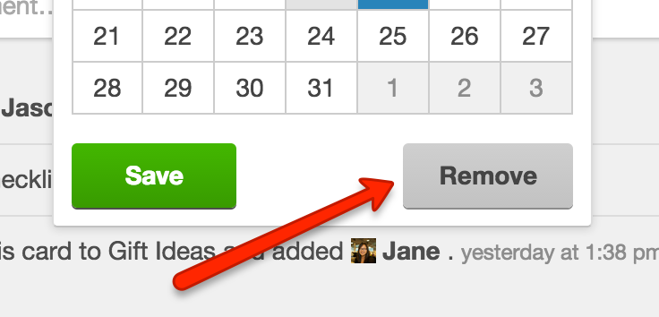
Card Actions – Adding due dates (Cont..)
Marking a due date as complete
Click the checkbox next to the due date to mark it as complete,
And turn the due date green.
This will also add a strikethrough on the card on the
Calendar View.
Removing:
Remove a due date by clicking the due date on the card back and selecting "Remove" from the lower right corner.

Slide 19
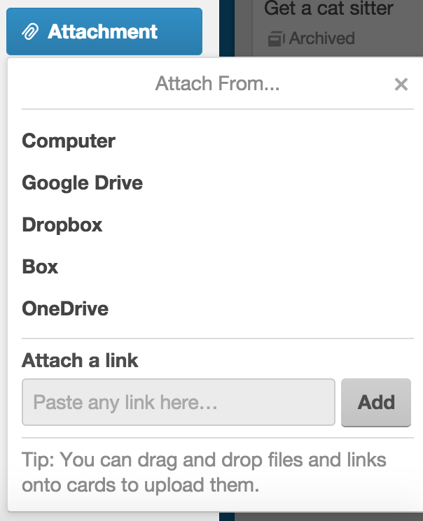
Adding Attachment to Cards
Card attachments are files uploaded to cards.
Attachments appear in the "Attachments
section of the card detail.
Click the front of the card to open it.
Click the "Attach File" button on the right side
of the card to upload.

Slide 20
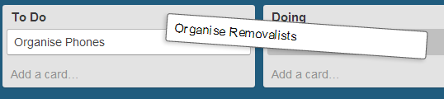
Move Cards
As the Project progresses you can move the cards to Doing and when finished move it to Done. To move the card
Click and Hold the card.
Drag it to the next list. It will drop in place.

Slide 21
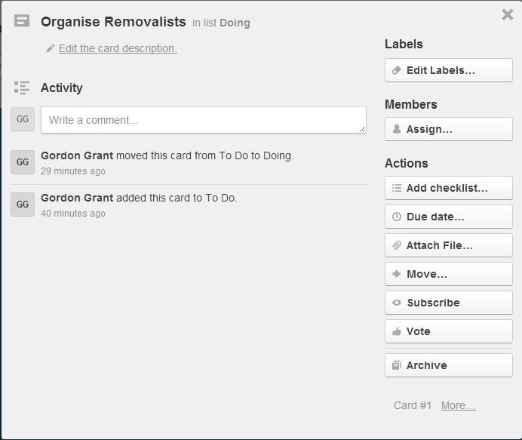
Modify Cards
To see and adjust actions of each card by using the “back” of the card.
Click on the card.

