Slide 1
EJB 3.1-Basics of EJB
01 / 09 / 2014
Process
Results

Slide 2
Overall Objective for EJB
Introducing the Distributed Environment and Understanding
Better about Enterprise Java Bean and its Type

Slide 3
Session Objectives
Introduction about Distributed Application
An Overview of Container and Components
Defining the JEE Architecture
EJB An Overview
Briefing about Difference between EJB 2.x Architecture and 3.x Architecture
Exploring New Features in EJB 3.x
Introduction to different types of Enterprise Beans

Slide 4

Distributed Application
A distributed system is a software system in which components located on network computers communicate and coordinate their actions by passing messages.
The components interact with each other in order to achieve a common goal.
Three significant characteristics of distributed systems are: concurrency of components, lack of a global clock, and independent failure of components.
Examples of distributed systems vary from SOA-bases systems to massively multiplayer online games to peer-to peer applications

Slide 5
Java EE 5 Containers
The Containers gives us the runtime support to the Java EE 5 application components.
The Java EE 5 Application components uses the services of the container throughout their life-cycle.
Container services are:
Security
Transaction
JNDI Lookup
Java EE 5 Remote Connectivity
During the deployment the Java EE 5 application, components are installed in the Java EE 5 containers.
They are of two types:
Web Container
EJB Container

Slide 6
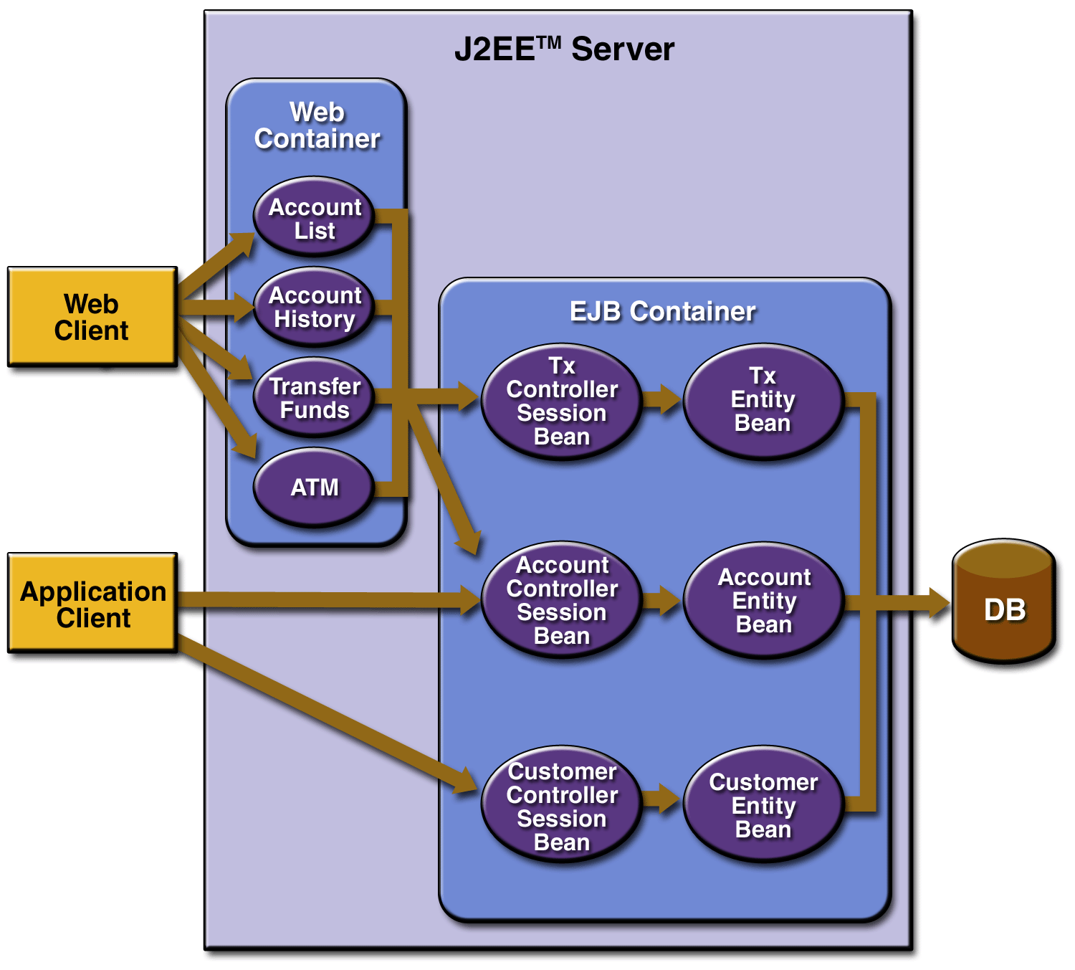
JEE Architecture

Slide 7
Overview On EJB
EJB is a standard for developing and deploying server side distributed components in java.
EJB is a component. A component is self contained entity that it can be reused in similar or a completely different application. It has an independent, reusable existence outside application using it.
A enterprise bean is written using the EJB APIs (the javax.ejb.*package) and is deployed in EJB container.
The EJB container then provides bean with various services
A client of EJB could be anything such as JSP, Servlet, stand alone java application, an applet, a Web service or even another EJB.
Notes:
At abstract level, EJB is a standard for developing and deploying server side distributed components in java. It defines contract between components and application server that enables any component to run in any compliant application server.
At implementation level, an EJB is a component. A component is self contained entity that it can be reused in similar or a completely different application. It has an independent, reusable existence outside application using it.
A enterprise bean is written using the EJB APIs (the javax.ejb.*package) and is deployed in EJB container. The EJB container then provides bean with various services such as life cycle management, security, transaction management, and so on. This is what makes it different that plain java bean. A client of EJB could be anything such as JSP, Servlet, stand alone java application, an applet, a Web service or even another EJB.

Slide 8
Introduction to EJB
It is an Server-Side Component which encapsulates the business logic of an Application.
The EJB processes is based the data entered by the user through the web components.
It creates the link between the presentation of your application which is viewed by the web browser and the back-end enterprise Information Systems
EJB is useful in building enterprise-level applications.
Benefits of EJB are
Simplicity
Reusability
Scalability
Notes:
Simplicity:
The application developer does not have to be concerned with system-level issues, such as security, transactions, multi-threading, security protocols, distributed programming, connection resource pooling etc. These system-level issues are taken care by the EJB Container, a component of EJB architecture.
Reusability: The Enterprise bean is a reusable component. It can be used reused in the following two ways:
The EJB which has not been deployed that can be reused with the different applications without making any changes.
Multiple applications can make calls to the deployed enterprise bean.
Scalability:
Basically EJB applications are highly scalable.
It also refers to the rate at capability increased for they application, with out any changes in the current processing.

Slide 9
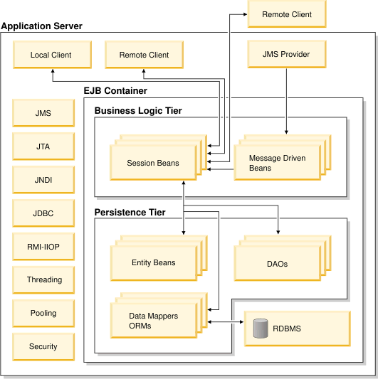
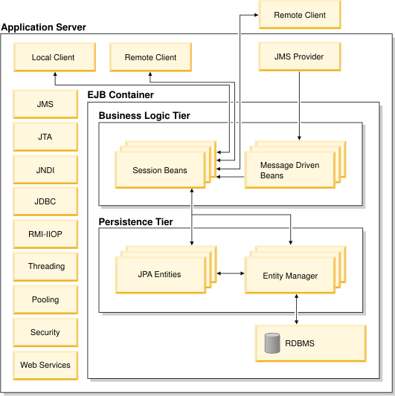
Difference between EJB 2.x and 3.1
Ejb 3.x
Ejb 2.x

Slide 10
EJB 3.1
Simplicity of EJB 3.1 is achieved in following ways:
No home and object interfaces are required
No component interface is required
Use of java metadata annotations
Simplification of APIs for accessing beans environment
Notes:
In versions earlier to EJB 3.1 you had to develop multiple artifacts to develop session and entity bean. This included home interface, remote interface, actual bean implementation, and various deployment descriptor files. This makes developers task difficult. EJB 3.1 overcame this drawback through use of feature called annotations introduced in Java 5

Slide 11

EJB 3.1 cont..
In the EJB 3.1 beans are POJO
Annotations can be used to define the bean's business interface, O/R mapping information, resource references, and just about anything else that was defined through deployment descriptors.
Notes:
In the EJB 3.1 world, all kinds of enterprise beans are just plain old Java objects(POJO) with appropriate annotations.
Annotations can be used to define the bean's business interface, O/R mapping information, resource references, and just about anything else that was defined through deployment descriptors. For example, you declare a stateless session bean by using the @Statelessannotation on the Java class. To reduce the amount of information you must specify for a component, EJB 3.0 has adopted a configuration-by-exception approach, meaning you provide intuitive defaults for all annotations so that most of the information can be inferred.
For example, you declare a stateless session bean by using the @Statelessannotation on the Java class. To reduce the amount of information you must specify for a component, EJB 3.0 has adopted a configuration-by-exception approach, meaning you provide intuitive defaults for all annotations so that most of the information can be inferred.

Slide 12
New Features of EJB 3.0
Annotations
EJB 3.0 depends on the annotations.
Annotation is a kind of attribute oriented programming.
In attribute oriented programming, programmers mark the program elements like classes, methods, to indicate they maintain application-specific or domain specific semantics.
The annotations are marked with @symbol.

Slide 13
New Features of EJB 3.0 cont..
@Remote
public interface calculator
{
public double dollarTors();
}
@Local
public interface calculator
{
public double dollarTors();
}
@Entity
public class Employee
{
-----------
----------
}
@Stateful
@Stateless
@Singleton

Slide 14
New Features of EJB 3.0 cont..
Callback methods
From EJB 3.0 is removed the call back methods like ejbPassivate, ejbActivate, ejbLoad, ejbStore etc., which is one of advantages of EJB 3.0 over the EJB 2.1.
Implementation of those methods now becomes optional
@PreDestroy is the callback Annotation.

Slide 15
New Features of EJB 3.0 cont..
Dependency Injection:
The Client, to use the constructed bean in its application, needs to know how to locate invoke that enterprise bean.
The Client EJB 2.1 session bean gets the reference session bean with JNDI.
@EJB annotation injects stubs of session bean having Session Bean Name.
@Resource annotation used to inject service object having JNDI name

Slide 16
New Features of EJB 3.0 cont..
Elimination of Home Interfaces and Home Objects:
In EJB 3.0 they have removed an unnecessary need of the home interface.
The Home interfaces are replaced by POJO’s and home objects replaced by POJI’s.
Simple Java bean is called as POJO.
Simple Java Interface is called as POJI.

Slide 17
New Features of EJB 3.0 cont..
Elimination of Component Interface:
Here both the business or component interface becomes as POJI
EJB 3.0 eliminated the Component Interface.
The EJBObject / EJBLocalObject and the remote exception which needs to be imported in EJB 2.1 to make component interface have also been removed.
Component interface needs to be local or remote which all depends on where business class located.
Now @Remote is annotation to generate component interface that is of remote type.

Slide 18
New Features of EJB 3.0 cont..
Interceptors
Methods which Intercept business method calls or lifecycle callback calls.
We can use interceptors methods inside a separate class called interceptor class.
Interceptors provide us way to enhance business method can be done by using interceptor methods.
@Interceptors annotations chain of interceptors associated with the bean.

Slide 19
Types of Enterprise Bean
Following are the types of enterprise beans:
Session beans
Message driven beans (out of scope)
One more it is
Entity class

Slide 20
Session Bean
A session bean performs work on the behalf of client code calling it. Session beans are reusable components that contains logic for business processes. For example, a session bean can perform banking transactions such as amount transfer from one account to another, price quoting, order entry, stock trades or complex calculations.
A session bean instance is relatively short lived object. It has roughly the lifetime equivalent of a session or execution of client code that is calling a method on session bean. Session bean instances are not shared between multiple clients and do not represent data in the database.
Two subtypes of session bean are :
1) stateless session bean
2) stateful session bean.
3) Singleton

Slide 21
Stateful session bean
Stateful Session Bean acts on behalf of single client and also it maintains the information throughout the session.
The Lifecycle is the duration of single client session.
It creates the conversational state across multiple method calls and transactions.

Slide 22
Stateful session bean
It does not maintain any conversational state; It will pooled by the EJB Container to handle multiple requests from multiple clients.
Basically, the stateless session bean is used in the case of single operation.
The multiple clients an perform any of the preceding operations simultaneously.
The Stateless Session Bean handles multiple client requests.

Slide 23
Stateless session bean
It does not maintain any conversational state; It will pooled by the EJB Container to handle multiple requests from multiple clients.
Basically, the stateless session bean is used in the case of single operation.
The multiple clients an perform any of the preceding operations simultaneously.
The Stateless Session Bean handles multiple client requests.

Slide 24
Singleton Session Bean
As the name implies a javax.ejb.Singleton is a session bean with a guarantee that there is at most one instance in the application.
What it gives that is completely missing in EJB 3.0 and prior versions is the ability to have an EJB that is notified when the application starts and notified when the application stops. So you can do all sorts of things that you previously could only do with a load-on-startup servlet. It also gives you a place to hold data that pertains to the entire application and all users using it, without the need for a static. Additionally, Singleton beans can be invoked by several threads at one time similar to a Servlet.

Slide 25
Entity Class
They are the Enterprise bean which contain persistent data and provides persistent storage to that data in a database.
The concept of persistence, is to save the storage mechanism for the entity bean.
The entity bean which manages persistence itself is called Bean Managed Persistence (BMP) entity bean.
The entity bean whose persistence is handled by the EJB Container is called Container Managed Persistence (CMP) entity bean.

Slide 26
Message Driven Beans
In the enterprise bean the concept of Java Messaging Services process the messages asynchronously.
The Message-Driven Beans which handle operations which will not require immediate response.

