Slide 1
Lethal Cancer Risk Factors in NHANES
Multidimensional Analysis of Potential Cancer Mortality Risk Factors in the National Health and Nutrition Examination Survey
Martin Skarzynski
Statistical Methods in Public Health IV (140.624)
Johns Hopkins Bloomberg School of Public Health

Slide 2
Context
Large epidemiologic studies,
such as the National Health and Nutrition Examination Survey (NHANES),
collect copious high-dimensional data and
allow for examination of multiple exposures in relation to a given outcome.

Slide 3
Goals
Explore the exposures measured in the Third NHANES (NHANES III) dataset
Search for factors associated with cancer mortality
Assess a variable selection method for cancer risk prediction models

Slide 4
Participants
NHANES III collected data on 33,994 participants aged 2 months and older from 1988 to 1994 in the United States, including Interview, Medical Examination, and Laboratory components.
The National Center for Health Statistics (NCHS) linked NHANES III data with mortality data from the National Death Index (NDI).

Slide 5

Participants
From the initial pool of participants, we selected 16,404 adult ($age≥18$) participants who
were cancer-free at baseline and
had no missing values for
follow-up time since interview,
NDI mortality,
primary sampling units (PSU),
stratification, and
sampling weight variables.
Among the 16,404 participants, there were
964 cancer deaths and
280,891 total years of follow-up.

Slide 6
Exposures
The initial publicly available dataset contained 3,544 exposures from the Interview, Medical Examination, Laboratory, and Mortality components.
We obtained the final set of 243 exposures, after removing variables that were
non-numeric,
missing any values,
correlated to another variable greater than 0.9, or
only had one unique value.

Slide 7
Data Processing
We modified the SAS code provided by NCHS to save the data as comma-separated-value (.csv) files, which are available on FigShare. The SAS code files (.sas) and analogous Jupyter Notebook files (.ipynb) are available on GitHub.

Slide 8
Methods
We fit thousands of Cox proportional hazards models with and without ridge penalties to randomly selected subsets of up to 50 variables.
We analyzed the descriptions of NHANES III variables provided by the National Center for Health Statistics (NCHS) and selected 3 variables known to be related to cancer risk (age, sex and race/ethnicity) to include in all future models.
We then compared highly significant variables (p < 10⁻¹⁰) that appeared most frequently in the Cox models and selected 5 high-frequency highly significant variables that we used to train a new group of models with fewer randomized variables.

Slide 9
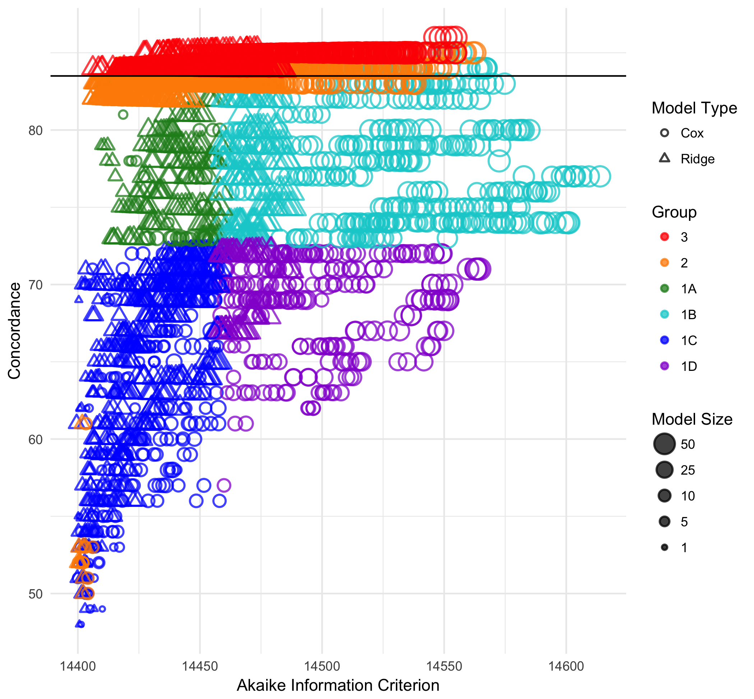
Figure 1.
Cancer Mortality Risk Prediction Models.
Each point in the scatter plot represents a Cox proportional hazards model (n = 3789). The sizes of the points are relative to the number of variables (maximum = 50) in each the model, while the shapes correspond to whether ridge penalties were applied (triangle) or not (circle). The colors of points distinguish between models that had 0 (Groups 1A-D; green, cyan, blue, purple), 3 (Group 2; orange) or 8 (Group 3; red) non-randomized predictor variables. Additionally, Group 1 models are further color coded by quadrants based on concordance and Akaike Information Criterion (AIC) values as follows: high-concordance and low-AIC (Group 1A; green), high-concordance and high-AIC (Group 1B; cyan), low-concordance and low-AIC (Group 1C; blue), low-concordance and high-AIC (Group 1D; purple). All Group 3 models have concordance values of 84 or higher (black horizontal line).

Slide 10
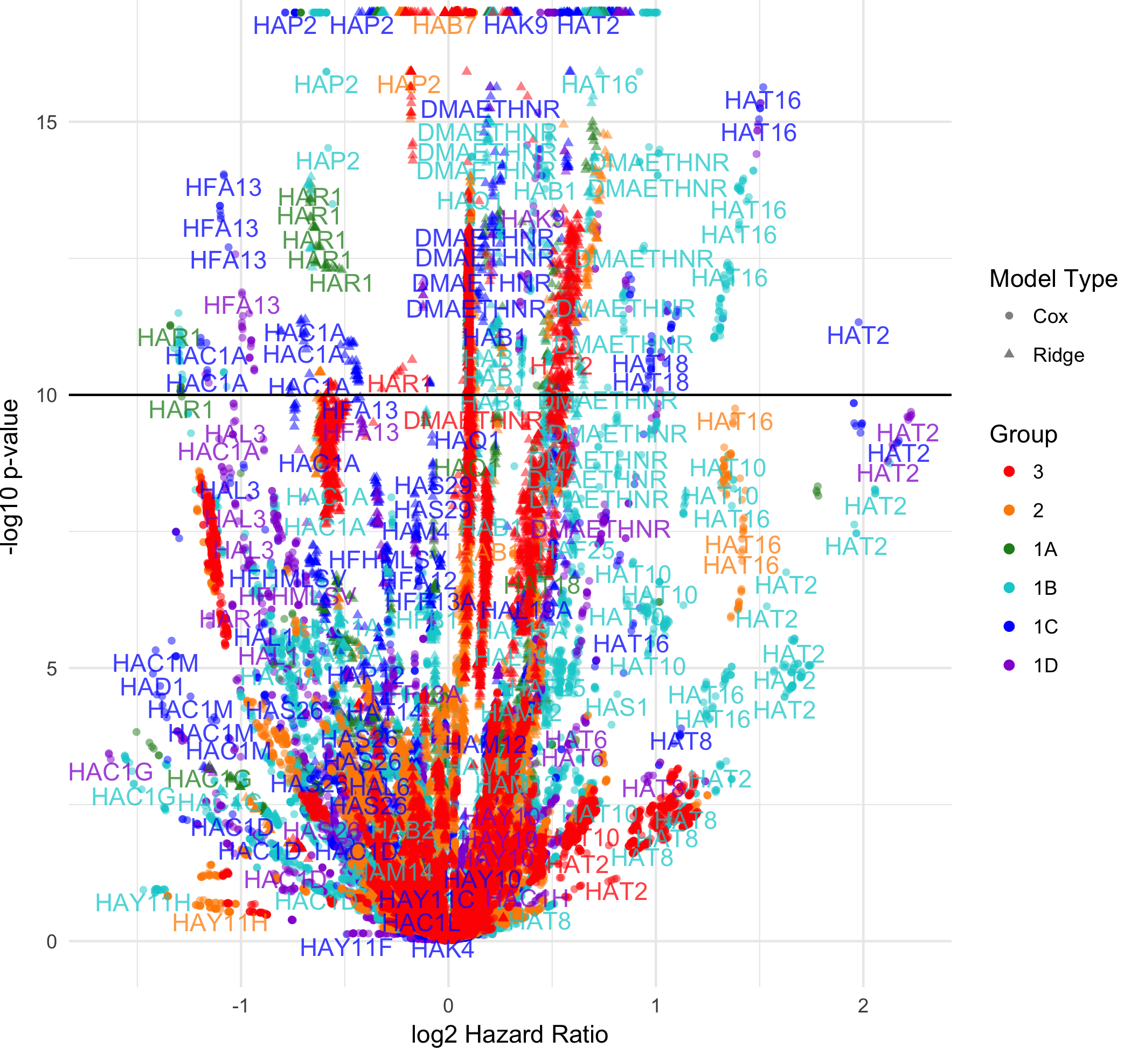
Figure 2.
Lethal Cancer Risk Predictor Variables.
Each point in the volcano plot represents a predictor variable (n = 98787) from a Cox proportional hazards model (n = 3789) trained on NHANES III data. Variables are considered to be highly significant when their negative log10 p-values (y-axis) are above 10 (black horizontal line), regardless of their log2 hazard ratios (x-axis). The shapes of points correspond to whether ridge penalties were applied (triangle) or not (circle). The colors of points describe the model each variable come from as in Figure 1.

Slide 11
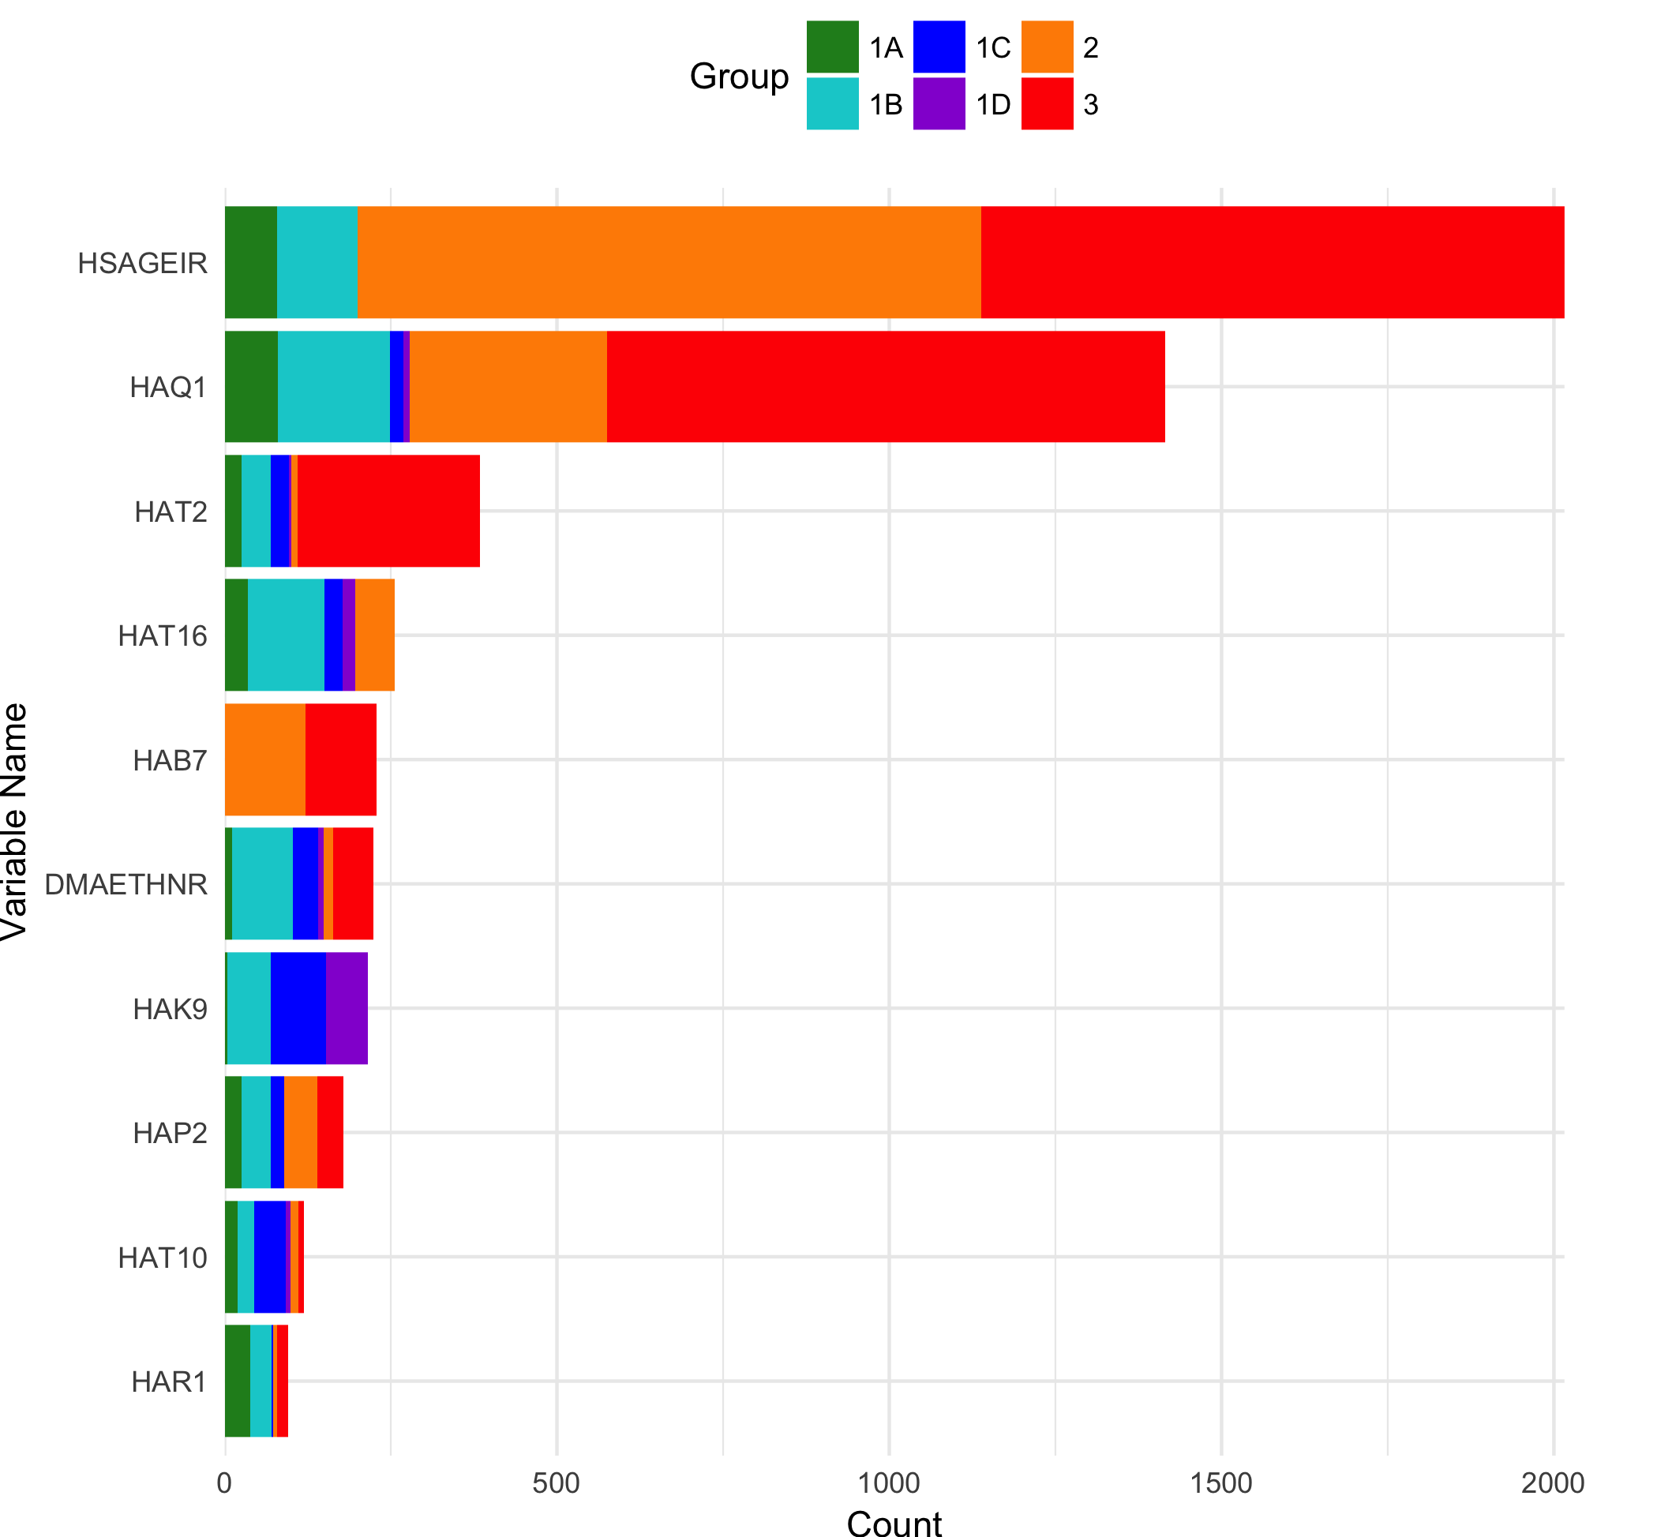
Figure 3.
Highly Significant Predictor Variable Frequency. Each bar represents the number of times (x-axis) a variables (y-axis) appeared in the 3789 Cox proportional hazards models. The colors of bars correspond to the proportion of variables that orginiated from each of the four Group 1 subgroups (Groups 1A-D; green, cyan, blue, purple) and the subsequent iterations (Groups 2-3; orange, red), as in Figures 1 and 2.

Slide 12
Apply domain knowledge to the top variables
Name | Median HR | n | Description
HSAGEIR | 1.04 | 2016 | Age in Years
HAQ1 | 1.07 | 1415 | How would you describe the condition of your natural teeth (excellent, very good, good, fair or poor)?
HAT2 | 1.50 | 384 | In the past month, did you jog or run?
HAT16 | 1.67 | 256 | In the past month, did you lift weights?
HAB7 | 0.99 | 228 | In the past 12 months, how many times were you in a nursing home?
DMAETHNR | 1.14 | 224 | Race/Ethnicity
HAK9 | 1.23 | 216 | How many times per night do you usually get up to urinate?
HAP2 | 0.81 | 179 | Do you use glasses, contacts, or both?
HAT10 | 1.43 | 119 | In the past month, did you do other dancing?
HAR1 | 0.63 | 96 | Have you smoked at least 100 cigarettes during your entire life?

Slide 13
Results Summary
The models with fewer randomized variables outperformed the fully randomized models in terms of concordance.
Across all of the models, the ten variables that most frequently surpassed the p-value threshold were
age,
race/ethnicity,
lifetime consumption of more than 100 cigarettes,
3 variables that pertain to physical activity, and
3 variables that may be related to aging.

Slide 14
Conclusions
The work described here constitutes an exploratory analysis of the NHANES III dataset that employs an iterative strategy for the generation of cancer risk prediction models.
Looking beyond this demonstration of a variable selection method, our ultimate goal is to build upon previously-described cancer risk factors towards
the discovery of novel contributors to cancer risk,
a deeper understanding of cancer etiology, and
an improved ability to predict cancer incidence and mortality.

