Slide 1
Predicting Under-Five Mortality Rate Using Machine Learning Models
Presented By: Muhammad Arslan
UET
Advanced Techniques In Data Sciences

Slide 2
Introduction
Analyze and predict under-five mortality rates per 1000 live births.
Focus on neonatal challenges and early childhood diseases.
High-risk regions: Sub-Saharan Africa and Southern Asia.
Key causes: Preterm births, pneumonia, diarrhea, and malaria.

Slide 3
Problem Statement
Neonatal deaths account for 44% of under-five mortality.
Main diseases: pneumonia, diarrhea, and malaria.
Importance: Develop predictive models to guide healthcare interventions.

Slide 4
Study Review
Machine Learning models used: Linear Regression, Decision Tree, Random Forest, K Neighbors.
Random Forest outperforms others due to ensemble learning.
Metrics: Mean Squared Error (MSE), Mean Absolute Error (MAE).

Slide 5
Dataset Description
Dataset Size: 31,465 rows, 6 features.
Key Features: Country, Year, Birth Rates, Mortality Rates.
Target: Mortality rate (per 1000 live births).
Preprocessing: Encoding categorical data, normalizing numerical features.

Slide 6
Methodology
Steps:
1. Data Cleaning: Handling missing values and encoding.
2. Splitting Dataset: 80% training, 20% testing.
3. Applying Models: Linear Regression, Decision Tree, Random Forest, K Neighbors.
4. Evaluation: Using MSE and MAE to compare performance.

Slide 7
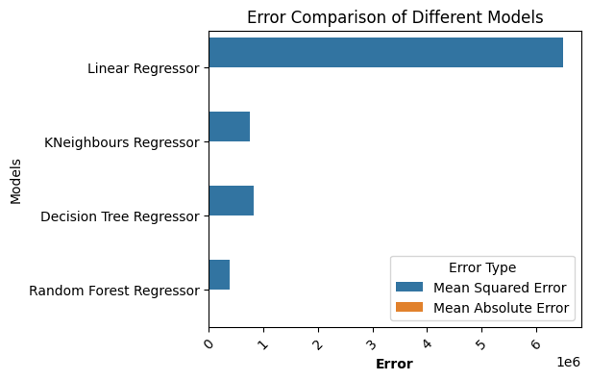
Data Visualization

Slide 8
Results
Model Performance (MAE):
Linear Regression: 2137.19
Random Forest: 182.01
Decision Tree: 226.76
K Neighbors: 211.85
=> Random Forest performed the best.

Slide 9
Conclusion
Random Forest is the most effective model with the lowest error.
Neonatal deaths are the primary contributors to under-five mortality.
Future Work:
Add more features like healthcare access and education.
Explore deep learning techniques for further improvement.

Slide 10
Thank You

