Slide 1
Machine Learning
a comprehensive introduction

Slide 2
Concepts
01
What is Data Science ?
02
Machine Learning Algorithms
03
Build Machine Learning model for face recognition

Slide 3
Data Science

Slide 4
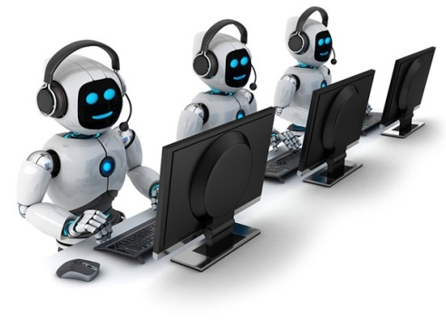
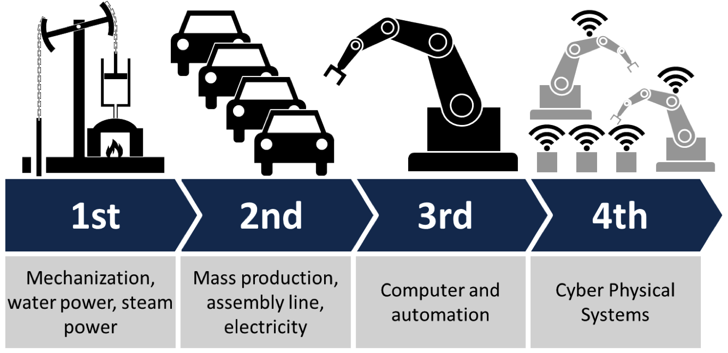
Notes:
1. Our World is changing, one thing that impact our life is artificial intelligence. AI bringing an new industrial revolution, previous industrial revolution expanded human mechanical power (machines, motors etc) now this new machine age expanding human cognitive power, mental power. Nowadays computer not only replacing mechanical labours but also replacing metal labours, i.e., AI giving is computer the ability to think. So where we stand today ?

Slide 5
















100+ AI tool available in market

Slide 6
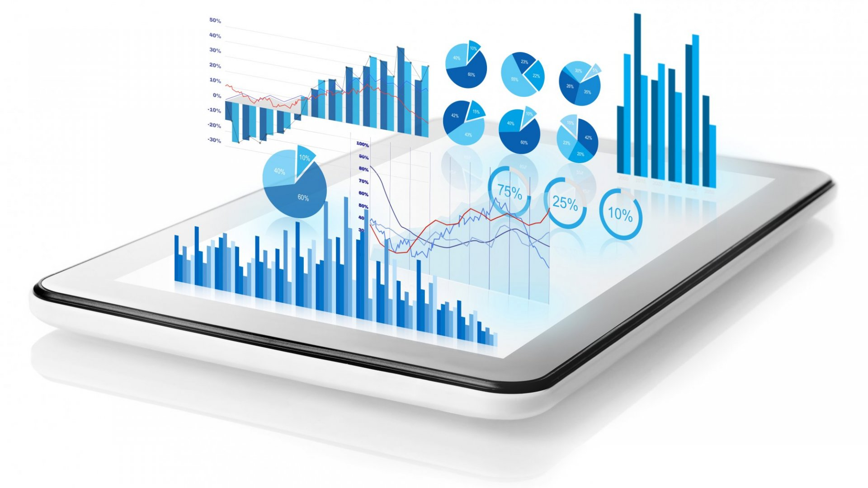
Data
In computing, data is information that has been translated into a form that is efficient for movement or processing. Relative to today's computers and transmission media, data is information converted into binary digital form

Slide 7
Learning from Data
ACTION
KNOWLEDGE
INFORMATION
DATA
Decision Making
Synthesizing
Analysing
Summarizing
Organizing
Collecting
Notes:
Machine Learning allows to learn from examples. ie., to learn from data contains information. Machine learning is a key to clone knowledge into computer. This is important, because knowledge is what enable intelligence. Putting a knowledge into computer is difficult, from previous approaches, why ?
There are many things which we know intuitively so we cannot communicate them verbally we do not have conscious access to that intuitive knowledge. how can we program computers with that knowledge what's the solution

Slide 8
Data Science
Dealing with unstructured and structured data
Process of extracting knowledge from data
Preparation
Analyze
Models

Slide 9
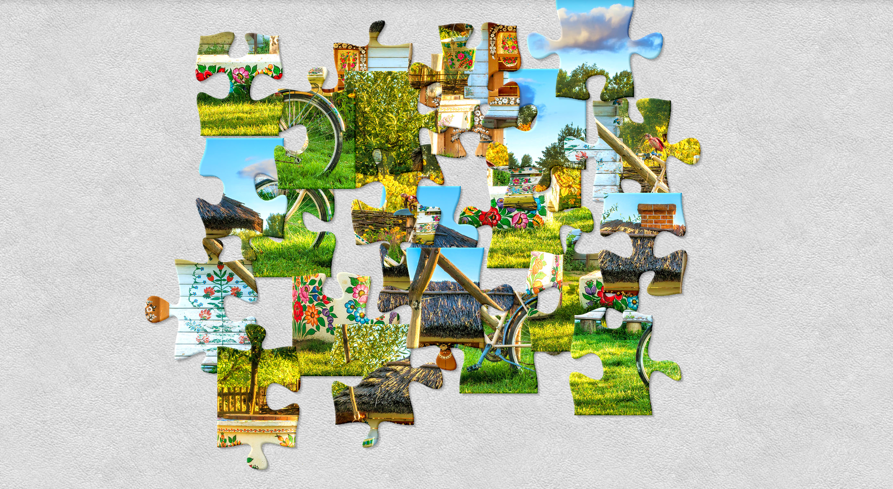
Raw Data

Slide 10
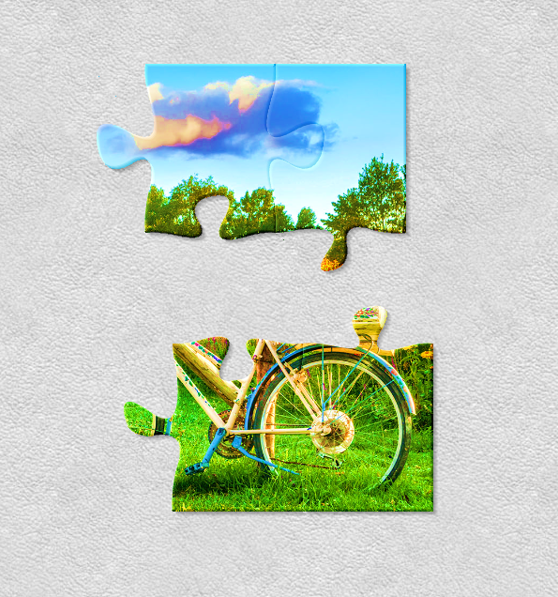
Preparing

Slide 11
Learning from Data
ACTION
KNOWLEDGE
INFORMATION
DATA
Decision Making
Synthesizing
Analysing
Summarizing
Organizing
Collecting
Notes:
Machine Learning allows to learn from examples. ie., to learn from data contains information. Machine learning is a key to clone knowledge into computer. This is important, because knowledge is what enable intelligence. Putting a knowledge into computer is difficult, from previous approaches, why ?
There are many things which we know intuitively so we cannot communicate them verbally we do not have conscious access to that intuitive knowledge. how can we program computers with that knowledge what's the solution

Slide 12

Analysis

Slide 13
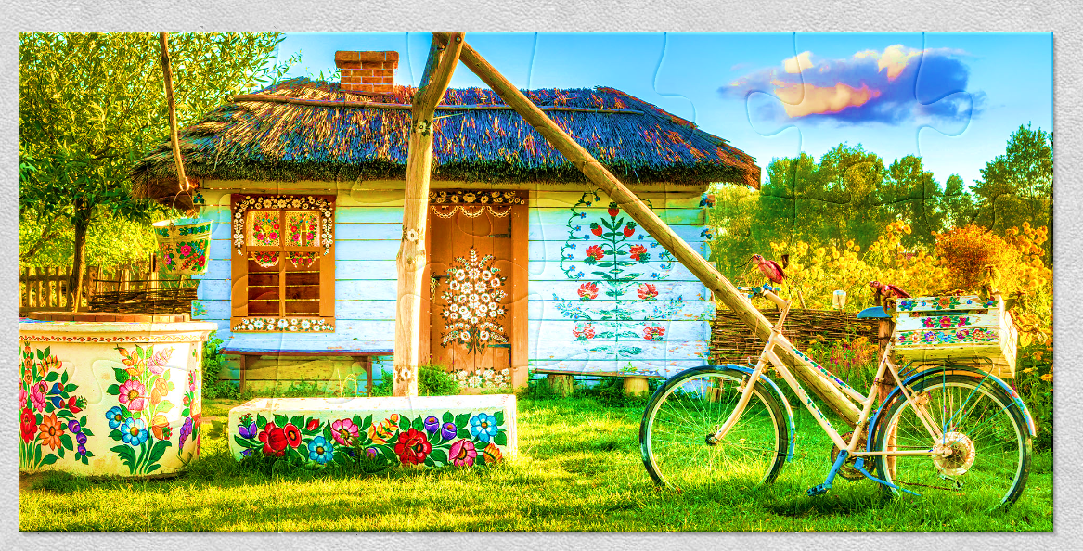
Insights

Slide 14
Data Analysis Life cycle
Raw Data
Data Understanding
Data Preparation
Analyzing and Visualization
Insights

Slide 15
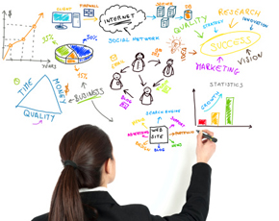
Statistics for Data understanding
Raw Data
Data Understanding
Statistics
How to Collect data ?
Conclusion from data
Analysis Data

Slide 16



Statistics for Data understanding
Raw Data
Data Understanding
Data Preparation
Extract
Transform
Loading

Slide 17
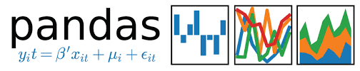
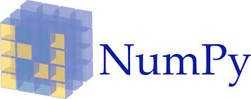


Data Analysis Life cycle
Raw Data
Data Understanding
Data Preparation
Analyzing and Visualization
Insights

Slide 18
Data Science
Process of extracting knowledge from data
Using knowledge predict the unknown

Slide 19
Where it is used
Machine Learning
Insights
Prediction or Decisions
Regression
Concept of Modelling:
From easy to measure parameters predict hard to measure
Eg:
- Age, Gender, Income, Education level etc.
and a difficult-to-measure metric
- Amount of loan to give; Will she buy or not; How many days a patient will stay in the hospital etc.,
Times Series
Classification
Clustering
Association Rules

Slide 20
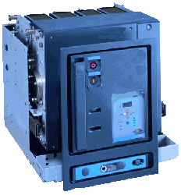

Regression: Predictive Maintenance
Over Several years many maintenance strategies emerged.
Reactive Maintenance
Preventive Maintenance
Predictive Maintenance
m/c -1
m/c -1
m/c -1
Breakdown
m/c -2
m/c -2
m/c -2
Maintenance
m/c -3
m/c -3
m/c -3
m/c -4
m/c -4
m/c -4
m/c -5
m/c -5
m/c -5
cycles
cycles
cycles
Failure always occurs
Increases uptime and
less failures
Maximizes life & uptime
No Failures
Reactive Maintenance: Fixes issues after they occur.
Preventive Maintenance: Fixes issues before they occur by following a schedule based on failure experience.
Predictive Maintenance: Fixes issues before they occur but considers the actual utilization of the equipment instead of working from a fixed schedule.

Slide 21
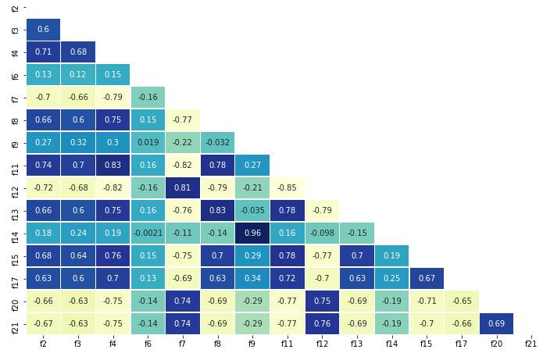
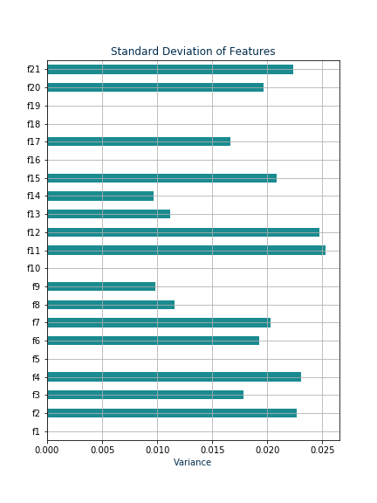
IDENTIFYING CRITICAL PARAMETERS
Before answering following question, first need to identify critical parameters w.r.t the target variable and while selecting make sure there is no multicollinearty.
Remove features with low variance
Analyzing variance for the remaining features
Variance of Parameters

Slide 22

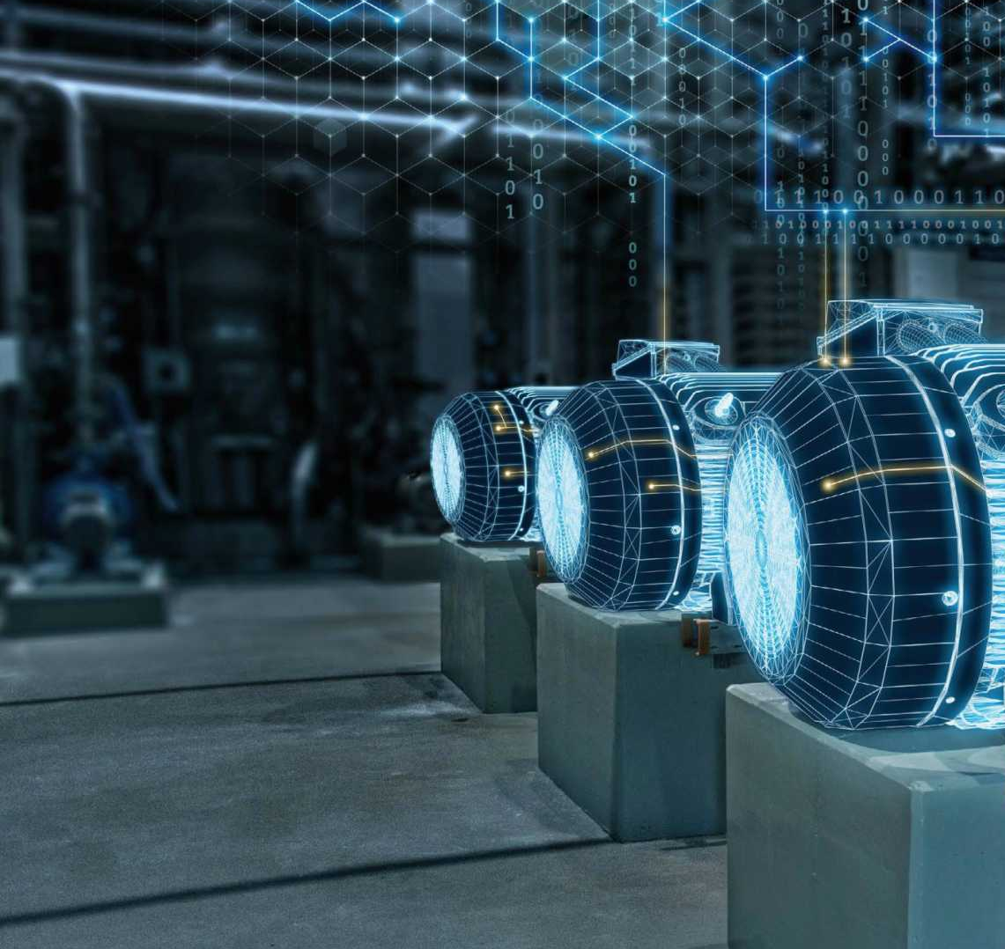

Features
Machine Learning
model
Time to failure prediction (TTF or RUL)
Predicting which equipment is likely to get fail.
Integrate with Enterprise Resource Planning (ERP) System
Generate Alerts and Reports
Interactive Dashboard
Give Alerts for timely maintenance of machine
TTF: 378
TTS: 300
Efail: None
ERP: None
TTF: 260
TTS: 300
Part: 4
ERP: 9
TTF: 126
TTS: 300
Part: 2
ERP: 3

Slide 23
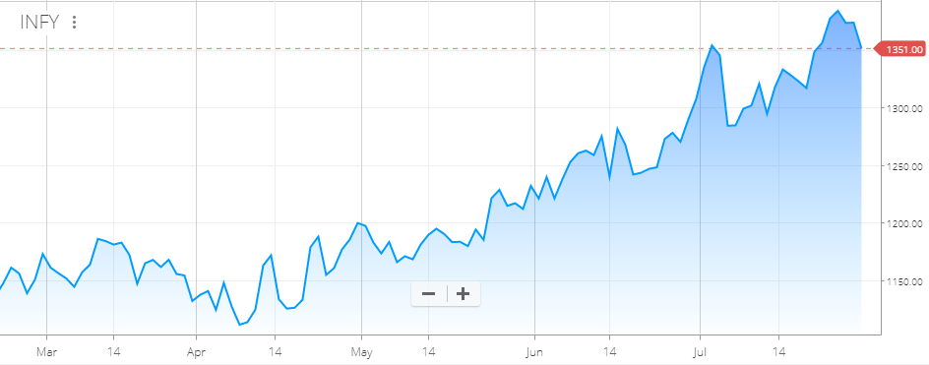
Regression and Time series for prediction

Slide 24
Where it is used
Machine Learning
Insights
Prediction or Decisions
Regression and Time Series
Classification

Slide 25
Domain | Question
Telecom | Is a customer likely to leave the network? (churn prediction)
Retail | Is he a prospective customer? that is likelihood of purchase vs. non-purchase?
Insurance | To issue insurance should a customer be sent for a medical checkup?
Insurance | Will the customer renew the insurance?
Banking | Will a customer default on the loan amount?
Banking | Should a customer be given a loan?
Manufacturing | Will the equipment fail?
Health Care | Is the patient infected with a disease?
Health Care | What type of disease does a patient have?
Entertainment | What is the genre of music?

Slide 26


Classification
Retail Market
Eg: Churn Problem
Which Kind of people are moving from airtel to jio
2. Why ?
3. What are the preventive measure to be taken to retail their customers

Slide 27
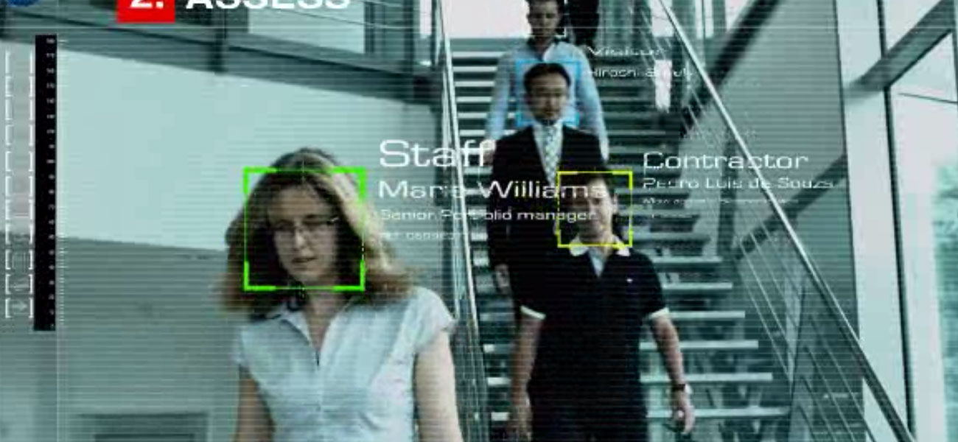
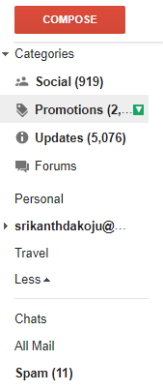
Classification
Medical Filed
Cancer Detection
Text Classification
Eg. Gmail Spam detection
Face Recognition
Many more …

Slide 28
Where it is used
Machine Learning
Insights
Prediction or Decisions
Regression and Time Series
Classification
Clustering and Rules

Slide 29
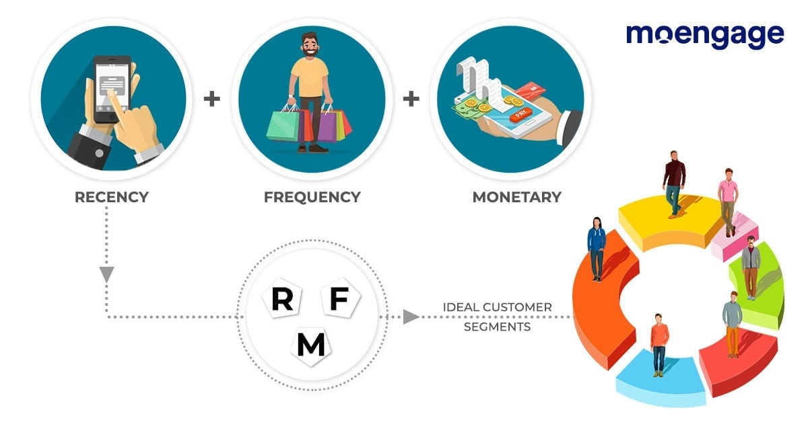
Clustering

Slide 30



Rules – Recommendation system
If you purchase on product you will purchase one more product
If you watch one movie you will watch one more movie

Slide 31

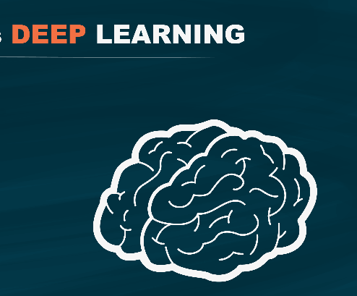
Machine Learning
Deep Learning
Insights
Prediction or Decisions
Regression and
Time Series
Neural Network
Classification
Convolutional Neural Network
Clustering and Rules
Recurrent Neural Network

Slide 32
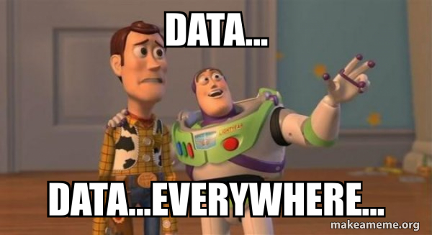

Slide 33
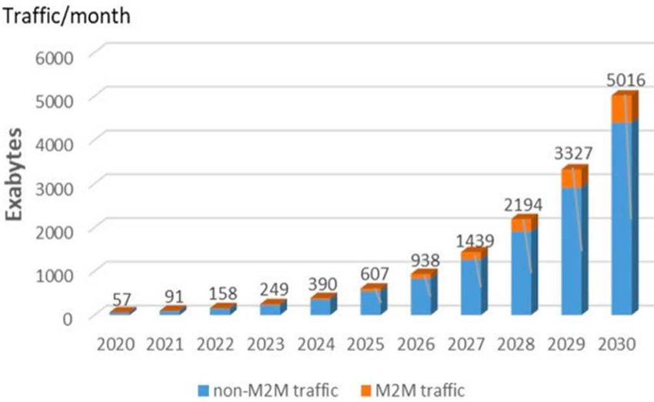

Slide 34

Face Recognition
Emp: 112885
Time: 12:53,687
Gender: Male
Emotion: Inquisit
Emp: 154665
Time: 12:53,687
Gender: Female
Emotion: happy
Emp: 134419
Time: 12:53,687
Gender: Female
Emotion: happy

Slide 35
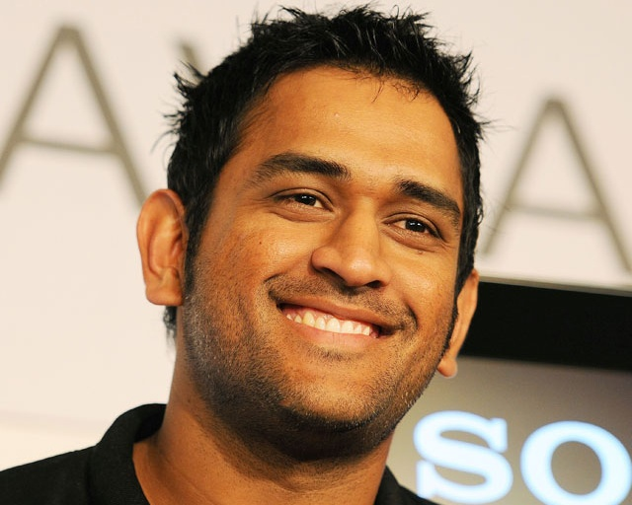
How computer see person ?

Slide 36
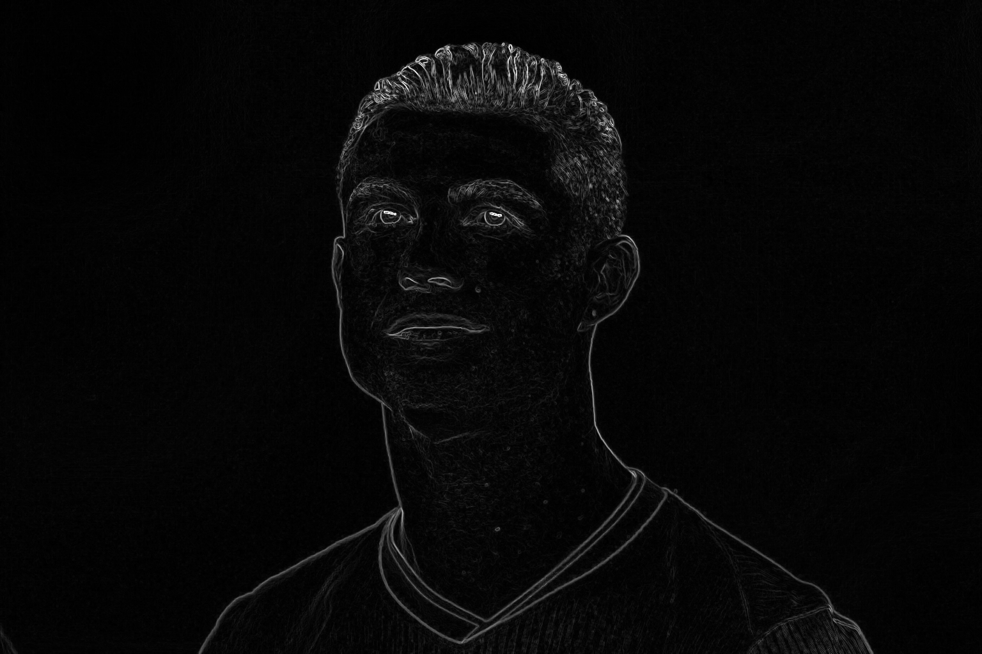
Guess this person ?

Slide 37

Cristiano Ronaldo

Slide 38
Image
An image is a picture that has been created by combination of vectors or values.
An image can be described in terms of vector graphics or raster graphics.
An image stored in raster form is sometimes called a bitmap.

Slide 39
Color Space
Color image is combination of three channel
Red Channel
Green Channel
Blue Channel

Slide 40
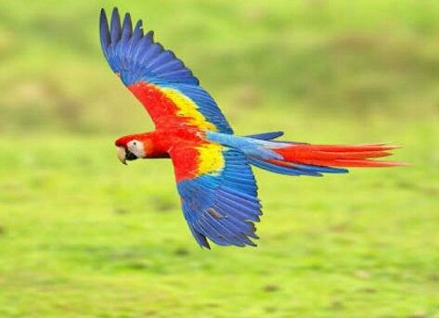
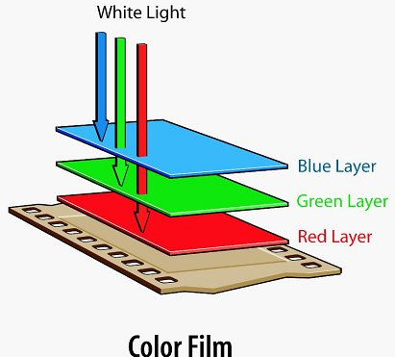
Basics of Image Processing
(343, 473 , 3)

Slide 41
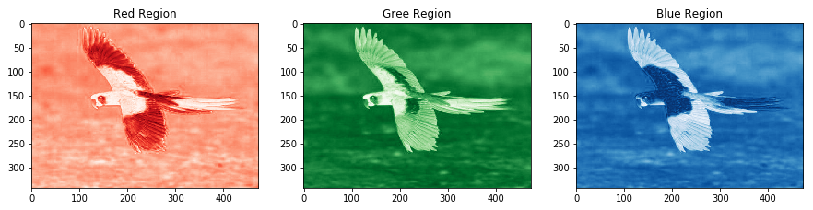
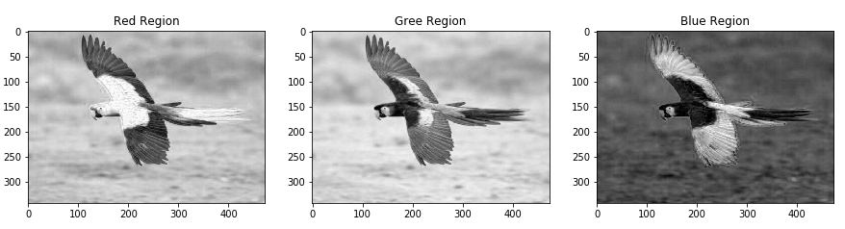
(343, 473)
(343, 473)
(343, 473)
(343, 473 , 3)
(343, 473)
(343, 473)
(343, 473)

Slide 42
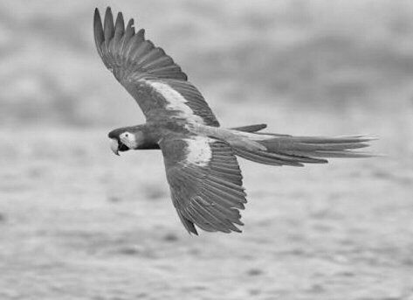
Use of Grayscale image
(343, 473 , 3)
(343, 473)
Length of matrix or array reduce by 3 times hence the computation time

Slide 43



Deeper into Image
PIXELS
(1200 , 1200 , 3)

Slide 44
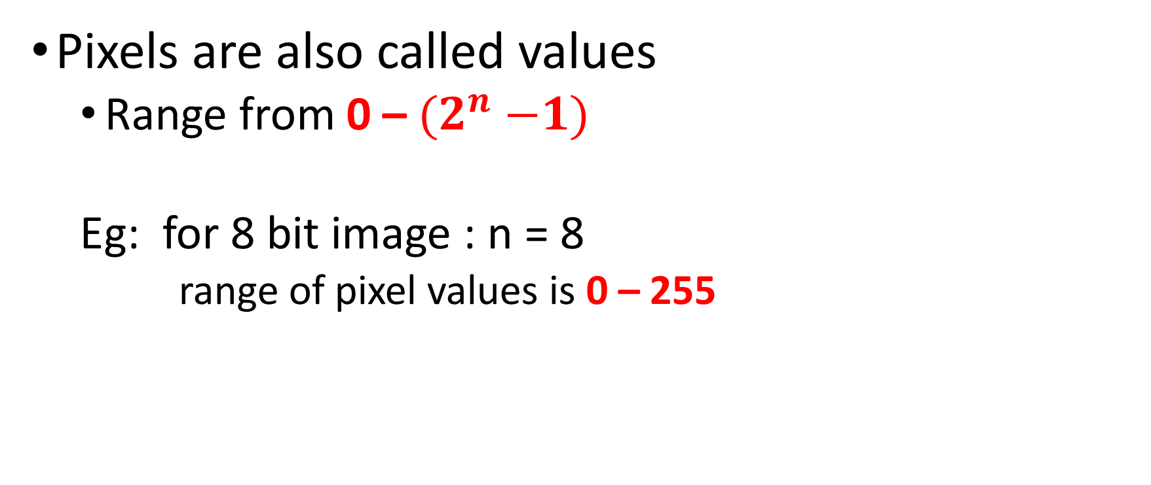
PIXELS
Pixels are also called values
Range from 0 – ${(2}^{n} −1)$
Eg: for 8 bit image : n = 8
range of pixel values is 0 – 255

Slide 45
PIXELS
Lower the value darker the color
Eg: black color for gray scale image
Higher the value lighter the color
Eg: White color for gray scale image
0
255

Slide 46

Array in graphical representation
Image is matrix and representation in graphical manner
0
230
255
53
235
255
20
240
255
0
255
70
255
100
120

Slide 47
Information in Image
Skill of extraction information or knowledge from data is called Data Science
Transformation
Analysis
Modeling
(1200, 1200)

Slide 48
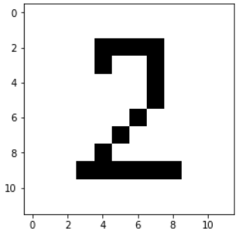
Data Transformation
Transforming the data into structured
Resize {Bring the all image into same shape}
Reshaping
Converting into either row matrix or column matrix
(10, 10)
(1, 100)

Slide 49
Analysis
Number of black bars
Distance between each bars
Width of each bars
Position or index of bars
(1, 100)

Slide 50
Train images or arrays

Slide 51
Face ?
Converting into Grayscale
Resize (Bring face into same size)
Reshaping
Transforming
Building Model

Slide 52

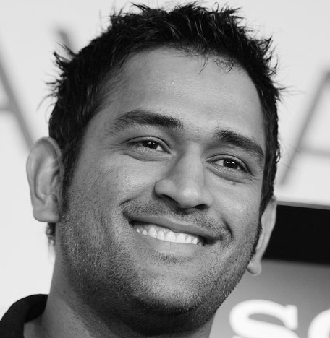
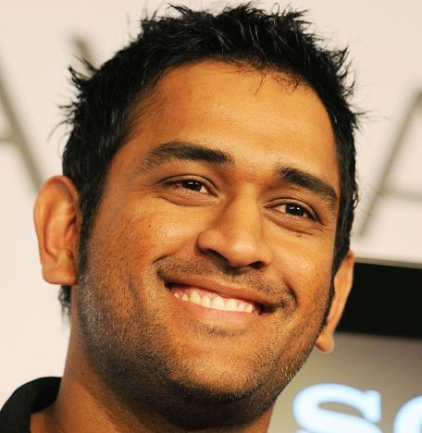

Slide 53

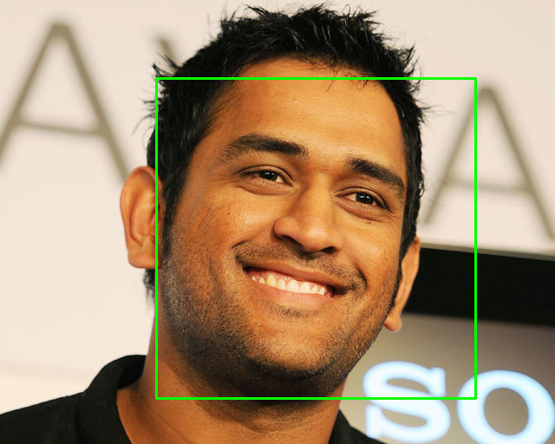
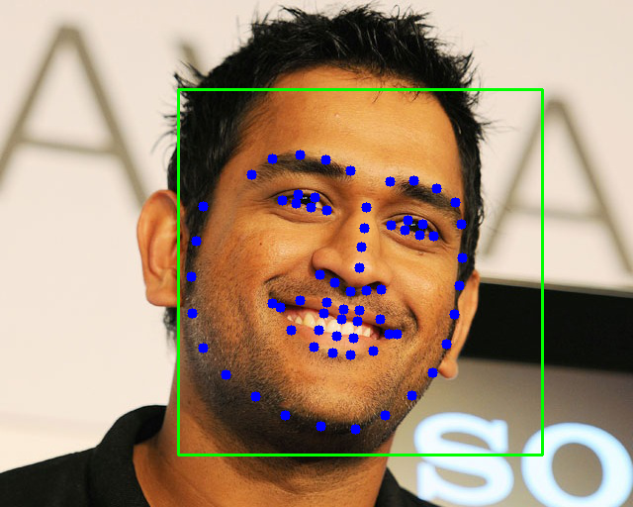

Recognition Algorithm
Input Image
Detect Face
Identify Shape or Transforming
Classification
128D unit Hyper sphere
Similarity Detection
Clustering
Deep Neural Network

Slide 54
Recognition Algorithm
Input Image
Detect Face
Identify Shape or Transforming
0.96, 0.56, 0.176, 0.784 ….. 0.49
1 x 128
Deep Neural Network

Slide 55
Let’s Building Face Recognition Model

Slide 56
K- Nearest Neighbor Algorithm

Slide 57
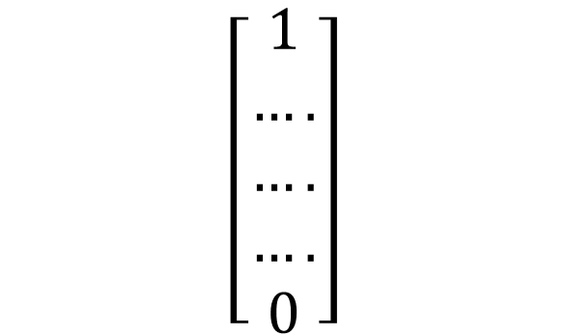
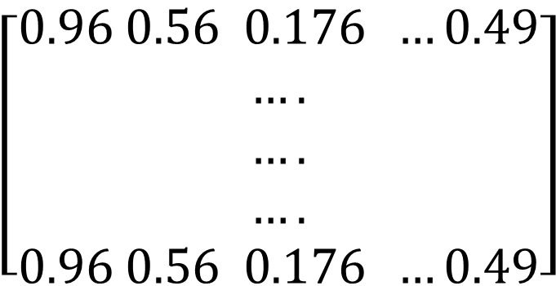
Male
male001.jpg
male002.jpg
.
.
.
Female
female001.jpg
female002.jpg
.
.
.
y
X1 x2 x3 x128
$$\left[\begin{aligned}0.96 0.56 0.176 …0.49 \\ …. \\ …. \\ …. \\ 0.96 0.56 0.176 …0.49\end{aligned}\right]$$
$$\left[\begin{aligned}1 \\ …. \\ …. \\ …. \\ 0\end{aligned}\right]$$
0.96, 0.56, 0.176, 0.784 ….. 0.49

Slide 58

What K-NN does for you
Female
Male

Slide 59
What K-NN does for you
Unknown
Female
Male

Slide 60
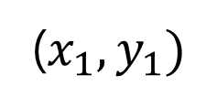
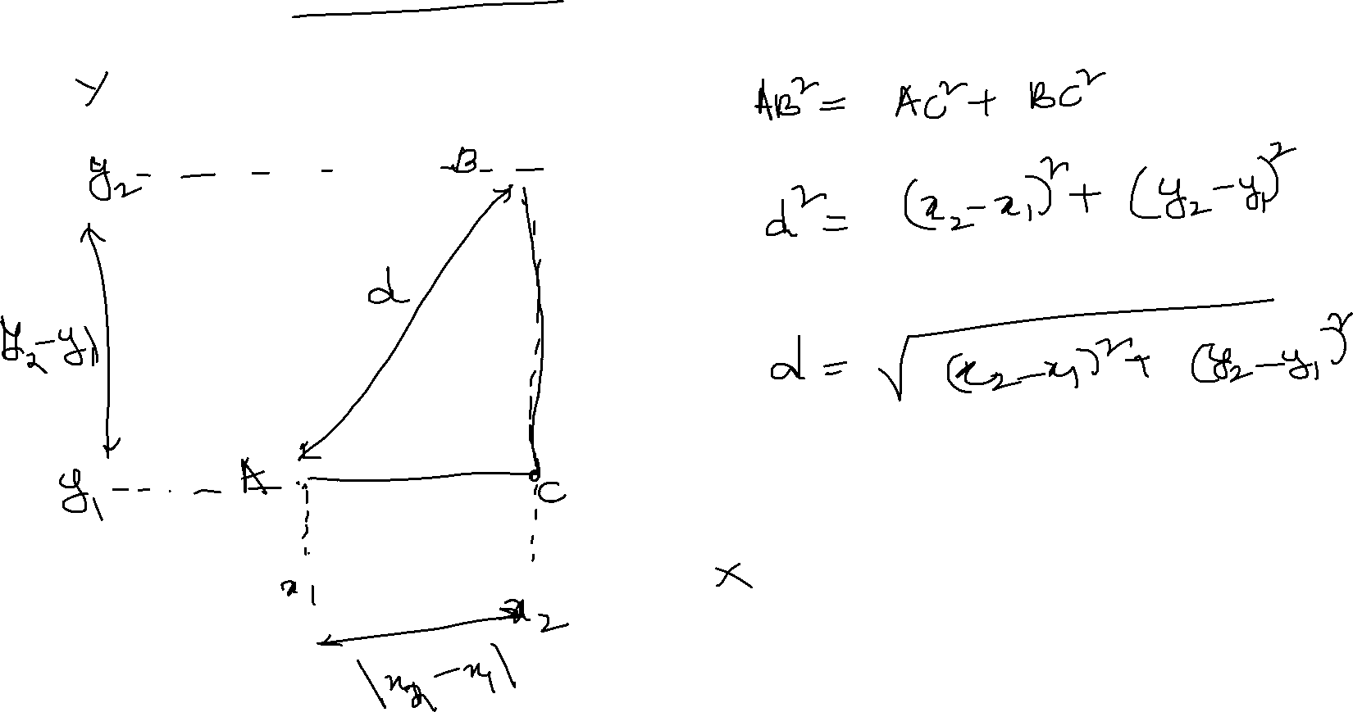
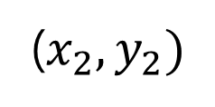
Euclidean Distance
($x_{2}, y_{2})$
($x_{1}, y_{1})$

Slide 61
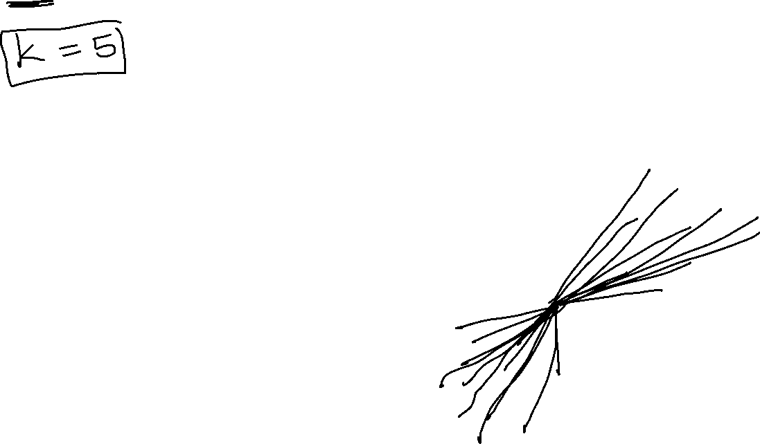
K-NN Algorithm
Unknown
Female
Male

Slide 62
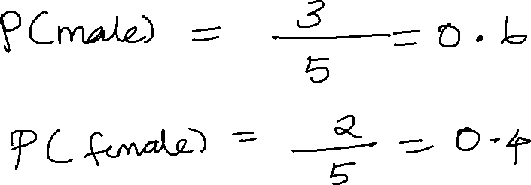
K-NN Algorithm
Female
Male

Slide 63
K-NN Algorithm
Female
Male

Slide 64
Let’s build K-NN for Face Recognition

Slide 65

Recognition Algorithm
Input Image
Detect Face
Identify Shape or Transforming
Haar Cascade Classifier
Regression model with Deep Learning
Male
ML
0.96, 0.56, 0.176, 0.784 ….. 0.49
Female
1 x 128
Deep Neural Network

