Slide 1

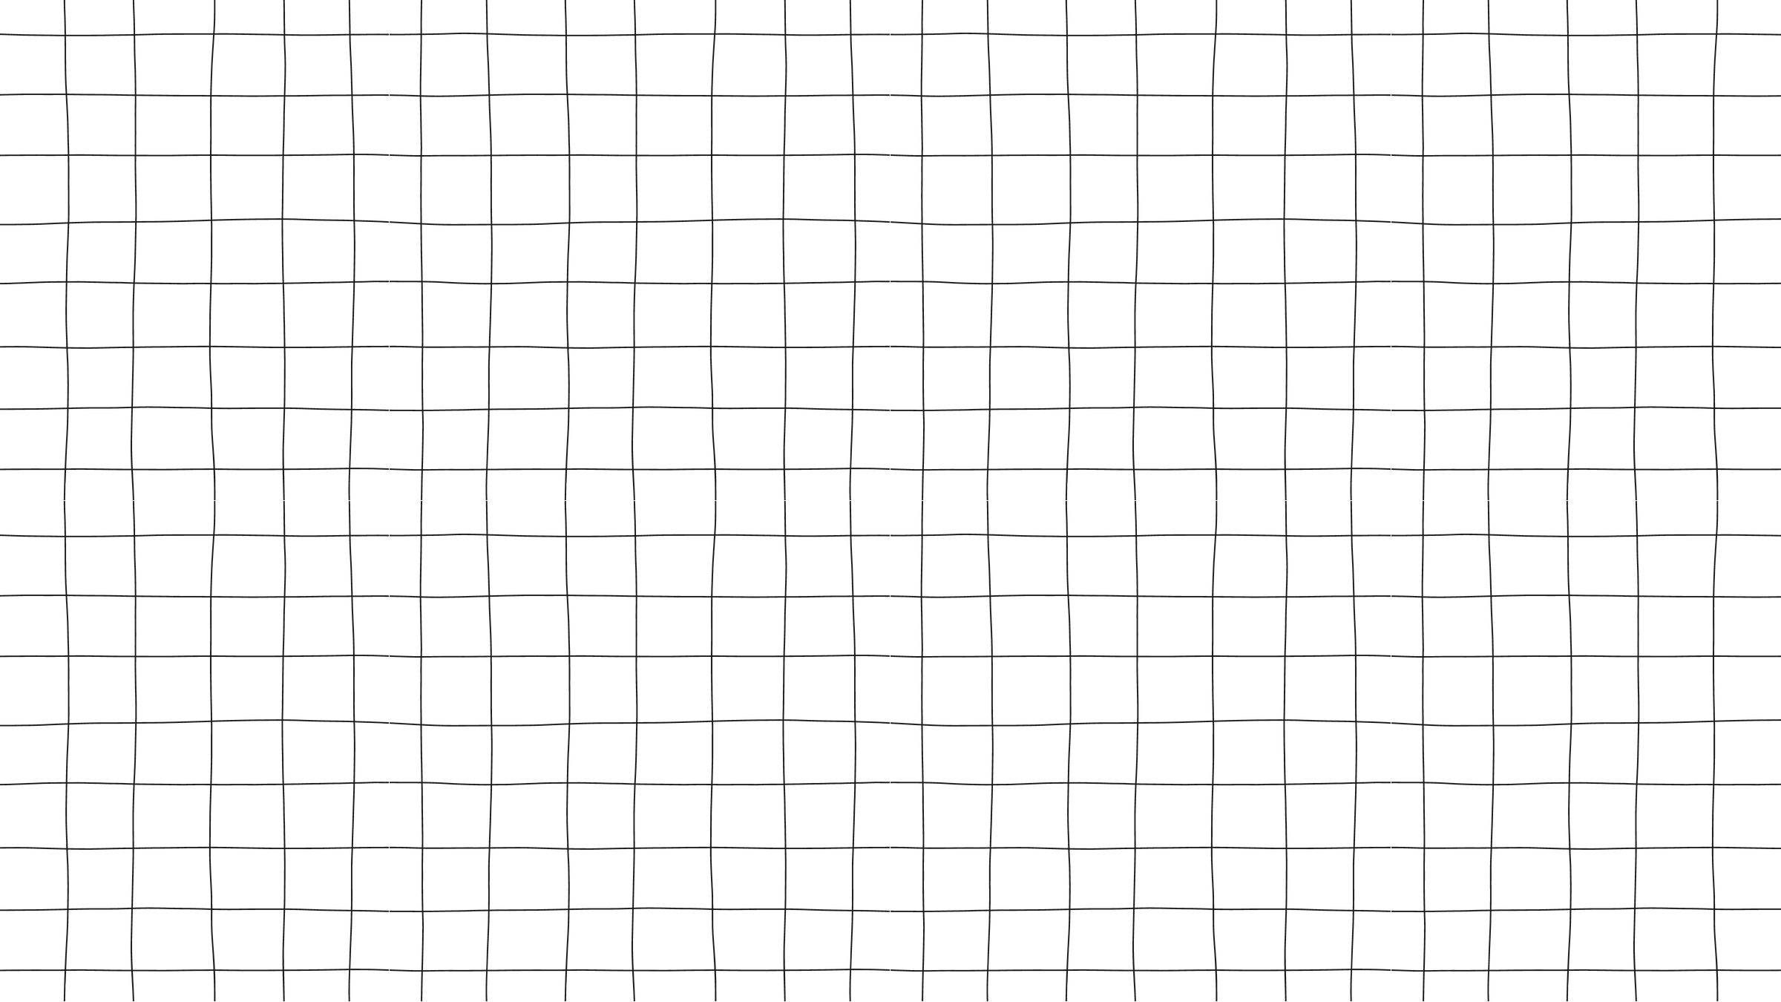





Finale
Project
Tower Of Hanoi Game

Slide 2

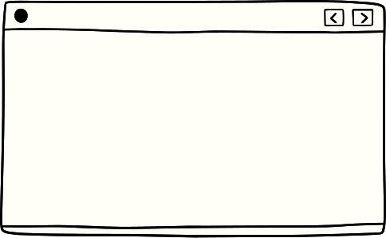



Contents
01
02
03
Game
Explaination
Code
Gui
04
05
06
Video
The Writer
Thank You

Slide 3

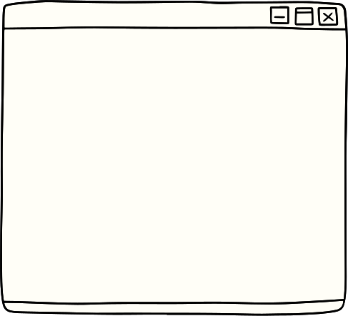


Explanation
Setup: The puzzle comprises three rods and various disks of different sizes. Initially, all disks are stacked in decreasing size on one rod.
Objective: The goal is to move the entire stack to another rod.
Rules:
Only one disk can be moved at a time.
A disk can be placed on top of another stack or an empty rod.
No disk may be placed on top of a smaller disk.
Strategic Concept: Solving the Tower of Hanoi puzzle highlights the principles of recursion and problem-solving, as players navigate through a series of moves while maintaining the specified rules.
Learning Opportunity: The puzzle serves as an engaging way to explore algorithmic concepts and develop problem-solving skills, making it a classic and instructive exercise.

Slide 4

Solve Explaination:
Base Case: Define a base case to stop the recursion. In the Tower of Hanoi, this occurs when there's only one disk to move. In this case, simply move the disk from the source rod to the destination rod.
Recursive Step: Assume you have a function that can solve the Tower of Hanoi for n-1 disks. To solve it for n disks, follow these steps:
Move the top n-1 disks from the source rod to the auxiliary rod (using the destination rod as a temporary rod).
Move the nth disk from the source rod to the destination rod.
Move the n-1 disks from the auxiliary rod to the destination rod (using the source rod as a temporary rod).
Repeat: Repeat the recursive step until you reach the base case.
Code
The code comes with two factors:
01
solvation
02
GUI

Slide 5
Solve Code
Code
The code comes with two factors:
private void TowerOfHanoi(int n, int sourceTower,
int targetTower, int auxiliaryTower)
{
if (n > 0)
{
TowerOfHanoi(n - 1, sourceTower, auxiliaryTower, TargetTower);
MoveDisk(n, sourceTower, targetTower);
TowerOfHanoi(n - 1, auxiliaryTower, targetTower, sourceTower);
}
}
01
solvation
02
GUI

Slide 6

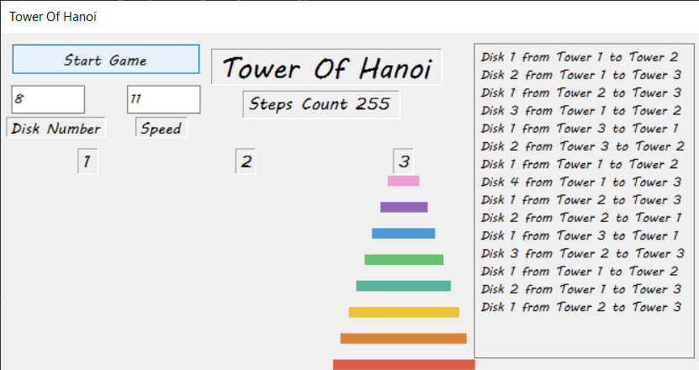
GUI:
Code
The code comes with two factors:
01
solvation
02
GUI

Slide 7
GUI Code:
Code
private void DrawDisks(int n, int towerIndex, int baseY)
{
int colorIndex = 0; // Index for selecting colors from the hexColors array
// Clear the entire tower
graphics.FillRectangle(SystemBrushes.Control, towerIndex * TowerSpacing, 0, TowerSpacing, ClientSize.Height);
// Draw the remaining disks on the tower
foreach (int diskSize in towerDisks[towerIndex])
{
string hexColor = hexColors[colorIndex % hexColors.Length];
Brush diskBrush = new SolidBrush(ColorTranslator.FromHtml(hexColor));
int towerX = towerIndex * TowerSpacing + TowerSpacing / 2 - TowerWidth / 2;
int diskWidth = DiskWidth + (diskSize - 1) * DiskWidth / 2;
int diskX = towerX - diskWidth / 2 + DiskWidth / 2;
int diskY = baseY - (MaxTowerHeight - diskSize) * DiskHeight; // Adjusted calculation
graphics.FillRectangle(diskBrush, diskX, diskY, diskWidth, DiskHeight);
baseY -= SpaceBetweenDisks + DiskHeight; // Adjust vertical position for the next disk
colorIndex++;
}
}
The code comes with two factors:
01
solvation
02
GUI

Slide 8
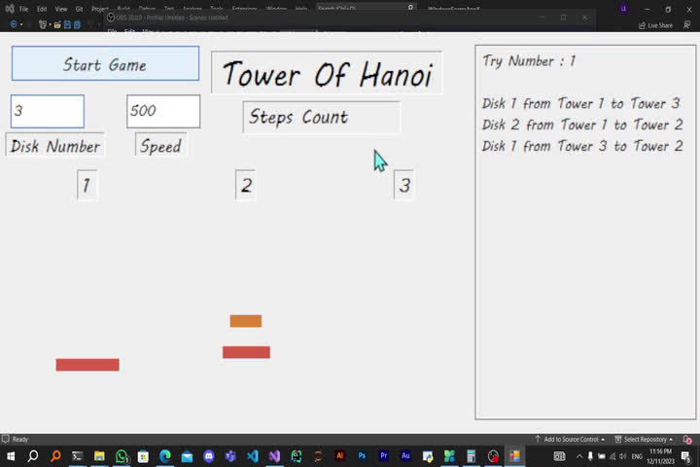

Slide 9

The Writer
Marslino Edward
Id: 323230084

Slide 10


Thank you
Github Repo

