Slide 1

FEINSCHLIFF. · SHOWCASE 2026
LAYOUT · TITLE ACCENT
Feinschliff
showcase deck.
JAN 2026 · SHOWCASE
SLIDE 1

Slide 2

FEINSCHLIFF. · SHOWCASE 2026
LAYOUT · TITLE INK
Title slide,
dark variant.
JAN 2026 · SHOWCASE
SLIDE 1

Slide 3

COVER
LAYOUT · FULL-BLEED COVER
An image does
the talking.
JAN 2026 · SHOWCASE
SLIDE 12 / 32

Slide 4
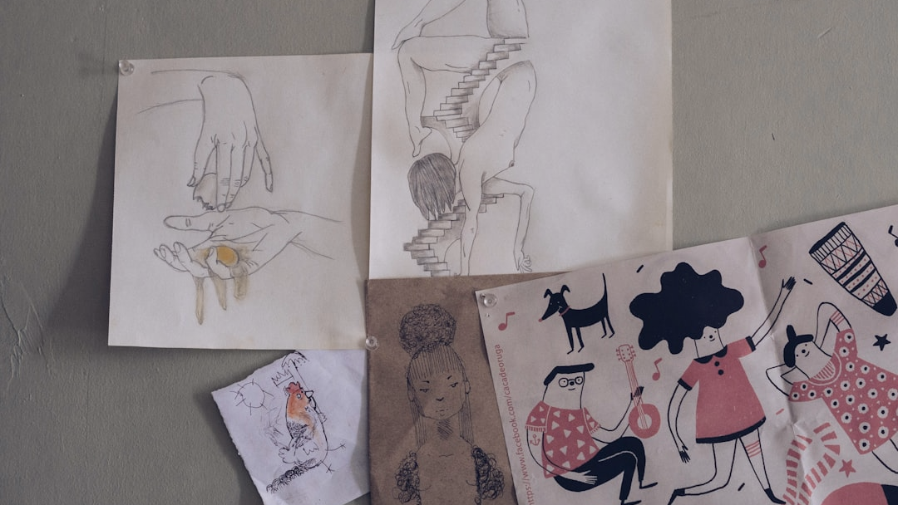
LAYOUT · FULL-BLEED EDITORIAL
And it's changing faster than we measured for.
Lake Mead, 2023. Sediment line marks 1983 high-water.
MAY 2026 · SHOWCASE
SLIDE 9 / 30

Slide 5
CHAPTER 01
LAYOUT · CHAPTER ACCENT
01
Chapter.
01 / 06
JAN 2026 · SHOWCASE
SLIDE 5 / 32

Slide 6

CHAPTER 02
LAYOUT · CHAPTER INK
02
Chapter
& Picture.
JAN 2026 · SHOWCASE
SLIDE 6 / 32

Slide 7
AGENDA
LAYOUT · AGENDA
Eight chapters across the day.
01 / 08
Welcome & frame
02 / 08
Quarter in review
Why we're here, what we'll decide.
Where the plan landed vs the bar.
03 / 08
Customer voice
04 / 08
Product roadmap
Three accounts, three lessons.
Eighteen months, three workstreams.
05 / 08
Go-to-market
06 / 08
People & culture
Pricing, packaging, motion.
Hiring plan, retention signals.
07 / 08
Risk register
08 / 08
Decisions & next steps
What could derail the plan.
What we commit to before EOM.
JAN 2026 · SHOWCASE
SLIDE 4 / 32

Slide 8
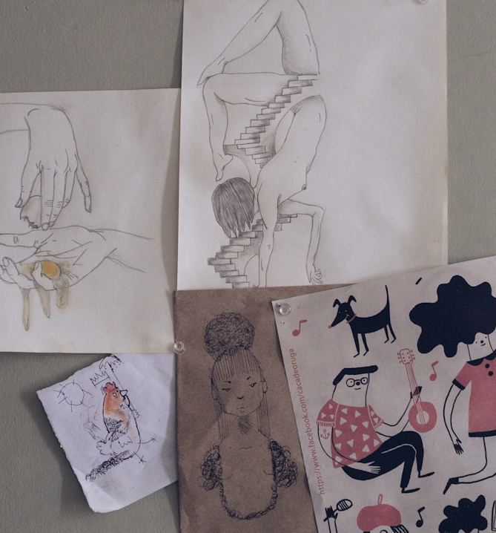
TODAY · 4 ACTS
AGENDA
Today.
01
Scale
Reservoirs, drawn to scale, the cycle as a system.
02
Stress
It's accelerating faster than we measured for.
03
Pathways
Where each drop goes.
04
Response
Three levers that work.
MAY 2026 · SHOWCASE
SLIDE 2 / 30

Slide 9
EXECUTIVE SUMMARY
LAYOUT · EXECUTIVE SUMMARY
One-line summary statement that frames the entire deck.
Two-to-three-sentence paragraph that elaborates on the headline and points to the supporting evidence.
INSIGHTS
NEXT STEPS
Insight 1.
Next step 1.
Description of insight 1.
Description of next step 1.
Insight 2.
Next step 2.
Description of insight 2.
Description of next step 2.
Insight 3.
Next step 3.
Description of insight 3.
Description of next step 3.
Insight 4.
Next step 4.
Description of insight 4.
Description of next step 4.
+5.1
2.4
37
%
KPI LABEL 1
M
KPI LABEL 2
KPI LABEL 3
JAN 2026 · SHOWCASE
SLIDE 26 / 32

Slide 10
LAYOUT · ACTION TITLE
SO WHAT?
ACTION-TITLE LAYOUT
Full-sentence takeaway that states the recommendation directly.
SUPPORTING NARRATIVE
+18%
2.3×
Supporting paragraph that explains the evidence behind the recommendation.
KPI LABEL 1
KPI LABEL 2
Caption 1
Caption 2
Source · placeholder
JAN 2026 · SHOWCASE
SLIDE 16 / 32

Slide 11
LAYOUT · KEY TAKEAWAYS
THREE TO REMEMBER
KEY TAKEAWAYS
Three things to remember from this section.
01
02
03
04
Takeaway 1.
Takeaway 2.
Takeaway 3.
Ship weekly.
One- or two-sentence elaboration of the first takeaway.
One- or two-sentence elaboration of the second takeaway.
One- or two-sentence elaboration of the third takeaway.
Every squad cuts a release every week; anything that can't be weekly is a platform bug to be retired.
Owner · Role
Owner · Role
Owner · Role
OWNER · ENG DIRECTOR
JAN 2026 · SHOWCASE
SLIDE 25 / 32

Slide 12
RECOMMENDATION
LAYOUT · RECOMMENDATION
THREE MOVES TO CLOSE THE GAP
Close the 12-point margin gap with three focused bets.
MOVE 01
MOVE 02
MOVE 03
Consolidate tooling 30%.
Re-onboard top 50 accounts.
Sunset three weak SKUs.
• Audit license sprawl across all functions.
• Assign named CS lead per account.
• Migrate affected customers to flagship.
• Pick one platform per category.
• Quarterly business reviews on cadence.
• Refund plus 12-month flagship credit.
• Renegotiate top-10 vendor contracts.
• Co-built roadmap for top 10.
• 60-day sunset notice.
+$2.1M ARR
−5% churn
+$0.8M margin
FINANCE · CTO
CS · CRO
PRODUCT
JAN 2026 · SHOWCASE
SLIDE 23 / 32

Slide 13
NEXT STEPS
LAYOUT · NEXT-STEPS
WHAT HAPPENS MONDAY
Five actions across the next 60 days.
Audit
License sprawl across all functions.
FINANCE
CFO · COO · Week of 16 Sep
Hire
Director of Customer Success (named-account model).
PEOPLE
CRO · People · Offer by 2026-10-15
Communicate
SKU sunset notice to affected customers.
PRODUCT
PRODUCT · CS · By 2026-10-01
Approve
Migration credit budget.
FINANCE
CFO · CEO · Board meeting 2026-10-22
Launch
Account-level QBR cadence with top 50.
GTM
CS · CRO · First QBRs in Nov 2026
JAN 2026 · SHOWCASE
SLIDE 19 / 32

Slide 14
LAYOUT · 2-COLUMN CARDS
TWO COLUMNS
Two columns.
01 · COLUMN
02 · COLUMN
Lead sentence for the first column.
Lead sentence for the second column.
Supporting detail line two.
Supporting detail line two.
JAN 2026 · SHOWCASE
SLIDE 8 / 32

Slide 15
LAYOUT · 3-COLUMN
THREE PILLARS
Three columns.
01
02
03
Column one.
Column two.
Column three.
Description for the first column.
Description for the second column.
Description for the third column.
JAN 2026 · SHOWCASE
SLIDE 9 / 32

Slide 16
LAYOUT · 4-COLUMN CARDS
PLAN, BUILD, PILOT, SCALE
Four columns.
Q1 · PHASE
Q2 · PHASE
Q3 · PHASE
Q4 · PHASE
Lead sentence for phase one.
Lead sentence for phase two.
Lead sentence for phase three.
Lead sentence for phase four.
Supporting detail.
Supporting detail.
Supporting detail.
Supporting detail.
JAN 2026 · SHOWCASE
SLIDE 10 / 32

Slide 17
LAYOUT · VERTICAL BULLETS
FIVE MOVES · H1
Six numbered rows, plan-of-record style.
Subtitle line one.
01 / 06
Item 01
Description for item 01.
02 / 06
Item 02
Description for item 02.
03 / 06
Item 03
Description for item 03.
04 / 06
Item 04
Description for item 04.
05 / 06
Item 05
Description for item 05.
06 / 06
Item 06
Description for item 06.
Subtitle line two.
JAN 2026 · SHOWCASE
SLIDE 18 / 32

Slide 18
LAYOUT · HORIZONTAL BULLETS
THREE FORCES
Three structured takeaways across one row.
01
02
03
Heading 1.
Heading 2.
Heading 3.
• Bullet 1
• Bullet 1
• Bullet 1
• Bullet 2
• Bullet 2
• Bullet 2
• Bullet 3
• Bullet 3
• Bullet 3
JAN 2026 · SHOWCASE
SLIDE 17 / 32

Slide 19
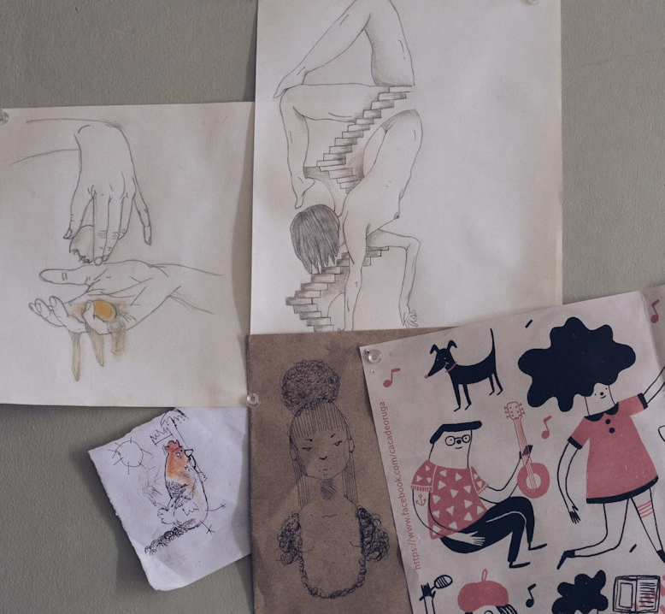
LAYOUT · TEXT + PICTURE
FLAGSHIP · 2026
Text paired with a picture.
Body copy on one side, image frame on the other. Replace via /deck.
Read the brief
Spec sheet
JAN 2026 · SHOWCASE
SLIDE 11 / 32

Slide 20
VOICE
“A short, memorable line that earns its full slide.”
ATTRIBUTION · PLACEHOLDER
JAN 2026 · SHOWCASE
SLIDE 15 / 32

Slide 21
LAYOUT · KPI GRID
FIGURES AT A GLANCE
Headline numbers.
62
14
40
92
k
bn
%
METRIC 1
METRIC 2
METRIC 3
METRIC 4
Caption 1
Caption 2
Caption 3
Caption 4
JAN 2026 · SHOWCASE
SLIDE 7 / 32

Slide 22
LAYOUT · KPI + PHOTO
OUTCOMES
What measurement bought us.
+47%
FORECAST SKILL (1980 VS 2025)
5 days
HURRICANE TRACK LEAD TIME GAINED
MAY 2026 · SHOWCASE
SLIDE 18 / 30

Slide 23
LAYOUT · SCORECARD
LAYOUT · SCORECARD
Headline takeaway about portfolio health.
WORKSTREAM
P1
P2
P3
P4
Workstream 1
On plan
On plan
Slip 1w
Cutover · 62%
Workstream 2
On plan
On plan
On plan
Cutover · 100%
Workstream 3
—
Start
Build
Pilot
Workstream 4
—
—
Scope
Plan
JAN 2026 · SHOWCASE
SLIDE 28 / 32

Slide 24
LAYOUT · GRAPHICAL BARS
LAYOUT · GRAPHICAL BARS
Headline takeaway from the chart.
Bar A
62%
Bar B
24%
Bar C
11%
Bar D
3%
Source · placeholder
JAN 2026 · SHOWCASE
SLIDE 13 / 32

Slide 25

LAYOUT · PHOTO GRID
SHOWCASE · 2026
Six places doing it right.
Singapore
Windhoek
Rotterdam
NEWater closed-loop covers 60 % demand.
Potable reuse in operation since 1968.
Blue-green roofs halved flood peaks.
Rajasthan
Cape Town
Tokyo
Johad step-wells revived by communities.
Day Zero cut per-capita use 15 % durable.
Acoustic leak detection: 98 % recovery.
Every working approach starts with measurement — scale follows.
MAY 2026 · SHOWCASE
SLIDE 26 / 30

Slide 26
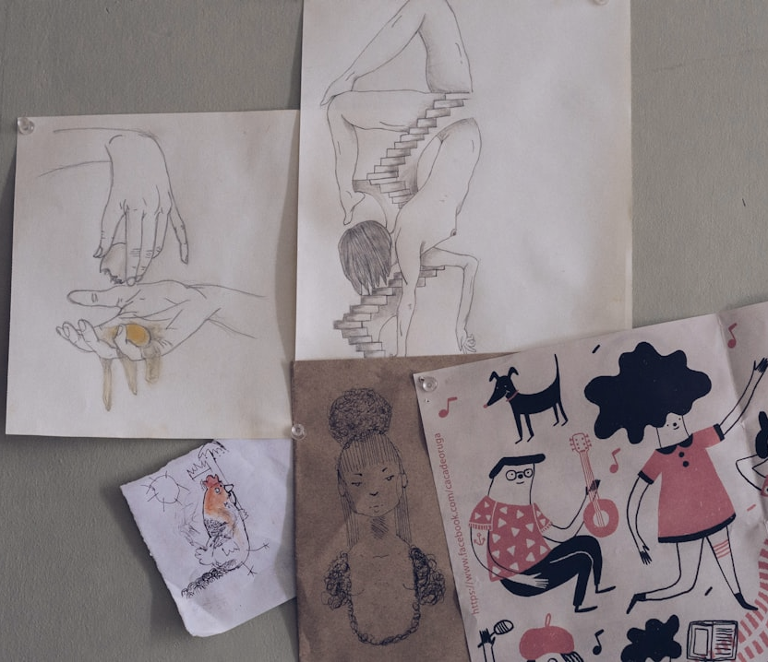
LAYOUT · PHOTO-STRIP 4
FUTURES
Four water futures.
Drier
Wetter
Managed
Wild
Arid bands expand; aquifers deplete; crop belts shift poleward.
Monsoons amplify; mountain rivers run faster; floods concentrate.
Engineered storage, treatment, reuse, ecosystem restoration.
Restored floodplains, reconnected rivers, beaver-built holding.
MAY 2026 · SHOWCASE
SLIDE 29 / 30

Slide 27
LAYOUT · CHART + PHOTO
TREND
Floods, concentrated.
1970s
38
1980s
52
1990s
84
2000s
133
2010s
211
Major urban floods per decade, 1970–2020.
MAY 2026 · SHOWCASE
SLIDE 12 / 30

Slide 28
LAYOUT · BAR CHART
LAYOUT · BAR CHART
Headline takeaway from the chart.
Bar A
62%
Bar B
24%
Bar C
11%
Bar D
3%
Source · placeholder
JAN 2026 · SHOWCASE
SLIDE / 32

Slide 29
DATA · REVENUE MIX
LAYOUT · STACKED BAR
Headline takeaway about the mix over time.
11.9
12.4
12.9
13.4
14.1
SEGMENT
1.4
Series A
1.1
−6% · 5y
1.7
1.8
1.9
2.1
Series B
1.6
+31% · 5y
Series C
3.2
3.5
3.7
3.9
4.2
+31% · 5y
Series D
+367% · 5y
6.8
6.7
6.6
6.5
6.4
P1
P2
P3
P4
P5
Source · placeholder
JAN 2026 · SHOWCASE
SLIDE 22 / 32

Slide 30
LAYOUT · LINE CHART
Series A
Series B
LAYOUT · LINE CHART
Headline takeaway from the trend over time.
P1
P2
P3
P4
P5
Source · placeholder
JAN 2026 · SHOWCASE
SLIDE 27 / 32

Slide 31
LAYOUT · WATERFALL
LAYOUT · WATERFALL
Headline takeaway about the bridge.
+0.3
−0.3
+0.4
−0.2
14.1
13.4
+0.6
Base
Step 1
Step 2
Step 3
Step 4
Step 5
Net
Source · placeholder
JAN 2026 · SHOWCASE
SLIDE 20 / 32

Slide 32
TIMELINE
2018 → 2026
LAYOUT · TIMELINE
HOW WE GOT HERE
Eight years from bootstrap to $40M ARR.
2018
2022
2026 Q3
Bootstrap.
Series A.
$40M ARR.
Two founders, six customers.
$12M, growth team.
Today.
FOUNDER-LED
SCALE PHASE
2020
2024
Seed round.
$10M ARR.
$2.5M led by Foundry.
First enterprise plan.
JAN 2026 · SHOWCASE
SLIDE 32 / 32

Slide 33
LAYOUT · GANTT
LAYOUT · GANTT
Headline takeaway about the delivery plan.
Q1 · PLAN
Q2 · BUILD
Q3 · PILOT
Q4 · SCALE
WORKSTREAM 1
MILESTONE 1
OWNER · TEAM A
WORKSTREAM 2
MILESTONE 2
OWNER · TEAM B
WORKSTREAM 3
MILESTONE 3
OWNER · TEAM C
WORKSTREAM 4
PREVIEW
GA
OWNER · TEAM D
COMMITTED · CRITICAL PATH · DEPENDENCY WINDOW · MILESTONE
JAN 2026 · SHOWCASE
SLIDE 29 / 32

Slide 34
ROADMAP
LAYOUT · ROADMAP
EIGHTEEN-MONTH PLAN
Three workstreams converge on Q4-2027 GA.
● Done ● In progress ● Next · Skip
FIRST PAYING TENANT
GA LAUNCH
Q4 2026
Q1 2027
Q2 2027
Q3 2027
Q4 2027
Platform
Foundations
Multi-tenancy
SSO
Audit log
ENGINEERING · TEAM A
Product
Beta
GA prep
Launch
Scale
PRODUCT · TEAM B
Go-to-market
Pricing
Channel
ABM
MARKETING · TEAM C
Operations
Pricing model
Quoting tool
Invoicing
FINANCE · TEAM D
JAN 2026 · SHOWCASE
SLIDE 26 / 32

Slide 35
LAYOUT · PROCESS FLOW
LAYOUT · PROCESS FLOW
Five stages, one highlighted as active.
01
02
03
04
05
Stage 1
Stage 2
Stage 3
Stage 4
Stage 5
Description for stage 1.
Description for stage 2.
Description for stage 3.
Description for stage 4.
Description for stage 5.
JAN 2026 · SHOWCASE
SLIDE 21 / 32

Slide 36
LAYOUT · PYRAMID
LAYOUT · PYRAMID
Headline takeaway about the value hierarchy.
TIER 03 · APEX
Description of the top tier.
Apex line.
TIER 02 · MIDDLE
Description of the middle tier.
Middle line.
TIER 01 · FOUNDATION
Description of the base tier.
Base line.
JAN 2026 · SHOWCASE
SLIDE 24 / 32

Slide 37
LAYOUT · FUNNEL
LAYOUT · FUNNEL
Headline takeaway about the funnel drop-off.
Stage 1
100
−22 pt
Description
100%
STAGE 1 → 2
Stage 2
84
Annotation explaining the largest drop-off.
Description
84%
Stage 3
62
−14 pt
Description
62%
STAGE 3 → 4
Stage 4
37
Annotation explaining the secondary drop-off.
Description
37%
JAN 2026 · SHOWCASE
SLIDE 30 / 32

Slide 38
LAYOUT · VENN
LAYOUT · VENN
Headline takeaway about the intersection of three sets.
SET A
SET B
Description A
Description B
01 · A × B
Overlap A∩B
Overlap label
Description of the A × B intersection.
Center
A∩B∩C
Overlap A∩C
Overlap B∩C
02 · A × B × C
Center label
Description of the center intersection.
SET C
Description C
JAN 2026 · SHOWCASE
SLIDE 31 / 32

Slide 39
V-MODEL
SDLC · V-MODEL
VERIFICATION · VALIDATION
Every design step on the left has a matching test on the right.
VERIFICATION PHASE
VALIDATION PHASE
PHASE 01
ACCEPTANCE PLAN
TEST 01
Requirement gathering
Acceptance testing
PHASE 02
SYSTEM TEST PLAN
TEST 02
System analysis
System testing
PHASE 03
INTEGRATION
TEST 03
Software design
Integration testing
PHASE 04
UNIT TESTS
TEST 04
Module design
Unit testing
PIVOT
CODING & IMPLEMENTATION
JAN 2026 · SHOWCASE
SLIDE 32 / 33

Slide 40
LAYOUT · 2×2 MATRIX
LAYOUT · 2×2 MATRIX
Headline takeaway about prioritisation.
Q1 · HIGH IMPACT · LOW LIFT
Q2 · HIGH IMPACT · HIGH LIFT
Reading the grid
Top-right item.
Top-left item.
Each quadrant holds one representative initiative. The accent cell marks the highest-priority quadrant.
High-impact, low-effort initiative.
High-impact, high-effort initiative.
IMPACT
Q3 · LOW IMPACT · LOW LIFT
Q4 · LOW IMPACT · HIGH LIFT
Bottom-right item.
Bottom-left item.
Low-impact, low-effort initiative.
Low-impact, high-effort initiative.
EFFORT TO SHIP
JAN 2026 · SHOWCASE
SLIDE 19 / 32

Slide 41
RISK MATRIX
LAYOUT · RISK-MATRIX
WHERE THE EXPOSURE SITS
Two high-severity risks dominate — both mitigated.
IMPACT (Y) × PROBABILITY (X) — 1 LOW → 5 HIGH
2
RISKS
5
1
Vendor renegotiation fails.
1
2
Top-five customer churn during sunset.
4
3
Director-CS hire slips Q4.
5
3
4
Analytics consolidation overruns.
3
5
Board pushback on credit budget.
2
4
1
1
2
3
4
5
JAN 2026 · SHOWCASE
SLIDE 24 / 32

Slide 42
RISK REGISTER
LAYOUT · RISK-REGISTER
WHAT COULD DERAIL THE PLAN
Six material risks, four mitigations active.
#
RISK
P
I
SEVERITY
MITIGATION
OWNER
1
Vendor renegotiation fails.
3
4
medium
Parallel RFP with three alternates in flight.
CFO
2
Top-five customer churn during sunset.
2
5
high
Named-CS coverage plus 12-month flagship credit.
CRO
3
Director-CS hire slips Q4.
3
3
medium
Backup interim from internal promotion list.
People
4
Analytics consolidation overruns.
4
2
medium
Phased migration with 30-day rollback window.
Data
5
Board pushes back on credit budget.
2
3
low
Pre-aligned with audit committee chair.
CEO
JAN 2026 · SHOWCASE
SLIDE 25 / 32

Slide 43
LAYOUT · TABLE
LAYOUT · TABLE
Headline takeaway about the table data.
ROW
COLUMN 1
COLUMN 2
COLUMN 3
COLUMN 4
COLUMN 5
Row 1
Cell
Cell
Cell
Cell
Cell
Row 2
Cell
Cell
Cell
Cell
Cell
Row 3
Cell
Cell
Cell
Cell
Cell
Row 4
Cell
Cell
Cell
Cell
Cell
Row 5
Cell
Cell
Cell
Cell
Cell
JAN 2026 · SHOWCASE
SLIDE 23 / 32

Slide 44
UI KIT
LAYOUT · COMPONENTS
UI library preview.
BUTTONS
RULES
Primary →
Default →
Ghost
SECTION · 56 × 1 · INK
TAGS
PRODUCTION
FEATURED
BETA
ARCHIVED
EMPHASIS · 80 × 4 · ORANGE
HAIRLINE · WIDTH × 1 · FOG
JAN 2026 · SHOWCASE
SLIDE 14 / 32

Slide 45
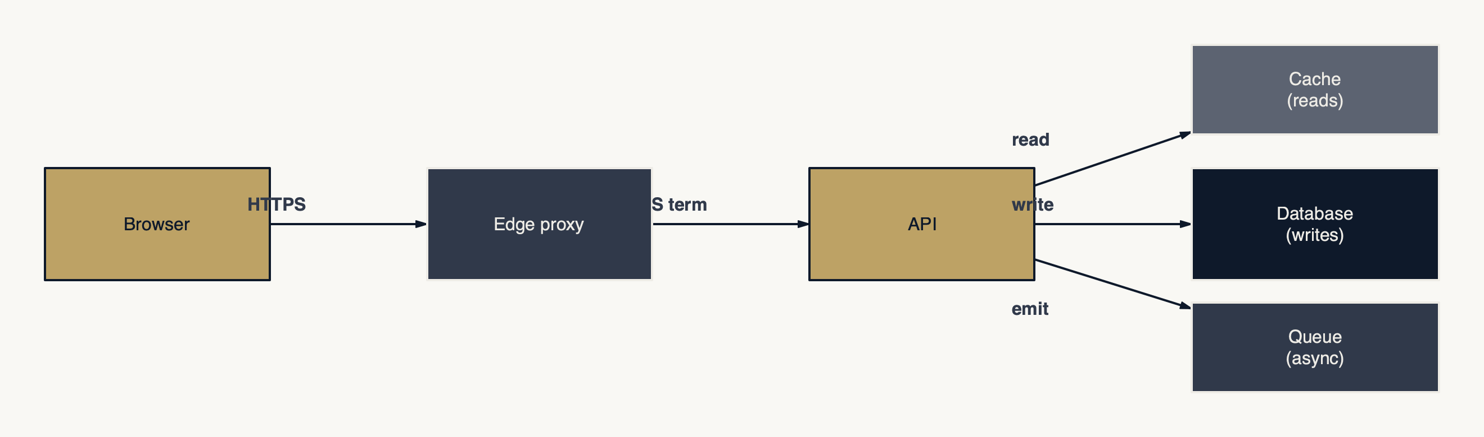
ARCHITECTURE
HOW REQUESTS FLOW
Three sinks behind one API: cache, DB, queue
So what: Reads serve from cache, writes commit to DB, side-effects fan out to the queue — three sinks, one API surface
Internal load test, 2026-05
FEINSCHLIFF
V0.3

Slide 46
ARCHITECTURE
REQUEST LIFECYCLE ACROSS THE PLATFORM
Twelve hops from edge to durable storage.
So what: P95 budget = 80 ms; 32 ms is the policy round-trip — cache decisions per request, refresh out-of-band
FEINSCHLIFF
V0.3

Slide 47
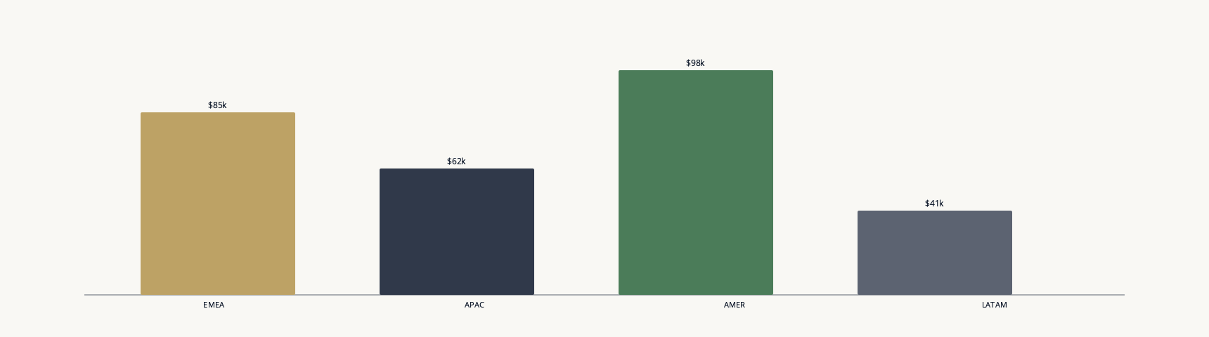
REVENUE
Q1 BY REGION
AMER pulled +18% YoY while LATAM softened
So what: AMER acceleration is the lever; protect it in Q2 plan
Finance OPS export, 2026-04-30
FEINSCHLIFF
V0.3

Slide 48
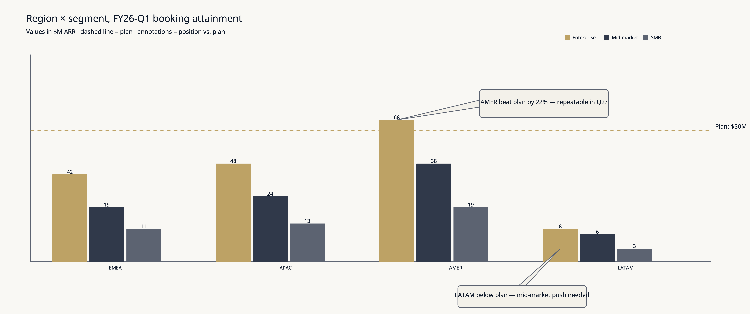
REVENUE
QUARTERLY REVENUE × REGION × SEGMENT
AMER enterprise carried Q1; LATAM mid-market is the Q2 unlock
FEINSCHLIFF
V0.3
So what: AMER over-attainment masked LATAM softness; build a LATAM mid-market plan or rebalance quota

Slide 49

END
Thank you.
WATER-CYCLE SHOWCASE · V1 · 2026-05
MAY 2026 · SHOWCASE
30 / 30

Slide 50
END
Thank you.
FEINSCHLIFF · V0.1 · 2026
JAN 2026 · SHOWCASE
SLIDE 1

