Slide 1
Network

Slide 2
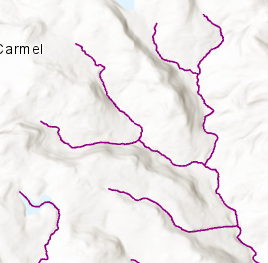
4
6
3
1
5
2
8
01204560
7
01204560

Slide 3
6
6
4
4
3
3
0.25
0.25
0.25
0.25
0.25
0.25
0.23
1
0.23
1
0.23
5
0.25
5
0.25
0.75
0.19
2
0.19
2
0.19
0.05
8
0.05
8
0.025
0.47
0.025
1.245
7
7

Slide 4
4
6
1
1
1
3
1
1
1
1
Fluffy River
Fluffy River
5
2
1
2
1
2
2
2
8
01204560
3
3
7
01204560

Slide 5
How do we determine priority
Name
A named river will be numbered sooner than an unnamed one
This And Upstream
If I take a branch, how long until I finish it
Straihler Number
In that order of priority

Slide 6
7
01204560
6
4
3
0.25
-
0.025
0.25
0.25
0.25
0.23
1
8
01204560 02
0.23
Fluffy River
8 to 2 is named “Fluffy River” and the other flow
Is not
5
0.25
0.75
0.19
2
Fluffy River
0.19
8
01204560 02
0.05
8
0.47
0.025
1.245
-
0.05
Fluffy River
7
2
01204560 52

Slide 7
1
2
8
7
Working With:
Upstream Is:
1
Queue
8
2
Downwards Ref ID:
[ None ]

