Slide 1
Network

Slide 2
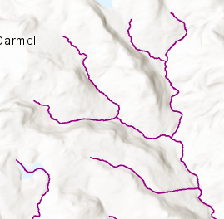
4
6
3
1
5
2
8
01204560
7
01204560

Slide 3
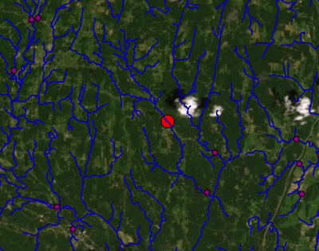
Notes:
The network is gathered via a geospatial operation called a buffer. We draw a “circle” polygon around the desired coordinate and find stuff inside it

Slide 4
6
6
4
4
3
3
0.25
0.25
0.25
0.25
0.25
0.25
0.23
1
0.23
1
0.23
5
0.25
5
0.25
0.75
0.19
2
0.19
2
0.19
0.05
8
0.05
8
0.025
0.47
0.025
1.245
7
7

Slide 5
4
6
1
1
1
3
1
1
1
1
Pyhton River
Python River
5
2
1
2
1
2
2
2
8
01204560
3
3
7
01204560

Slide 6
How do we determine priority
Name
A named river will be numbered sooner than an unnamed one
This And Upstream
If I take a branch, how long until I finish it
Straihler Number
In that order of priority

Slide 7
7
01204560
6
4
3
0.25
-
0.025
0.25
0.25
0.25
0.23
1
8
0.23
01204559 98
8 to 2 is named “Python River” and the other flow
Is not
5
0.25
Python River
0.75
0.19
2
Python River
0.19
8
01204559 98
0.05
8
0.47
0.025
1.245
-
0.05
Python River
7
2
01204559 93

Slide 8
6
7
01204560
4
3
0.25
8
0.25
0.25
0120455998
0.25
0.23
1
2
0120455993
0.23
5
0120455974
5
0.25
Python River
0.75
3
0120455951
0.19
2
Python River
0.19
1
0.05
8
0120455926
0.47
0.025
1.245
4
0120455901
Python River
7
6
01204558

Slide 9


0120455901
01204558
6
1
0120455926
4
3
0120455951
0.25
0.5
1
0120455926
(0120455901)
8
(0120455951)
0120455993
5
(0120455974)
$$d= 0.25 ∗0.5 ∗UL$$
0120455974
2
$$N_{ID}=0120455951 −d$$
8
0120455998
0120455939
(0120455951)
If there is no 01204559 in the shapefile,
chop off the 39 extension
7
01204560
01204559
7
8
2
5
3
1
4
6

Slide 10
What if the real is not at the bottom

Slide 11
4
6
3
1
Assign 8-10 digit numbers downstream of the real site.
5
2
8
7
4
6
3
1
Run pSNA from the purple nodes (1 out from the sites in yellow).
5
2
8
7

Slide 12
What if we have two or more real sites

Slide 13
4
6
4
6
4
6
4
6
3
3
3
3
1
1
1
1
5
5
5
5
2
2
2
2
8
8
8
8
7
7
7
7
[7]
[7, F(8,7),8]
[7, F(8,7),8,F(2,8),2]
[7, F(8,7),8,F(2,8),2,F(5,2),5]
4
6
6
4
3
3
4
4
6
3
3
1
1
1
1
5
5
2
2
5
2
8
8
2
i = 8
8
8
7
k = 12
7
7
[7,…,F(3,2),3]
[7,…,F(3,2),3,F(1,8),8]
[7,…,F(3,2),3,F(1,8),8,F(4,1),4]
i = 8
i = 8
i = 8
k = 12

Slide 14

8
2
5
3
1
4
4
6
4
F
F
3
3
F
0.25
0.25
1
1
01257855
012572
5
F
2
2
8
8
7
Old Graph
Add up the flow lengths encountered between the two real sites ( )
F
3
01257855
Calculate the difference in ID space and divide
by the length of all ( )
4
01257840
F
-
15
$$UL=\frac{15}{0.5}=30$$

Slide 15

3
1
F
4
$$UL=30$$
F
0.25
0.25
01257855
01257840
Solve intermediate nodes
3
1
F
4
F
0.25
0.25
01257855
01257848
01257840
Solve as normal

Slide 16
What if Unit Length is < 0

Slide 17
Pick one of the sites and work from there, ignore the other

