Slide 1
Cloud Computing
Presented by: Lee Ting Le
Mikael Koay
Goon Chin Yi

Slide 2
System Introduction
Company Background | Propose Architecture | Benefit of Proposed Architecture
It’s a Japanese association Creates Japanese related events Started through social media All the payment process done in direct messages | Allow users to visit the website Allow users to view the events available Allow users to purchase ticket from the website Automatically key in each purchase into the database Will have backup database in case of emergency | Reduce amount of employees needed Smoothen the whole purchase process Increase customer retention Flexible specifications Backup database ensure continuous operation

Slide 3
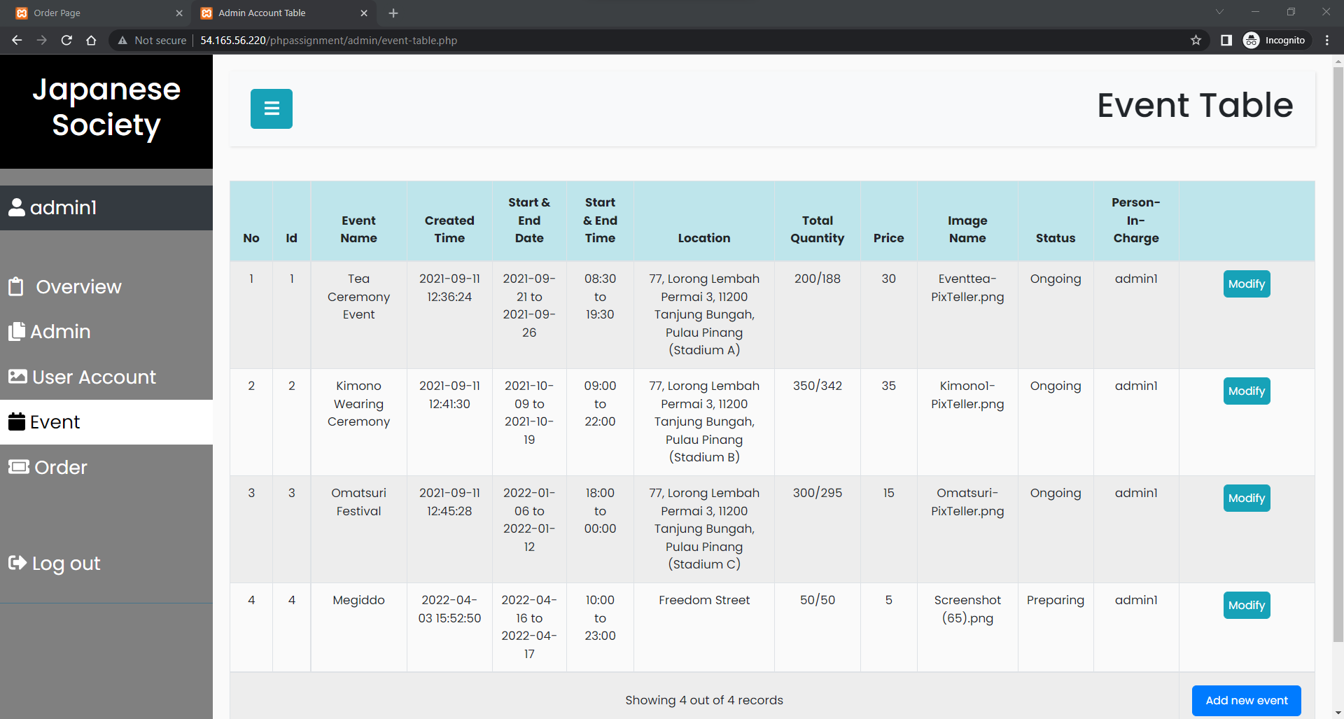
Admin Manage Events

Slide 4
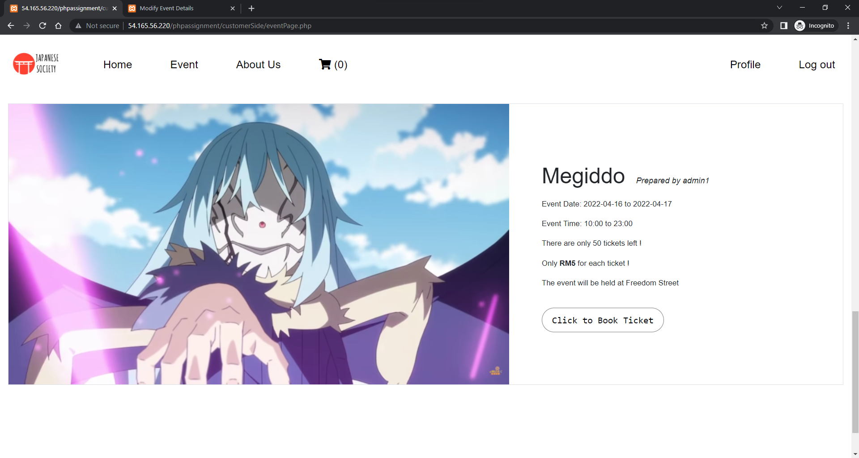
View Events

Slide 5
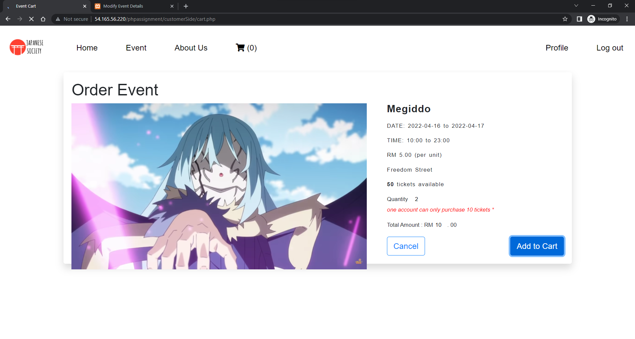
Add To Cart

Slide 6
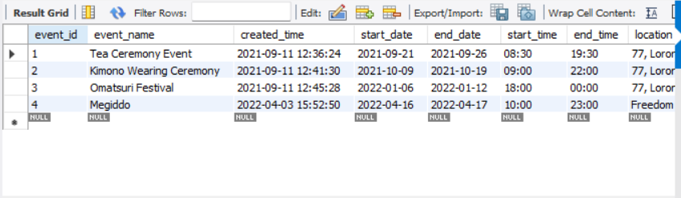
Database event table

Slide 7
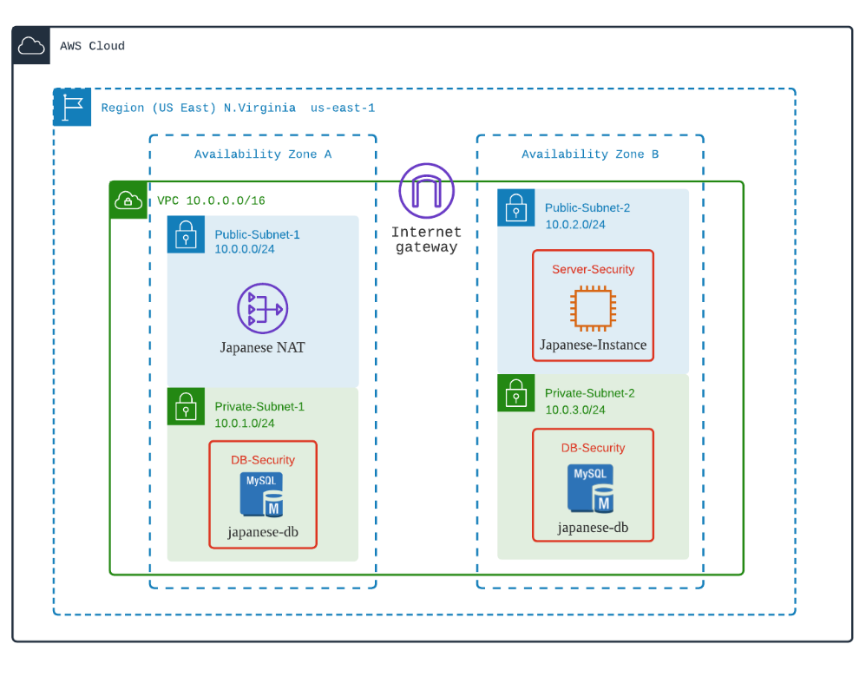
Cloud Architecture Diagram

Slide 8
VPC, EC2, RDS
VPC
EC2
Database
With public and private subnet
Microsoft Windows Server 2022 Base.
Public Subnet 2
Enable auto-assigned IP address
Add new rule: HTTP
Create new key pair (RSA)
MYSQL
Private subnets

Slide 9
Subsetting
Elastic IP Address
Subnets
Route Table
Attach to EC2
Provide a static IP to the EC2
One private & one public
2 Private subnets
2 Public subnets

Slide 10
Extra Software
Remote Desktop
MYSQL Workbench
Connect to VM
Install xampp
Edit firewall to allow all inbound traffic
Copy PHP application source code into VM
Connect RDS database through RDS endpoint and password

Slide 11

THANK YOU

