Slide 1
Metrics and Correlation Analysis
By Team C

Slide 2
Key Points
Goal
Better know metrics, like definitions, algorithms etc. and their correlations
Questions
Is test coverage metrics overrated?
More discussed later
Metrics
Introduce six metrics from five aspects
Perform experiment, for example subject programs, data collection etc.
Analyze correlations

Slide 3
Goal
Obtain comprehensive knowledge of the six selected metrics from five aspects, like its definition and algorithm e.g..
Measure these metrics on the selected five open-source systems.
Analyze correlations between them.

Slide 4
Metrics – Selected Metrics
Testing Coverage Metrics
Statement Coverage
Branch Coverage
Test Suite Effectiveness Metrics
Mutation Score
Complexity Metrics
Cyclomatic Complexity
Software Maintenance Effort Metrics
Code Churn
Software Quality Attribute Metrics
Post-release Defect Density

Slide 5
Metrics - Subject Programs
 | Subject Programs
Criterion | Apache Commons Configuration | Apache Commons Collection | Apache CXF | Apache Axis2 | TBD
URL | http://commons.apache.org/configuration/ | http://commons.apache.org/collections/ | http://cxf.apache.org/ | http://axis.apache.org/axis2/java/core | TBD
Bug-tracking | http://issues.apache.org/jira/browse/CONFIGURATION | http://issues.apache.org/jira/browse/COLLECTIONS | http://issues.apache.org/jira/browse/CXF | https://issues.apache.org/jira/browse/AXIS2 | TBD
NLOC | 11,743 | 13,084 | 104,426 | 103,591 | TBD
Version | 2.4 | 4.3 | 3.3.2 | 1.7.9 | TBD
Type | Single Module | Single Module | Multiple Module | Multiple Module | TBD
Language | Java | Java | Java | Java | C | TBD

Slide 6
Metric 1&2&4: Test Coverage & Complexity
Statement Coverage
Statement coverage measures the percentage of executed statements.
Branch Coverage
Coverage of True and False
Cyclomatic Complexity
CC measures the number of linearly independent paths.
TOOL: Jacoco
By using Jacoco, it generates a report containing LOC, statement coverage, branch coverage and CC complexity.

Slide 7
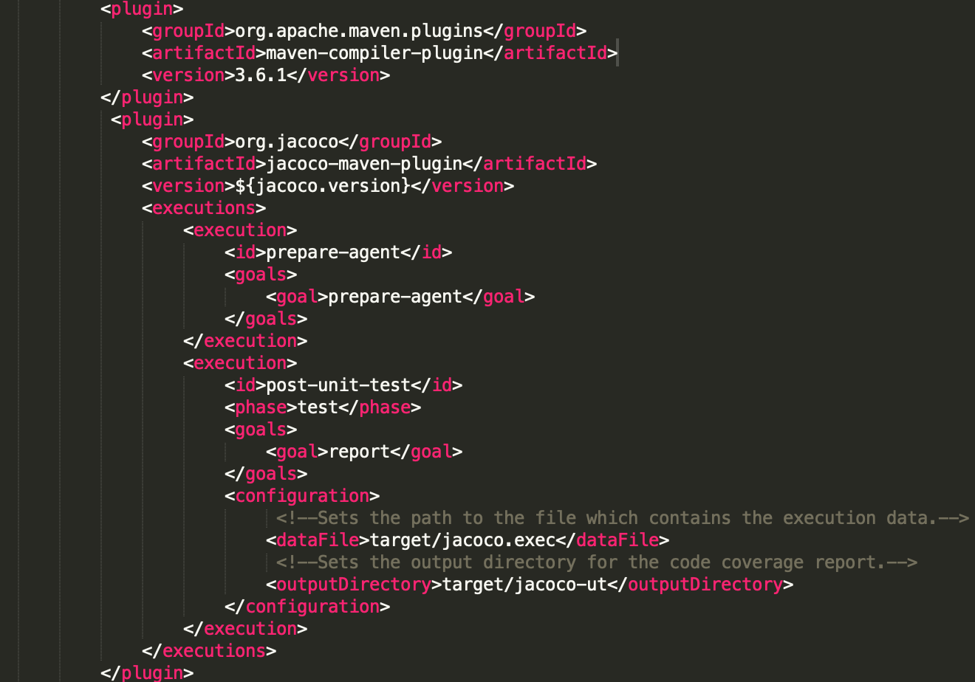
Metric 1&2&4 - Jacoco Plugin
Single-Module System, Jacoco plugin inserts in pom.xml
Multiple-Module System, Jacoco plugin inserts in root’s pom.xml

Slide 8
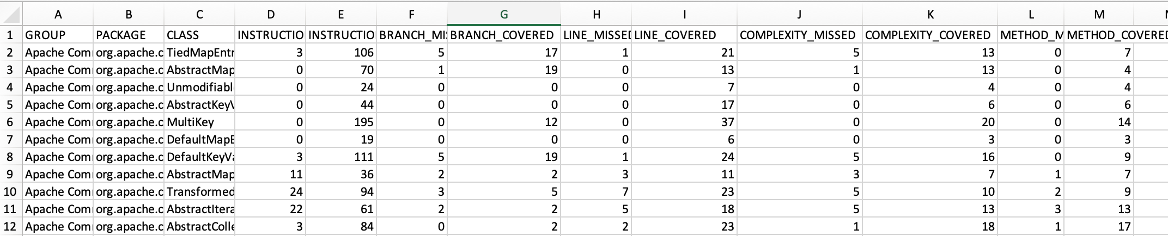
Metric 1&2&4 - Jacoco Report
Single-module system can get a Jacoco report.
Multiple-module system can get a bunch of reports corresponding to each module.
(Apache-Commons-Collection-4.3)
Branch Coverage
Statement Coverage
Sum equals to CC Complexity

Slide 9
Metric 2 :Test Suite Effectiveness - Mutation Score
Mutation Testing is a type of software testing where we mutate (change) certain statements in the source code and check if the test cases are able to find the errors.
The goal of Mutation Testing is to assess the quality of the test cases which should be robust enough to fail mutant code.
The mutation score is defined as the percentage of killed mutants with the total number of mutants.
Mutation Score = (Killed Mutants / Total number of Mutants) * 100
Automation of Mutation Testing Tool: PITest

Slide 10
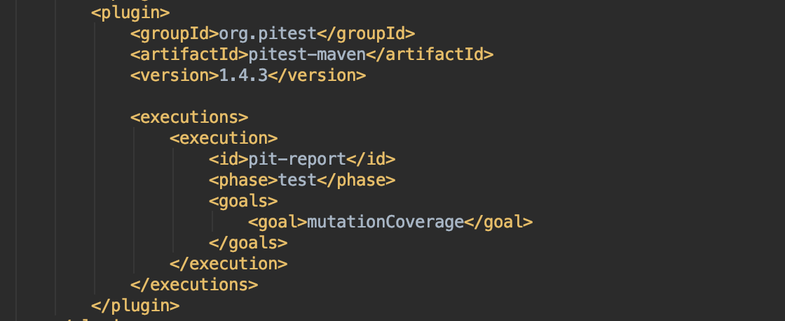
Metric 2 :Test Suite Effectiveness - PITest
We add PITest dependency into root’s pom.xml. PITest dependency code implementation is as follows:

Slide 11
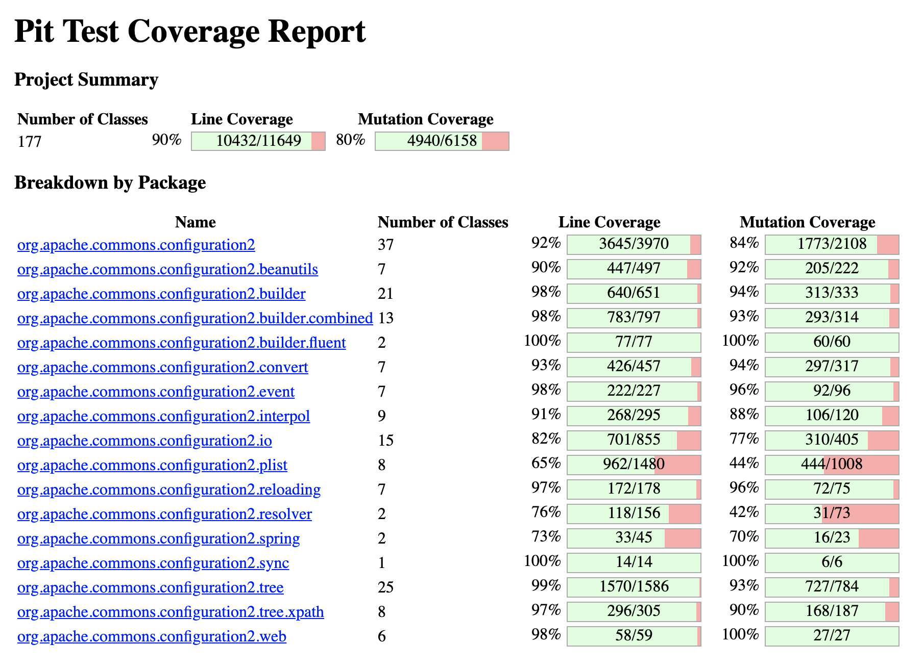
Metric 2 :Test Suite Effectiveness – PITest Report
The result of the mutation test is as follows(Apache Commons Configuration 2.5):

Slide 12
Metric 5: Software Maintenance Effort - Code Churn
Definition
Code churn is a measure of the amount of code change taking place within a software unit over time. Most version control systems use a file comparison utility (such as diff) to automatically estimate how many lines were added, deleted and changed by a programmer to create a new version of a file from an old version.

Slide 13
Metric 5: Software Maintenance Effort - Implementation
Steps:
To append a compare commend after the repository's path to search the project's compare view of different version in Github.
Use the path like this : https://github.com/apache/projectName/compare/version1...version2.
Click the Files changed and we can get the change of code in two versions by adding the additions and deletions.

Slide 14
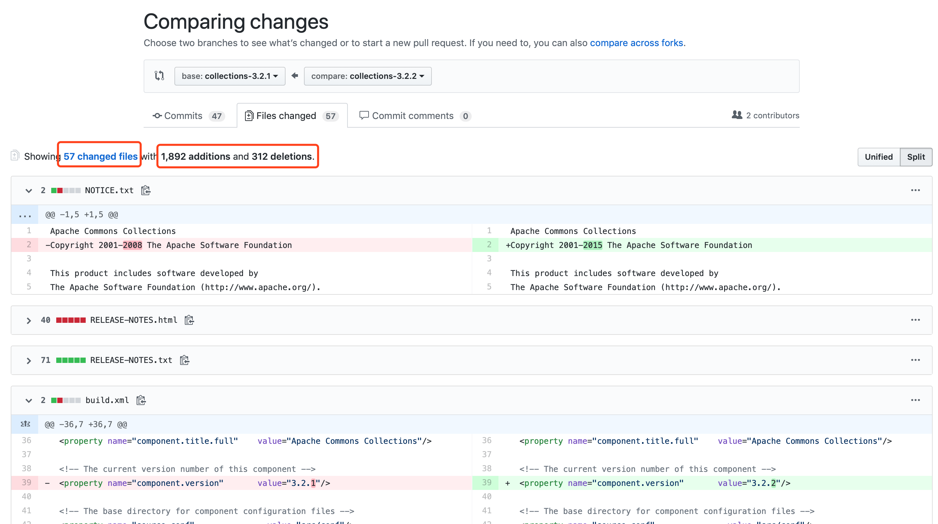
Metric 5: Software Maintenance Effort - Implementation
Example:

Slide 15
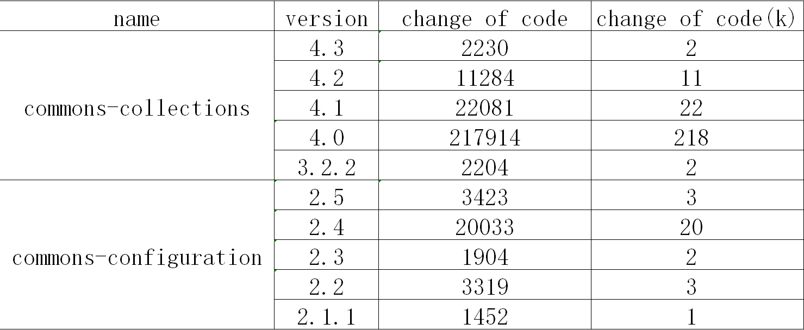
Metric 5: Software Maintenance Effort - Result

Slide 16
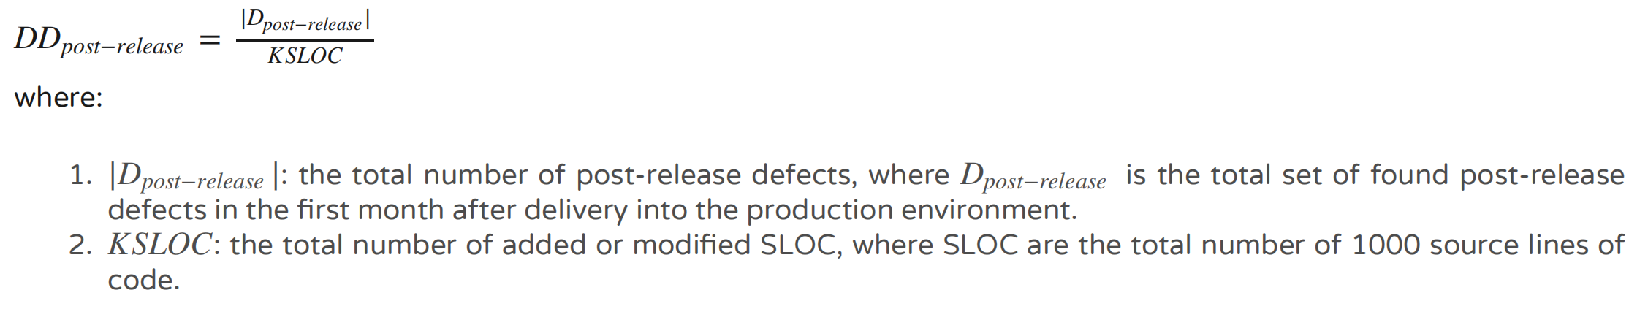
Metric 6: Software Quality Attribute - Post-release Defect Density
Definition
Post-release Defect Density (also called operational defects) defines a quality indicator for the software quality. It is the number of identified defects found during the operational phase.
Only the total number of added or modified source lines of code are used by the calculation of the post-release Defect Density. The definition of Post-release Defect Density is shown as follows:

Slide 17
Metric 6: Software Quality Attribute - Implementation
Steps:
Use the result of code churn in Metric 5 to get the change of code,which is KSLOC in different versions in the project.
Use the issue tracking system (https://issues.apache.org/jira/browse/ZOOKEEPER-3421?jql=) to search the project we want to find.
Use the filter and set the condition to find bugs. We set issue type as bug and the version which the bug affected. We also can know the time of this bug update acccording to the sort order.
Calculate the result according to the formula in the definition.

Slide 18
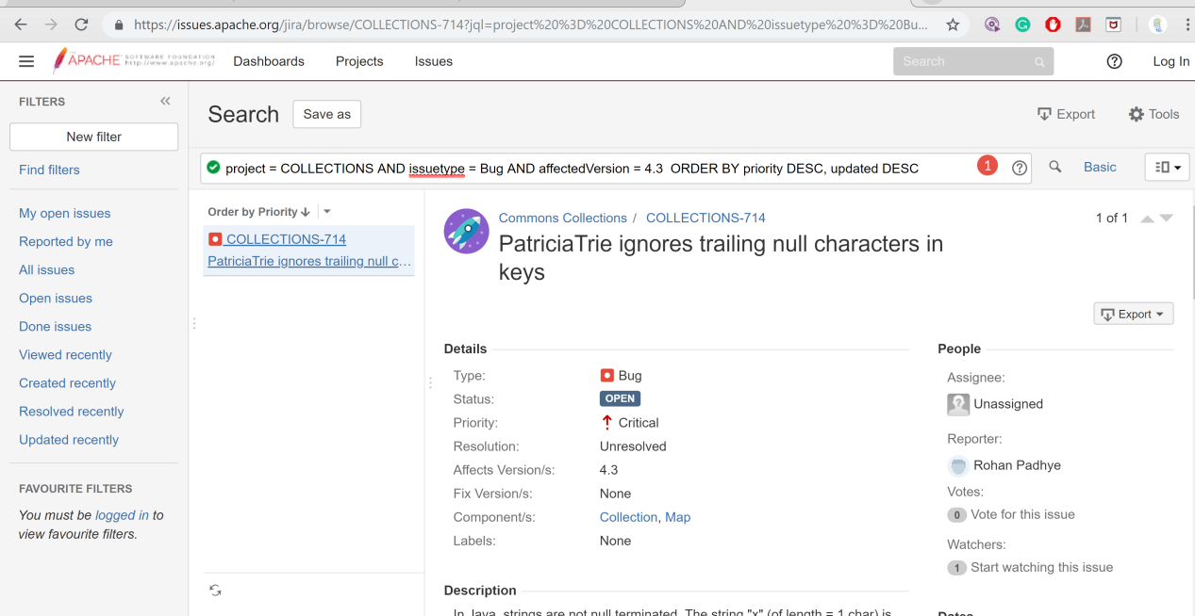
Metric 6: Software Quality Attribute - Implementation
Example:

Slide 19
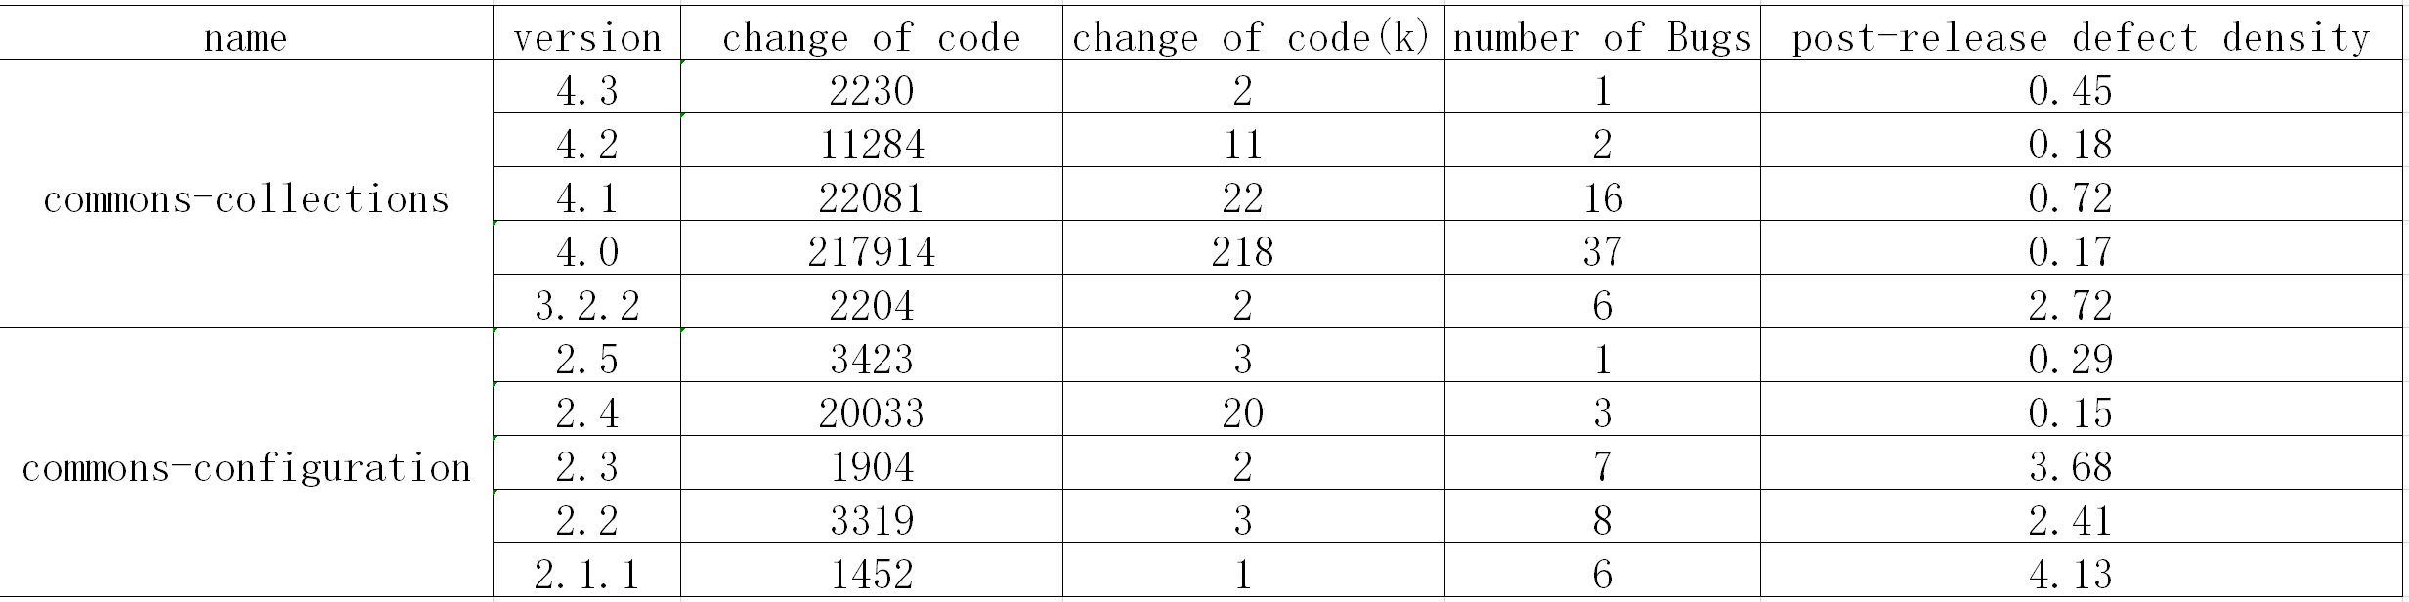
Metric 6: Software Quality Attribute - Result

Slide 20
Metrics - Correlation Analysis
Statement coverage & CC complexity(class level)
Branch coverage & CC complexity(class level)
Statement coverage & Mutation score(class level)
Branch coverage & Mutation score(class level)
Statement coverage & Post-release defects(version level)
Branch coverage & Post-release defects(version level)
Code churn & Post-release defects(version level)
Spearman correlation analysis

Slide 21
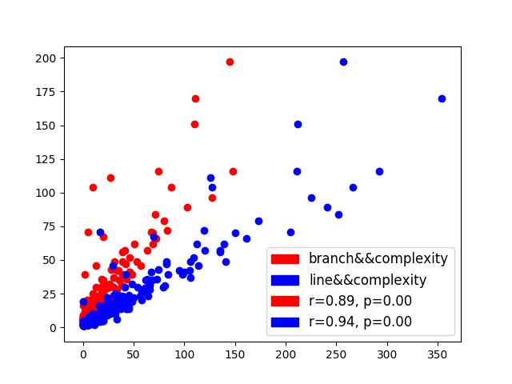
Correlation Analysis – Coverage vs Complexity
Branch Coverage and Cyclomatic Complexity have strong positive correlation(r = 0.89, p = 0) (Apache Commons Configuration 2.5)
Statement coverage and Cyclomatic Complexity have very strong positive correlation(r = 0.94, p = 0) (Apache Commons Configuration 2.5)

Slide 22
Question
Are Test Coverage Metrics Overrated?
Yes! But only if you attempt to use them as an objective overall measure of the quality of the code you have written as opposed to understanding that they are just one informative piece of a large multifaceted puzzle. Test coverage is a useful tool for finding untested parts of a codebase. However, it is of little use as a numeric statement of how good your tests are.

Slide 23
What we’ve done
Selected six metrics from five aspects
Selected four open-source systems
Designed the experiment, like method, tool selection etc.
Collected data
Performed the experiment using selected tools
Visualized results
Analyzed results to find correlation between them
Answer questions discussed above based on results
Wrote the report according to the current progress

Slide 24
In-progress
Select the 5th open-source system
Calculate the selected six metrics on the 5th system
Visualize and analyze the result
Analyze the remaining correlations between metrics
Analyze, discuss and answer the questions
Finish the remaining parts of the report

Slide 25
Chongwen Li 40042828
Lei Xu 40046329
Jiahui Wang 40070981
Jiahui Wang 40070981
Zhongxu Huang 40052560
Zhongxu Huang 40052560
Xiayan Zhong 40051749
Xiayan Zhong 40051749
Lei Xu 40046329
Chongwen Li 40042828
Jiahui Wang 40070981
Team C

