Slide 1
Shape-constrained inversion in Geoscience
Huseyin Denli and Jeremy Brandman
SIAM Geosciences Conference
March 11, 2019

Slide 2
Outline
Motivation
Examples
  History matching anisotropic permeability
  Joint inversion of travel-time and gravity data
  Multi-scale FWI
Conclusion

Slide 3
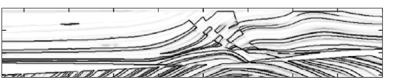
Our goal is to estimate multiple subsurface parameters in a structurally consistent manner
Strategy: invert for geologic interfaces shared by the unknown subsurface parameters, along with parameter values within each geobody
Boundary set
Geobody (e.g. container)
P/S-wave velocities
Density
Anisotropy
Attenuation
Conductivity
Permeability
…

Slide 4



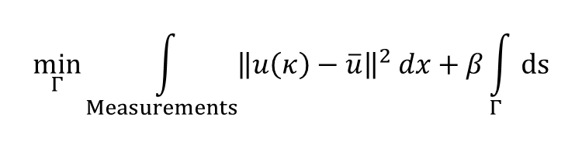







We consider two shape-constrained inversion techniques: Mumford-Shah and phase-field
$$Γ$$
$$k_{1}(x)$$
$$k_{3}(x)$$
$$Γ$$
$$k=k_{1}$$
$$k_{2}(x)$$
$$k=k_{2}$$
$$k=k_{1}$$
$$k_{5}(x)$$
$$k_{4}(x)$$
Phase-field (P-F)
Mumford-Shah (M-S)
$$\min_{Γ}{\int_{Measurements}{{\left\|u\left(κ\right)−\overline{u}\right\|}^{2} dx}+β\int_{Γ}{ds}}$$
$$\min_{κ,Γ}{\int_{Measurements}{{\left\|u\left(κ\right)−\overline{u}\right\|}^{2} dx}+MS\left(κ,Γ\right),}$$
$$MS\left(κ, Γ\right)=α\int_{Ω\backslash Γ}{{\left|∇κ\right|}^{2} dx}+β\int_{Γ}{ds},$$

Slide 5
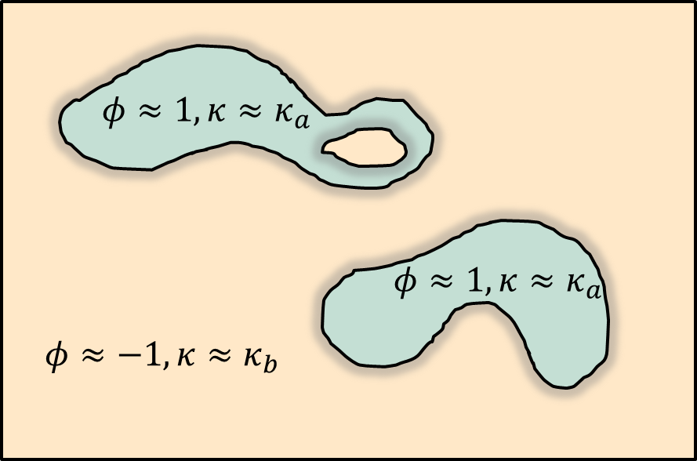

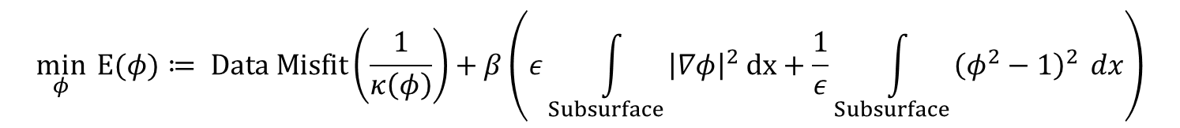
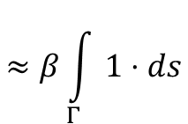

Phase-field inversion represents a diffuse interface discretization
$$κ=κ{(κ}_{a}, κ_{b};φ)$$
Inversion formulation:
$$\min_{φ}{ E(φ)≔ Data Misfit\left(\frac{1}{κ\left(φ\right)}\right)}+β\left(ε\int_{Subsurface }{{\left|∇φ\right|}^{2} dx}+\frac{1}{ε}\int_{Subsurface }{{\left(φ^{2}−1\right)}^{2}} dx\right)$$
$$≈β\int_{Γ }{1⋅ds}$$
Optimization by
Gauss-Newton
$$Δx≪ε≪1$$
Notes:
In the context of salt inversion, phase-field builds on conventional voxelized acoustic version, in which cell values of the bulk modulus are solved for.

Slide 6

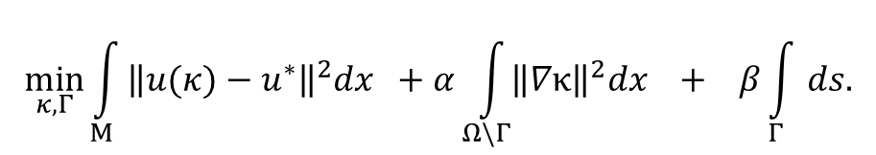




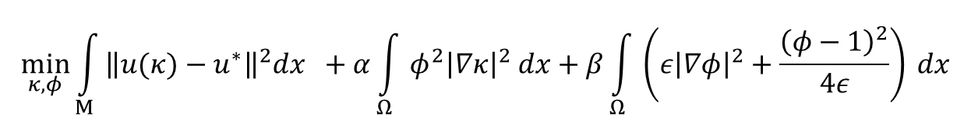

Mumford-Shah is discretized using the Ambrosio-Tortorelli approximation
$$\min_{κ,Γ}{\int_{M}{{\left\|u(κ)−u^{∗}\right\|}^{2}dx +α\int_{Ω\backslash Γ}{{\left\|∇κ\right\|}^{2}dx} + β\int_{Γ}{ds.}}}$$
Geometric problem:
Data misfit
Smoothness within
region
Boundary length
$$Γ$$
$$φ≈1$$
$$φ≈1$$
$$κ=κ_{1}(x)$$
$$κ=κ_{2}(x)$$
$$φ≈0$$
Discretized problem:
$$\min_{κ,φ}{\int_{M}{{\left\|u(κ)−u^{∗}\right\|}^{2}dx +α\int_{Ω}{φ^{2}{\left|∇κ\right|}^{2} dx}+β\int_{Ω}{\left(ε{\left|∇φ\right|}^{2}+\frac{{\left(φ−1\right)}^{2}}{4ε}\right)} dx }}$$
Optimization by Gauss-Newton
$$Δx≪ε$$

Slide 7
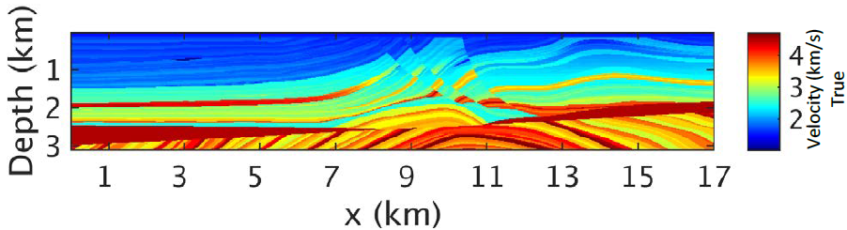
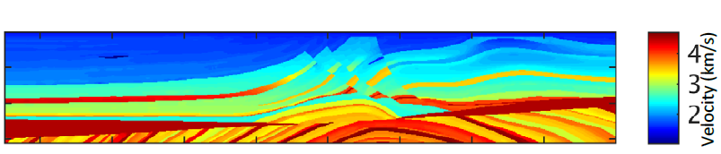
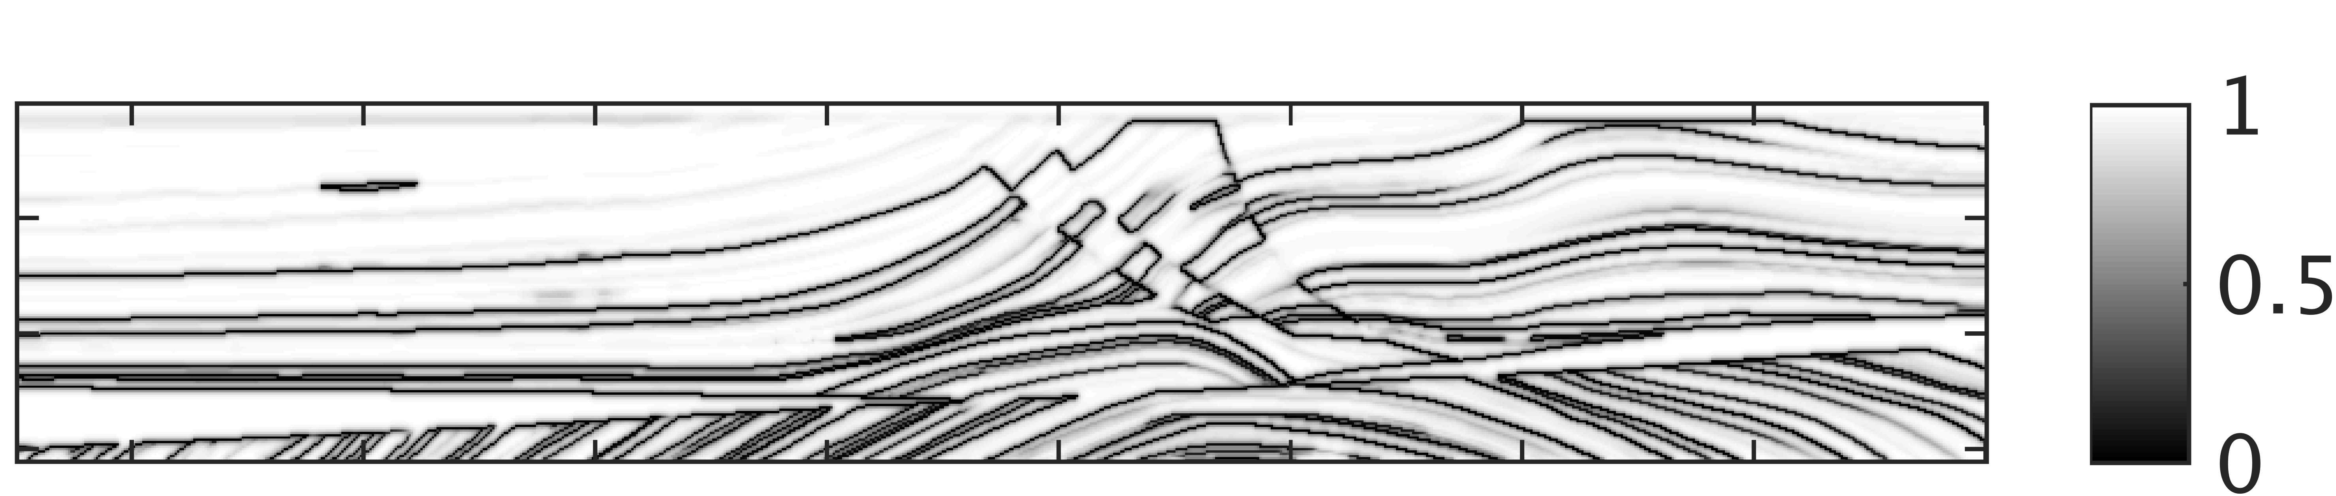
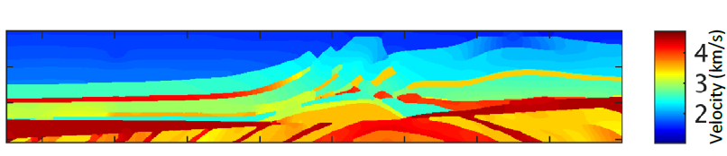
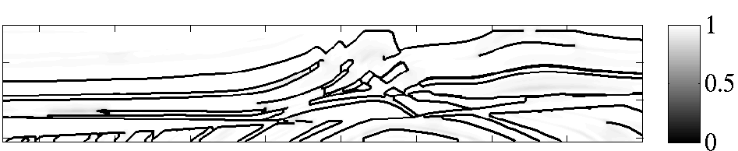







As a proof-of-concept, we apply Mumford-Shah to segment Marmousi
$$α=10, β=1$$
$${V_{P}}_{true}$$
$$V_{P}$$
$$Γ(φ)$$
$$α=100, β=10$$
$$V_{P}$$
$$Γ(φ)$$

Slide 8
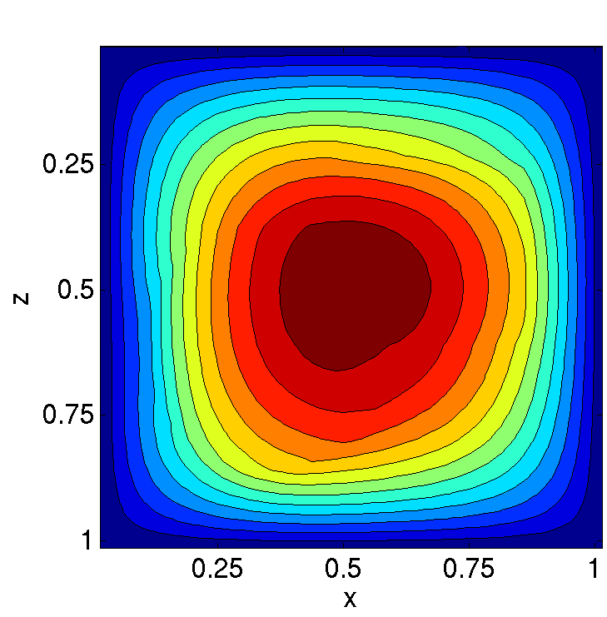
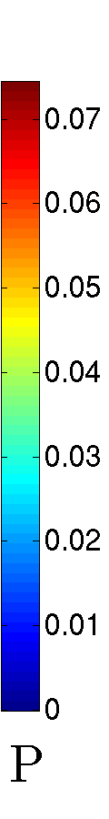
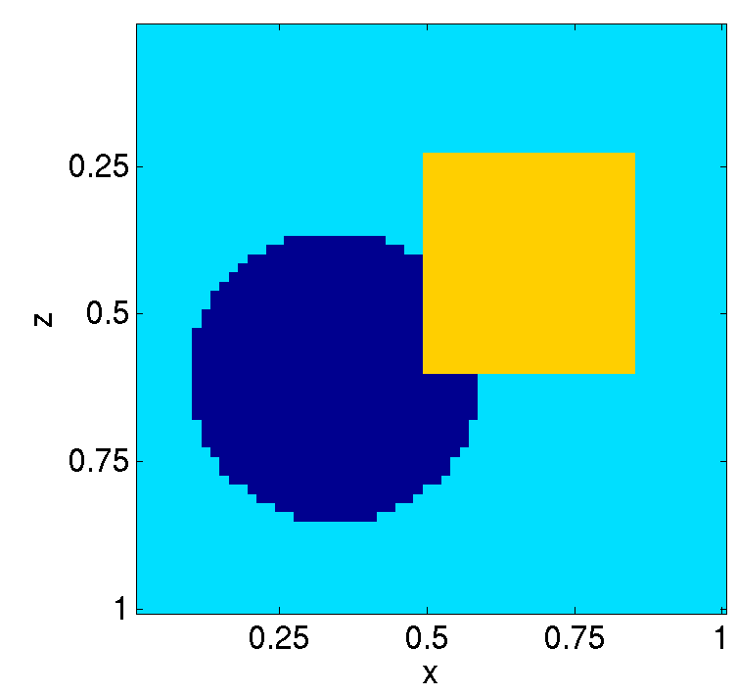
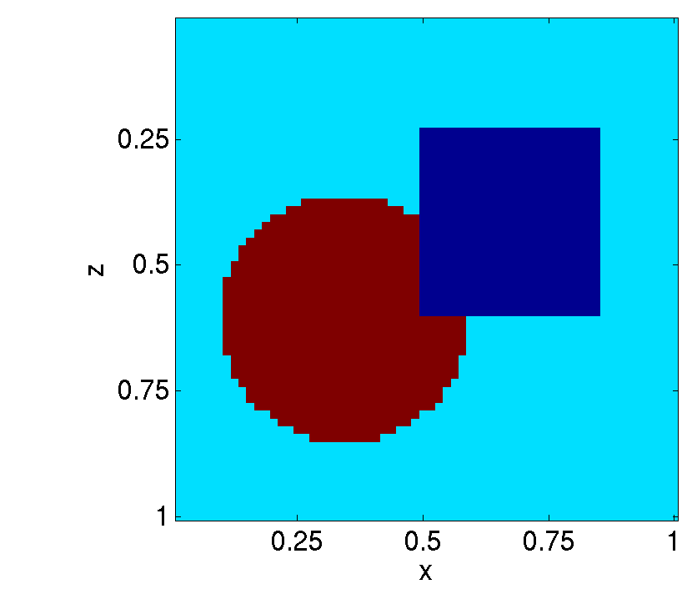
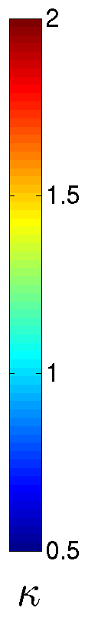


This example estimates an anisotropic permeability tensor from pressure data
Noise
One-phase flow:
$$−∇⋅κ\left(x\right)∇P\left(x\right)=1+ε$$
Inverse problem: Determine $κ=\left(\begin{matrix}κ_{xx} & 0 \\ 0 & κ_{zz}\end{matrix}\right)$given $P(x)$ everywhere.
Target permeability
Pressure
$$κ_{xx}$$
$$κ_{zz}$$
Notes:
Acknowledge lack of realism. Explain situation and future work to remedy it.

Slide 9


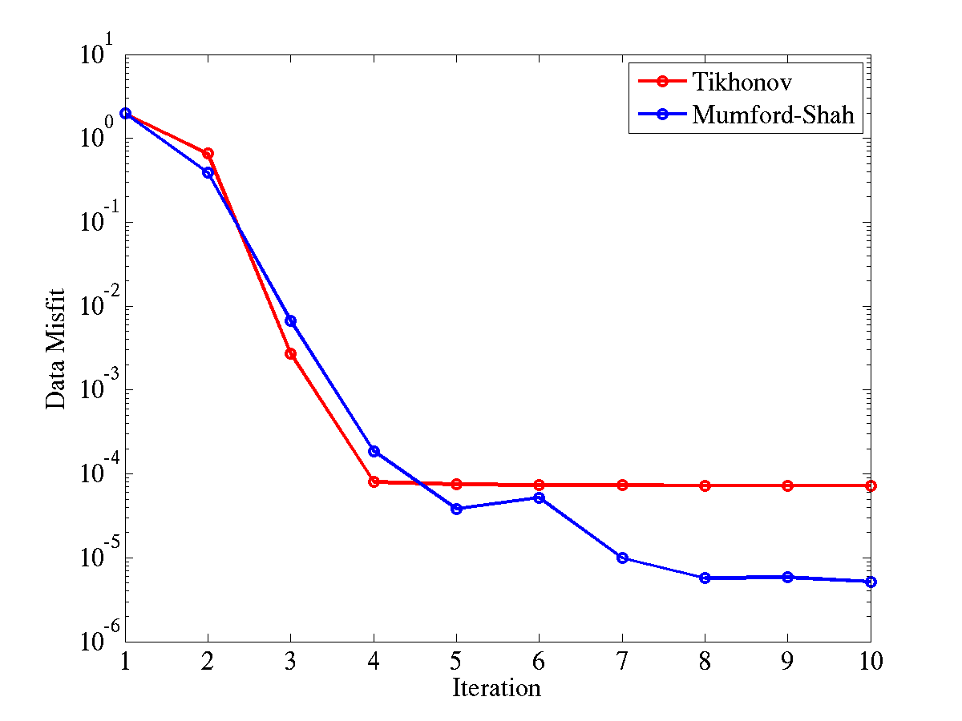
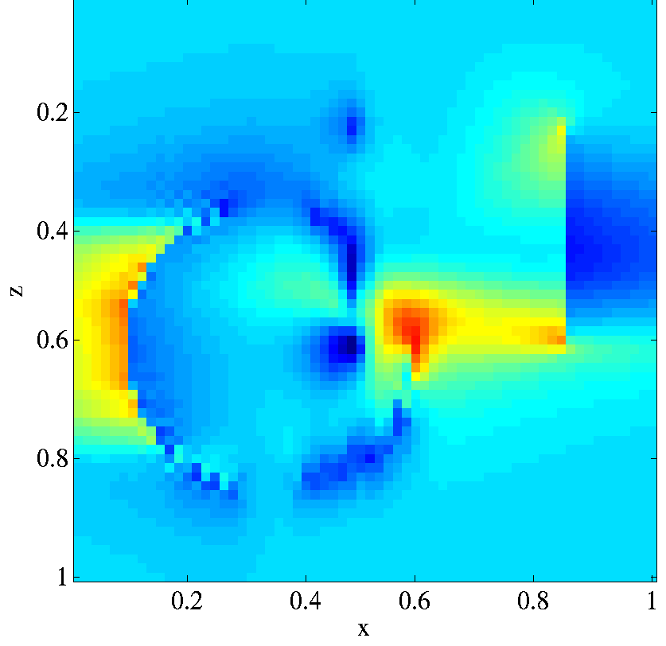
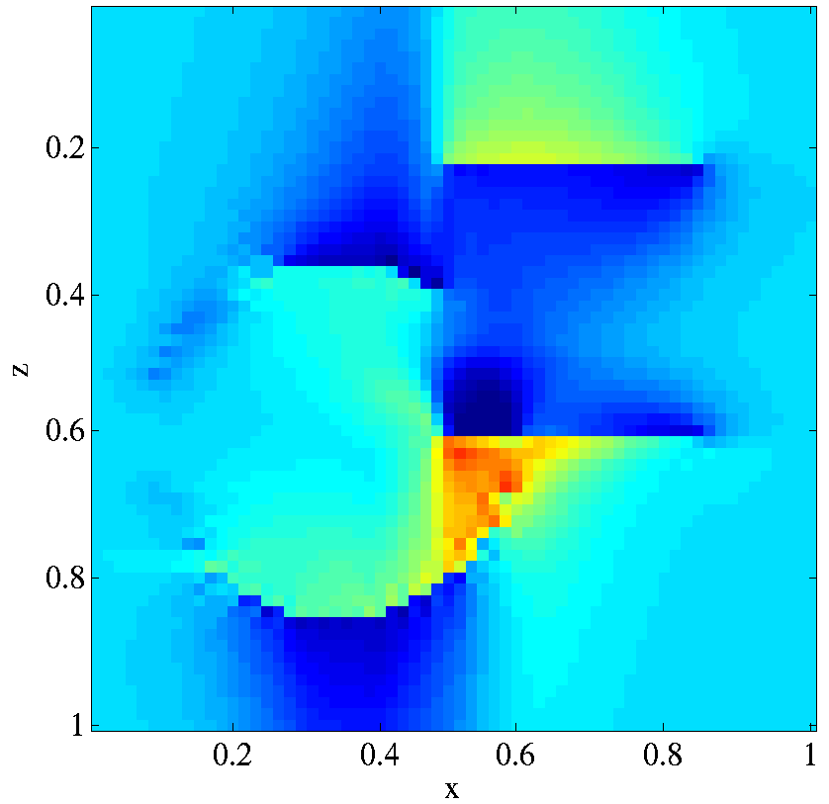
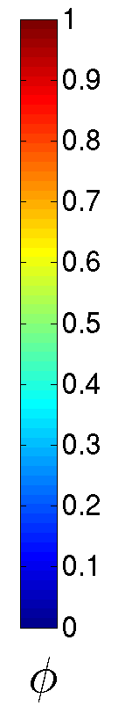
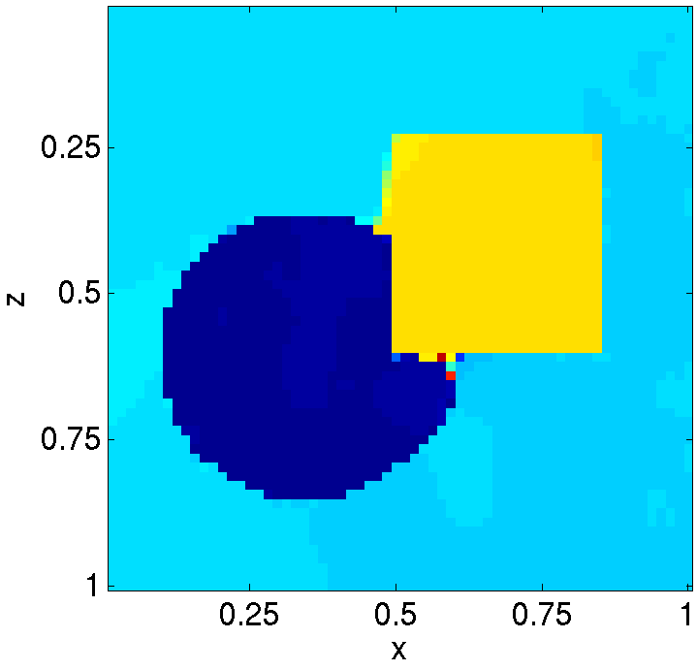
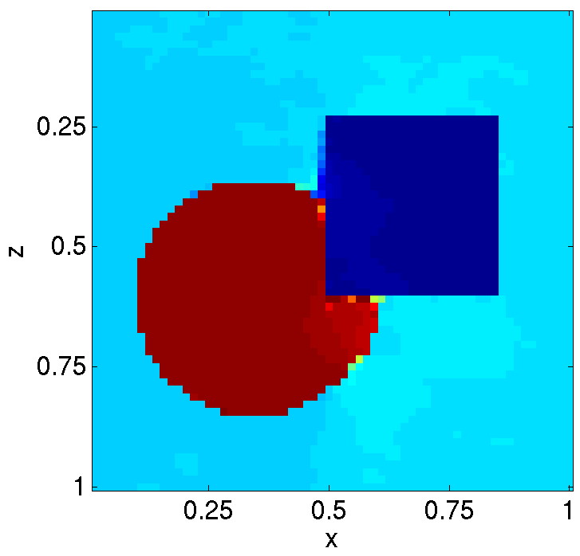
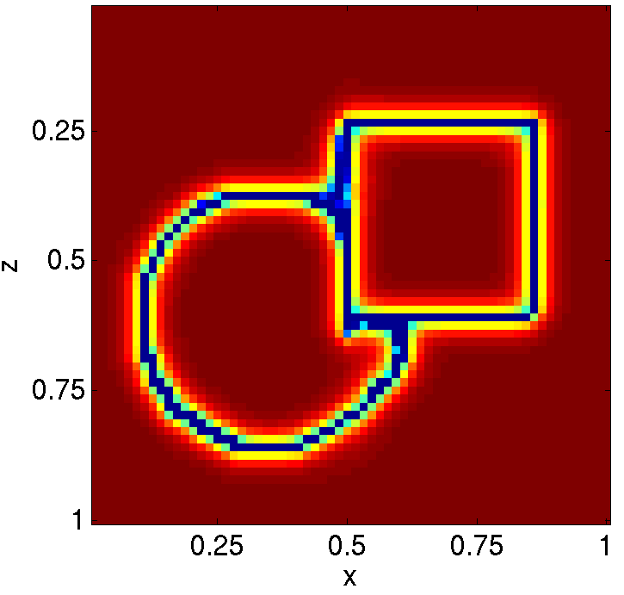



M-S eliminates non-uniqueness through a structural constraint
$$κ_{xx}$$
$$κ_{zz}$$
Convergence
True
Voxelized
$$φ$$
Mumford-Shah
Notes:
Point out we get boundaries.

Slide 10
This example examines joint travel-time and gravity inversion of a rectangular anomaly

Slide 11
The data consists of first-arrival and gravity surface measurements

Slide 12
Inversion using travel-time data does a good job recovering velocity

Slide 13
Inversion of gravity data alone is unable to resolve the anomaly

Slide 14
Joint inversion improves the density field and provides a small uplift to wave speed

Slide 15
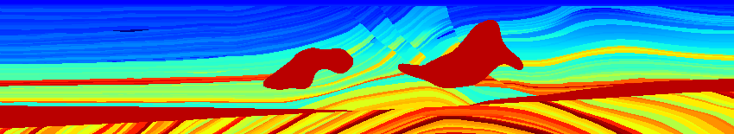
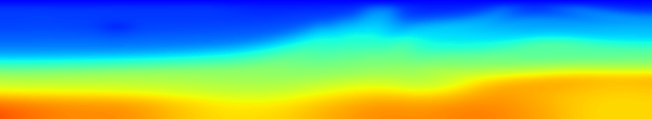
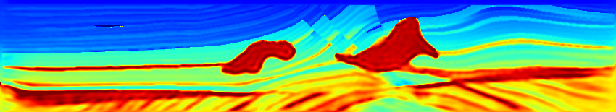
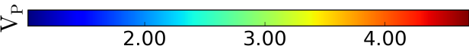

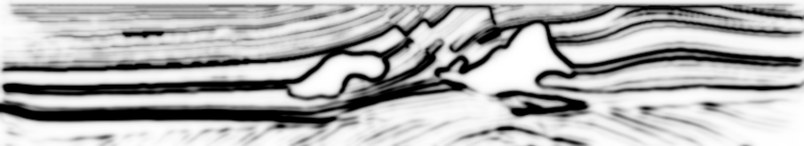
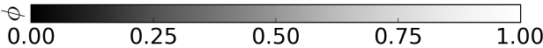
In this acoustic FWI example, two salt bodies are overlaid on the standard Marmousi model
True velocity model
Initial velocity model
M-S: inverted velocity model
Initial boundary set
M-S: inverted boundary set
Notes:
Modified-Marmousi model (17km x 3.1km) with inclusions of two additional salt anomalies
Survey
100 sources and 500 receivers on the surface
5Hz Peak frequency Ricker with 2Hz low cut filtered
FWI Algorithm
Simultaneous source-encoding changing every iteration
Gauss-Newton with 10 CG linear iterations
Inverting for $1/{V_{P}^{2}}$

Slide 16
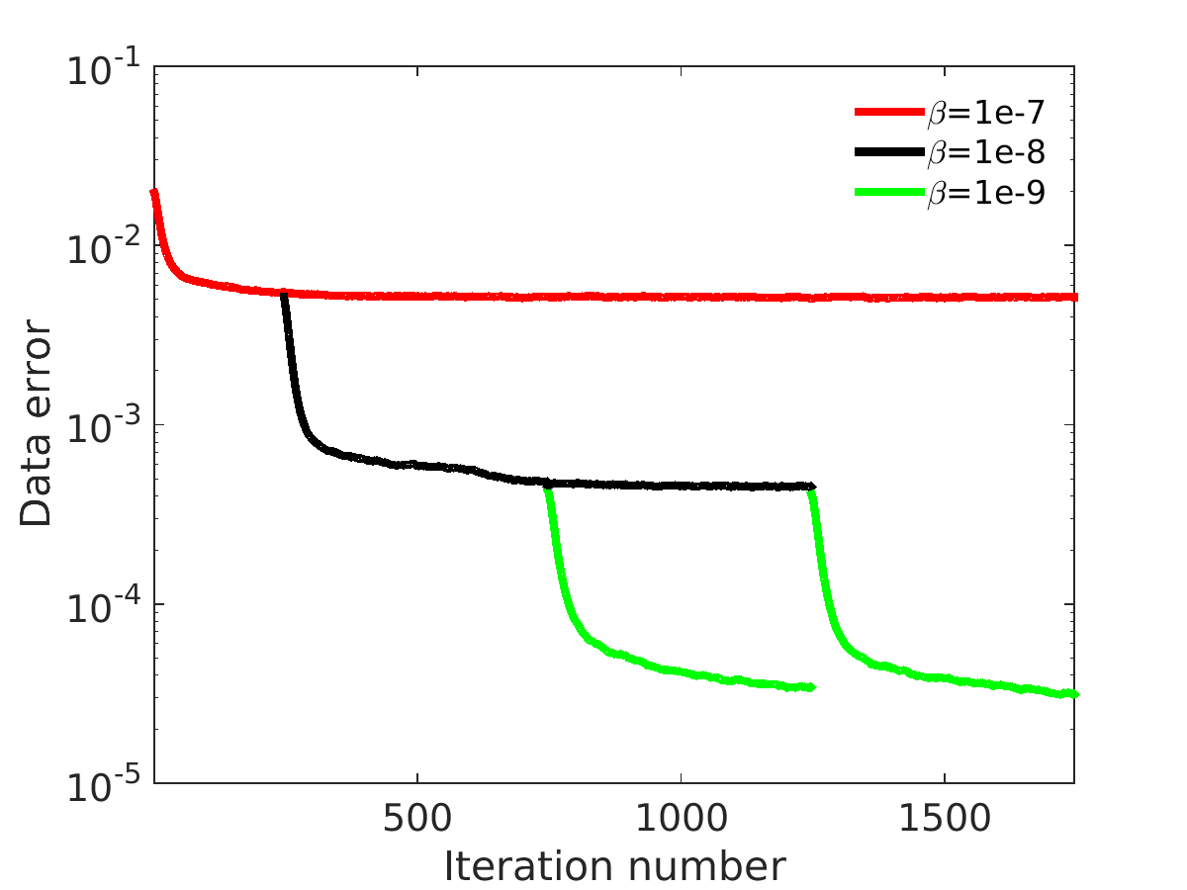
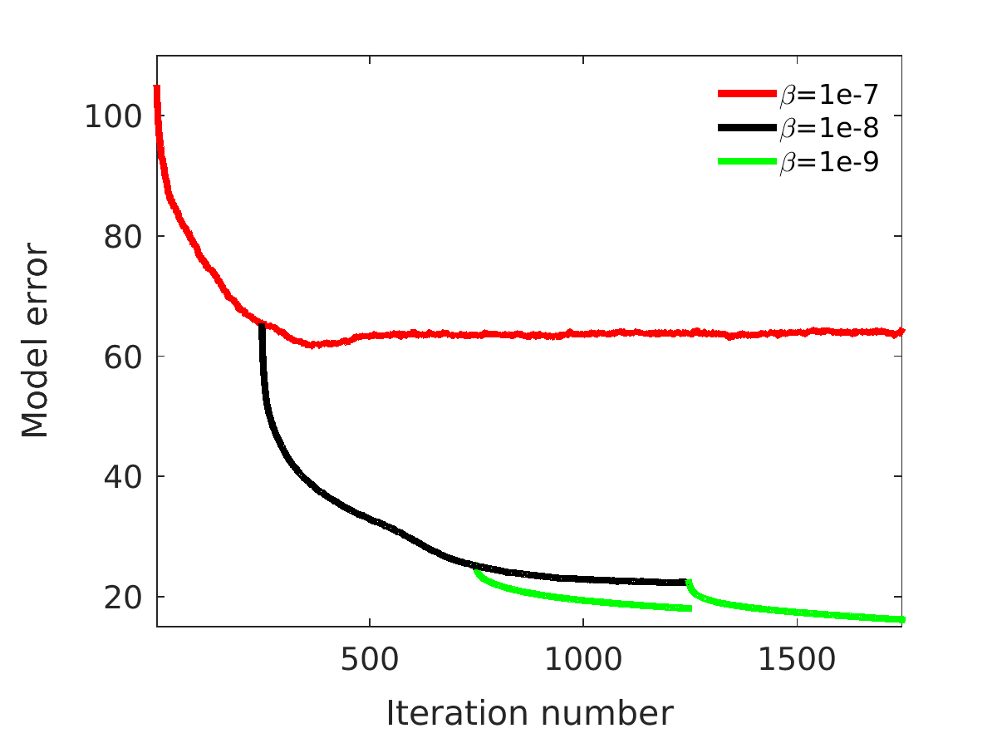
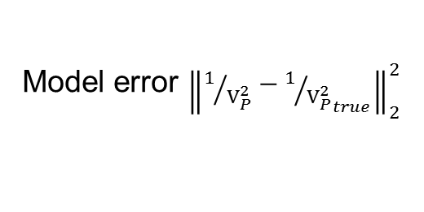
Continuation on M-S parameters improves convergence
Data error
Model error ${\left\|1/{V_{P}^{2}}−1/{{V_{P}^{2}}_{true}}\right\|}_{2}^{2}$

Slide 17
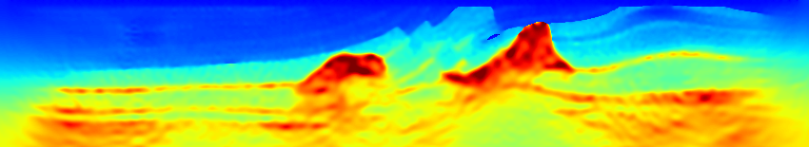

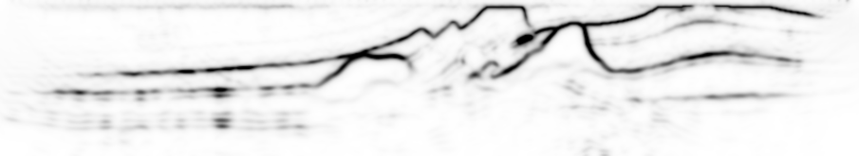
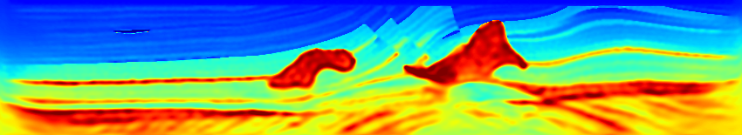
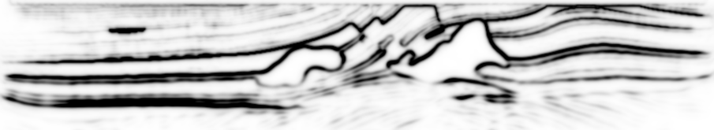






Continuation identifies features in a coarse-to-fine manner
$$V_{p}$$
Model convergence
$$ϕ$$
$$V_{p}$$
$$ϕ$$
$$V_{p}$$
$$ϕ$$

Slide 18
Conclusion
Shape-based inversion provides a structurally consistent approach for performing multi-parameter and joint inversion
Diffuse interface approximation enables a flexible geometric representation of a wide variety of shapes
Continuation in geometric hyper-parameters enables multi-scale representation and inversion of shapes

