Slide 1
Reproducibility study:
Learning feature relevance through step-size adaptation in TD learning
INF8953DE– Reinforcement Learning
Marwane Adala
Ali Fakhri
Catherine Landry
2021-12-14

Slide 2
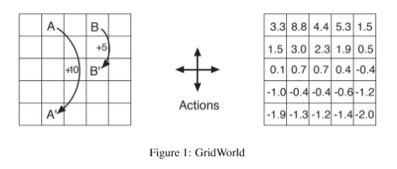
Introduction
Implementation of four algorithms on a gridworld:
TD(0)
TIDBD with full gradient
TIDBD with semi-gradient
AutoStep TIDBD
Notes:
Catherine

Slide 3
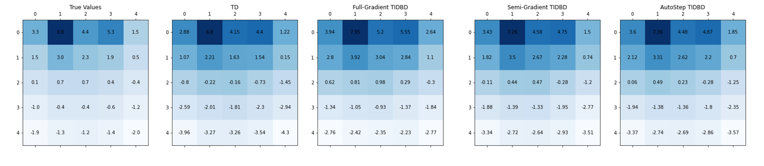
Testing the algorithms
Notes:
Ali

Slide 4
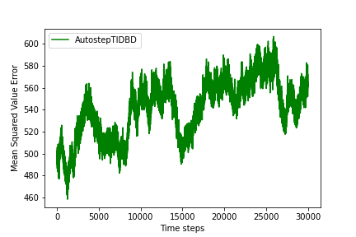
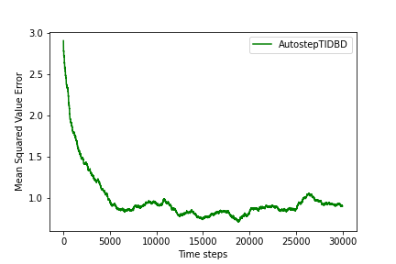
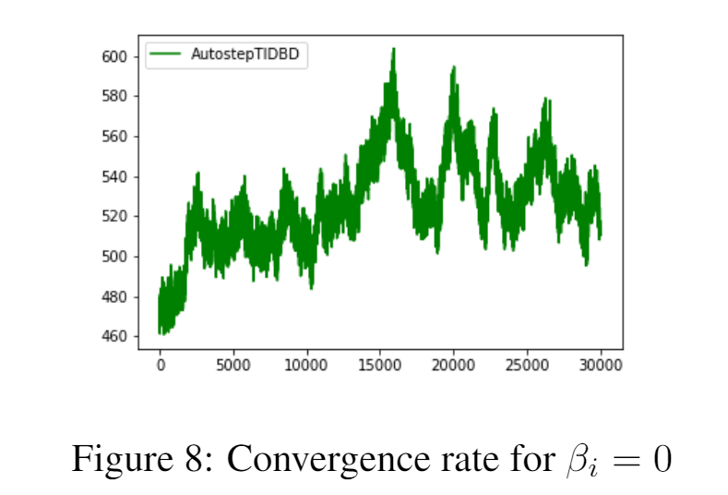
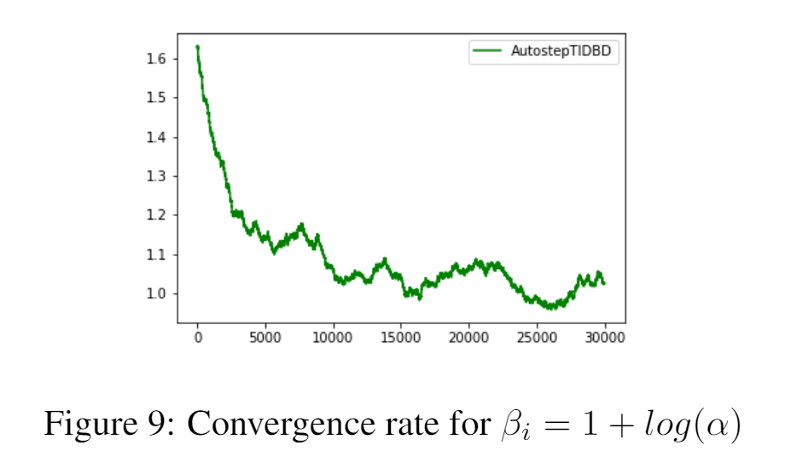
2. Results: beta initialization
Notes:
Catherine

Slide 5
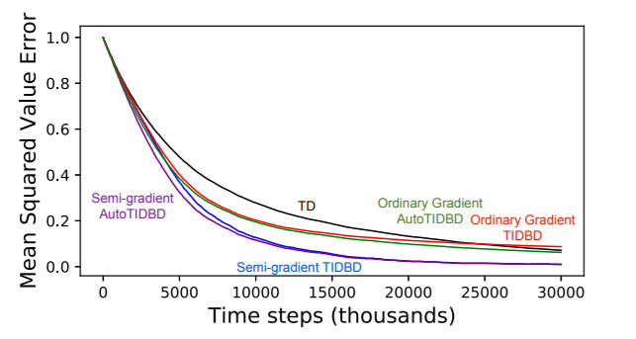
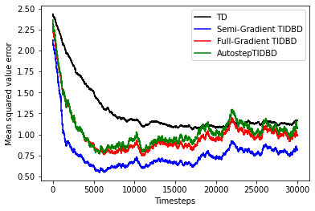
2. Results: Convergence for alpha = 0.01
Notes:
Ali

Slide 6
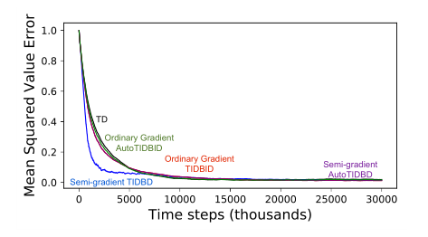
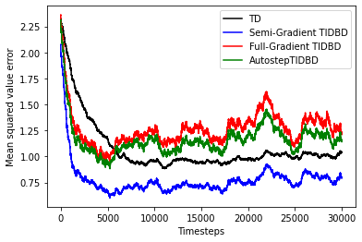
2. Results: Convergence for alpha = 0.025, 0.05
Notes:
Ali

Slide 7
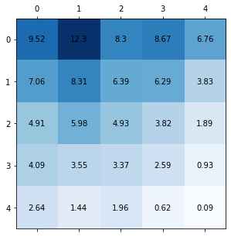
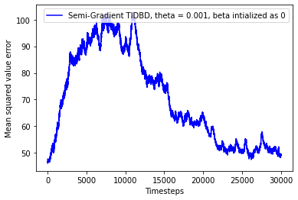
2. Results: Semi-grad TIDBD, alpha = 0.5, theta = 0.001
Notes:
Ali

Slide 8
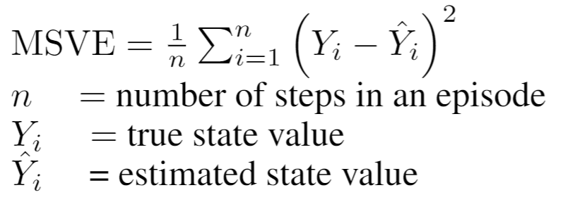
Defining a clear error
Notes:
Ali

Slide 9
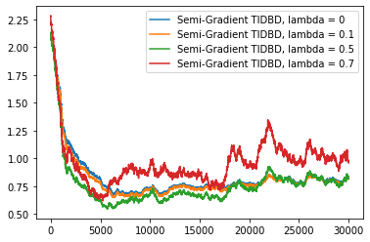
2. Results: What is the effect of changing λ values?
The comparisons done remain consistent for different λ values
Notes:
Marwane
One other thing we investigated was the effect of changing lambda values?
Our experiment showed that our comparisons done remain consistent for different λ values, in fact, as in the figure below, asymptotically the shape and comparisons don't change when changing lambda values, but, the learning improves.
Learns more slowly for aggressive α0 than TIDBD
Issues with off-policy prediction methods, as well as approaches using various eligibility traces

Slide 10

Conclusion
Implementing successfully all four algorithms
Reproducing that AutoStep TIDBD converges faster than TD(0)
Reproducing that TIDBD converges faster than TD(0)
Implementing a custom environment
Finding that the meta-weights (beta) does matter
Defining a clear way to calculate the error

Slide 11
Future Work
Showing robustness of algorithms according to meta-step size (theta) choice
Implementing algorithms on a non-tabular environment
Generalize TIDBD to a more general multi-step update
Notes:
Marwane:
Future contributions would be to pursue this study and plot the affect of meta step-size θ on different algorithms.
Implementing successfully all four algorithms especially within the robotic arm task would also be a very interesting study.
One other perspective to consider in this context, will be to generalize TIDBD from being based on only one step TD error to a more general multi-step update.
We can attempt to change TIDBD so that it can use online RL with eligibility traces to train for example a deep neural network as a function approximato, and therefore investigate multi step-size tuning.
A final perspective will be also to conduct extensive research on the effect of the parameter λ on TIDBD and AutoTIDBD especially in the robotic arm setting.

