Slide 1
Mediator Pattern
Behavioral pattern

Slide 2
Pattern definition
Structural patterns
A structural design pattern serves as a blueprint for how different classes and objects are combined to form larger structures. Unlike creational patterns, which are mostly different ways to fulfill the same fundamental purpose, each structural pattern has a different purpose.
Question: What unifies structural patterns?
Answer: They all involve connections between objects.
In some sense, structural patterns are similar to the simpler concept of data structures.
Ref: https://www.gofpatterns.com/design-patterns/module5/structural-design-pattern.php
Behavioral patterns
Some of these patterns describe how a group of peer objects cooperate to perform a task that no single object can carry out by itself. An important issue here is how peer objects know about each other. Peers could maintain explicit references to each other, but that would increase their coupling. In the extreme, every object would know about every other. The Mediator pattern avoids this by introducing a mediator object between peers. The mediator provides the indirection needed for loose coupling.
Ref: https://www.gofpatterns.com/design-patterns/module6/intro-behavioral-designPatterns.php

Slide 3
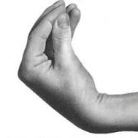
Spagetti pattern™
Alle objekter kalder hinanden uden nogen videre former for struktur.
Svære at opnå loose coupling
Det er svære at udbygge / genbruge kode potentielt.
*If it doesnt match any other pattern, its most likely spaghetti pattern ™ *

Slide 4
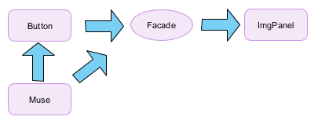
Facade pattern
Structural pattern
Ensrettet kald til en skjult underliggende struktur
Mere loose coupling end som spaghetti og mediator pattern

Slide 5
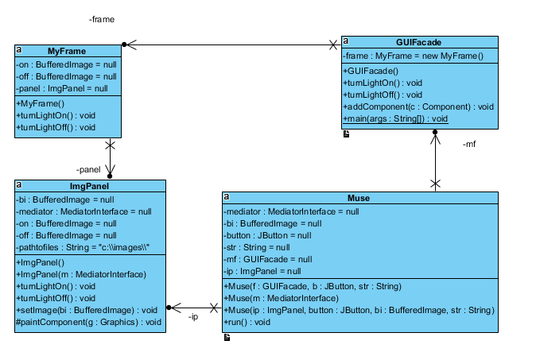
Facade
1. Bruger får en ide
2. Trykker på knappen
3. Knappen siger ”i’m out of ideas”
4. Knappen kalder facaden
5. Facaden tænker for lyset i pæren
6. Muse bliver started og kører i 5 sekunder

Slide 6
Mediator pattern
Sørger for loose coupling
Søger for at forskellige objekter kan snakke sammen uden at kende til hinanden.

Slide 7
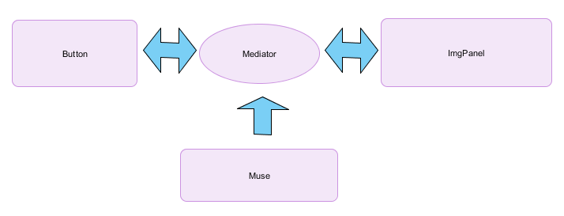
Mediator pattern eksempel
Bruger får en ide
Button siger til mediator at den skal vise at der er lys I pæren
Mediator fortæller ImgPanel at der skal være lys I pæren
Hvis der skal være lys I pæren så lav en muse
Musen mister sin magiske egenskaber efter 5 skunder,
og fortæller mediator at der ikke længere skal
være lyst I knappen
2. Mediator siger til ImgPanel at..
3. Osv.
ImgPanel siger til Mediator at Button skal opdatere sin tekst
Mediator siger til button at den skal opdatere sin tekst

Slide 8
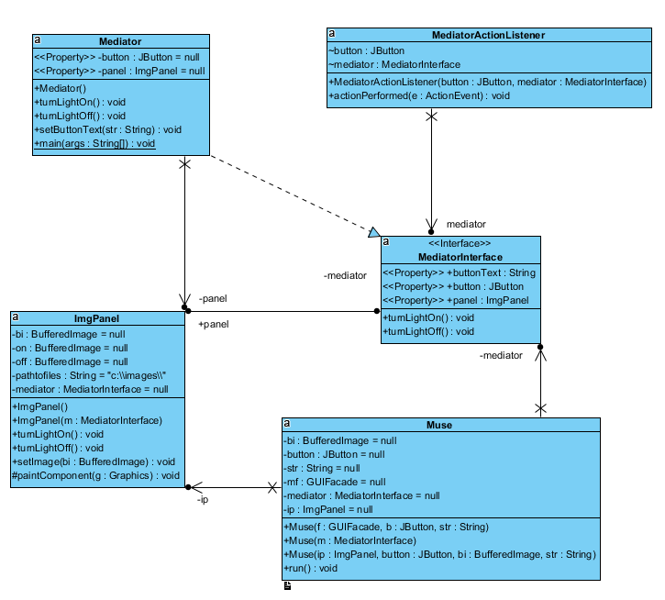
Mediator pattern

