Slide 1
MOVIES AND MARKET ANALYSIS FOR ROCKBUSTER STEALTH
Prepared by Marta Kolesnyk

Slide 2
MOTIVATION
Rockbuster Stealth LLC is a movie rental company that used to have stores around the world.
Facing stiff competition from streaming services, the Rockbuster Stealth management team is planning to use its existing movie licenses to launch an online video rental service in order to stay competitive.

Slide 3
OBJECTIVE
Determine the most profitable movies and regions that should be prioritized when switching to the online platform.

Slide 4





1,000
DATA OVERVIEW
Amount of movies
Number of customers
Most common movie language
Average rental duration
Average rental rate
English
5 days
$2.98
599

Slide 5
WHICH MOVIES CONTRIBUTED THE MOST/LEAST TO REVENUE GAIN?

Slide 6
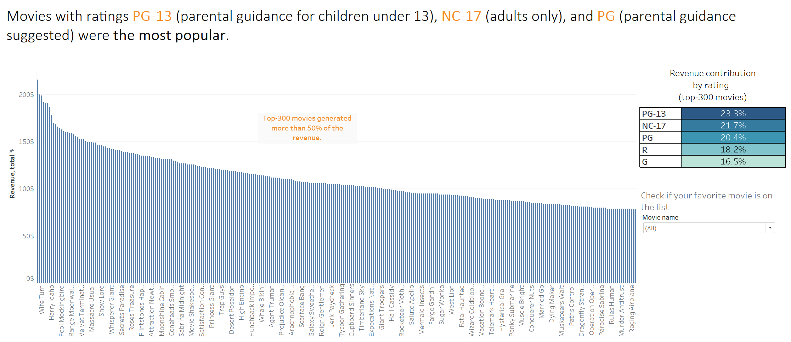
MOVIES CONTRIBUTION TO THE REVENUE GAIN

Slide 7
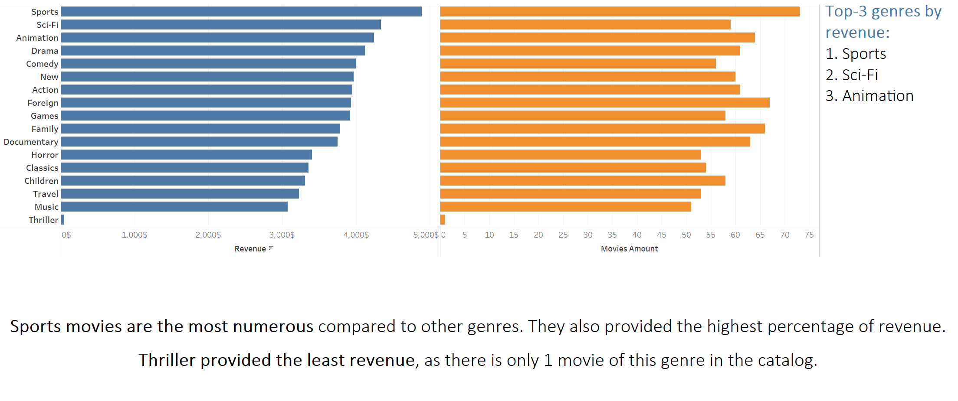
MOVIES POPULARITY BY GENRE

Slide 8
How do sales and customer numbers vary between geographic regions?

Slide 9
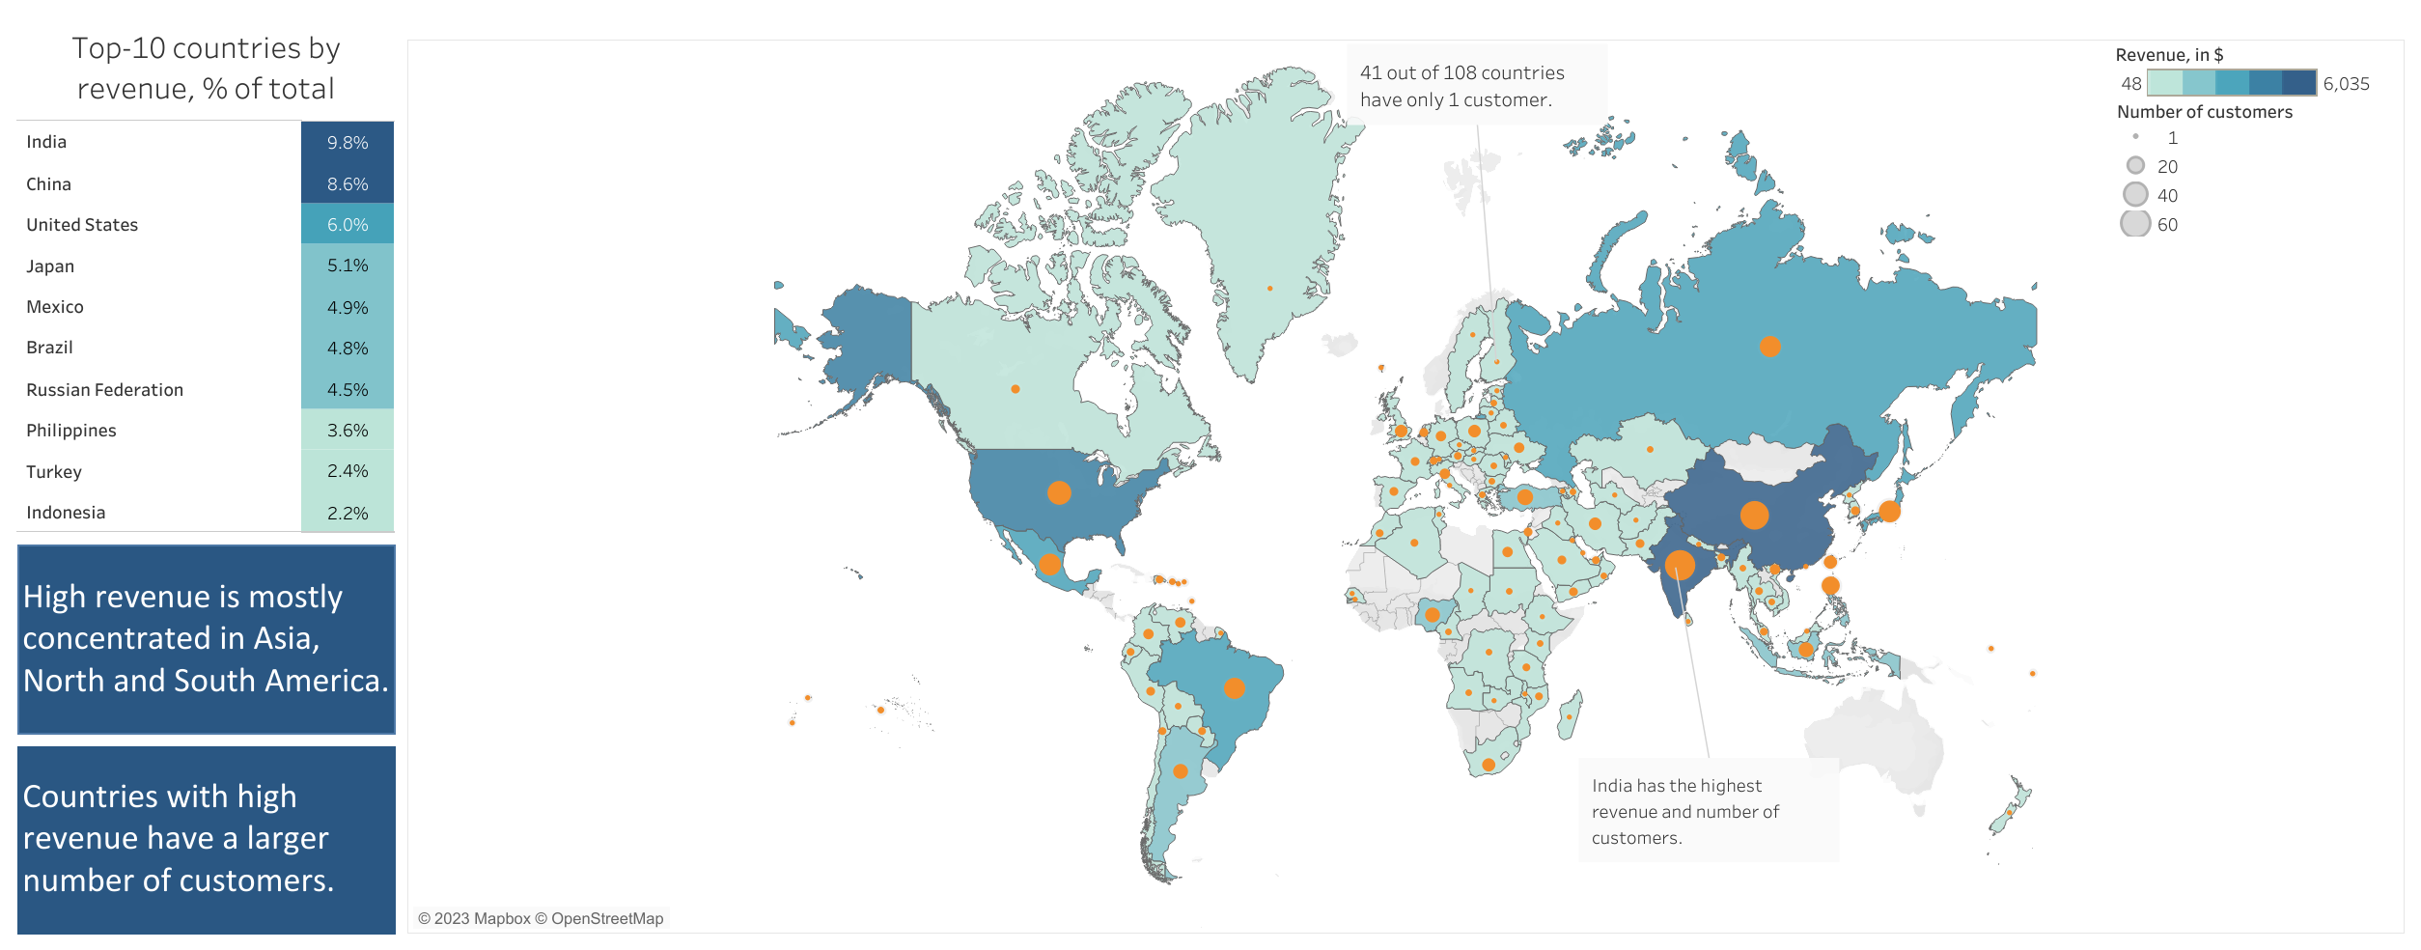
SALES AND CUSTOMER NUMBERS ACROSS GEOGRAPHIC REGIONS

Slide 10
Where are customers with a high lifetime value based?

Slide 11
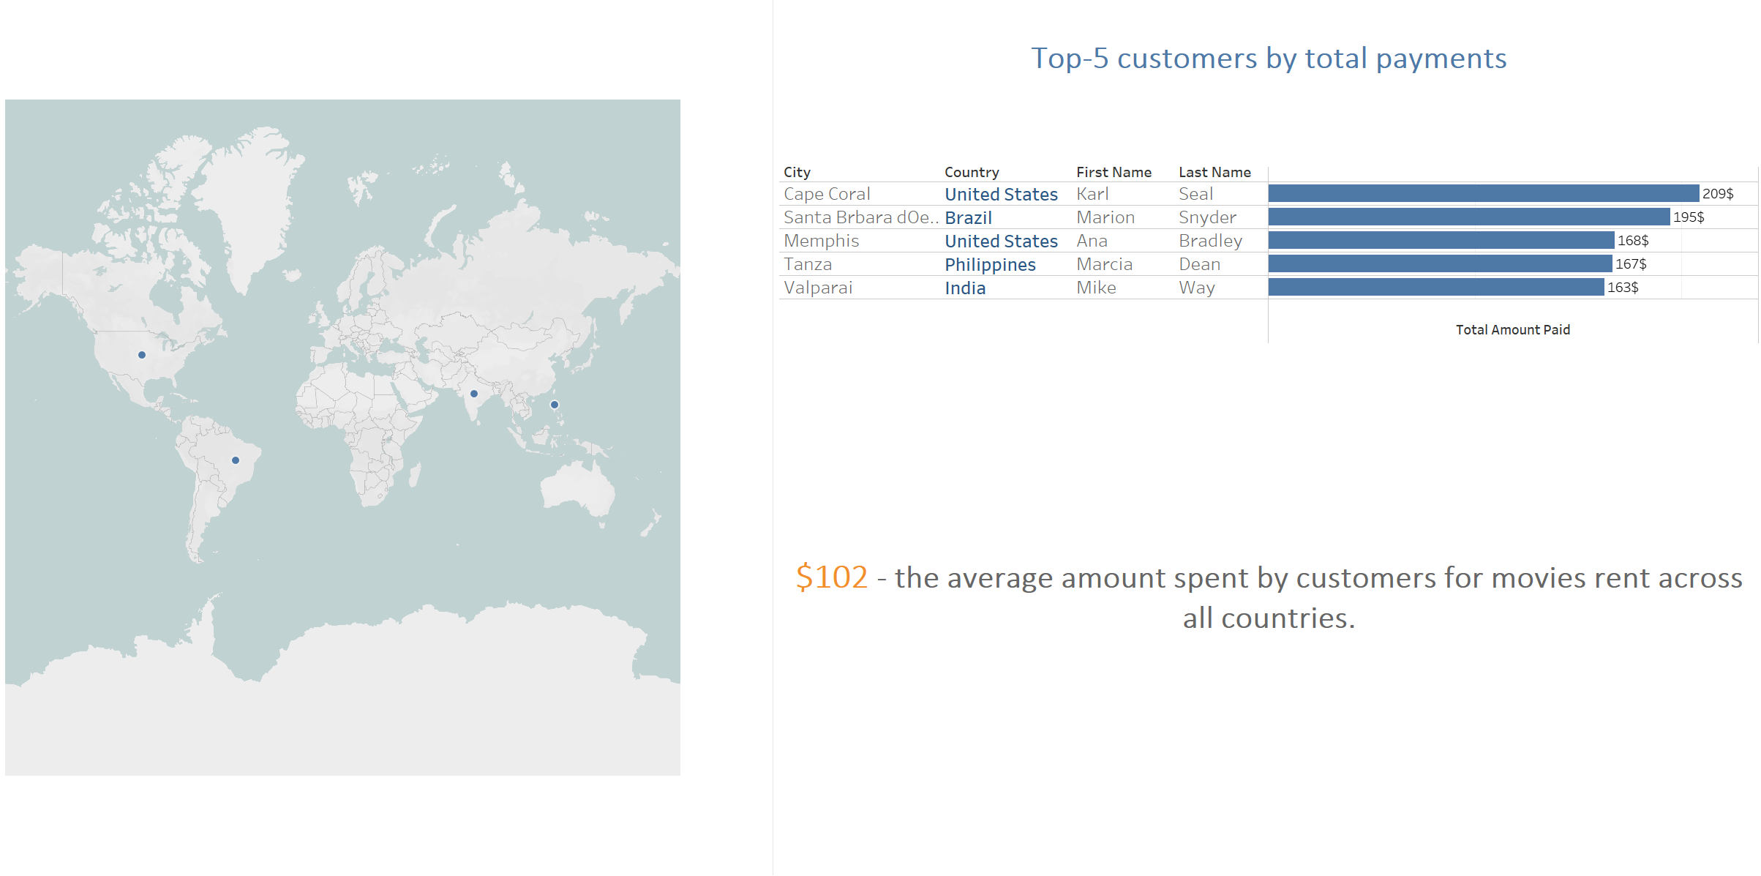
COUNTRIES WITH THE MOST LOYAL CUSTOMERS

Slide 12
RECOMMENDATIONS
Extend licenses for movies with the most popular genres and ratings.
Prioritize Asia, North and South America regions when launching the online platform.
Introduce special rates or rewards for loyal customers to encourage them to rent more movies and to attract new customers.
NEXT STEPS
Analyze countries with only 1 customer to determine the reasons of the low company products’ popularity in these places.
Consider surveying the existing customers to find out their product preferences and use results of the survey to modify the current movie catalog.

Slide 13
THANK YOU!
All visualizations are available on Tableau Public

