Slide 1
High speed PA testbench for studying vibrations on preloaded piezo actuators
Marta Alfonso
26-05-2023

Slide 2
List of contents
Overview of the architecture of the system
Requirements of the system
Electrical design
Software design
API
GUI
Mechanical design
Measurements
System validation
Troubleshooting

Slide 3
Architecture of the system
PC
Functional generator
Power amplifier
Piezo stack
Power supply

Slide 4
Overview of the proposed solution
PC
FGEN – 33600A Series Keysight Technologies
OPAMP - EK57U APEX
OPAMP - EK57U APEX
Piezo stack
PSU – SM70-22 Delta Elektronika
PSU – SM70-22
Delta Elektronika

Slide 5
Requirements of the system
Driving a piezoelectric brick up to 500 kHz with a full voltage range of 0 to 150 V.
User interface enabling remote generation of vibrations.
API for configuration of the function generator that gives the input signal for the system.
GUI for controlling and monitoring? the system from the PC.
A stand-alone chassis encapsulating the amplifier.
Rack mountable
Ventilation

Slide 6
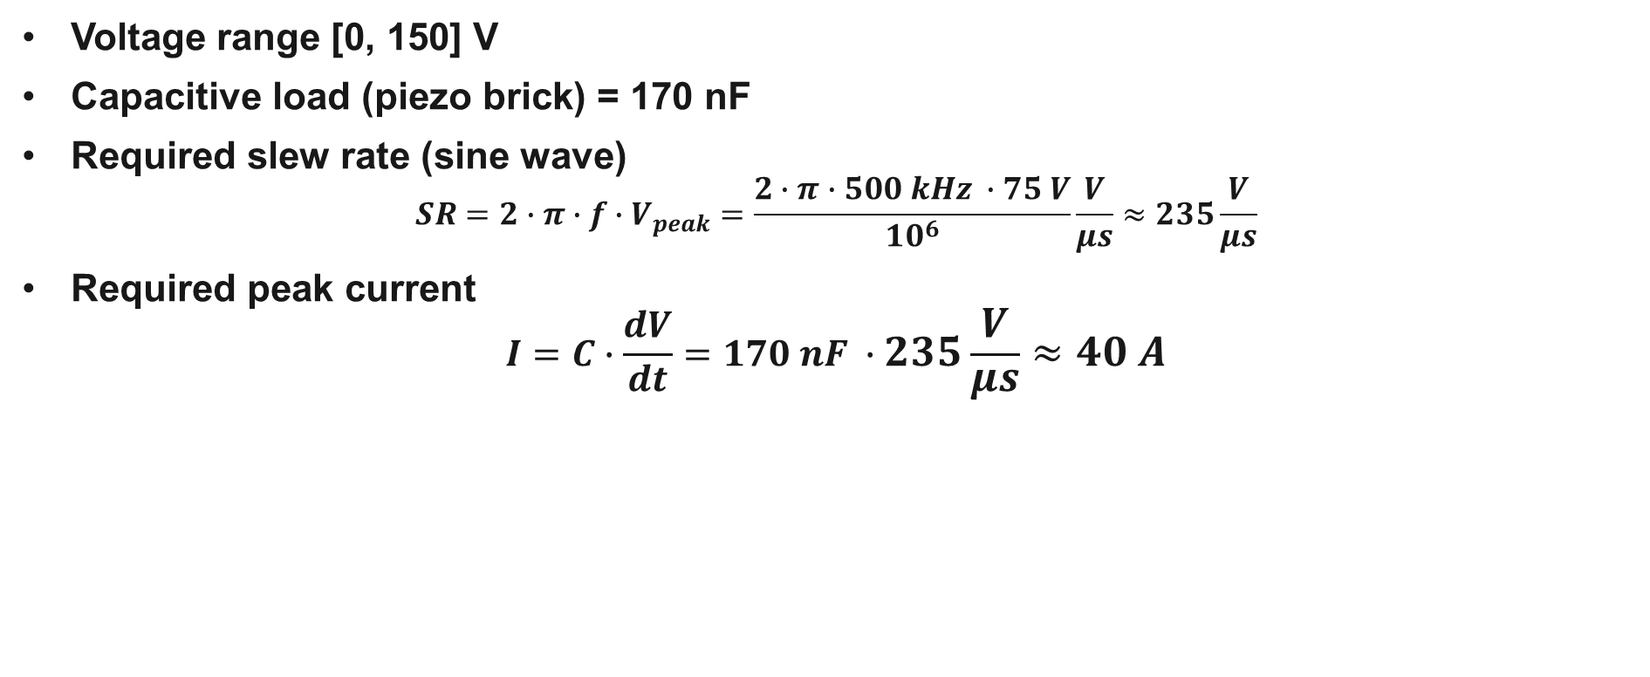
Electrical design: requirements
Voltage range [0, 150] V
Capacitive load (piezo brick) = 170 nF
Required slew rate (sine wave)
$$SR=2∙π∙f∙V_{peak}=\frac{2∙π∙500 kHz ∙75 V}{{10}^{6}}\frac{V}{μs}≈235\frac{V}{μs}$$
Required peak current
$$I=C∙\frac{dV}{dt}=170 nF ∙235\frac{V}{μs}≈40 A$$

Slide 7
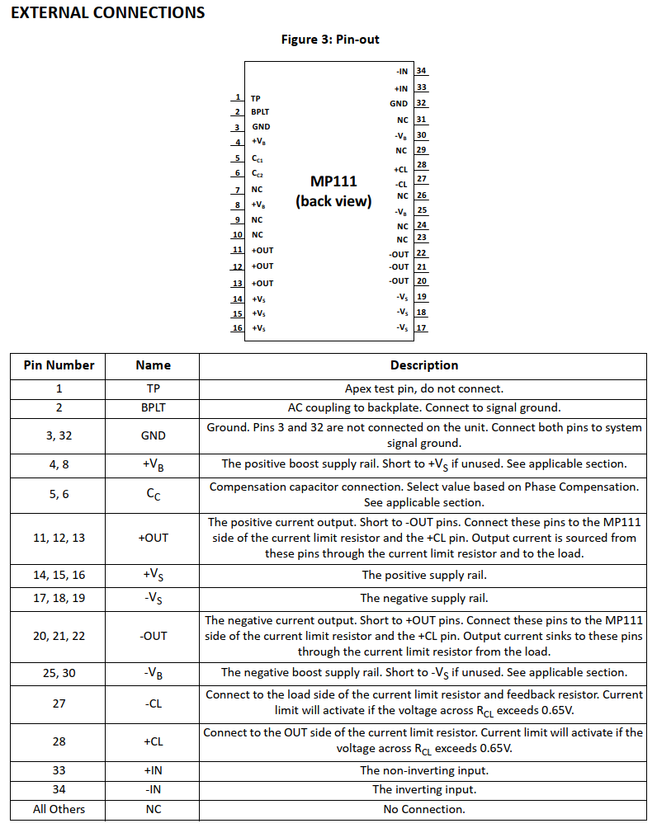
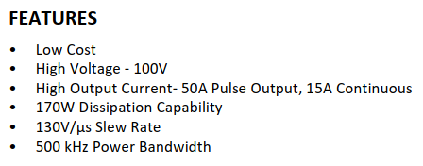
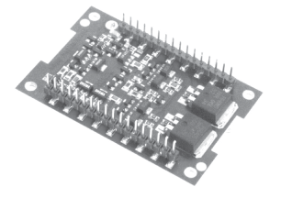
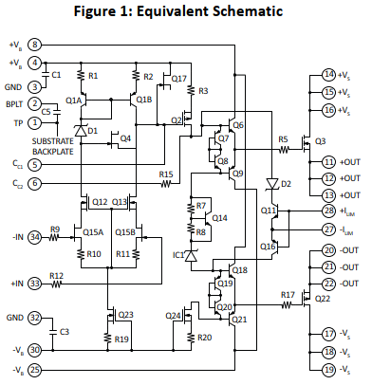
Electrical design
Chosen amplifier: APEX MP111u

Slide 8
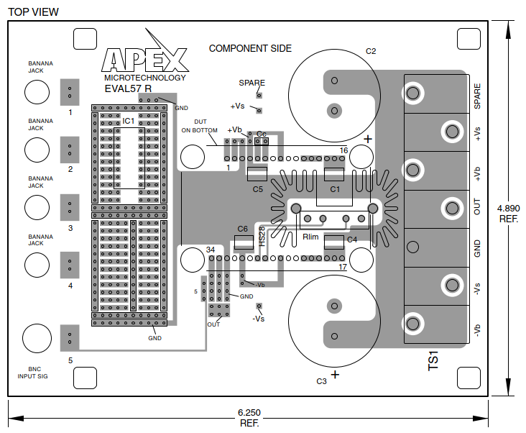
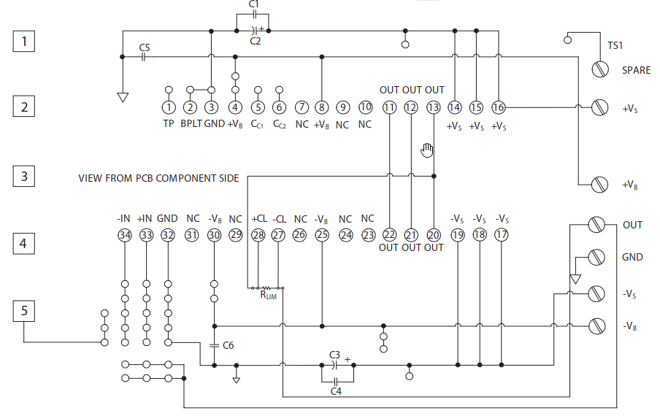
Electrical design
Implemented with the APEX EK57 evaluation kit

Slide 9
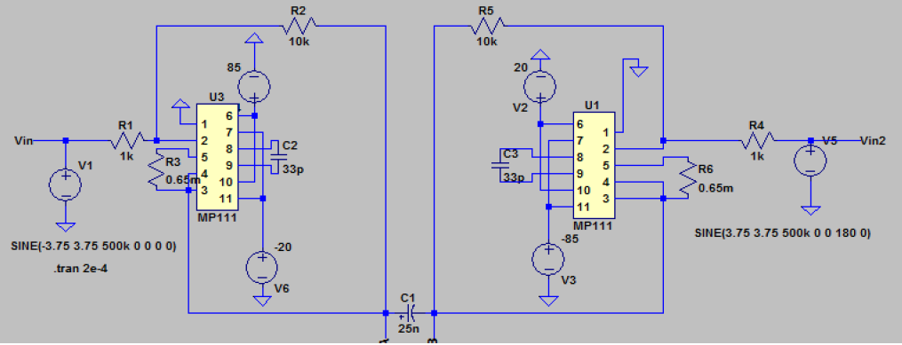
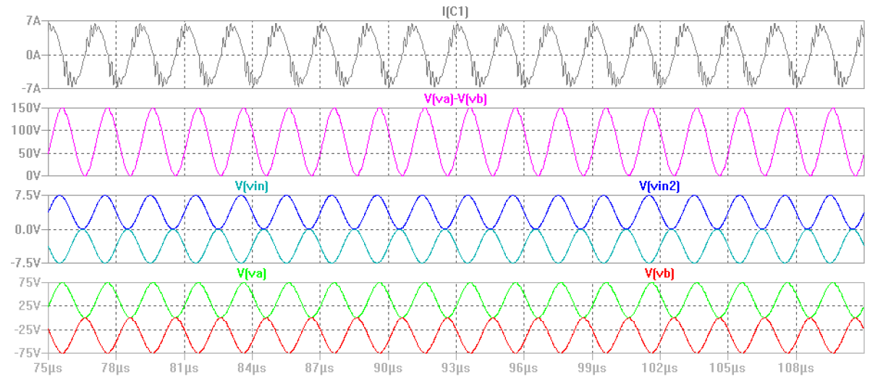
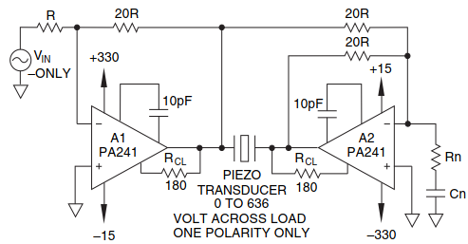
Electrical design
Unipolar bridge configuration with two amplifiers
For a total voltage swing of 0 to 150 V
Voltage swing of master amplifier
0 to 75 V, Vpk = 37.5 V
Voltage swing of slave amplifier
0 to -75 V, Vpk = -37.5 V
Required slew for each opamp (Vpk=37.5 V)
117.8 V/µs
Required peak current
20 A

Slide 10
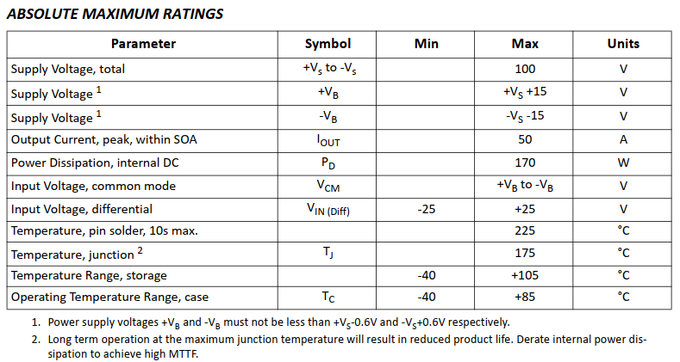
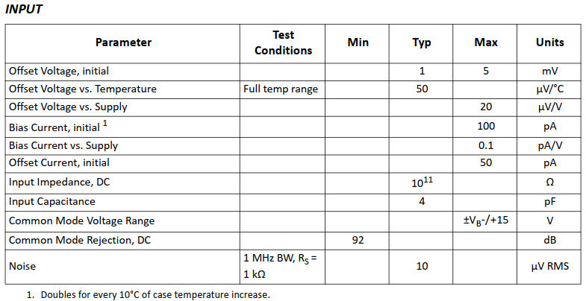

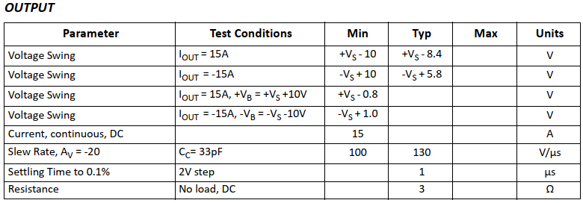
















Electrical design
Unipolar bridge configuration with two amplifiers
Supply rails
Report says +Vs = 85 V to have a maximum output of +Vs – 8.4 ≈ 75 V
And –Vs =-20 V to have a minimum output of –Vs ≈ -14.2 V
Input common mode range taking Vcm into account: +Vs – 15 V = 70 V and –Vs + 15 V = -5 V
Datasheet:

Slide 11
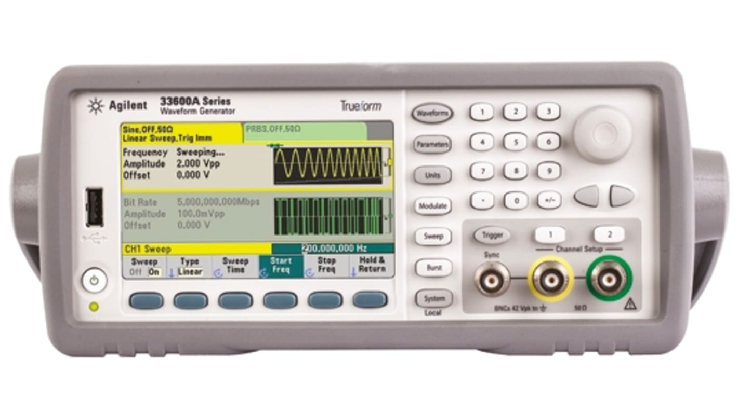
Software design
API for the remote configuration of the function generator.
Python interface with Agilent 33600A series function generator.
Use of PyVISA library with Keysight’s VISA driver for PC.
Configuration of the instrument with SCPI commands.

Slide 12
Software design
User interface
Control of one or both input signals for the two amplifiers of the bridge configuration.
Setting of vibration characteristics: Amplitude and Frequency.
Visualization of the generated signals as well as signal across the piezo load.
Logging and reporting features.

Slide 13
Mechanical design
System on rack
Encapsulation of the power amplifiers in a subrack
Power supplies and generator mounted on the rack as well
PXI?
Opamps subrack
Front panel and back panel connections with other instruments
ON/OFF general switch?
Emergency stop button?
Preloaded piezo stacks mounting
Piezo support? Mounting?
Measurement system: interferometers?
Also needed to include in the rack:
Measurement systems: vibrometer, interferometer?

Slide 14
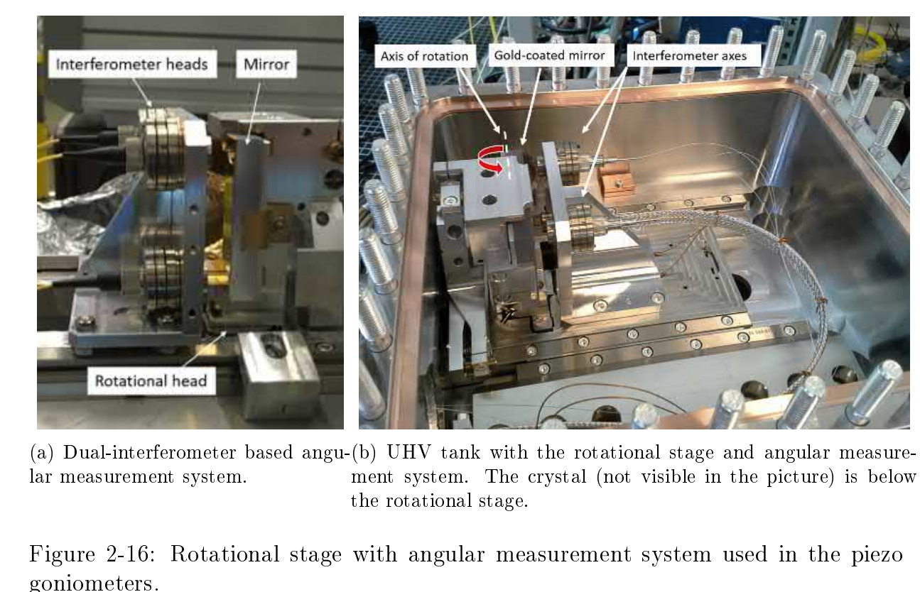
Measurements
Measurements performed with the piezo stack mounted in the piezogoniometer?
Different/new structure for the testbench?
Moving part (piezo) vs fixed part (measurement system)
Relative or absolute measurements?
Which measurements?
Angle of displacement? Distance of displacement?
Speed? Acceleration?
Frequency? Voltage amplitude?
Which instruments?
Interferometer?
Vibrometer?

Slide 15
System validation
Experiments to validate the system

Slide 16
Troubleshooting
Problem #1: one of the amplifiers doesn’t work

