Slide 1
Reconfigurable Computing
Course presentation
2021/2022 academic year
Iouliia Skliarova

Slide 2
Reconfigurable Computing
Scientific area
Architecture of computing systems
Relevant course units
Introduction to Digital Systems
Digital Systems Laboratory
Computer Architecture I
Computer Architecture II
Advanced Computer Architecture
Operating Systems
Contact hours
3h (lecture + lab)
ECTS credits
6
The number of ECTS credits assigned to a course does not indicate how many hours of classes you will have. Instead, it indicates the expected number of hours to study.
1 ECTS = 25-30 hours of study. 6 ECTS = 150-180 hours of study.
The semester has ~ 15 weeks => you must study at least 10 hours per week.
These hours include: lectures, labs, book reading, exercise solving, exam study, etc.

Slide 3
Objectives
It is intended that students acquire skills in Systems-on-Chip (SoCs) design, complex digital systems development and hardware-software co-design.
Design of specialized or reconfigurable computational platforms for embedded systems based on FPGAs and programmable SoCs (PSoCs)
specification, construction and specialization of the hardware platform and design and execution of software.

Slide 4
Expected outcomes
Upon completing this course unit, students will acquire the following skills:
Modeling based on advanced use of hardware description languages and system programming languages.
Development and prototyping of integrated systems based on high capacity programmable logic devices (FPGAs and PSoCs).
Use of computer-aided design tools for modeling, simulation, synthesis, implementation, debugging, test, and optimization.

Slide 5
Topics
Construction of heterogeneous multiprocessor platforms for SoCs, containing processors, memory, communication infrastructures, standard peripherals and specialized modules, based on high-level tools and languages, hardware description languages and high capacity programmable logic devices (FPGAs and PSoCs).
Use of computer-aided design tools for development and reuse of intellectual property cores, simulation, synthesis, implementation, debugging and testing.
Development, compilation, execution, debugging and profiling of embedded software, running in standalone mode or on the top of a kernel/operating system.
Analysis of the metrics resulting from the implementation of a system and the introduction of restrictions and optimizations, both at hardware and software levels, in order to improve the final quality of the design and/or the fulfillment of the specifications.

Slide 6
Evaluation
Final classification is obtained by two mutually exclusive alternatives:
Discrete evaluation (default):
Theoretical evaluation T (test 1 <May> 25%, test 2 <June> 25%) – 50%
Practical evaluation P (group final project 30%, practical assignments 20%) – 50%
Final exam:
Final exam (50%) <normal examination period>
Practical evaluation P (group final project 30%, practical assignments 20%) – 50%
The evaluation method is discrete by default but might be altered to final during the first two weeks of the semester (< 21.03.2022).
Minimum grade for each component (T and P): 7.5.
For approval, the total weighted average must be ≥ 9.5.

Slide 7
Practical assessment
Group final project 30%
One project for a group of two students
Project specifications will be discussed in May
Project presentation and defense will be organized during the last week of classes (on June 22)
Objective: implementation of a system with specialized hardware that allows to accelerate/facilitate a certain operation / functionality
Practical assignments 20%
One kit for every student
The kits must be picked up at the university and returned back by the end of the semester
The respective rules for loan and use of the development boards are explained at the course website

Slide 8
Repeaters
Repeating students who have obtained a positive grade in the practical component of the course in 2020/2021 do not maintain their grade.

Slide 9
Student Absences
The classes are of compulsory attendance.
In accordance with the current study regulations, all students who, not having a specific student status, inexcusably miss more than 30% of classes, will be reproved automatically and will not be allowed to participate in subsequent evaluations during the current academic year.
The proper documentation of the illness, injury, or other reason must be submitted to DETI secretariat within the stated deadlines. In parallel, and as early as possible, the student should send a copy of the justification to the course coordinator.

Slide 10
Working Students
Working students who have not been able to attend regular lab classes during the semester, will have their final exam(s) during the exam season.
The practical evaluation will only include the final project whose weight is 50% of the final grade.
The final project for these students must be individual.
It is possible to waive the status of worker-student by signing a declaration available on the course website.

Slide 11
Bibliography
P.P. Chu, FPGA Prototyping by VHDL Examples: Xilinx MicroBlaze MCS SoC, 2nd ed., John Wiley & Sons, 2017.
I. Skliarova, V. Sklyarov, FPGA-Based Hardware Accelerators, Springer, Switzerland, 2019.
V. Sklyarov, I. Skliarova, A. Barkalov, L. Titarenko, Synthesis and Optimization of FPGA-Based Systems, Springer, Switzerland, 2014.
A. Pedroni, Circuit Design with VHDL, MIT Press, 2020.
F. Wakerly, Digital design: Principles and practices, 5ª ed., Pearson, 2018.
B. C. Readler, VHDL by Example - A Concise Introduction for FPGA Design, Full ArcPress, 2014.
B. Mealy, F. Tappero, Free Range VHDL, www.freerangefactory.org, 2016.
L. Crockett, R. Elliot, M. Enderwitz, R. Stewart, The Zynq Book: Embedded Processingwith the Arm Cortex-A9 on the Xilinx Zynq-7000 All Programmable SoC, StrathclydeAcademic Media, 2014.
R. Jasinski, Effective Coding with VHDL: Principles and Best Practice, MIT Press, 2016.
Manuals

Slide 12
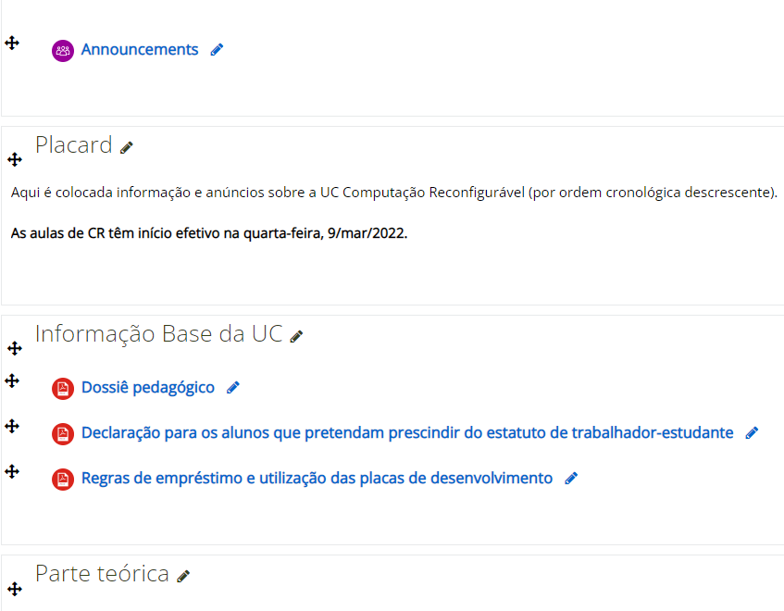
Course website: elearning.ua.pt
Support materials for classes
Lab guides
Course software
Assessment
Bibliography
Full reading of the teaching dossier is mandatory!

Slide 13
Final notes
Copying, in whole or in part, of any material delivered for evaluation is considered fraud.
The detection of this practice implies the attribution of the classification 0 (zero) to the respective evaluation element.

Slide 14
Let’s start!

