Slide 1
Introduction to Reconfigurable Computing Introduction to the development kits and design software
Lecture 1
Iouliia Skliarova

Slide 2
Reconfigurable Computing
A computer architecture that facilitates faster and more complex computing by using reprogrammable integrated circuits to process data that solves problems and directs specified functions.
Offers the higher speed and efficiency of computer hardware to perform serial and parallel tasks combined with software’s flexible capacity to allow changes to a circuit’s purpose in the field to adjust for changing circumstances.
Core advantages:
More functionality from simpler and smaller hardware designs
Cost savings on low volume products and those whose useful life is extended by updating
Shorter/faster development time-to-market

Slide 3
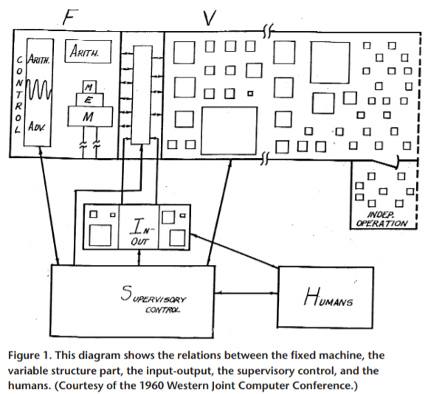
Original Idea
The earliest work on reconfigurable computer architecture was done at the University of California at Los Angeles – in 1960’s Gerald Estrin proposed a standard processor extended with an array of “variable” hardware.
The main goal was to permit computations which are beyond the capabilities of present systems by providing an inventory of high speed substructures and rules for interconnecting them such that the entire system may be temporarily distorted into a problem oriented special purpose computer.
At that time, digital technology was not ready for such a revolutionary change.

Slide 4
Other Computing Models
Traditionally, computing was classified into General-Purpose Computing performed by a General-Purpose Processor (GPP) and Application-Specific Computing performed by an Application-Specific Integrated Circuit (ASIC).
Reconfigurable computing acts as a trade-off between the two extreme characteristics of GPP and ASIC, combining the advantages of both.
When compared to GPP:
provides ability to make substantial changes to the datapath itself in addition to the control flow
can have better performance with respect to a software implementation in GPP but paying this in terms of time to implement
When compared to ASIC:
possibility to adapt the hardware <during runtime> by "loading" a new circuit on the reconfigurable fabric
can be used to design a system without requiring the same design time and complexity compared to a full custom solution but being beaten in terms of performance

Slide 5
Overview
Advantages / Features
Flexible hardware/software co-design
Customization (parallelism exploration, specialized control and datapaths)
Fast prototyping
Faster design cycles, lower risk, cheaper for small to medium size markets compared with ASICs
Dynamic system upgrades (field updates for both hardware and software)
Target applications
Application-specific hardware accelerators/coprocessors/processors
Telecommunications, networks, image/audio processing, cryptography, space, automotive, medical, etc.

Slide 6
Overview
Limitations
Overhead due to reconfiguration time and/or additional hardware circuit delays -> mais lentos que os processadores
Supporting technologies
High capacity FPGAs/Programmable SoC
Processor customization frameworks
Fixed processor cores + extension coprocessors / flexible processors
Reconfiguration approaches
Static (at manufacturing, deployment or boot time)
Dynamic
Total (at run-time between execution phases)
Partial (at runtime replacing some components, while others remain operational)

Slide 7
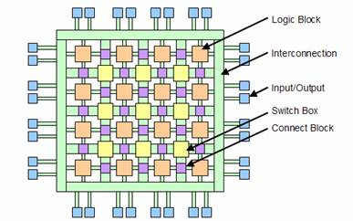
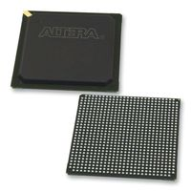
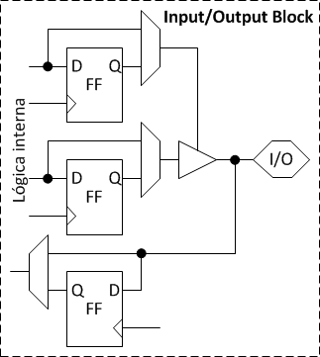
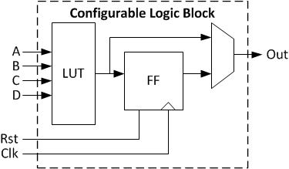
FPGA – Field-Programmable Gate Array

Slide 8
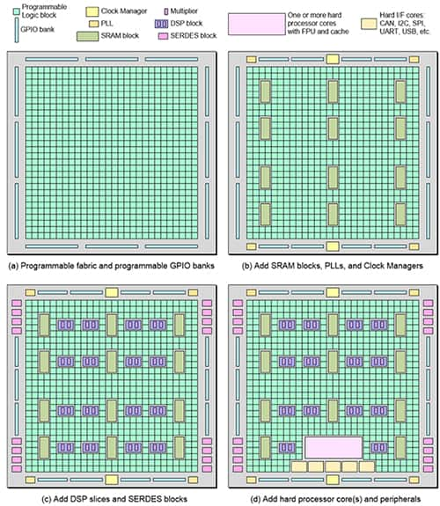
Modern FPGA
The simplest FPGAs contain only programmable fabric and configurable general purpose IO (GPIO) (a); different architectures augment this fundamental fabric with memory blocks, PLLs, and clock managers (b); DSP blocks and SERDES interfaces (c); and hard processor cores and peripherals (d). (Image source: Max Maxfield)
6-input LUTs configurable as distributed memory
Embedded memory blocks - block RAM with built-in FIFO logic for on-chip data buffering
High-speed serial connectivity with built-in multi-gigabit transceivers
User configurable analog interfaces, incorporating analog-to-digital converters
DSP slices with dedicated multipliers for high-performance filtering
Clock management tiles providing clock frequency synthesis, deskew, and jitter filtering functionality
Soft and hard processors
=> FPGAs with hard processor cores are referred to as programmable systems-on-chip (PSoC)

Slide 9
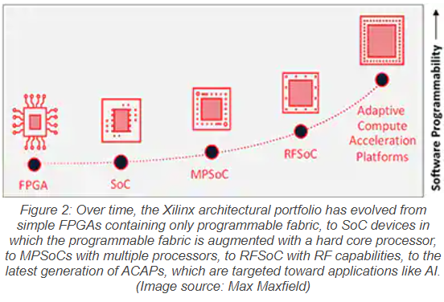
Xilinx Programmable Devices
The performance and capabilities of the programmable device offerings from Xilinx span from modest to extremely high:
traditional FPGAs
PSoCs (FPGA programmable fabric with a single hard core processor)
MPSoCs (FPGA programmable fabric with a multiple hard core processors)
RFSoCs (MPSoCs with RF capability)
ACAPs (Adaptive Compute Acceleration Platforms)

Slide 10
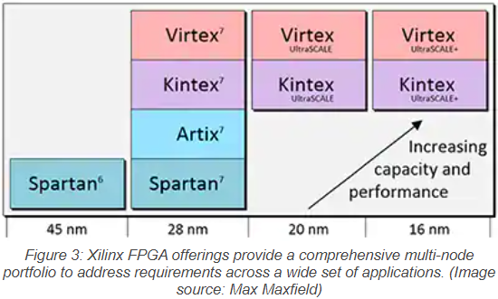
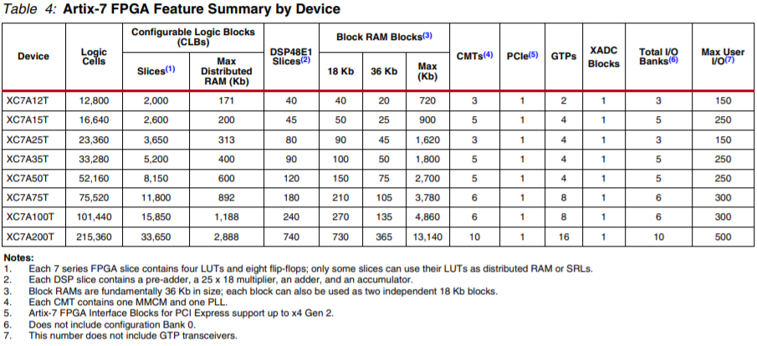
Xilinx FPGA

Slide 11
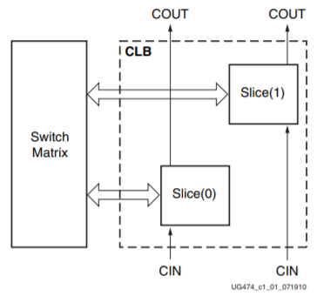
Artix-7 CLB (Configurable Logic Block)
CLBs are the main logic resources for implementing sequential as well as combinatorial circuits.
Each CLB element is connected to a switch matrix for access to the general routing matrix.
A CLB element contains a pair of slices.
Every slice contains:
Four logic-function generators (or look-up tables)
Eight storage elements
Wide-function multiplexers
Carry logic

Slide 12
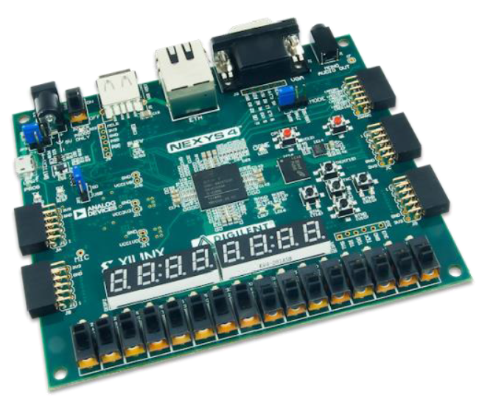
Nexys-4 Development Board
16 user switches
16 user LEDs
Two 4-digit 7-segment displays
USB-UART Bridge
Two tri-color LEDs
Micro SD card connector
12-bit VGA output
PWM audio output
PDM microphone
3-axis accelerometer
Temperature sensor
10/100 Ethernet PHY
16MB CellularRAM
Serial Flash
Four Pmod ports
Pmod for XADC signals
Digilent USB-JTAG port for FPGA programming and communication
USB HID Host for mice, keyboards and memory sticks
FPGA: xc7a100Tcsg324-1

Slide 13
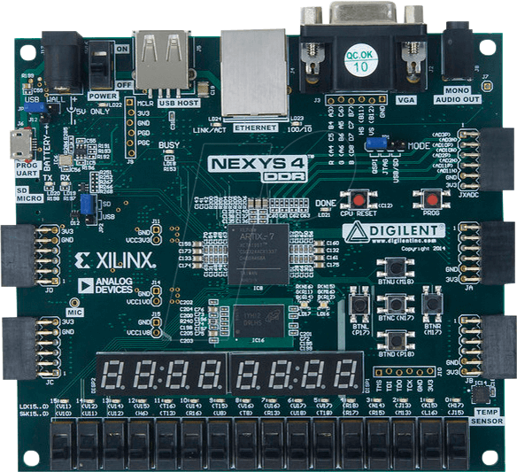
Nexys-4 Development Board
Power select jumper: USB
Power switch
USB cable for power supply and programming
Programming mode jumper: USB/SD
External configuration jumper (SD / USB): USB

Slide 14
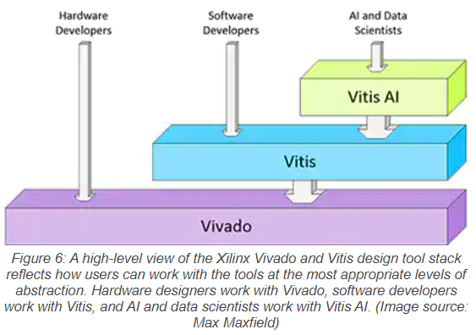
Development Tools
Xilinx Vitis
For portability of projects between different computers, it is recommended to install version 2020.2
Installation instructions are available at the course website
Requires at least 70 GB of disk space
License: Vivado Design Suite 30-day evaluation license -> floating license available within the UA campus or with active VPN

Slide 15
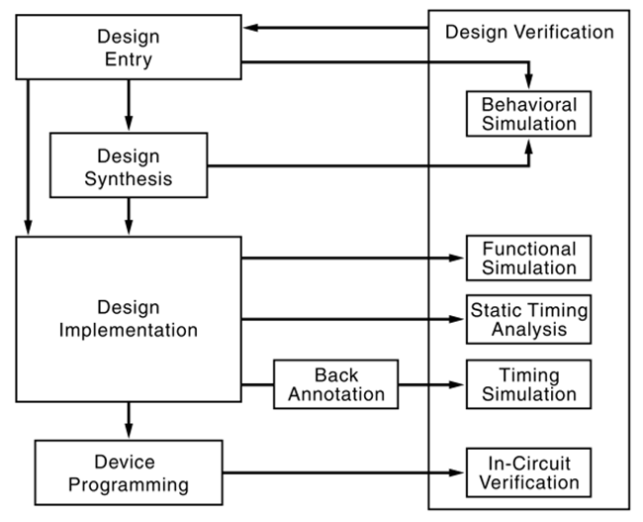
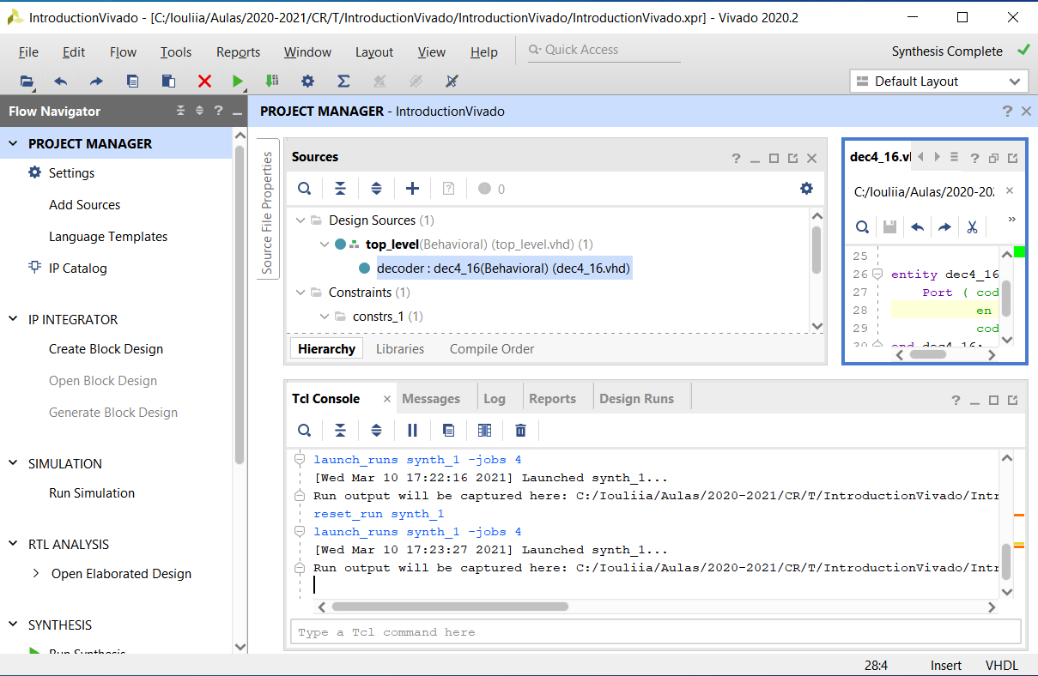
FPGA Design Flow
Design entry based on:
Hardware description languages
State diagrams
Schematic capture
C/C++ and other high level languages

Slide 16
Logic Synthesis
Results in a netlist (i.e. hardware components and their interconnections) that implement the modeled behavior and structure
Outputs
Netlist
Circuit performance and resource usage estimations

Slide 17
Implementation (Map, Place and Route)
Maps the netlist in FPGA primitives
Places the primitives in specific FPGA locations
Routes the interconnections between primitives
Outputs
FPGA configuration file
Reports with FPGA resource usage, circuit delays, power consumption, …

Slide 18
Device (FPGA) Programming
Transfers the configuration file to the FPGA
Done with a software tool and a programming cable
Most FPGAs are based on SRAM (volatile configuration)
Some devices are based on non volatile FLASH memory

Slide 19
System-on-Chip (SoC)
A SoC is a single integrated circuit integrating at least components like a processor and I/O peripherals to perform general user interface and housekeeping tasks and special hardware accelerators to handle computation-intensive operations.
A SoC integrates a processor, memory modules, I/O peripherals, and custom hardware accelerators into a single chip.
We will construct several SoCs containing a Xilinx MicroBlaze soft-core processor, memory-mapped I/O subsystem that can incorporate custom I/O cores, ....

Slide 20
Hardware-Software Co-Design
The FPGA technology allows us to tailor the processor, select only the needed I/O peripherals, create a custom I/O interface, and develop specialized hardware accelerators for computation-intensive tasks.
Both the hardware and software can be customized to match specific needs.
The methodology of exploiting the trade-offs between hardware and software and developing and integrating them concurrently is referred to as hardware-software co-design.

Slide 21
Development Flow of SoC
Partition the tasks to software routines and hardware accelerators
Design user custom cores if needed
Develop the hardware
Develop the software
Implement the hardware and software and perform testing.

Slide 22
Final Remarks
At the end of this lecture you should be able to:
Describe the main features of reconfigurable computing
Outline a typical FPGA architecture
Know difference between FPGA and PSoC
Identify the main steps of FPGA design flow
Define software-hardware co-design
To do:
Install Xilinx Vitis 2020.2

