Slide 1
Backup Plan - Presentation Undergraduate Thesis Presentation ( KI141502) RANCANG BANGUN APLIKASI WEB LELANG ONLINE (E-AUCTION) BERBASIS KERANGKA KERJA LARAVEL
PRESENTASI TUGAS AKHIR – KI141502
Ronauli Silva Natalensis Sidabukke (5113 100 142)
Supervisor :
Rully Soelaiman, S.Kom., M.Kom. Rizky Januar Akbar, S.Kom., M.Eng

Slide 2







Home

Slide 3
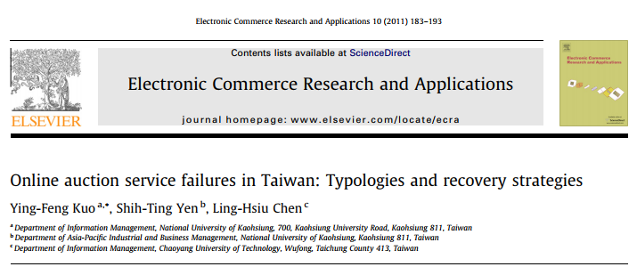
System Explanation Based from a Paper
Based on a paper researching of online auction services in Taiwan
Providing the added observed value to the online auction platform that satisfies the users

Slide 4


Analysis Section The Foresight

Slide 5

Design Section The Blueprint Details

Slide 6
Implementation Section Beyond the Dirty Coding Hands

Slide 7

Test Section Art of Keep on the Track

Slide 8

Evaluation Section Measuring the Work

Slide 9
Introductory Section
Author :
Ronauli Silva Natalensis Sidabukke - 5113100142
Undergraduate Thesis Presentation (KI141502) – Plan B
Rancang Bangun Aplikasi Web Lelang Online Berbasis Laravel
Disclaimer Applied

Slide 10



Introductory – Base Paper Analysis A Research Paper to Start
Online Auction services failures in Taiwan :
Typologies and recovery strategies
E-Commerce Research & Application 2011 pg. 183-193

Slide 11
Analysis Section
Author :
Ronauli Silva Natalensis Sidabukke - 5113100142
Undergraduate Thesis Presentation (KI141502) – Plan B
Rancang Bangun Aplikasi Web Lelang Online Berbasis Laravel
Disclaimer Applied

Slide 12
Starter Preliminary
Background
Digitizing conventional auction process
Learn from former online-auction platform failures
Problem Formulation
How to create online-auction web-app ?
Application architecture that suits the base paper suggestion?
Objectives
Building an online-auction web-app that is credibel, according to the base paper

Slide 13




Starter Limitations
A web-application based on PHP
Built upon Laravel and PostgreSQL
Didn’t cover the shipment, tracking and payment process

Slide 14
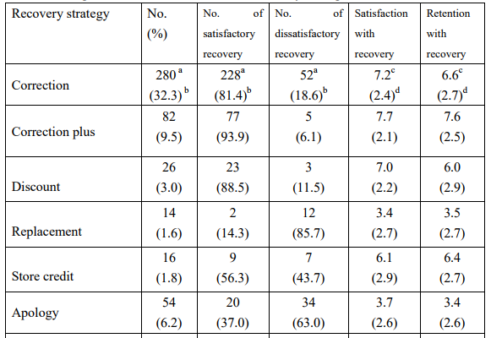
Introductory Base Paper Top 6 Suggestions
PS : The application cannot accomplish the top 2 solutions suggested because of the limitations.

Slide 15
Introductory Base Paper Top 6 Suggestions
PS : The application cannot accomplish the top 2 solutions suggested because of the limitations.
Accomplished in coupon management feature

Slide 16


Introductory – Base Paper Analysis Implemented Suggestion
Discount
Store Credit (free shipping coupon)

Slide 17
Design & Analysis – Bussiness Engineering Bussiness Engineering Aspects*
Product Manager Job Scope, to view a software purely as a product*
Function
What does it do?
Market
Who is it for?
Sales
Available price, advertising, sales channels?
Legal
licenses, legal protections shall apply to the product?
Vivek Nalur’s Presentation on Bussiness Aspects in Software Engineering, 2010 *

Slide 18
Design & Analysis – Bussiness Engineering Concerned Aspects
Aspects that we choose to concern on (based on time and speciality)
Market : Create Products that is
customers well-tailored
Legal : explained in Chap. Evaluation
Function
What does it do?
Market
Who is it for?
Sales
What price, advertising, sales channels are available?
Legal
licenses, legal protections

Slide 19


Design & Analysis – Bussiness Engineering Market, the Customers
Quick Loading
Expect to loads < 2s*
Impression
Familiarity**
Tend to leave if loads > 3s*
79% won’t return if the web’s performance is trouble*
44% will tell friends their poor experiences*
UI Design that supports Usability
Psychological Matters for Credibility (ex : Placebo effect of Lock icon in Checkout Page)
Need For Speed – Fast Loading the key to Satisfying UX ( Usabilla Blog, September 2014)*
E-commerce: the role of familiarity and trust (David Geven, Omega 28 (2000) p. 725-737)**
UI / UX / CX / Usability; the difference and why it matters ( Rick de Groot, LinkedIn 2015) ***
15 ways psychology can boost ecommerce sales (ClickZ Newsfeed, 2016)****

Slide 20

Design & Analysis Technical Analysis (1)
Performance
Page & Assets Size Only 10-20% of response time taken to get HTML 80-90% goes to loading assets (img, js, css, etc) Tackling : Caching, Service Worker (vue.js)
High Performance Websites [2007] ( Steve Sounders , O’Reilly Media – p. 22) *
StackOverflow Discussions **
**

Slide 21

Design & Analysis Technical Analysis (2)
Software Flexibility
(to changes)
Database Growth Impacts to Performance Performance usually bottlenecks on DB tier * Web Performances fall when DB reaches critical size ** Tackling : Good & Future-visioned software design
Requirement & Feature Changes Frequency Maintainability – Programmer-friendly program Flexibility – Not refactor much if changes occur Tackling : Good & Future-visioned software design
StackOverflow Discussions *
eCommerce Web performance & Speed ( Alex Pinto, Yottaa Blog Sept 11, 2015 ) **

Slide 22
Design Section
Author :
Ronauli Silva Natalensis Sidabukke - 5113100142
Undergraduate Thesis Presentation (KI141502) – Plan B
Rancang Bangun Aplikasi Web Lelang Online Berbasis Laravel
Disclaimer Applied

Slide 23
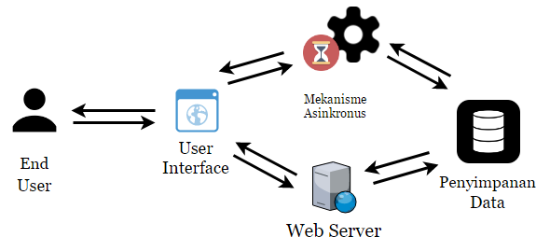
Design & Analysis Application Architecture

Slide 24
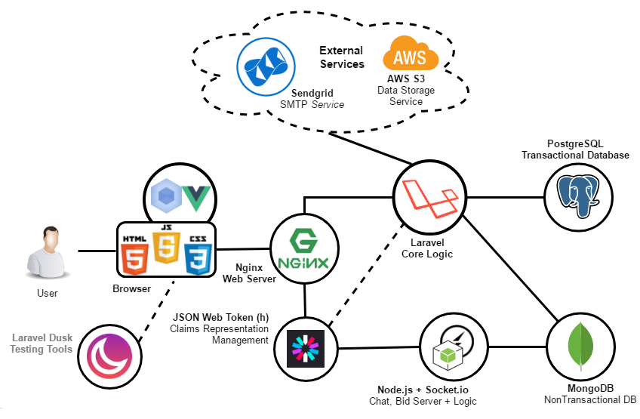
Design & Analysis Technology Choosing

Slide 25
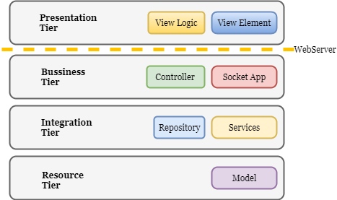
The System - Explanation Tiers
Application consists of 4 layers, each of them own their responsibility. p

Slide 26
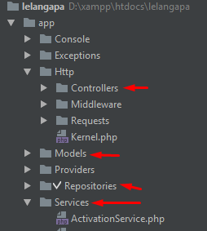
The System - Explanation Tiers
Application consists of 4 layers, each of them own their responsibility. p

Slide 27
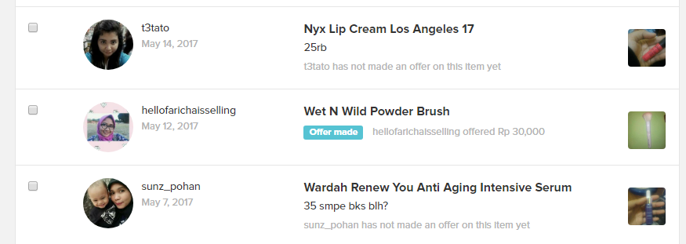
Design Adaptation

Slide 28
Implementation Section
Author :
Ronauli Silva Natalensis Sidabukke - 5113100142
Undergraduate Thesis Presentation (KI141502) – Plan B
Rancang Bangun Aplikasi Web Lelang Online Berbasis Laravel
Disclaimer Applied

Slide 29

Implementation Live Application
Can be accessed from :

Slide 30
Implementation Notable Points
Service Worker
(Sharing worloads between server and client)
Familiarity ( compared to Tokopedia and Carousell )
UX ( components placement & usability)
View’s Logic Modularity

Slide 31
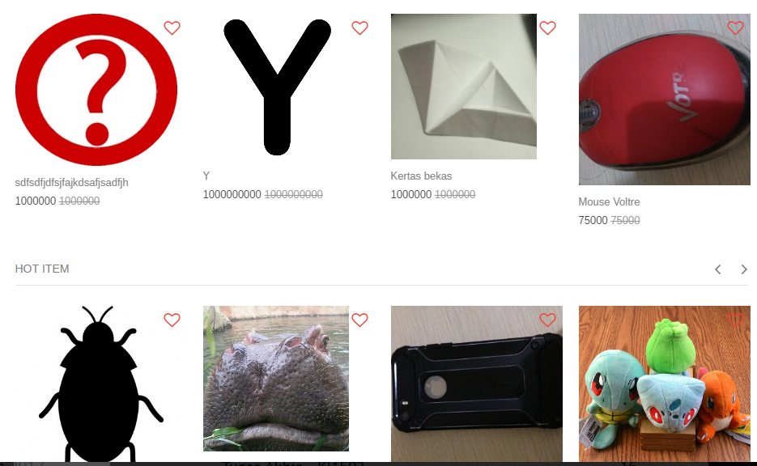
Implementation – Service Worker How the Service Worker Works
Split a big job into small job chunks
Example : Loading Images

Slide 32

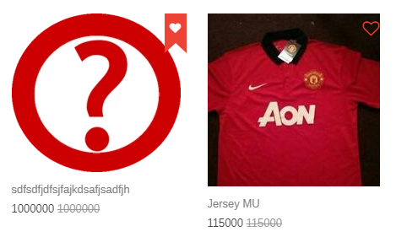
Implementation – UX View’s Logic Scripts Modularity(1)
Actually this snap consists of 2 elements (the favorite element)
*Implemented using Vue and webpack

Slide 33
Implementation – UX View’s Logic Scripts Modularity(2)
Actually this snap consists of 2 elements (the item image element)
*Implemented using Vue, compiled with webpack

Slide 34
Implementation – UX View’s Logic Scripts Modularity(3)
We could just “include” and “uninclude” scripts
... based on each page needs.

Slide 35
Implementation – UX View’s Logic Scripts Modularity(3)
In author’s humble opinion, here are the benefits :
Effectiveness on code coverage increased Making sure that the page is only including the needed script – page loads faster
Clean Code Less duplicated code, easier to change features (in the future) since it is all integrated
Compiling based on needs We could configure the compiler to minify or obfuscate the code, based on needs.

Slide 36
Implementation – Service Worker Page Loading Logic
Initiating
Fetching HTML and
Logic Script
2. Fetching Image URLs
3. Replace DOM (iimage URL)
To the New One

Slide 37
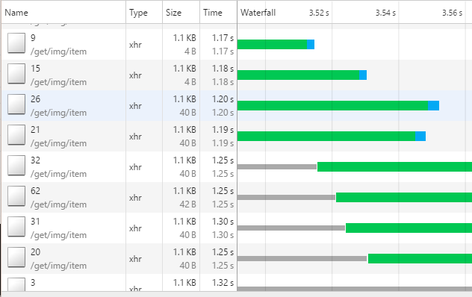
Implementation – Service Worker Element Inspections
Getting each item’s image url

Slide 38
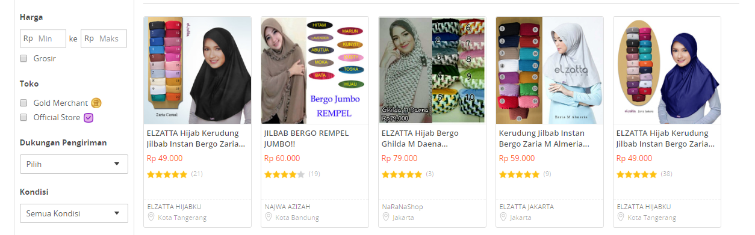
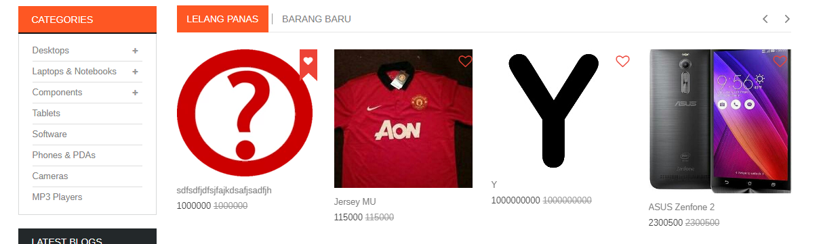
Implementation – Familiarity Comparison to another Platform
Adapting
the Gigantous
E-Commerce :
Tokopedia Layouting
(the downward is the thesis’s layout, upward is Tokopedia’s)

Slide 39



Implementation – UX Usability Example: “Search” placement

Slide 40
Test & Evaluation Section
Author :
Ronauli Silva Natalensis Sidabukke - 5113100142
Undergraduate Thesis Presentation (KI141502) – Plan B
Rancang Bangun Aplikasi Web Lelang Online Berbasis Laravel
Disclaimer Applied

Slide 41
Testing & Evaluation Preliminary – Legal’s Aspect Obstacles
Vendu Reglement
Must involve a legally authorized officer from Bea Cukai Government’s Department to verify ‘keabsahan’ status of items
UU Perlindungan Konsumen
Pasal 4 and Pasal 7
Conclusion
Cannot do a proper end-user test
Objected with KUHP(page

Slide 42
Functionality Testing

Slide 43
Testing & Evaluation – Functionality Test
Functionality Test
Scoreboard:
Passed : 14/17
(Once passed) : 1 Reviews
Unfinished : 1 feature (searching)
Buggy features:
Automated mail : Expired free account, have to reconfigure all the settings on new account

Slide 44
Testing & Evaluation – Functionality Test
Recaps
Misconception between Developers
On Management Review Function
Creating duplicate tables & mechanism for same feature
Premature Optimization
Want to implement service worker in Vue for better performance
Learning gaps for vue is actually high, cannot be finished

Slide 45
Testing & Evaluation Another Platform (balelang.com)
Parameter | R1 | R2 | R3 | R4 | R5 | R6 | R7 | R8 | R9 | R10 | Average
Design & Web Impression | 2 | 4 | 4 | 2 | 4 | 4 | 4 | 3 | 2 | 4 | 3,3
Consistency & Descriptiveness | 3 | 4 | 3 | 4 | 3 | 3 | 3 | 4 | 4 | 4 | 3,5
Easiness | 1 | 4 | 3 | 3 | 3 | 4 | 3 | 4 | 3 | 3 | 3,1
Clear Error Message | 3 | 4 | 4 | 3 | 4 | 4 | 3 | 4 | 3 | 5 | 3,7
Clear Process Status | 2 | 3 | 4 | 4 | 3 | 3 | 4 | 3 | 4 | 3 | 3,3
Performance | 4 | 3 | 4 | 4 | 4 | 4 | 3 | 4 | 3 | 4 | 3,7
Rating on average | 3 | 4 | 5 | 3 | 4 | 3 | 4 | 4 | 3 | 4 | 3,7
Would recommend this to friend? | 2 | 4 | 4 | 4 | 3 | 3 | 3 | 3 | 4 | 4 | 3,4

Slide 46
Testing & Evaluation Lelangapa Platform (lelangapa.com)
Parameter | R1 | R2 | R3 | R4 | R5 | R6 | R7 | R8 | R9 | R10 | Average
Design & Web Impression | 4 | 5 | 4 | 4 | 4 | 4 | 5 | 4 | 4 | 3 | 4,1
Consistency & Descriptiveness | 4 | 5 | 5 | 3 | 4 | 4 | 4 | 4 | 5 | 4 | 4,2
Easiness | 3 | 4 | 4 | 4 | 5 | 3 | 4 | 4 | 4 | 4 | 3,9
Clear Error Message | 4 | 4 | 5 | 4 | 4 | 4 | 4 | 3 | 4 | 3 | 3,9
Clear Process Status | 4 | 3 | 4 | 4 | 5 | 4 | 4 | 4 | 4 | 4 | 4
Performance | 3 | 4 | 5 | 3 | 4 | 3 | 5 | 4 | 3 | 4 | 3,8
Rating on average | 4 | 4 | 5 | 4 | 5 | 4 | 4 | 4 | 4 | 5 | 4,3
Would recommend this to friend? | 4 | 5 | 4 | 4 | 4 | 4 | 5 | 4 | 5 | 4 | 4,3

Slide 47
Testing & Evaluation – User Experience Comparison
Parameters | Other App’s Average Score | Lelangapa App’s Average Score | Difference (in %)
Design & Web Impression | 3,3 | 4,1 | ⬆ 20%
Consistency & Descriptiveness | 3,5 | 4,2 | ⬆ 17%
Easiness | 3,1 | 3,9 | ⬆ 21%
Clear Error Message | 3,7 | 3,9 | ⬆ 5%
Clear Process Status | 3,3 | 4 | ⬆ 18%
Performance | 3,7 | 3,8 | ⬆ 3%
Rating on average | 3,7 | 4,3 | ⬆ 14%
Would recommend this to friend? | 3,4 | 4,0
Total Average |  |  | ⬆ 15%

Slide 48
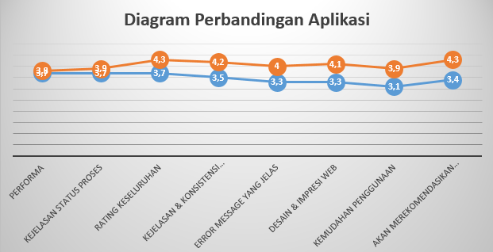
Testing & Evaluation - User Experience Comparison Visualization
Slight difference better than another platforms, but it does slightly better

Slide 49
Testing & Evaluation – Maintainability Assesment Questionnaire Design
KPI Based on A Software Maintainability Evaluation Methodology
Peercy, David E. IEEE TRANSACTIONS ON SOFTWARE ENGINEERING, VOL. SE-7, NO. 4, JULY 1981
Defined on papers that:
Maintainability lies on 2 fundamentals Documentation(40%) & Source Code(60%)
Can be measured through 5 parameters beside
Measured in 5-scale ( Completely Agree to Comp. Disagree )
Evaluator agreement goal is 0.8
Parameter
Modularity
Descriptiveness
Consistency
Simplicity
Trackability

Slide 50
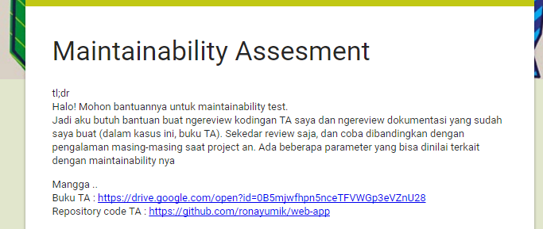
Testing & Evaluation – Maintainability Assesment Survey Methodologies
KPI Based on A Software Maintainability Evaluation Methodology
Peercy, David E. IEEE TRANSACTIONS ON SOFTWARE ENGINEERING, VOL. SE-7, NO. 4, JULY 1981
Conducted online (via google forms)
Reviewing code via github and reviewing documentation via undergraduate thesis book (buku TA)

Slide 51
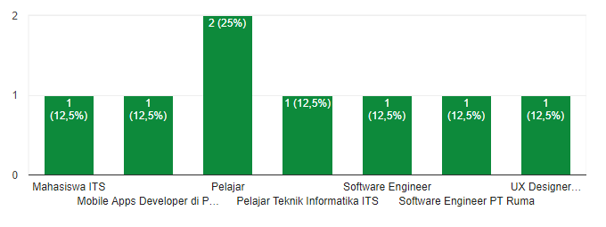
Testing & Evaluation – Maintainability Assesment Respondent’s Statistics (1)
8 respondents, all are already experienced medium to high tensity projects , some of them already works on IT Companies (all of them are TC’s alumnaes)

Slide 52
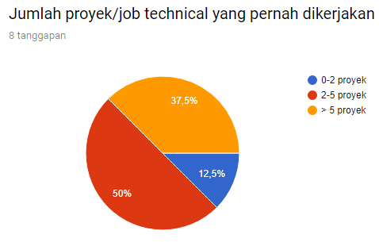
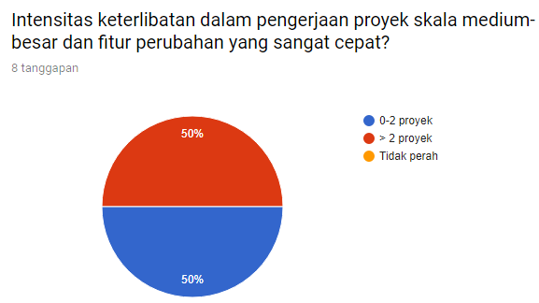
Testing & Evaluation – Maintainability Assesment Respondent’s Statistics (2)

Slide 53
Testing & Evaluation – Maintainability Assesment Survey’s Result
Respondents | Source Code |  |  |  |  | Documentation |  |  |  |  | Average
Responden 1 | 4,8 | 4,8 | 4,8 | 4,8 | 4,8 | 3,6 | 3,6 | 3,6 | 3,6 | 3,6 | 4,2
Responden 2 | 6 | 4,8 | 4,8 | 6 | 4,8 | 4,8 | 4,8 | 4,8 | 3,6 | 4,8 | 4,92
Responden 3 | 3,6 | 2,4 | 3,6 | 3,6 | 2,4 | 4,8 | 4,8 | 4,8 | 4,8 | 4,8 | 3,96
Responden 4 | 6 | 6 | 6 | 6 | 6 | 6 | 6 | 6 | 6 | 6 | 6
Responden 5 | 4,8 | 6 | 6 | 3,6 | 3,6 | 4,8 | 6 | 6 | 3,6 | 3,6 | 4,8
Responden 6 | 4,8 | 4,8 | 3,6 | 2,4 | 2,4 | 3,6 | 4,8 | 3,6 | 3,6 | 2,4 | 3,6
Responden 7 | 4,8 | 4,8 | 3,6 | 4,8 | 4,8 | 4,8 | 4,8 | 3,6 | 4,8 | 4,8 | 4,56
Responden 8 | 4,8 | 6 | 4,8 | 4,8 | 4,8 | 4,8 | 4,8 | 4,8 | 4,8 | 4,8 | 4,92
Average | 4,95 | 4,95 | 4,65 | 4,5 | 4,2 | 4,65 | 4,95 | 4,65 | 4,35 | 4,35 | 4,62

Slide 54
Testing & Evaluation – Maintainability Assesment The Result
KPI Based on A Software Maintainability Evaluation Methodology
Peercy, David E. IEEE TRANSACTIONS ON SOFTWARE ENGINEERING, VOL. SE-7, NO. 4, JULY 1981
Parameters | Source Code | Documentation | Average
Modularity | 83% | 83% | 83%
Descriptiveness | 83% | 78% | 80%
Consistency | 78% | 73% | 75%
Simplicity | 75% | 73% | 74%
Trackability | 75% | 73% | 0,77
Average | 79% | 76% | 77%
Weights | 60% | 40%
Final Score | 77% (96% accomplished to target score)

Slide 55
Testing & Evaluation – Speed Test
Speed Test Insights
Google Browser Developer Tools record the time log based on this segmentation:
DOM Loading
The time html page returned from web server
Scripting
Time taken to fetch scripts and assets
Rendering
Rendering all content, scripts and assets to browser page

Slide 56
Testing & Evaluation – Speed Test
The Result
Average Loading Time : 2,9 ms
Back-end is fast enough, but scripting is goddamit slow! Scripting takes 75% of the loading time
Slowest loading is on item show page Main culprit : Uncompressed Image

Slide 57
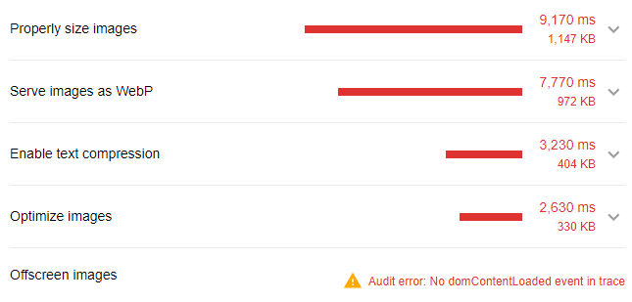
Testing & Evaluation – Speed Test
Result Analysis
Opportunity analysis from Lighthouse on the slowest page

Slide 58
Testing & Evaluation Evaluation’s Summary
Test | Score | Conclusion
Functionality | 14/17 | 82,3 % finished
Speed | 3.2 s | Exceeds 6% Not too bad either
Maintainability | 77% | 96% accomplished
User Experience | +15% | Good

Slide 59

Finale
Conclusions
Suggestions
Future Enchancements

Slide 60

Finale Conclusions
Software Design Initiation is really important for a flexible and long-lasting software (which is really needed)
Bussiness aspects is important to create an e-commerce related application, if we want to create a fully-functioned app.

Slide 61




Finale Suggestions
JWT Expiration
Take care of JWT Token Expiration & Refresh Token Mechanism and its coordination to Back-end server
Legal
Involvements
Involve a legal financial authority in the bussiness process design & monitoring of online auction app.

Slide 62
Finale Further Enchancements
Image Compression (often called Image Optimization) in optimizing a website’s performance
User Experience’s Impact to Business Matter Delivery
How the Google Search Delay Impacts on Its Revenue
Analyzing the eye movements to the information-eyecatchiness to deliver key values to the customers
Early Fraud Detection from Bid Activities
Credit Scoring from Customer Purchasement & Transaction’s Pattern
Early Fraud Detection & Succesful Transaction Pattern Rate using Machine Learning Methods

Slide 63
Thank you.
This is the end of this presentation.

