Slide 1

Clustering European Cities
IBM – Data Science – Capstone Project
Marta Castiella Fernández

Slide 2
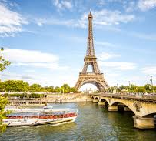
1. Business Problem
Cluster Most Important European Cities
People Movement
Useful to explain or predict Covid 19 spread

Slide 3
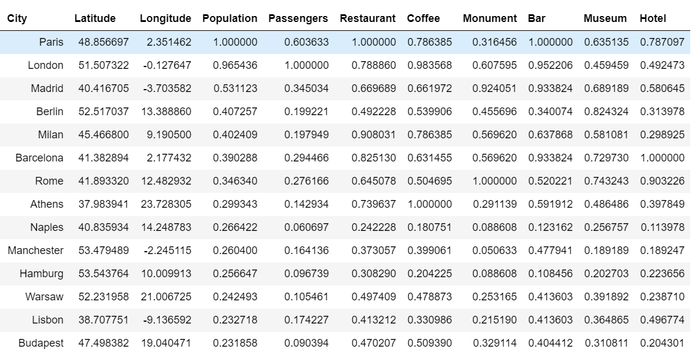
2. Data

Slide 4
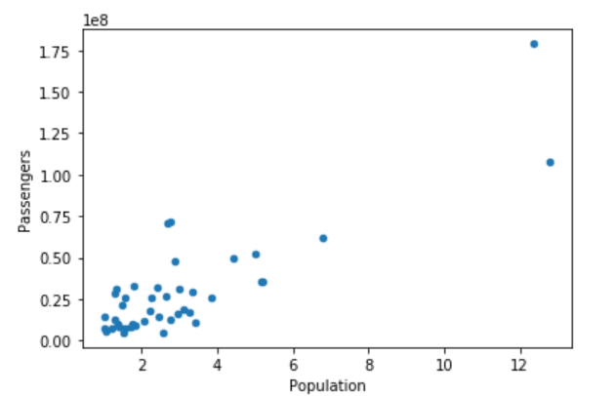
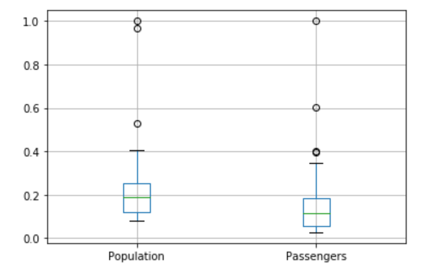
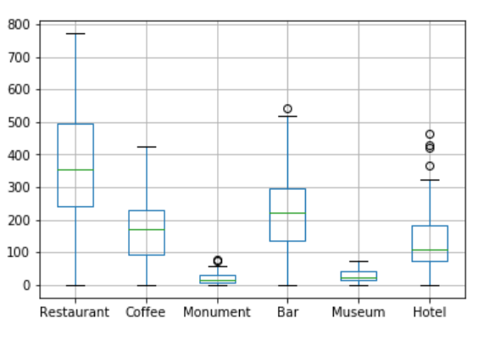
2. Data

Slide 5
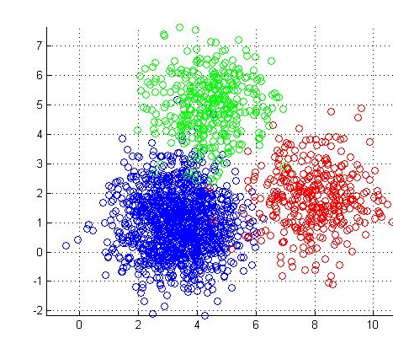
4. Methodology
K Means
K = 3

Slide 6
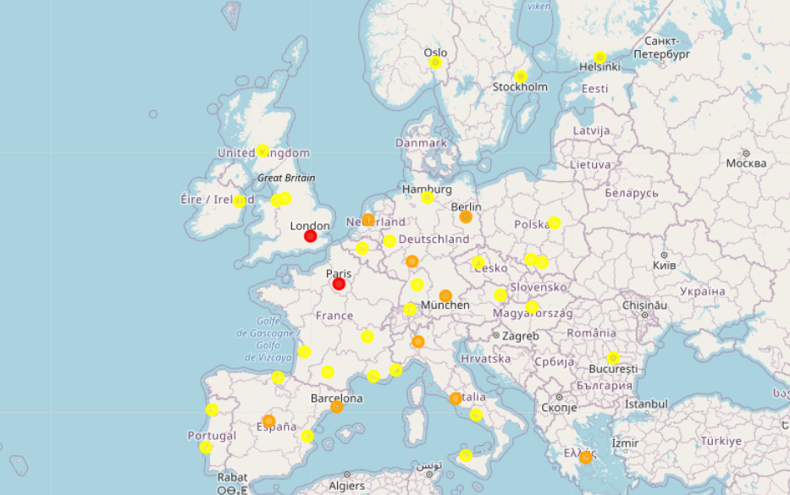
5. Results

Slide 7
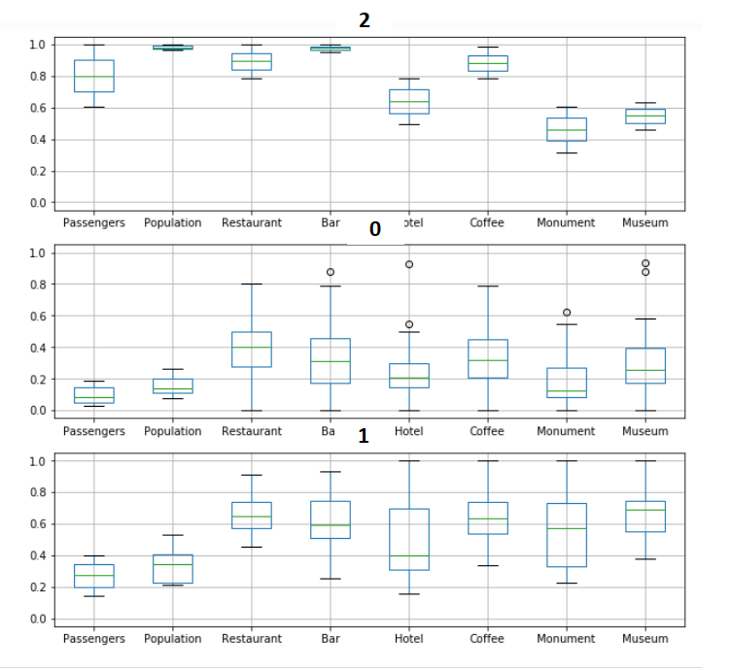
6. Discussion

Slide 8

6. Conclusions & Future Lines
Cluster Most Important European Cities – People Movement
Venues → More Accurate
Try Models

