Slide 1


Single-threaded Event Loop

Slide 2

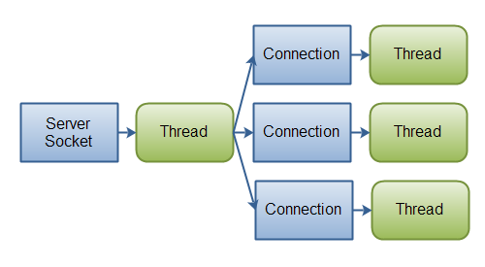
Blocking IO
Thread-based concurrency
Thread is blocked waiting for data
https://jenkov.com/tutorials/java-nio/nio-vs-io.html

Slide 3
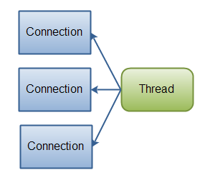
Non-Blocking IO
Event-base concurrency
Readiness API
Single thread possible
while running:
can_read, can_write = wait_for_readiness() # blocks!
for fd in can_read:
data = read_nb(fd) # non-blocking, only consume from the buffer
handle_data(fd, data) # application logic without IO
for fd in can_write:
data = pending_data(fd) # produced by the application
n = write_nb(fd, data) # non-blocking, only append to the buffer
data_written(fd, n) # n <= len(data), limited by the available space
https://jenkov.com/tutorials/java-nio/nio-vs-io.html

Slide 4


Java NIO

Slide 5
IO vs NIO
IO | NIO
Streams | Buffer
Socket, ServerSocket | Channel (SocketChannel, ServerSocketChannel)
 | Readiness Selection
Some text

Slide 6
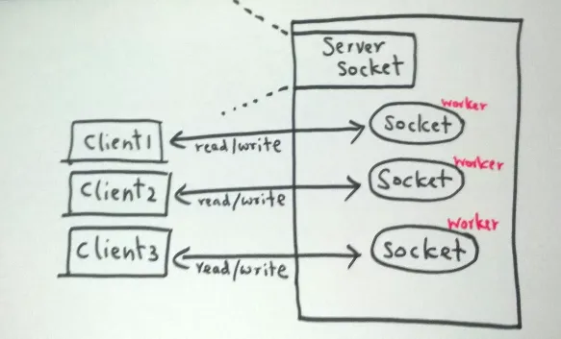
Blocking IO
https://medium.com/coderscorner/tale-of-client-server-and-socket-a6ef54a74763

Slide 7
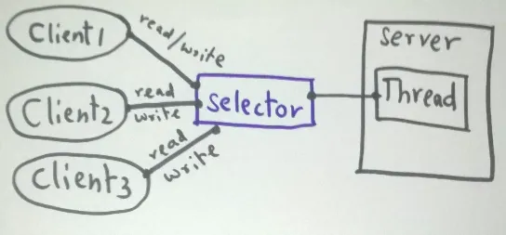
NIO
https://medium.com/coderscorner/tale-of-client-server-and-socket-a6ef54a74763

Slide 8
NIO cheat sheet
ServerSocketChannel serverChannel = ServerSocketChannel.open();
serverChannel.bind(new InetSocketAddress(8080));
serverChannel.configureBlocking(false);
Selector selector = Selector.open();
serverChannel.register(selector, SelectionKey.OP_ACCEPT);
while (true) {
selector.select();
for (SelectionKey key : selector.selectedKeys()) {
if (key.isAcceptable()) {
SocketChannel clientChannel = serverChannel.accept();
clientChannel.configureBlocking(false);
clientChannel.register(selector, SelectionKey.OP_READ);
} else if (key.isReadable()) {
SocketChannel clientChannel = (SocketChannel) key.channel();
ByteBuffer buffer = ByteBuffer.allocate(256);
clientChannel.read(buffer);
buffer.flip();
clientChannel.write(buffer);
}
}
}
DON’T USE THE CODE AS IS

Slide 9
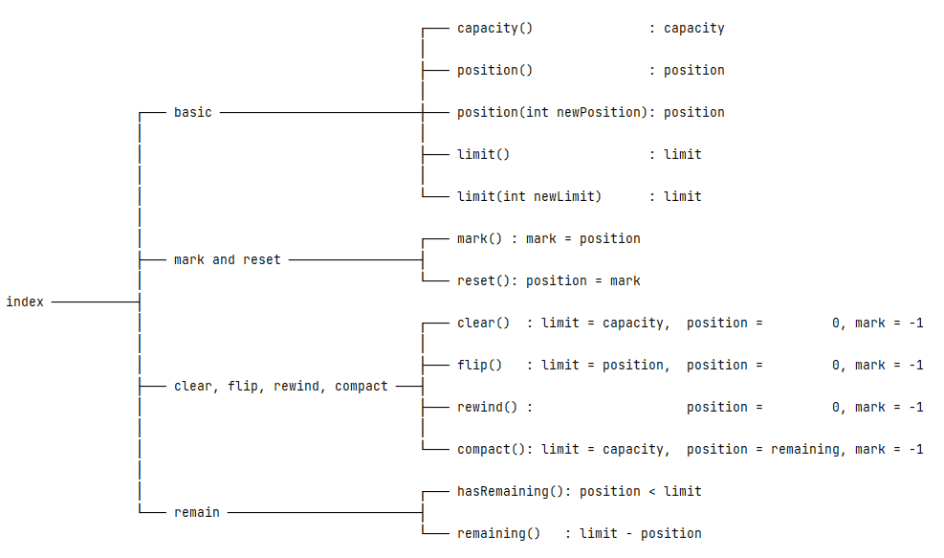
Buffer cheatsheet
Capacity: the maximum number of data elements the buffer can hold
Limit: an index to stop read or write
Position: the current index to read or write
Mark: a remembered position
mark <= position <= limit <= capacity
https://www.baeldung.com/java-bytebuffer

Slide 10
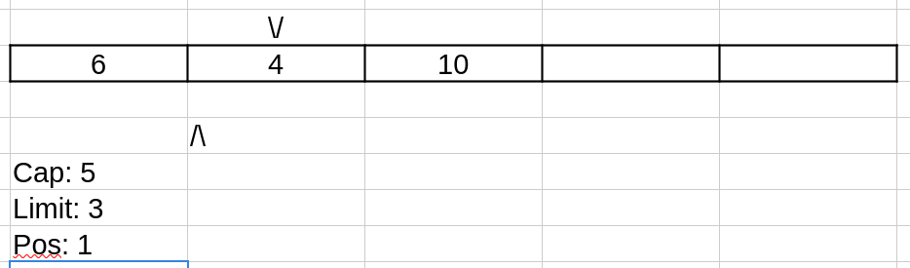
Buffer Example

Slide 11

Thank you
Author: Kostiantyn Synytsia
My LinkedIn: Link to your LI
Date: November 2024
Join Codeus community in Discord
Join Codeus community in LinkedIn

