Slide 1
EDA
US National Flight Delays January-June 2024

Slide 2
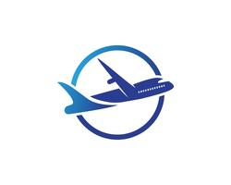
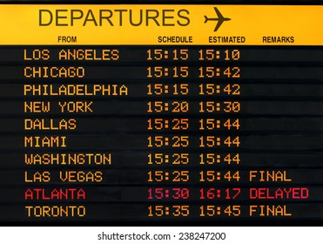
CONTEXT
One of the biggest frustrations these days is flight delays at the airports. Not knowing how long the delay is, the reason for the delay, there are more delays on some days than others, etc.This is valuable information today for when we go on vacation, or if we take flights often for work.In the following analysis we will try to answer these questions with information on US domestic flights between January-June 2024

Slide 3
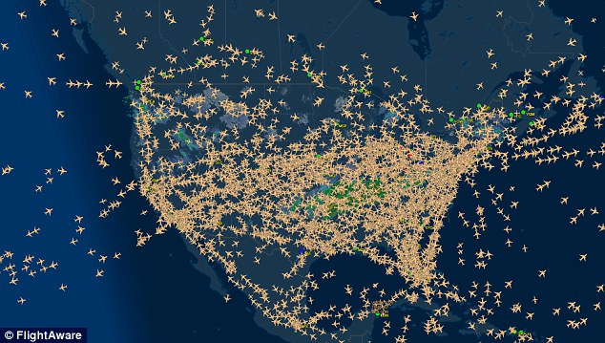
3,461,319 National flights for the period Jan-Jun 2024
336 Airports
16 Airlines

Slide 4


HYPOTESIS
HYPOTESIS
Between Friday and Sunday, as is the beginning of the weekend, there should supposedly be a greater number of flights.
HYPOTESIS
June and January should be the months with higher air traffic due to seasonality, while February should be the month with lowest air traffic as there is no festive
HYPOTESIS
The most populated cities in the US are New York, Los Angeles and Chicago in that order. The cities with the greatest number of flights should be those 3.
.
ANALYSIS
On the analyzed data we can see that Tuesday and Friday are the highest days in terms of traffic air, while Saturday is the lowest.
This discrepancy could be due to various factors, such as increased prices during the weekend or the preference for traveling on weekdays.
ANALYSIS
Base on the data , the month with higher number of flights is June, and February is the month with the lowest flights
ANALYSIS
According to the data, top 3 cities with the top three cities with the highest number of flights are Chicago, Atlanta, and Dallas. In contrast, the cities with the lowest number of flights are Moab, Gustavus, and Dillingham.
CONCLUSION:
The analysis confirms that June has the highest number of flights and February shows the lowest number
CONCLUSION:
The hypothesis that the cities with the highest number of flights correspond to the most populated cities in the US is not supported by the data. Instead, other factors such as airport hub status, regional connectivity, and airline operations may play a more critical role in determining flight traffic.
CONCLUSION:
The hypothesis that the weekend has the highest number of flights does not hold true according to the analyzed data.
NEXT STEPS
The shorter duration of February (28 or 29 days) compared to other months likely contributes to its lower flight count. To make a fair comparison, future analyses should standardize the number of days across months, such as comparing flight numbers based on the first 28 days of each month. This approach would provide a more accurate assessment of seasonal trends and ensure that February’s shorter length does not skew the results.
NEXT STEPS
We could analyze further into other factors, such as pricing and travel preferences, and see how might influence flight patterns more significantly

Slide 5
HYPOTESIS
HYPOTESIS
Delays are more frequent on the days with higher air
.
HYPOTESIS
By the end of the day, flights leave with a higher number of minutes of delay, as delays from other flights are accumulated
.
ANALYSIS
The days with the highest number of delays are Friday, Sunday and Thursday, with Tuesday being the day of the week with the fewest delays. This data is correlated to the level of flight volume on those days.
ANALYSIS
According to the data, there is a trend towards longer delays as the day progresses. Arrival delays are shorter for flights leaving early and longer for flights leaving later.
.
New projects/ongoing:
The data supports the hypothesis that delays increase as the day progresses.
CONCLUSION:
The analysis confirms the hypothesis that delays are more frequent on days with higher air traffic. Days like Friday, Sunday, and Thursday, which have higher flight volumes, also report the most delays. This suggests a direct correlation between the number of flights and the frequency of delays.

Slide 6
HYPOTESIS
HYPOTESIS
More than 50% of the flights should have less than 30min. Only exceptional cases such weather delays, nas delay, carrier delay can cause a delay higher than 30min
.
HYPOTESIS
Each airline has different operational or assignment processes. Therefore, there will be companies that have a higher volume of delays than others.
.
ANALYSIS
Data shows that 79% of flights departure have had less than 15 min delay on the departure, while 21% more than 15 in delay. On the arrival delays , we see similar numbers, being 78% for less than 15 min delay and 22% of the flight with more than 15 min delay on the arrival.
ANALYSIS
According to the data, airlines with the codes F9 (Frontier Airlines), AA(American Airlines), B6(JetBlue Airlines), are the top 3 airlines with higher number of arrival delays.
On the other hand, YX(Republic Airlines), arrives in advance.
New projects/ongoing:
The analysis confirms that airlines have varying levels of delays, influenced by their unique operational processes
CONCLUSION:
The hypothesis is validated, as the data shows that a significant majority of flights experience delays of less than 15 minutes. This indicates that severe delays are not common and usually stem from exceptional factors like weather, NAS, or carrier-related issues. The results demonstrate that the overall punctuality of flights is relatively high, with only a small percentage of flights experiencing significant delays.

