Slide 1

Using Cocoon for
Enterprise Web Applications
XML Web Development Framework
Lars Huttar / Ken Prettol
Nov. 19, 2004
CTC04

Slide 2
Application:
Language Group Information Center
Our business need:
  Corp. Comm. priority project to share lang/project info within the “family”
  Make appropriate enterprise data accessible on Intranet
  Integrate data from diverse sources
    Ethnologue, WNN, LPD, LAM, PPS…
  Consistent web presentation
  Make results available as web service
  http://apps.sil.org/lgic/ (SIL Intranet)
Notes:
Enterprise data was coming from different DBs, e.g. Oracle and SQLServer.
Data from each DB is keyed off Ethnologue codes.
Needed to observe strict sensitivity constraints.
Web service: Needed to make results available not only as HTML, but also as XML so that other WO’s can format it their own way and deliver it to their Communications staff.
We chose to implement LGIC using Cocoon.
We’re going to come back to LGIC and demo it. But first, more about Cocoon itself.

Slide 3

What is Cocoon?
XML Web Development Framework
Top-level Apache project
Component-pipeline architecture
Written in Java
Open standards: XML and XSLT
Open source; active community
Supports many data sources and output formats
Notes:
XML Web Development Framework – not a CMS; a CMS can (and has been) built on top of Cocoon
Apache foundation. Uses Apache components for XML parser and XSLT processor
Architecture: components, connected by pipelines
Add your own custom components by extending Java classes
There is also a healthy set of provided components; we haven’t had to write any of our own yet, so Java programming expertise is not required. However you may occasionally need some Java help with debugging library / classpath issues.

Slide 4
Seeing heavy use by real big orgs
A global 100 healthcare company
The Swiss national TV network
A 3000-employee travel agent
MyTV, a leading digital terrestrial tech provider
A top 100 world bank
RZB Group, the largest Austrian bank
  A number of local gov’t customers in Belgium
  The Swiss Exchange
  VNU bus. publications, the largest tech. publ. in the UK
  Vodafone Germany
  One of the largest brokerage firms in the world
Numbers like 50 requests per second continuous average and 2 million page impressions a day were mentioned in these presentations.
-Gianugo Rabellino
at GT2004
Notes:
RZB Group, the largest Austrian bank (which with the previous one means at least 2% of the top 100 banks are using Cocoon...)
Large scalability is due to SAX processing - can process huge documents without keeping the whole thing in memory at once.

Slide 5
Apache Cocoon Background
Origins
  Started by the Italian student Stefano Mazzocchi
  Frustrated by the limitations of HTML
  Wanted to use the emerging technologies of XML and XSL to build a more flexible, dynamic way of publishing information to the web
Today
  Now one of the most important Apache projects
  Two other top-level Apache projects, Lenya (CMS) and Forrest (Doc’n frwk), are built on Cocoon
  Thousands registered on all mailing lists
  Includes major companies such as HP, IBM
- Matthew Langham, S&N

Slide 6
Cocoon Advantages
Excels in content transformation
Powerful application framework
Separation of Concerns
  Content, presentation, logic (MVC)
Extensible
Design app. “w/o programming”
Notes:
Content transformation: deliver your content in many formats (HTML, PDF, etc.)
Application framework: alternative to Java Struts, or Zope. Cocoon can be used to implement the model-view-controller paradigm in a tiered architecture.
Separation of concerns: content, logic, presentation/style. This means you can divide responsibility and each developer doesn’t have to be an expert in every part.
Plugging components together via pipelines allows application design without “programming”. Sort of.

Slide 7
Caveats
Cocoon is evolving rapidly.
  Techniques you use may be deprecated later.
  Docs don’t always keep up with new features.
Many components available.
  It can be hard to find the one that does what you need if it’s not one of the most common.
For the above problems, the mailing list provides pretty good help.
Default XSLT processor is a little buggy.
Notes:
Developing rapidly.
Techniques you use may be deprecated. (But you can keep using the old version of Cocoon as long as you want…)
Docs don’t always keep up with dev.
But the developers hang out on the Cocoon user mailing list and are quite helpful about answering questions.
For both problems, the mailing list provides good help.
But Cocoon admittedly has a ways to go as far as getting its documentation into a systematic, consistent state.
Xalan, the default XSLT processor, seems to me buggier than some other XSLT processors, and doesn’t give as good error diagnostics. However you can use Saxon or any other XSLT processor if you want to.
Fortunately, Xalan bugs seem to be stylesheet-related rather than data-dependent, so if it works once it will keep working for you.

Slide 8
How Cocoon Works:
Request Processing
http://apps.sil.org/lgic/profile?code=DUG
Client
Cocoon
Cocoon Sitemap
Cocoon Pipeline
http request
Sequence of Interactions
Map start of URL to sitemap
Map rest of URL to pipeline
http response
Notes:
The Cocoon top-level sitemap sees the green part, “lgic/”, strips it off, and sends the rest to the lgic sitemap.

Slide 9
How Cocoon Works:
A Pipeline
A pipeline starts with a generator (data source), has any number of transformers, and ends with a serializer.
http request
File Generator
SAX
XSLT Transformer
SAX
HTML Serializer
result
Cocoon pipeline
Notes:
Again, a pipeline is a set of components, linked together.
SAX events are an abstract way of representing XML that allows components to transmit nodes of a parsed document so they can be processed without the whole document being in memory.
A generator is what gathers the data and converts it into SAX events Cocoon can send down the pipeline. E.g. File generator reads a file; db query engine (XSP page), directory, HTMLTidy…
Our previous slide shows an example pipeline definition in a sitemap.

Slide 10
How Cocoon Works:
A Sitemap
A sitemap defines pipelines and maps HTTP requests to them via match patterns.
Sitemap fragment:
<map:pipeline>
<map:match pattern="*.html">
<map:generate type="file" src="docs/samples/{1}-page.xml"/>
<map:transform type="xslt" src="stylesheets/page/simple-page2html.xsl"/>
<map:serialize type="html"/>
</map:match>
<map:match pattern=“*/inspect-*">
<map:generate type=“serverpages" src=“queries/{2}.xsp”>
<map:parameter name=“role” value=“{1}” />
</map:generate>
<map:transform type="xslt" src="stylesheets/inspect2html.xsl"/>
<map:serialize type="html"/>
</map:match>
</map:pipeline>
Notes:
As you can see, a sitemap is an XML file.
Go through example
src attributes are URLs/file system paths
Note the pattern matching: image/**.png
** matches any string
* matches any string without a slash in it
{1} substitutes the value of the first match from the pattern.
This pattern-matching mechanism means your URL space doesn’t have to match your file space. You can define a mapping between them pretty intuitively.
By the way your file generator src can be a URL, including a URL to another Cocoon pipeline (use cocoon:/ pseudoprotocol)

Slide 11
Available Components
Generators (input):
  File
  Directory
  XSP (XML Server Pages – dynamic page templates; supports SQL queries)
Serializers (output):
  HTML
  Text
  PDF (via FOP)
  SVGtoPNG (via Batik)
Notes:
There are many others.

Slide 12
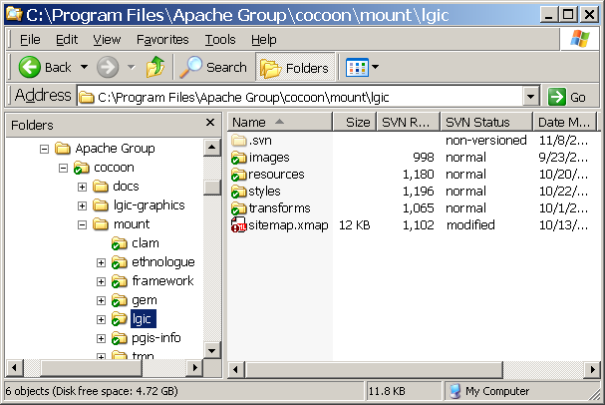
Cocoon application files
Notes:
Top-level “cocoon” folder
Contains top-level sitemap, and “mount” folder
Contains folder for each Cocoon app
Contains sitemap, stylesheets, images, and all other application resources
Those little green and red icons as many of you know are from TortoiseSVN (Subversion client).
If I go into a browser and type http://host/lgic/profile?code=DUG, the Cocoon top-level sitemap mounts cocoon/mount/lgic/sitemap.xmap and hands it the URL “profile?code=DUG”. From there on the LGIC Cocoon application has control.

Slide 13
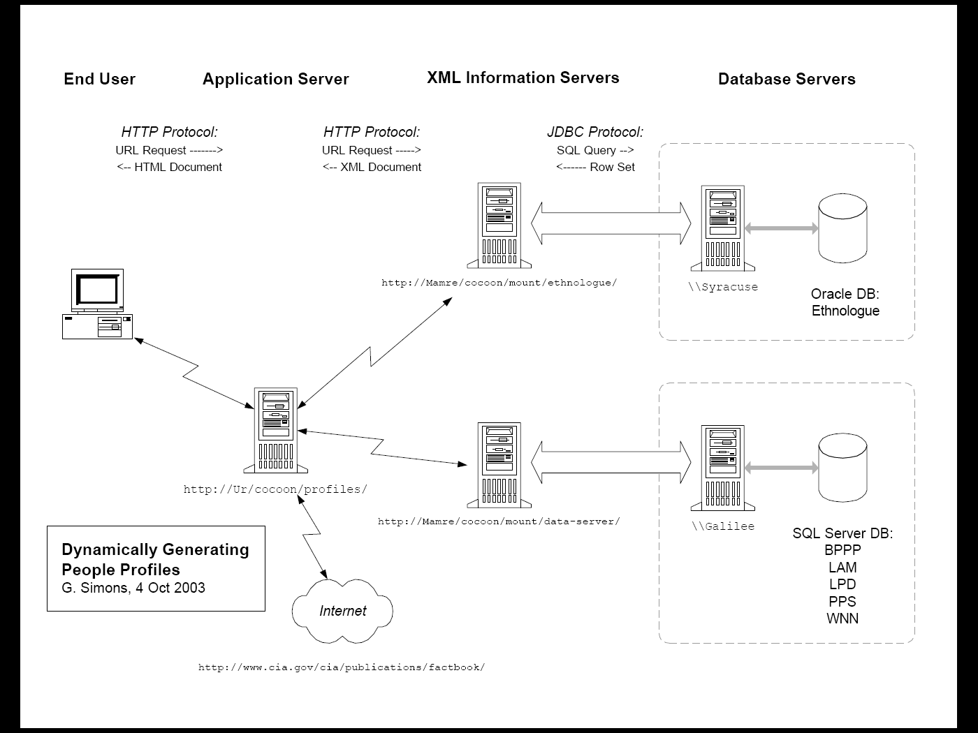
Notes:
This is the web architecture for LGIC (early version). The two middle tiers (app server and info servers) are Cocoon applications. Here we chose to separate the information servers and application server, so that if the database servers were widely scattered, we wouldn’t have to be running JDBC over distant connections. Thus Cocoon applications serve both as a web service provider and a consumer.

Slide 14
LGIC Demo
(see other pres)

Slide 15
Cocoon apps in SIL
Cocoon apps in production or beta:
  SIL Electronic Book Reviews
  Publishing Ethnologue 15th Ed.
  Language Group Information Center
In development:
  GEM (EA app generation)
  Cocoon - Language Assessment Maps
  Wycliffe News Network CMS
Others?
Notes:
LGIC: https://silintranet.sil.org/lgic/
SIL EBR: http://www.sil.org:8090/silebr/
Ethnologue publishing: http://mamre.sil.org/mount/ethnologue/index.html

Slide 16
Further info on Cocoon
http://www.pankaj-k.net/sdwest2002/Cocoon-FWS.ppt
Helpful introduction
http://cocoon.apache.org/2.1/features.html
What features Cocoon supports
http://cocoon.apache.org/community/mail-lists.html
Cocoon user mailing list
http://wiki.apache.org/cocoon/
Cocoon Wiki
http://www.arielpartners.com/arielpartners/content/public/topics/technology/technologyReviews/zopeVsCocoon
Comparison of Cocoon with Zope (out of date)

