Slide 1
How Does a Bike-Share Navigate Speedy Success?
Cyclistic, Chicago 2019-2020
Prepared by Marta Tofan

Slide 2
Main problems
How do annual members and casual riders use Cyclistic bikes differently?
Why would casual riders buy Cyclistic annual memberships?
How can Cyclistic use digital media to influence casual riders to become members?

Slide 3
How do annual members and casual riders use Cyclistic bikes differently?
Annual members VS casual riders – average duration time per ride in a week day
Annual members VS casual riders – number of rides in a week day

Slide 4
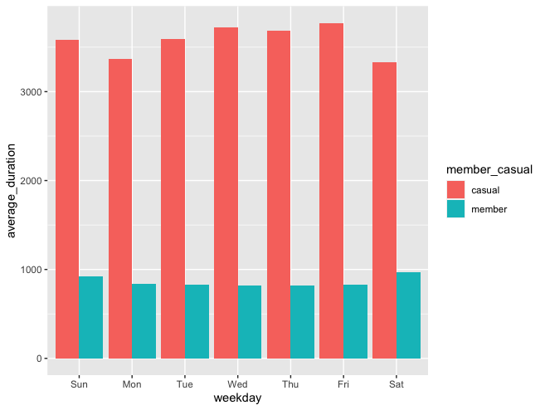
Annual members VS casual riders – average duration time per ride in a week day

Slide 5
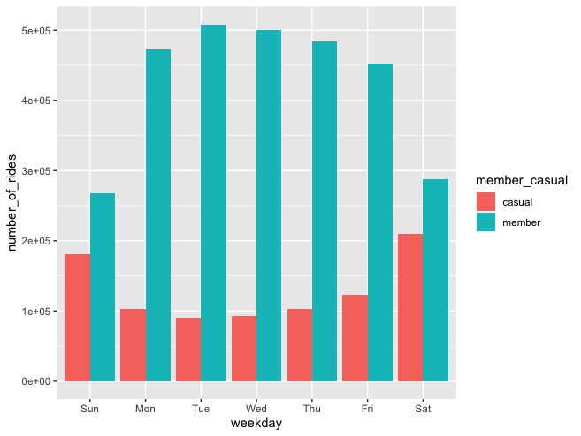
Annual members VS casual riders – number of rides in a week day

Slide 6
Why would casual riders buy Cyclistic annual memberships?
TO SPEND LESS – 3 types of packages:
Promotion for current casual members
Annual for all family
Annual for weekends

Slide 7
How can Cyclistic use digital media to influence casual riders to become members?
Promote TOP 3 packages for casual riders
Organize an family or corporates events
Giveaway free bicycle equipment to the most active annual members

Slide 8
Thank you for your attention and time.

