Slide 1
Treatment of long time series
From 27/07/2023

Slide 2
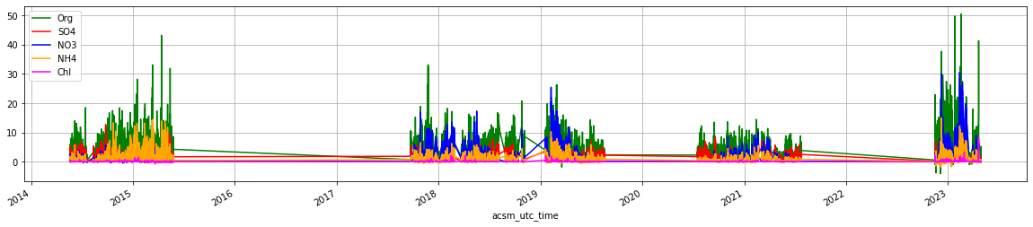
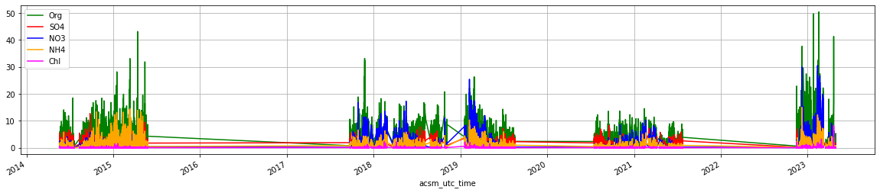
Negative values below DL are filtered.

Slide 3
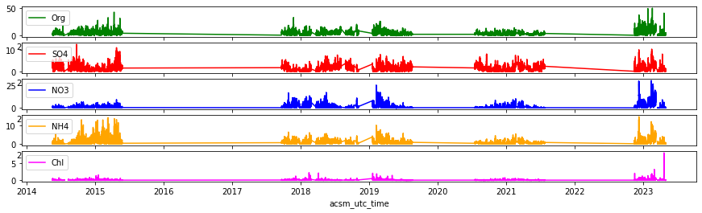

Slide 4
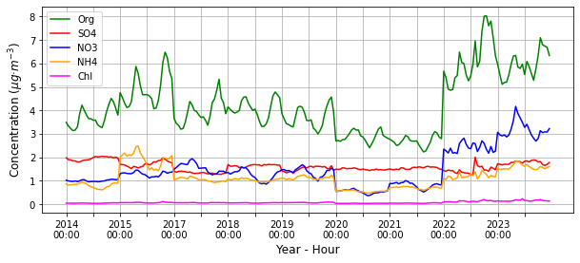
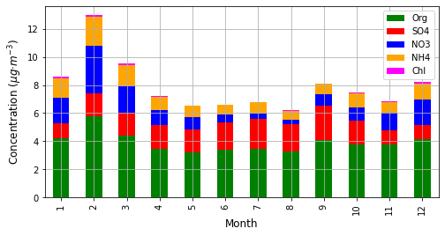

Slide 5
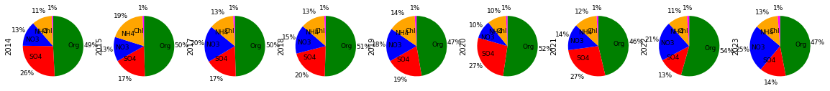
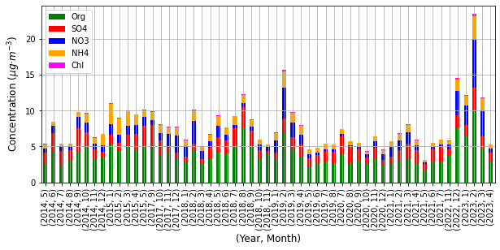
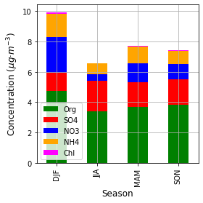

Slide 6
Mann-Kendall of NR-PM1 compounds (with daily data)
OA: Mann_Kendall_Test(trend='no trend', h=False, p=0.8020832669106384, z=0.25065188053211357, Tau=0.005207270330542766, s=2781.0, var_s=123012050.33333333, slope=5.446051540645161e-05, intercept=3.6245811812775677)
SO4: Mann_Kendall_Test(trend='no trend', h=False, p=0.06839956103795486, z=-1.8223653990342012, Tau=-0.037847736494520286, s=-20213.0, var_s=123012050.33333333, slope=-0.00018392122907037687, intercept=1.4621263648148495)
NO3: Mann_Kendall_Test(trend='decreasing', h=True, p=0.0009298013648013637, z=-3.310949049244703, Tau=-0.06876180810806257, s=-36723.0, var_s=123012050.33333333, slope=-0.00023036417806813578, intercept=0.9347857080994469)
NH4: Mann_Kendall_Test(trend='no trend', h=False, p=0.1251121072259358, z=1.5336649236875006, Tau=0.03185216670005861, s=17011.0, var_s=123012050.33333333, slope=9.068193077733832e-05, intercept=0.7899302799312826)
Chl: Mann_Kendall_Test(trend='increasing', h=True, p=0.021246907284180994, z=2.303567975225092, Tau=0.04791087924816137, s=25439.0, var_s=121944961.66666667, slope=8.625841383399218e-06, intercept=0.04173018322601094)

Slide 7
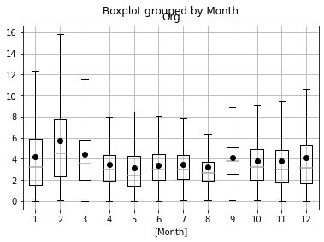
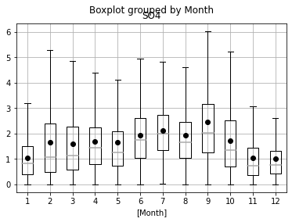
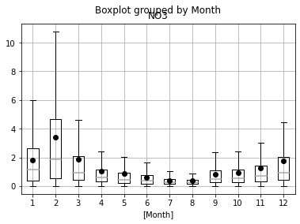
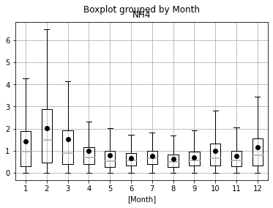
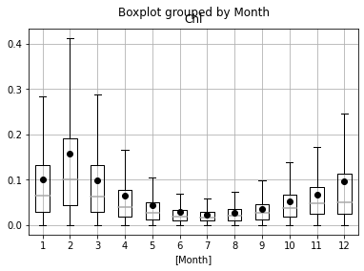

Slide 8
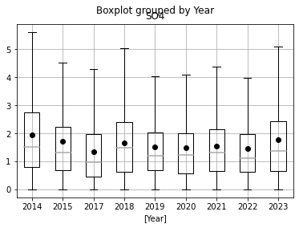
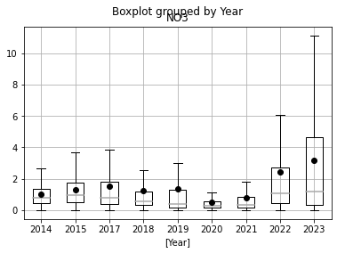
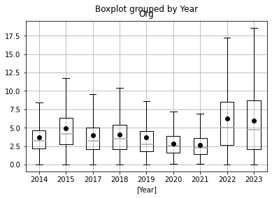
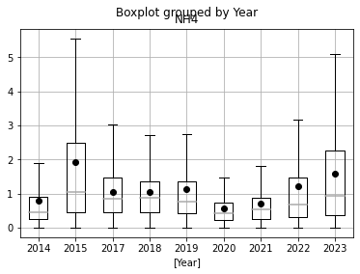
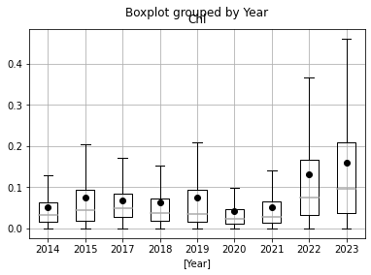

Slide 9
Analysis of the Specs, Error matrices.

Slide 10
Processes:
I filter out specs with concentrations <-0.05 and specs and errors >1.
I sum to evaluate OA.
OA Thail-Senn estimator:
OA: Mann_Kendall_Test(trend='decreasing', h=True, p=1.4743068765810108e-08, z=-5.664526953922774, Tau=-0.10033846489791462, s=-101090.0, var_s=318478783.3333333, slope=-0.0006136112771554702, intercept=3.6906167200140425)

Slide 11
Preliminary source apportionment (that from Benjamin’s spreadsheet

Slide 12
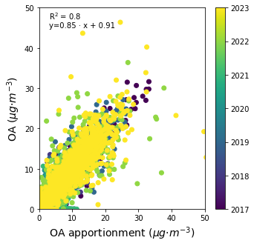
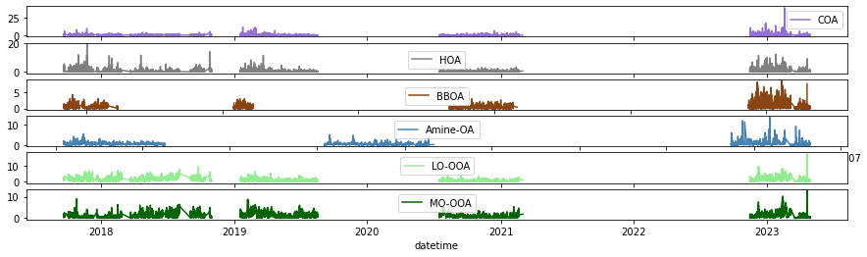
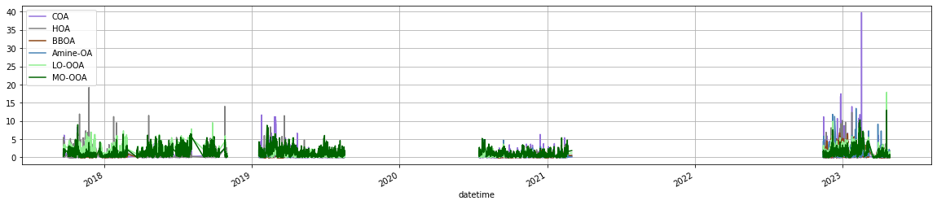

Slide 13
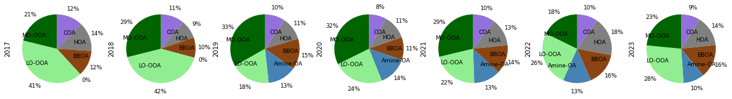
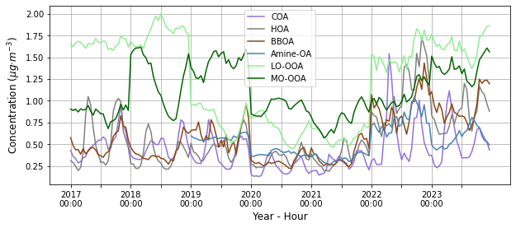

Slide 14
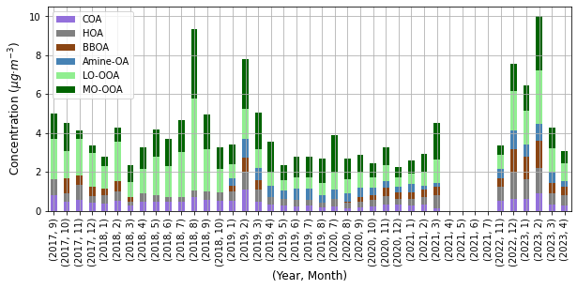
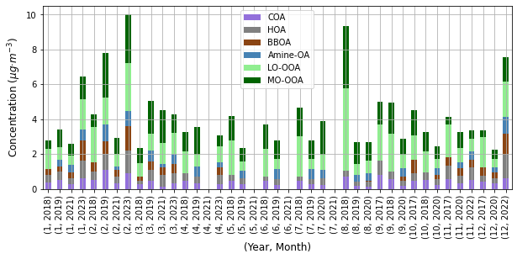
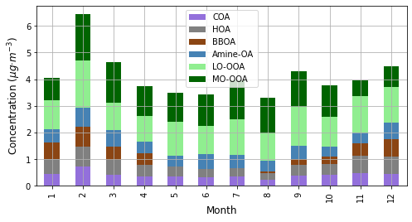
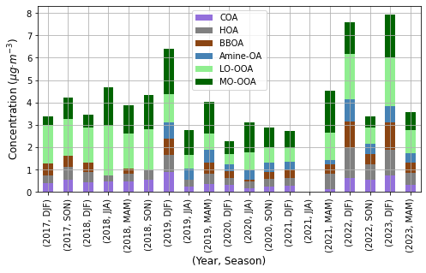
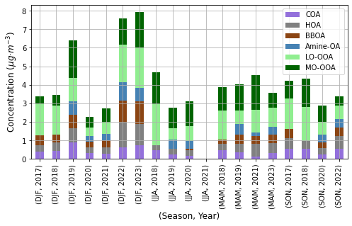
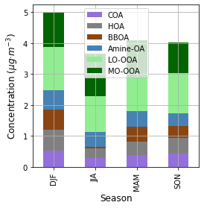

Slide 15
COA: Mann_Kendall_Test(trend='decreasing', h=True, p=2.886579864025407e-14, z=-7.603072235412979, Tau=-0.17160078277886498, s=-65766.0, var_s=74818916.66666667, slope=-0.00021937256779017527, intercept=0.4205665376723531)
HOA: Mann_Kendall_Test(trend='increasing', h=True, p=3.6834258221318805e-07, z=5.084630426301198, Tau=0.11476060013046314, s=43982.0, var_s=74818916.66666667, slope=0.00016600836654142329, intercept=0.2670812120407706)
Amine-OA: Mann_Kendall_Test(trend='decreasing', h=True, p=0.0004818896135070361, z=-3.490626392885032, Tau=-0.0980362829597223, s=-15731.0, var_s=20307231.0, slope=-0.00022789774656384903, intercept=0.5726986369854902)
BBOA: Mann_Kendall_Test(trend='increasing', h=True, p=1.7037340156456082e-05, z=4.30055171881661, Tau=0.13066371304421914, s=15336.0, var_s=12715083.333333334, slope=0.0002272335320400874, intercept=0.27986836120250436)
LO-OOA: Mann_Kendall_Test(trend='decreasing', h=True, p=0.0, z=-8.332569472628153, Tau=-0.18806523157208088, s=-72076.0, var_s=74818916.66666667, slope=-0.000781586239386972, intercept=1.305875659630159)
MO-OOA: Mann_Kendall_Test(trend='no trend', h=False, p=0.6309726237020423, z=-0.48035832339604545, Tau=-0.01084409654272668, s=-4156.0, var_s=74818916.66666667, slope=-3.8486960779216355e-05, intercept=0.9703456241082448)
POA: Mann_Kendall_Test(trend='increasing', h=True, p=0.01422334215550225, z=2.4515727754570236, Tau=0.08515201576674492, s=5876.0, var_s=5742832.666666667, slope=0.000984226892402408, intercept=1.0082830609721167)
OOA: Mann_Kendall_Test(trend='decreasing', h=True, p=7.714108019030164e-09, z=-5.7745891444787185, Tau=-0.13033268101761253, s=-49950.0, var_s=74818916.66666667, slope=-0.0009642476524153549, intercept=2.4097938154956307)

Slide 16
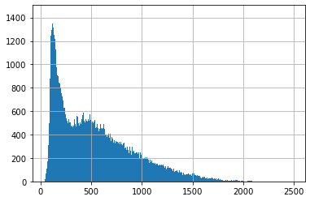
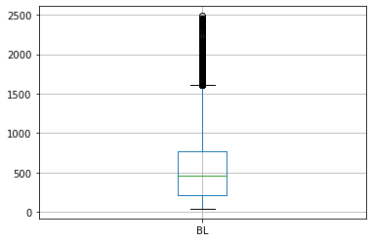
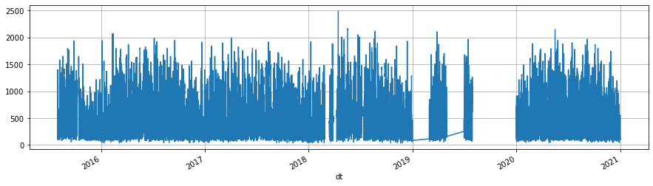
Boundary layer
(in m)

Slide 17
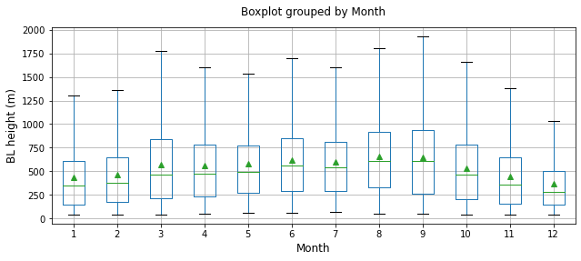
Boundary layer
Higher I summer, as expected

Slide 18
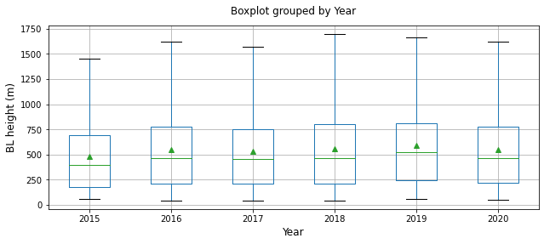
Boundary layer
Stable

Slide 19
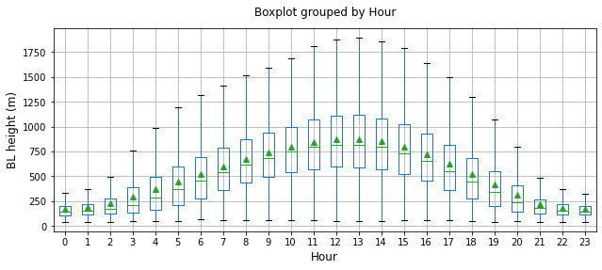
Boundary layer
Growth in the central hours of the day, as expected.

Slide 20
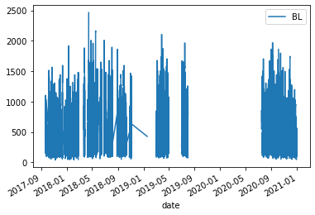
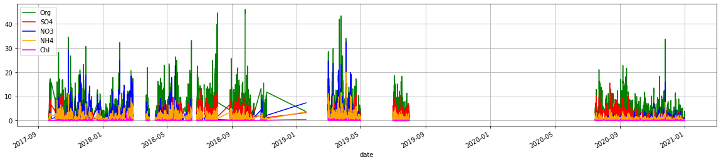
Boundary layer averaging to ACSM timestamps
Normalisation: BL_norm = BL/BL.median
Normalised by BL

Slide 21
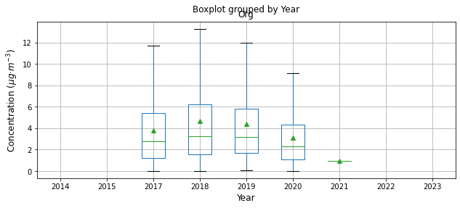
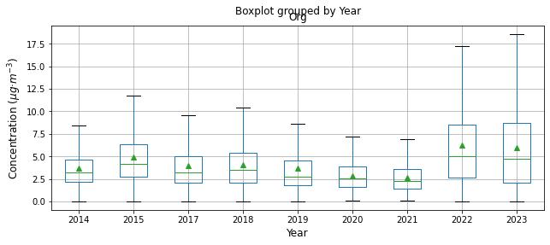
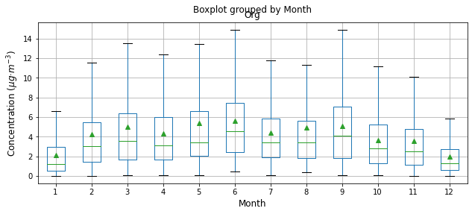
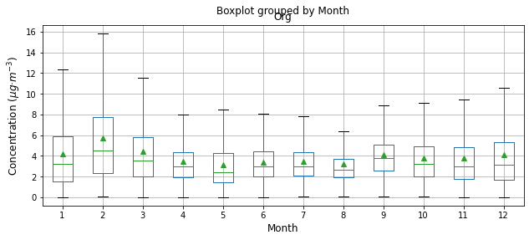
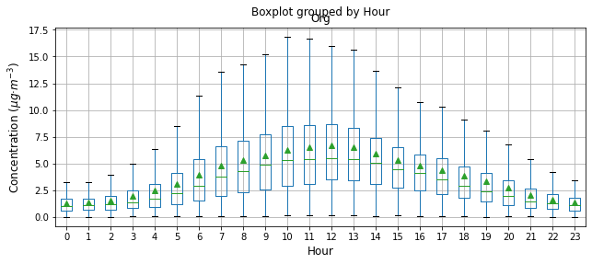
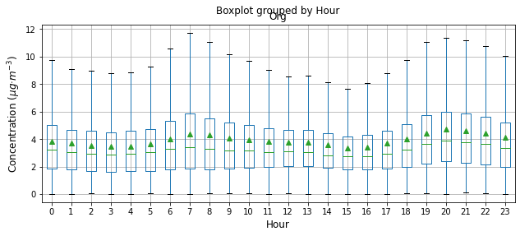
Boundary layer-normalised NR-PM1
Normalised
Raw

Slide 22
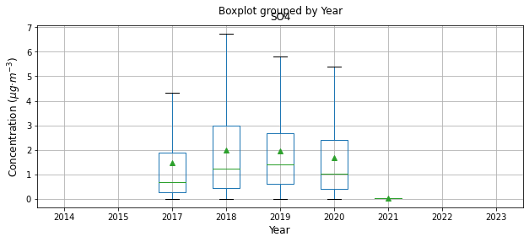
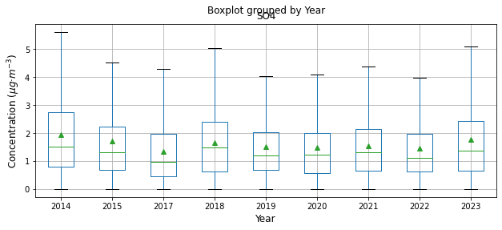
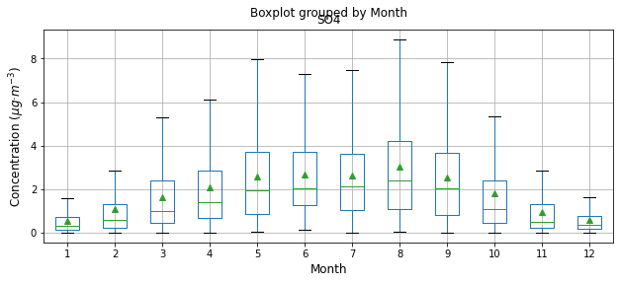
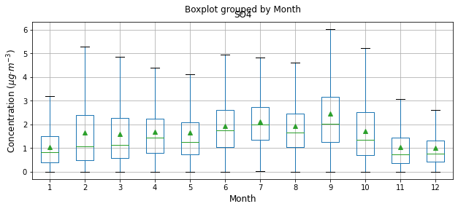
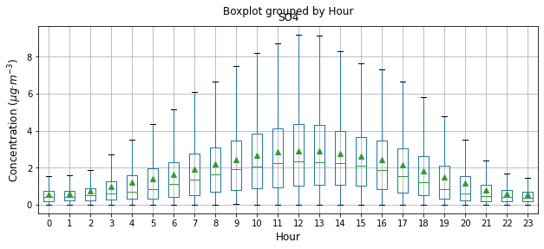
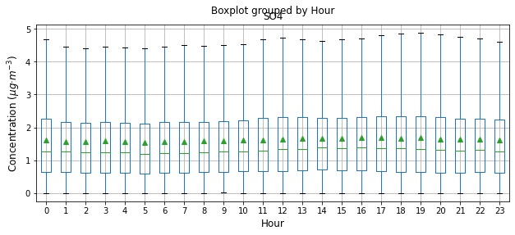
Boundary layer-normalised NR-PM1
Normalised
Raw

Slide 23
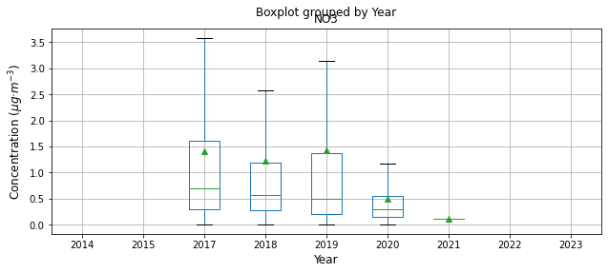





Boundary layer-normalised NR-PM1
Normalised
Raw

Slide 24






Boundary layer-normalised NR-PM1
Normalised
Raw

Slide 25






Boundary layer-normalised NR-PM1
Normalised
Raw

Slide 26






Boundary layer-normalised OA compounds
Normalised
Raw

Slide 27






Boundary layer-normalised OA compounds
Normalised
Raw

Slide 28






Boundary layer-normalised OA compounds
Amine-OA
Normalised
Raw

Slide 29






Boundary layer-normalised OA compounds
BBOA
Normalised
Raw

Slide 30






Boundary layer-normalised OA compounds
LO-OOA
Normalised
Raw

Slide 31






Boundary layer-normalised OA compounds
MO-OOA
Normalised
Raw

Slide 32


Ions study

Slide 33


Ratios study

Slide 34




Ratio SOA freshness (f43/f44)

Slide 35




Ratio POA/SOA

Slide 36


Traffic

Slide 37



Biomass burning

Slide 38


OC

Slide 39


Ratio OA:OC
Parametrising OA and OA/OC

Slide 40

Ratio OA:OC
Parametrising only OC
This is stupid! How can that be so high??

Slide 41

Ratio OA:OC
Parametrising only OC
How can the filters OA/Oc be so high?

Slide 42






Monthly means

