Slide 1
Barcelona – Palau Reial
2014 - 2023

Slide 2
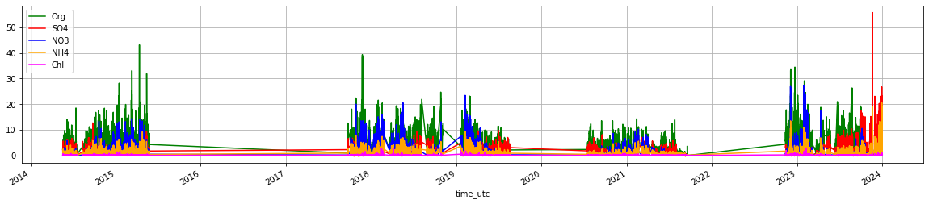
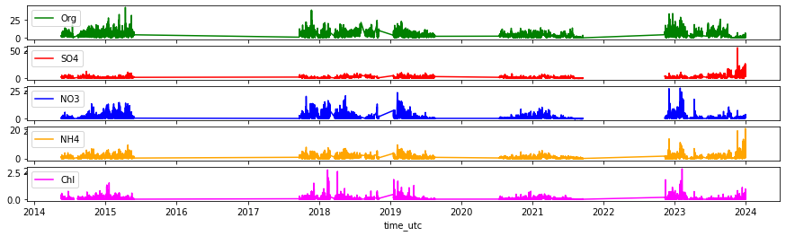
NR-PM1
Filtered upon DL

Slide 3
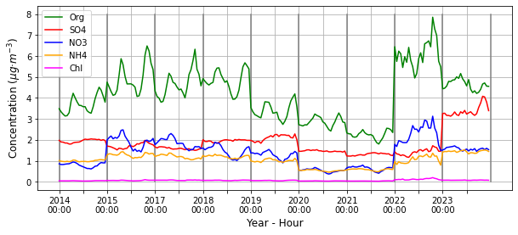
NR-PM1
YEARLY STRUCTURE
COVID?

Slide 4
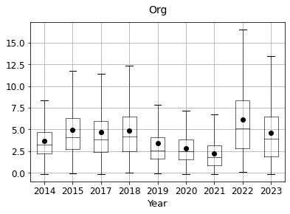
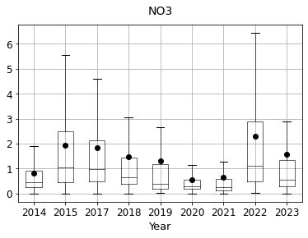
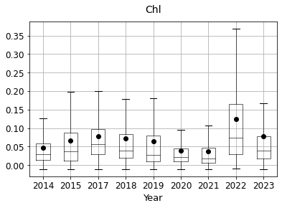
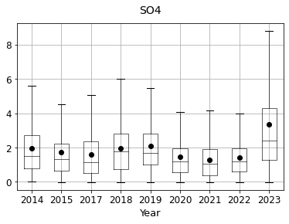
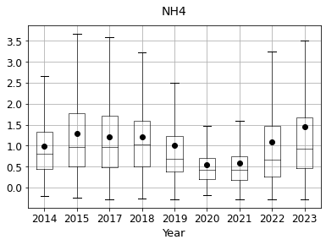
NR-PM1
YEARLY STRUCTURE
Clear decrease during covid, stable otherwise.
Reduced, during covid, high on 2022, episodes on 2023
Slight decrease during covid, clear increase during 2023.
Clear decrease during covid, stable otherwise.

Slide 5
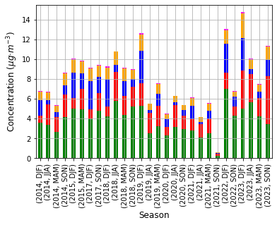
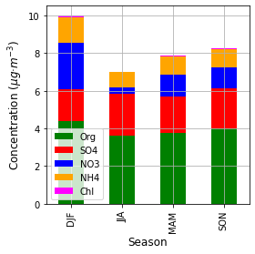
NR-PM1
SEASONAL STRUCTURE
Refer amb els gaps pertinents?

Slide 6
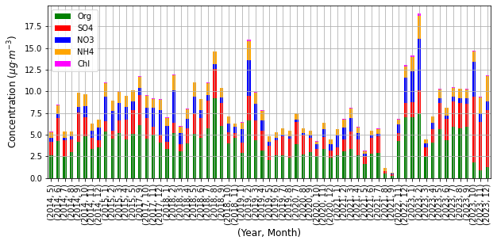
NR-PM1
MONTHLY STRUCTURE

Slide 7
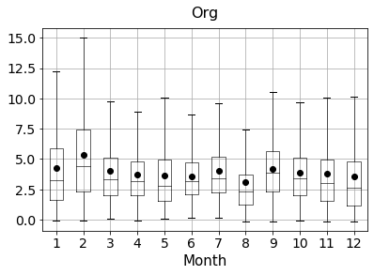
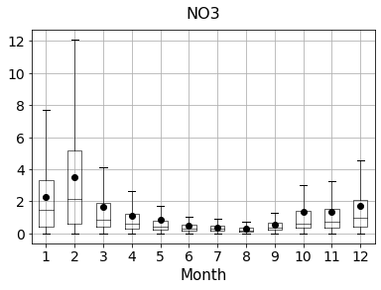
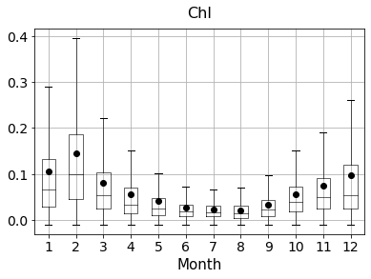
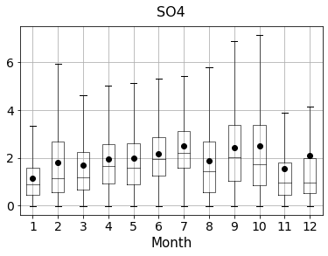
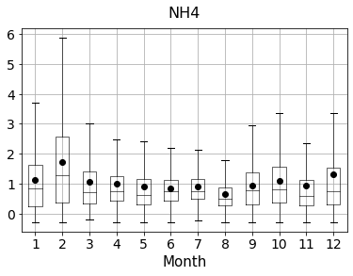
NR-PM1
MONTHLY STRUCTURE
Little trend, higher in winter generally.
Clear decrease on summer
Clear decrease on summer
Increase on summer
Slight decrease on summer

Slide 8
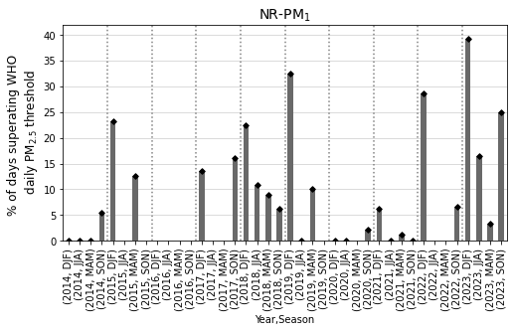
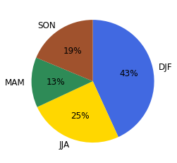
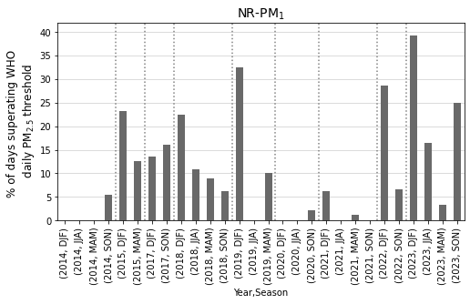
NR-PM1
SUPERATIONS
Add a shaded column if there is no data
Old

Slide 9
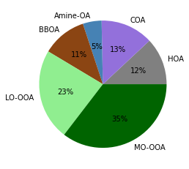
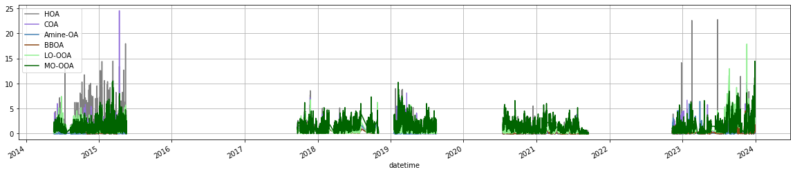
SA
MEAN

Slide 10
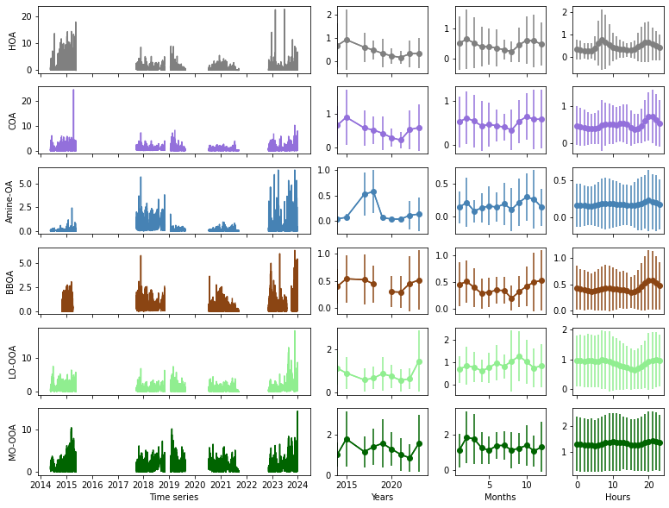
SA
MEAN AND MEAN CYCLES

Slide 11
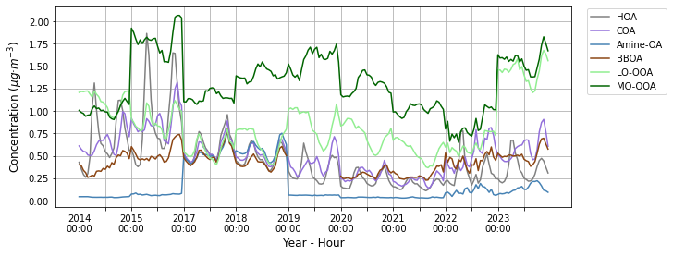
SA
YEARLY STRUCTURE

Slide 12
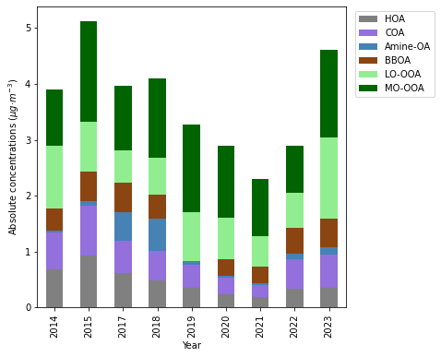
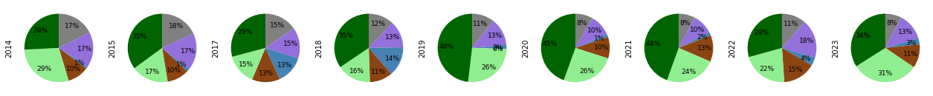
SA
YEARLY STRUCTURE

Slide 13
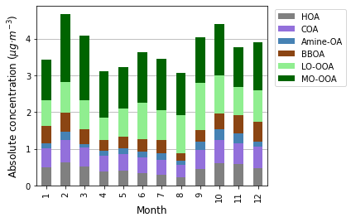
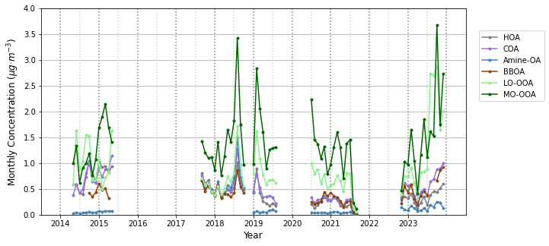
SA
MONTHLY STRUCTURE

Slide 14
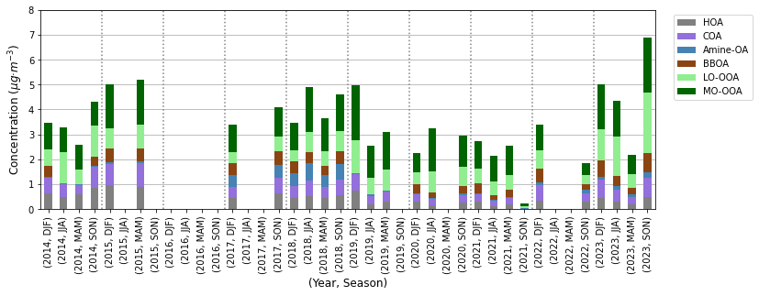
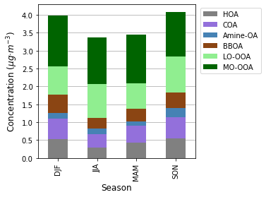
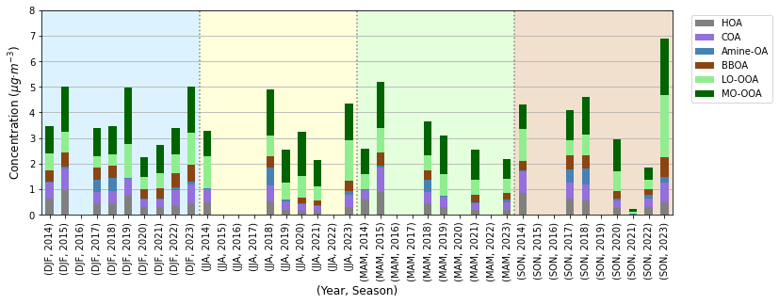
SA
SEASONAL STRUCTURE

Slide 15
IONS
SEASONAL STRUCTURE

