Slide 1
Barcelona – Palau Reial
2014 - 2023

Slide 2
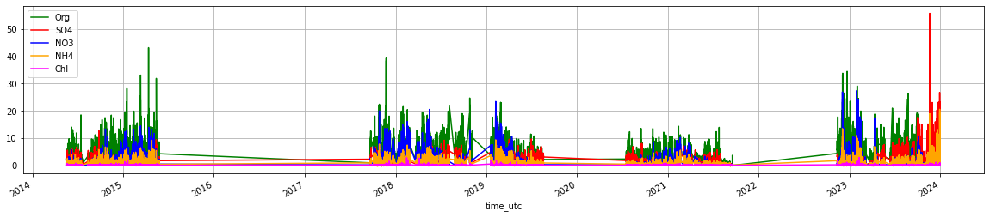
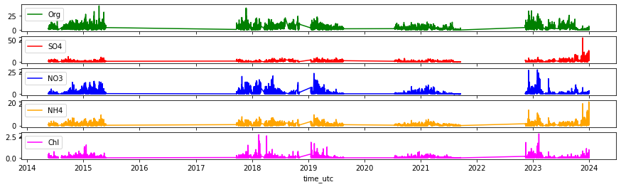
NR-PM1
Filtered upon DL

Slide 3
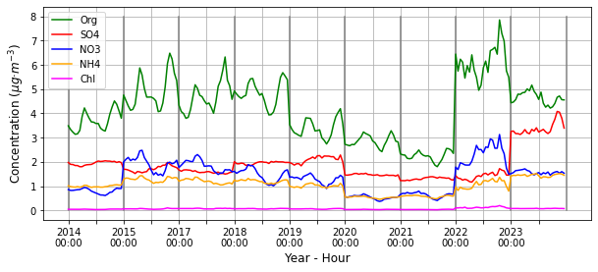
NR-PM1
YEARLY STRUCTURE
COVID?

Slide 4
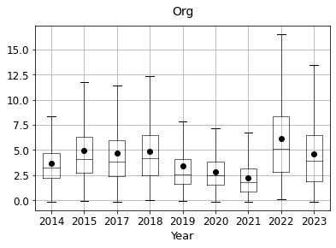
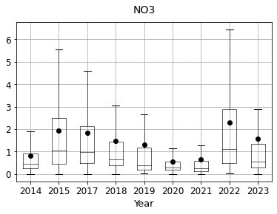
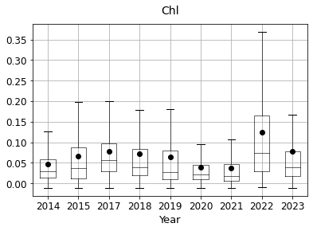
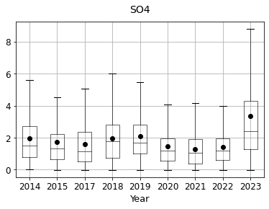
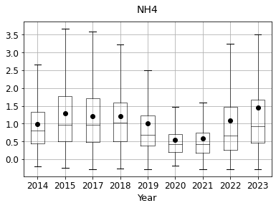
NR-PM1
YEARLY STRUCTURE
Clear decrease during covid, stable otherwise.
Reduced, during covid, high on 2022, episodes on 2023
Slight decrease during covid, clear increase during 2023.
Clear decrease during covid, stable otherwise.

Slide 5
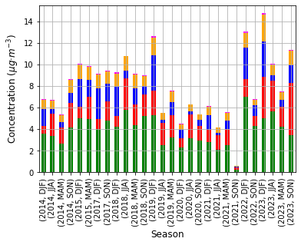
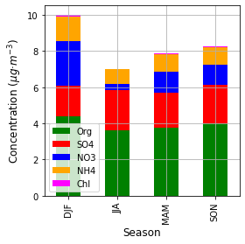
NR-PM1
SEASONAL STRUCTURE
Refer amb els gaps pertinents?

Slide 6
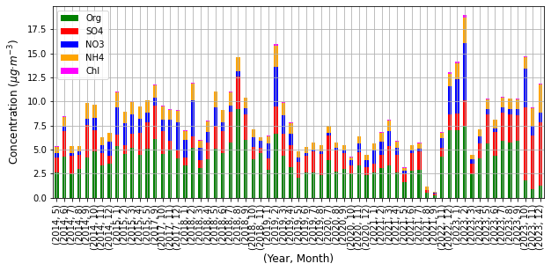
NR-PM1
MONTHLY STRUCTURE

Slide 7
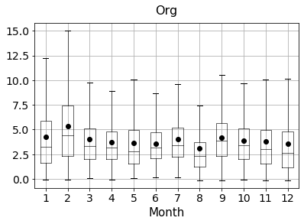
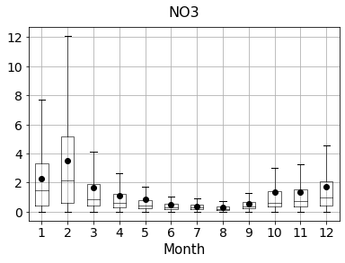
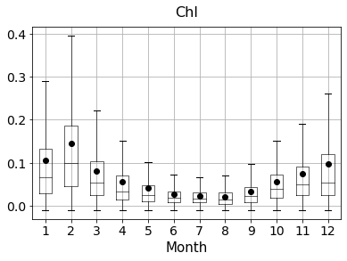
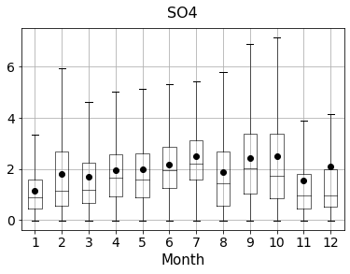
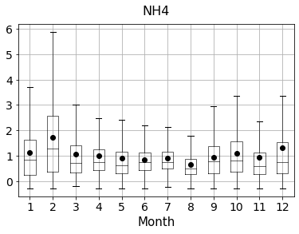
NR-PM1
MONTHLY STRUCTURE
Little trend, higher in winter generally.
Clear decrease on summer
Clear decrease on summer
Increase on summer
Slight decrease on summer

Slide 8
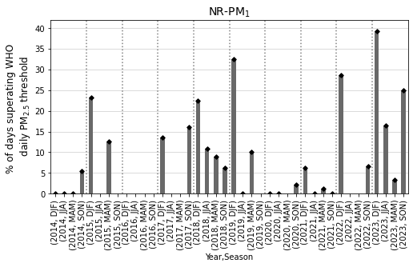
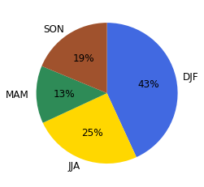
SUPERATIONS
OCCURRENCE
Add a shaded column if there is no data?

Slide 9
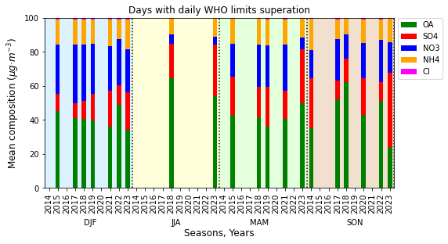
SUPERATIONS
COMPOSITION
Sulphate is not low in SON
Nitrate very high in winter.
Above 40% of OA always

Slide 10
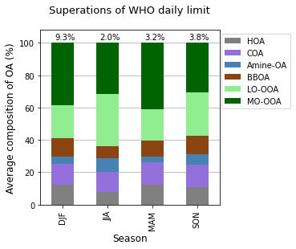
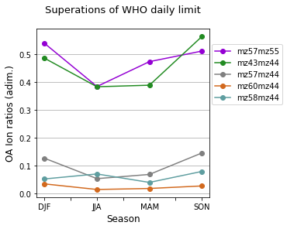
SUPERATIONS
COMPOSITION
Percentages above represent the percentage of days per season which superate the wHO limit.

Slide 11
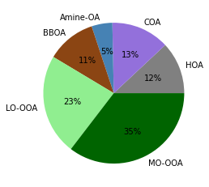
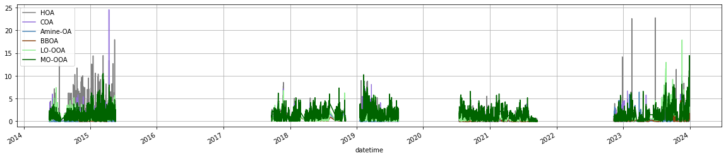
SA
MEAN

Slide 12
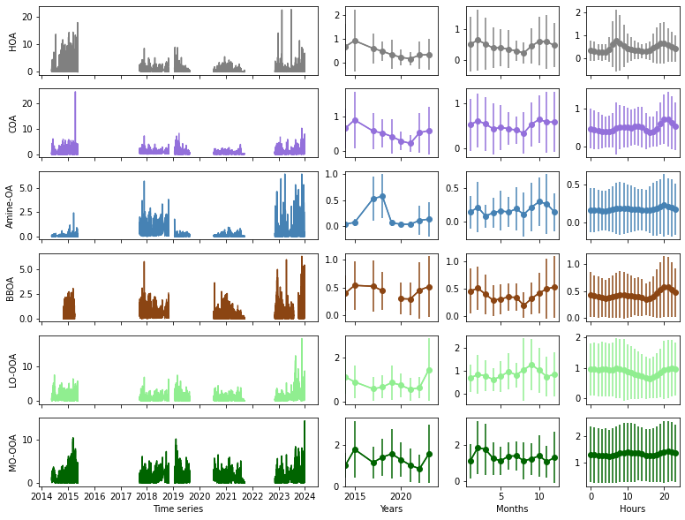
SA
MEAN AND MEAN CYCLES

Slide 13
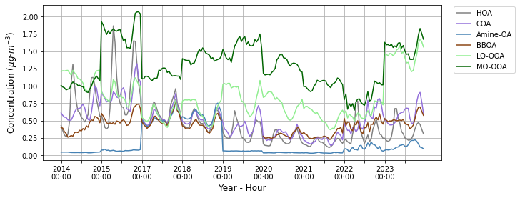
SA
YEARLY STRUCTURE

Slide 14
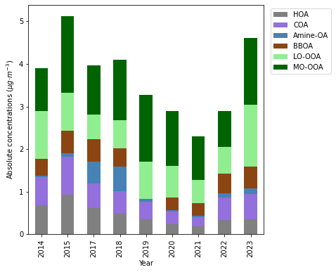
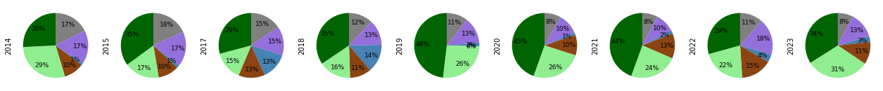
SA
YEARLY STRUCTURE

Slide 15
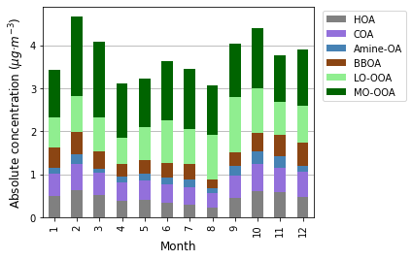
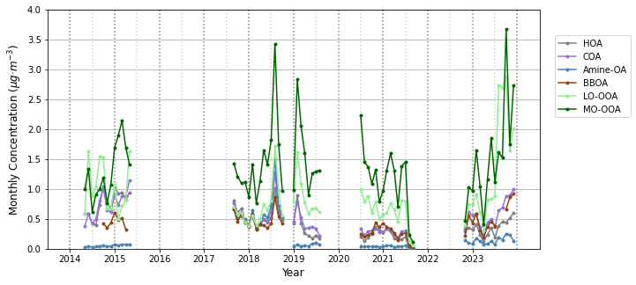
SA
MONTHLY STRUCTURE

Slide 16
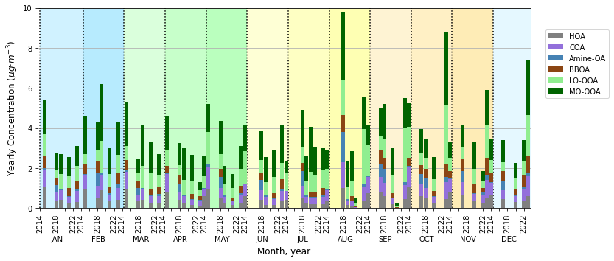
SA
MONTHLY STRUCTURE

Slide 17
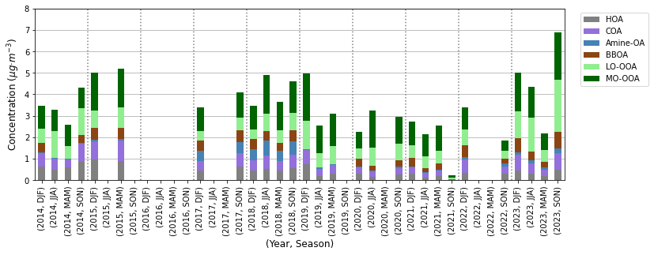
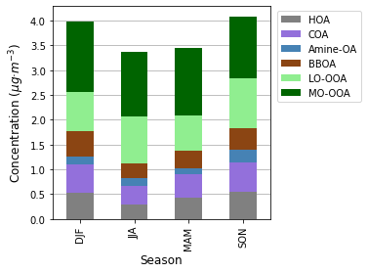
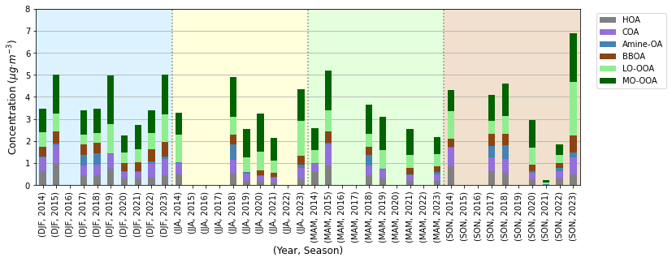
SA
SEASONAL STRUCTURE

Slide 18
SA
SUPERATIONS
Percentages above represent the percentage of days per season which superate the wHO limit.

Slide 19
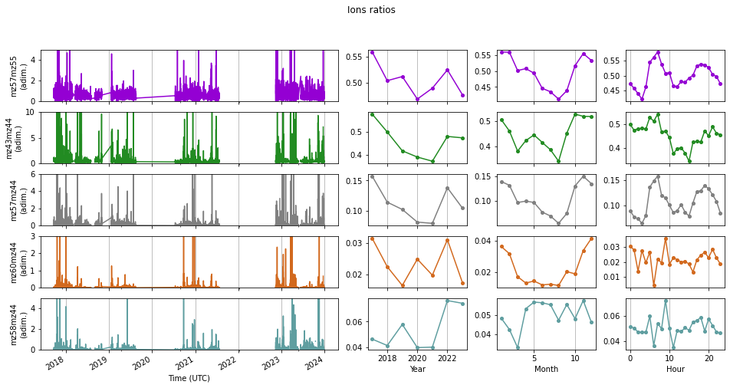
IONS
TIME SERIES

Slide 20
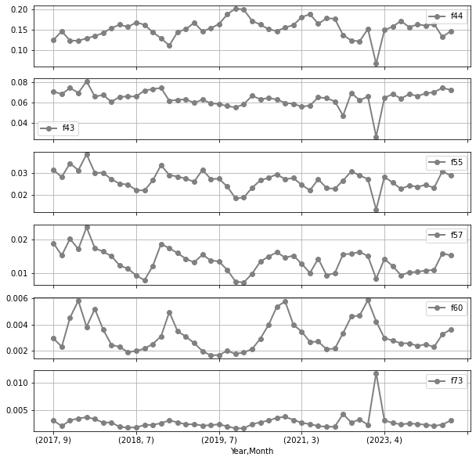
IONS
TIME SERIES

Slide 21
IONS
SEASONAL STRUCTURE

Slide 22
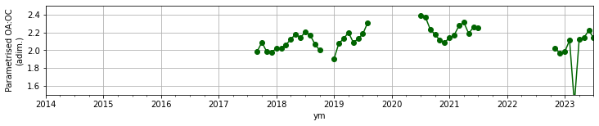
IONS
SEASONAL STRUCTURE
ratios=pd.DataFrame()
ratios['dt']=ions_f['dt']
ratios['SOA_freshness']=ions['f43']/ions['f44']
ratios['POA_SOA']=(ions['f55']+ions['f57']+ions['f60']+ions['f73'])/(ions['f43']+ions['f44'])
ratios['Traffic']=(ions['f55']+ions['f57'])/(ions['f43']+ions['f44']+ions['f60']+ions['f73']+ions['f55']+ions['f57'])
ratios['BB']=(ions['f60']+ions['f73'])/(ions['f43']+ions['f44']+ions['f60']+ions['f73']+ions['f55']+ions['f57'])
ratios['OC']=0.079+4.31*ions['f44']
ratios['OAOC']=1.29*ratios['OC']+1.17
ratios['OAOC_nop']=oa/ratios['OC']

Slide 23
Future work:
By scenarios
PBL

