Slide 1

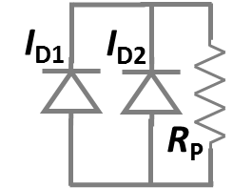
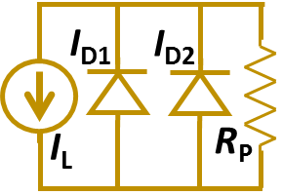
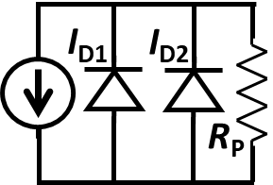
Junction models:
metal
semiconductor
Resistors model the horizontal current flow
front metal
8
7
9
I_{D1}
I_{D2}
4
5
6
7
8
9
I_{L}
R_{P}
1
3
4
5
6
2
I_{D1}
I_{D2}
1
2
3
back metal
R_{P}

