Slide 1
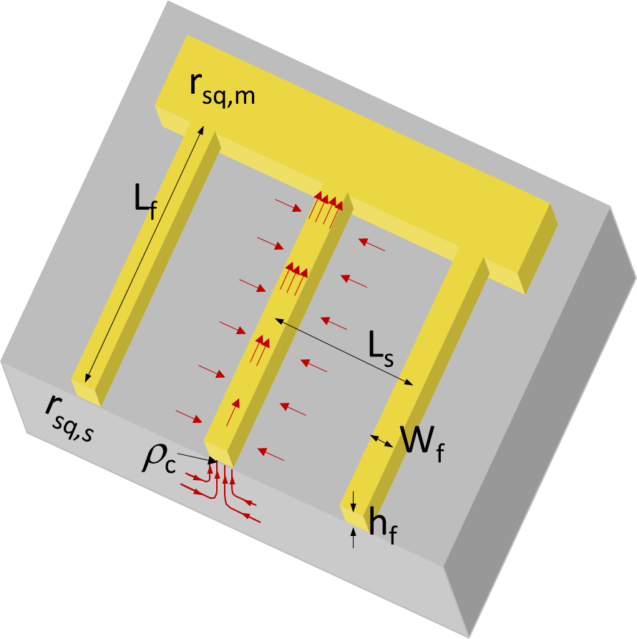
fingers
buses
h_{f} | Finger thickness
W_{f} | Finger width
L_{f} | Finger length
L_{s} | Distance between fingers
r_{sq,m} | Sheet resistance of metal
r_{sq,s} | Sheet resistance of semiconductor
ρ_{c} | Contact resistivity

