Slide 1
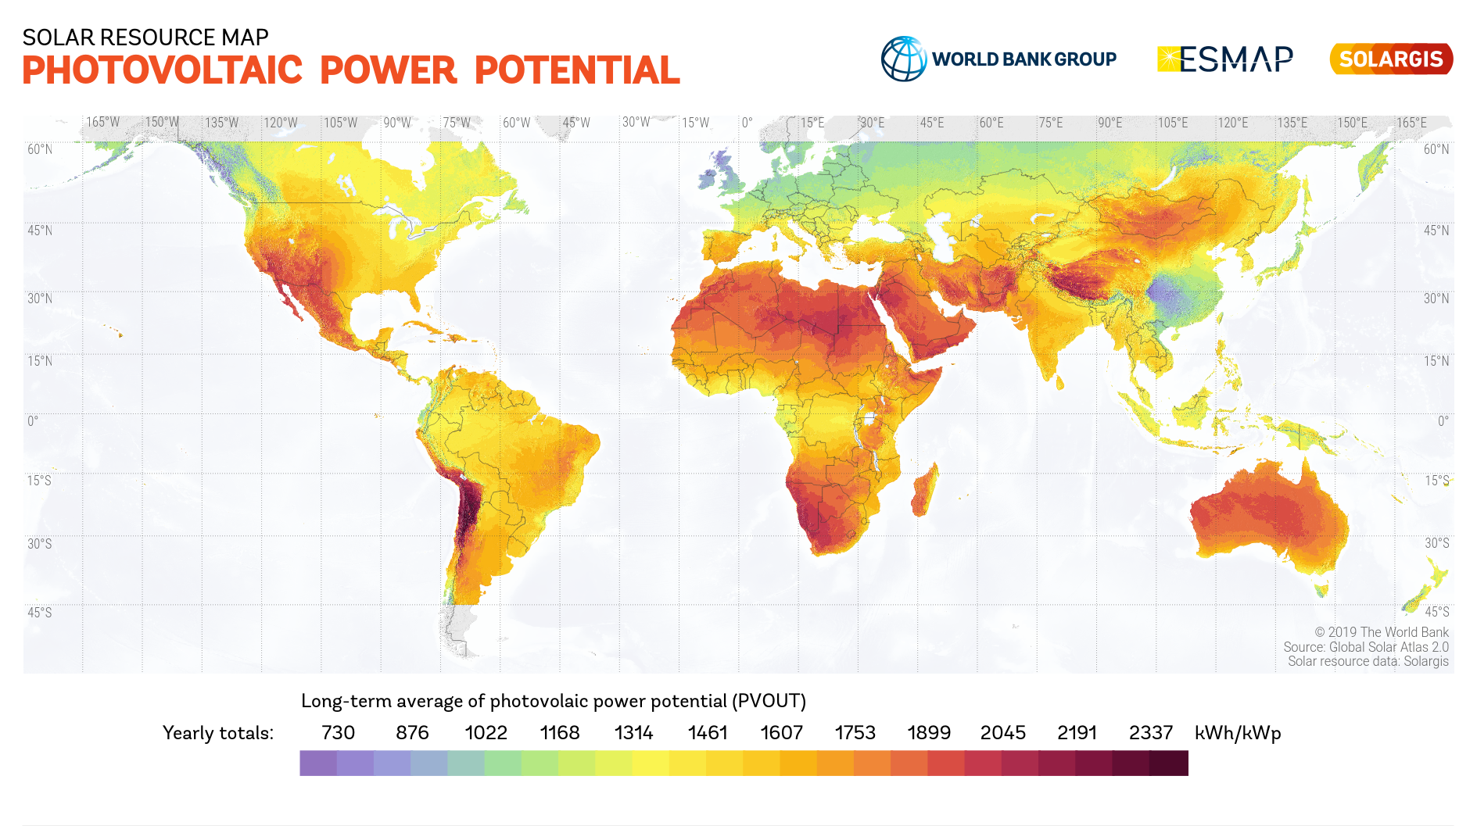
Equivalent hours (kWh/kW):
730 876 1022 1168 1314 1461 1607 1753 1899 2045 2191 2337
Energy payback time (EPBT):
2 years
1.5 year
1 year
10 months

