Slide 1
Aluminium frame
Glass
Encapsulant (EVA)
Solar cells
Encapsulant (EVA)
Back sheet (copolymer)

Slide 2
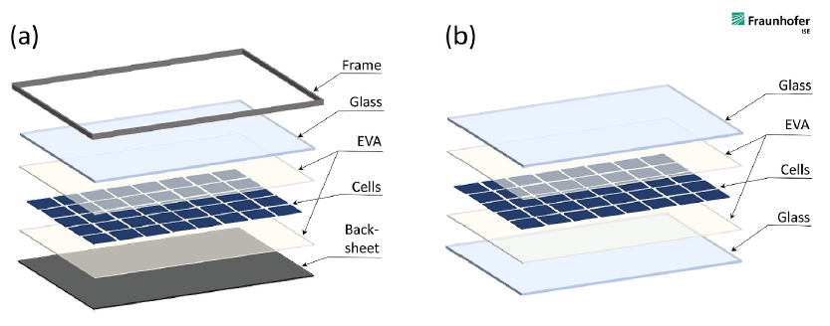
Junction box

