Slide 1
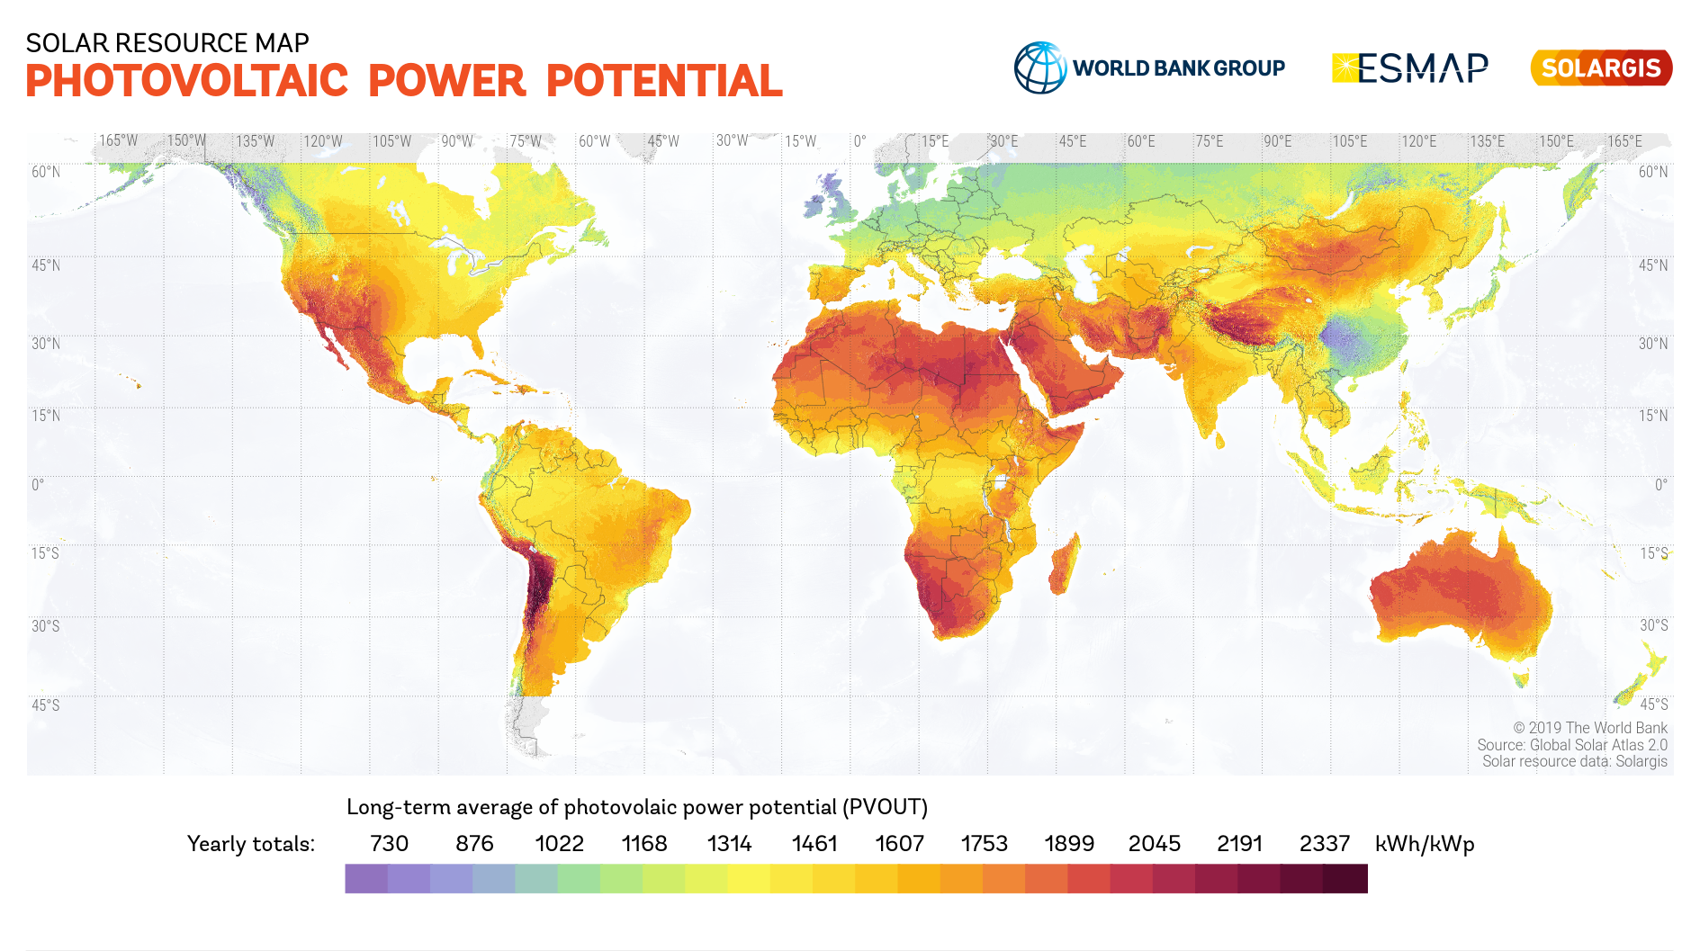
Peak Sun Hours (kWh/kW):
730 876 1022 1168 1314 1461 1607 1753 1899 2045 2191 2337
Energy payback time (EPBT):
1.5 years
1 year
10 months
6 months

