Slide 1
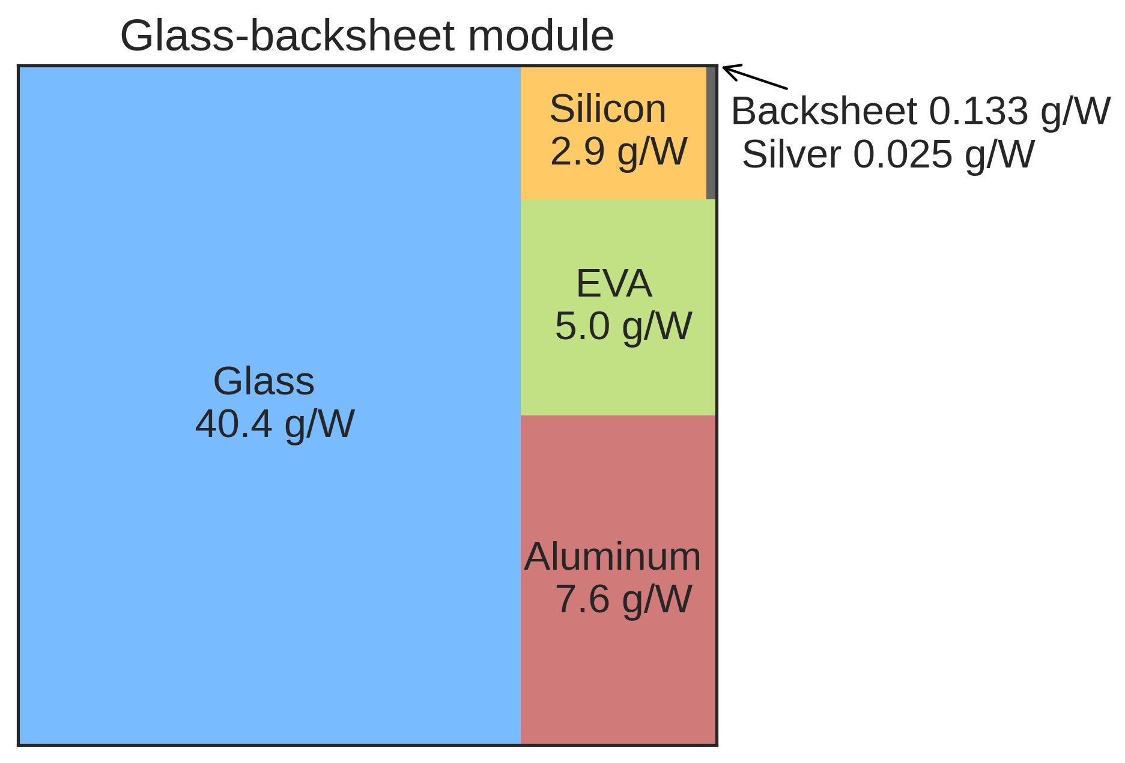
Aluminium frame
Glass
Encapsulant (EVA)
Solar cells
Encapsulant (EVA)
Backsheet (copolymer)

