Slide 1
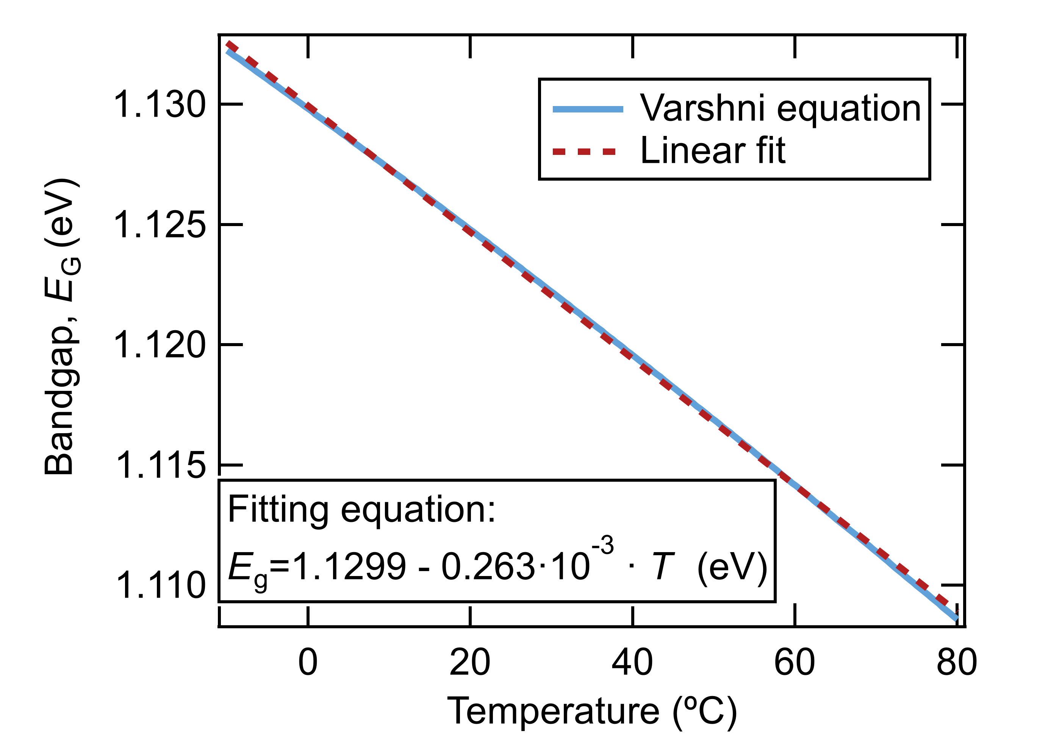
Silicon temperature parameters
E_{g}(0 K) | 1.1692 eV
a | 0.49 meV/K
b | 655 K
Linear coeff | 0.263 meV/K

