Slide 1
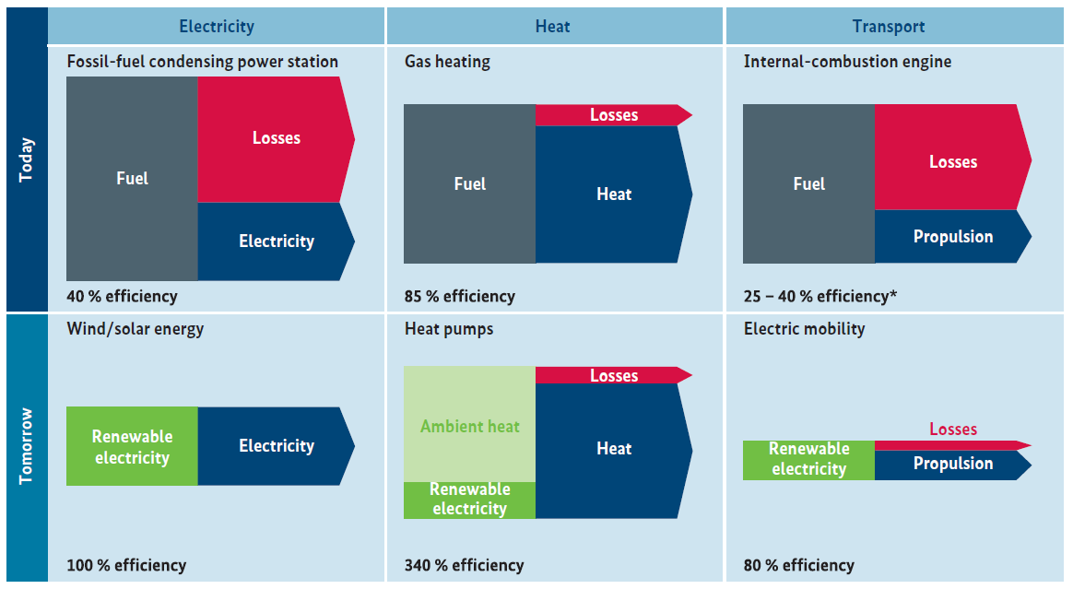
Fossil fuel power plant (40% efficiency)
Gas boiler (90% efficiency)
Fuel
Losses
Fuel
Losses
Local demand
Heat
Electricity
Grid connection
Wind/solar energy
Wind/solar energy
Renewable Electricity
Electricity
Renewable Electricity
Electricity

