Slide 1
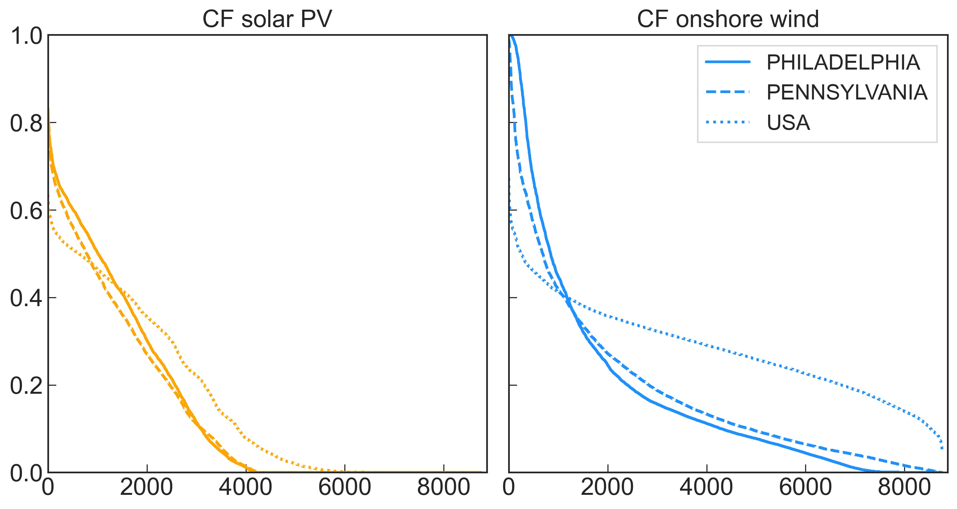
283 miles (485km)

