Slide 1
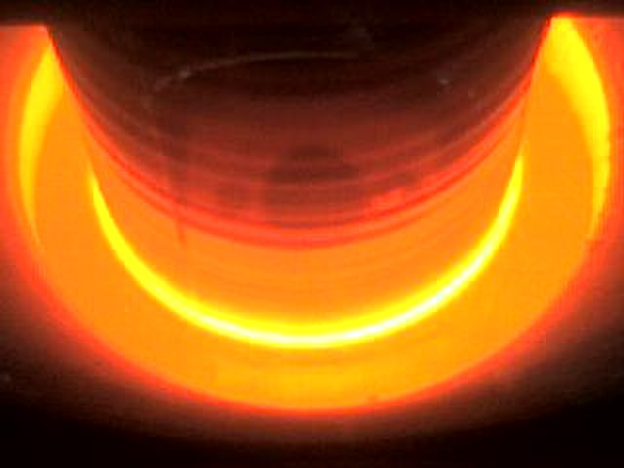
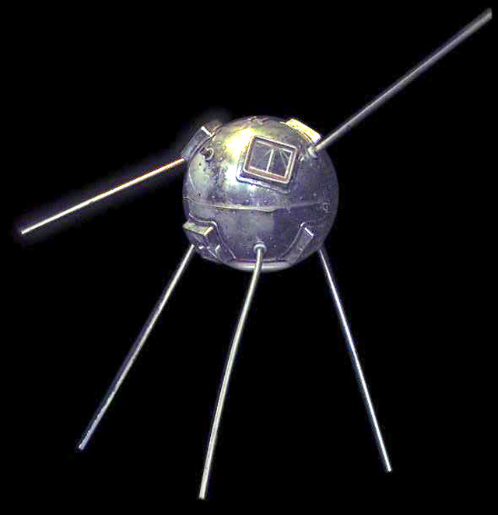
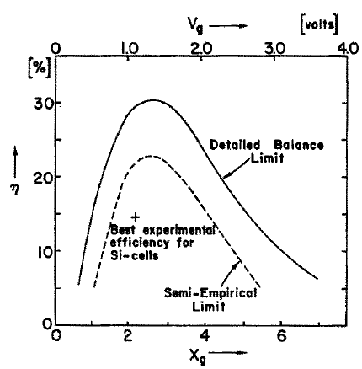
1958: The American satellite Vanguard 1 is launched. It was the first satellite with a solar PV power system.
Sputnik II satellite in 1957, was already powered with silicon cells.
https://www.nrel.gov/docs/fy04osti/33947.pdf
Alexandre-Edmond Becquerel discovered the photovoltaic effect, that is, the conversion of absorbed light into electricity. Becquerel placed two platinum electrodes in a container filled with an electrolyte and measured that the current flowing between the electrodes increased when the setup was exposed to sunlight.
1839
Photoelectric and photovoltaic effects are related, but they are not the same. In both cases, light is absorbed, and it causes the excitation of an electron to a higher energy level. We refer to the photoelectric effect when the electron is ejected out of the material, and to the photovoltaic effect when the excited electron is still contained within the material.
1876
William Adams and Richard Day proved that a selenium rod connected to platinum electrodes produced electricity when it was illuminated. This was the first observation of the photovoltaic effect in solids.
The inventor Charles Fritts built a small array of selenium cells with a total area of 30 cm² and achieved an efficiency close to 1%.
1883
1905
Albert Einstein presented his quantum theory. Einstein explained the photoelectric effect by assuming that light consists of quantized energy packages that we call photons.
Jan Czochralski invented a method to grow high-quality crystalline materials. The method is still used today (see Chapter 5).
1916
William B. Shockley, the coinventor of the transistor, explained the principles of operation of the pn junction. Solar cells were developed during this decade at Bell Labs.
1950
Daryl Chapin, Calvin Fuller, and Gerald Pearson at Bell Labs presented the first silicon solar cell with an efficiency of 6% and an area of 2 cm².
In the same year, a thin-film heterojunction solar cell based on Cu₂S/CdS attaining also 6% efficiency was developed at Air Force Base (USA)
1954
1958
The first satellite with a solar PV power system (NASA Vanguard 1) was launched. The Russian satellite Sputnik 3 launched the same year also included solar cells.
1961
Shockley and Queisser developed the Detailed Balance theory for calculating the maximum theoretical efficiency that can be attained by a solar cell. The Shockely-Queisser limit is presented in Chapter 6.
Bell Labs launched the first solar-powered telecommunications satellite (Telstar).
1962

Slide 2
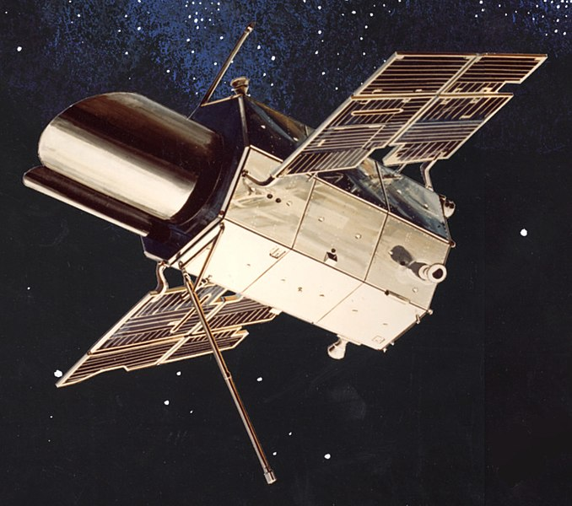
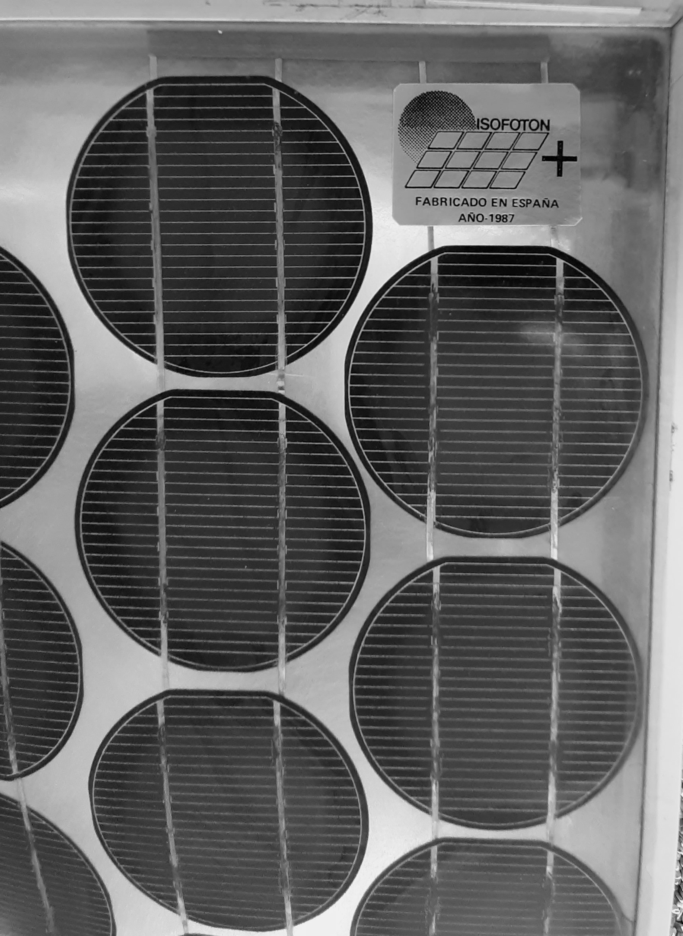
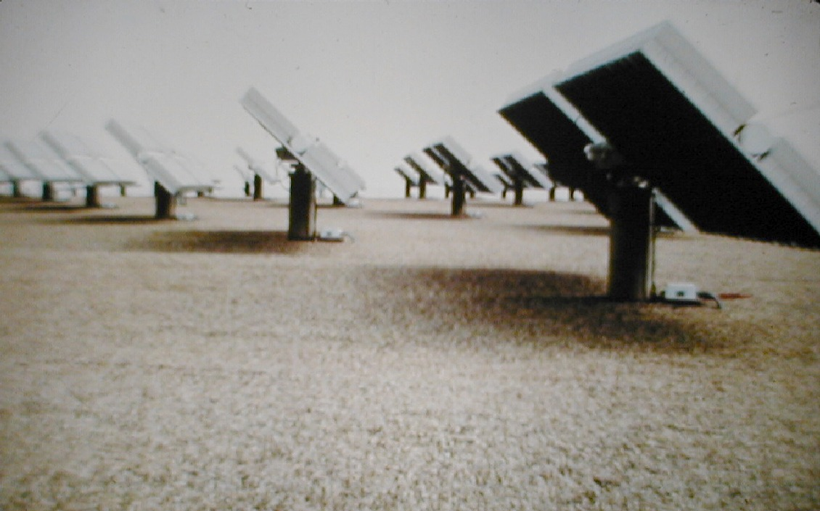
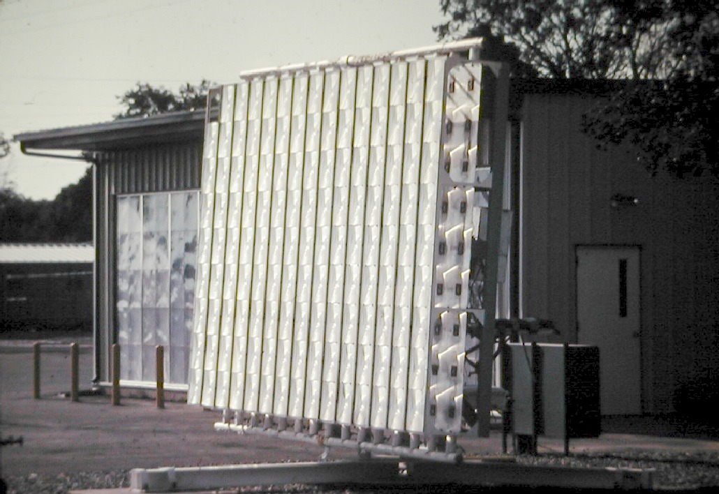
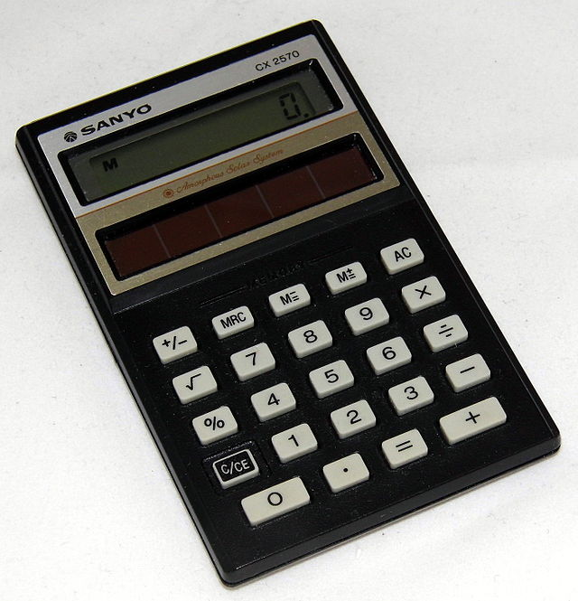
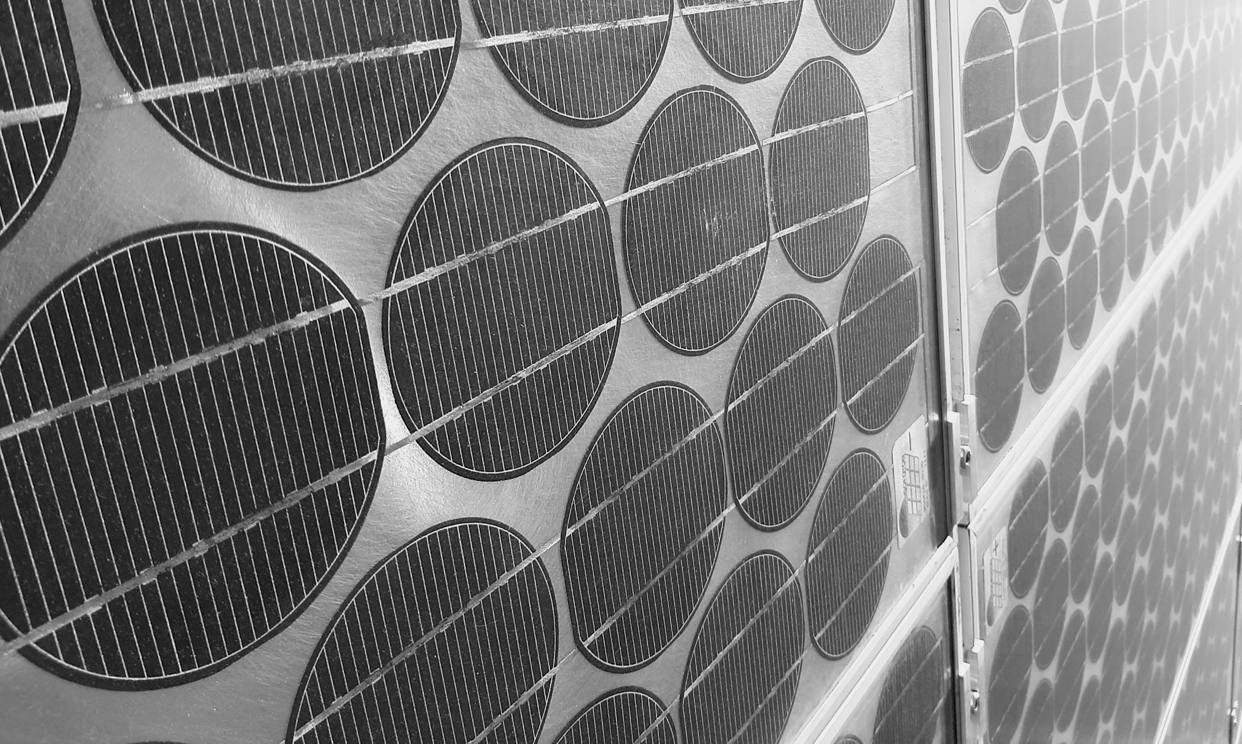
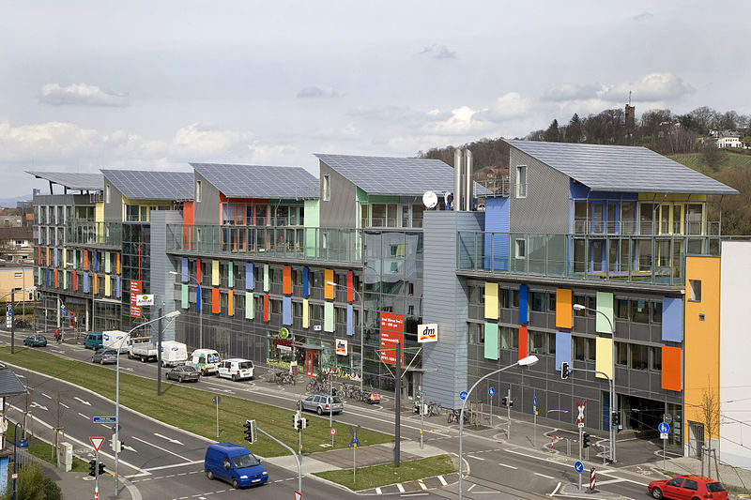
1966
NASA launched the first Orbiting Astronomical Observatory powered by a 1kW PV array.
A group at Ioffe Institute in San Petersburg led by Zhores I. Alferov developed a solar cell based on GaAlAs/GaAs heterojunction. The main benefits of GaAs cells were their high efficiency and resistance to the ionizing radiation in space.
1970
1973
Geopolitical reasons triggered the two oil crises where the prices of oil skyrocketed. Populations and governments become more aware of the vulnerability of the oil economy and significant efforts were made to develop alternative energy sources. It is in this period that many solar research labs and institutions were founded.
Todelo PV es de 1994, casi 12 años después de la de California
1979
70’s & 80’s
The first solar-powered pocket calculators and watches arrived on the market.
First 350 kW Concentrator-PV array installed in Saudi Arabia.
1981
First 1 MW utility-scale PV power plant with Arco Si modules on 2-axis trackers installed in California.
1982
Silicon solar cell attained efficiency >20% under standard sunlight (UNSW, Australia) and >25% under 200X concentration (Stanford Univ., USA)
1985
The Spanish company Isofoton manufactured and installed bifacial PV panels.
1987
1990
Cumulative Global PV capacity reached 1 GW.
1991
Germany launched the “1000-roofs” program aiming at installing 1000 domestic solar PV systems. This marks the beginning of policy support for PV.
GaInP/GaAs 2-terminal multijunction solar cell attained efficiency >30% (NREL, USA).
1994
First silicon solar cell with >25% efficiency (PERL design) (UNSW, Australia) .
1999
The race for high-efficiency commercial silicon cells resulted in innovative cell architectures (IBC, TOPCon) with efficiency >25%.
2015
2020
Solar PV covered 20% of the annual electricity demand in California (USA).
2022
Cumulative global PV capacity reached 1 TW.

