Slide 1
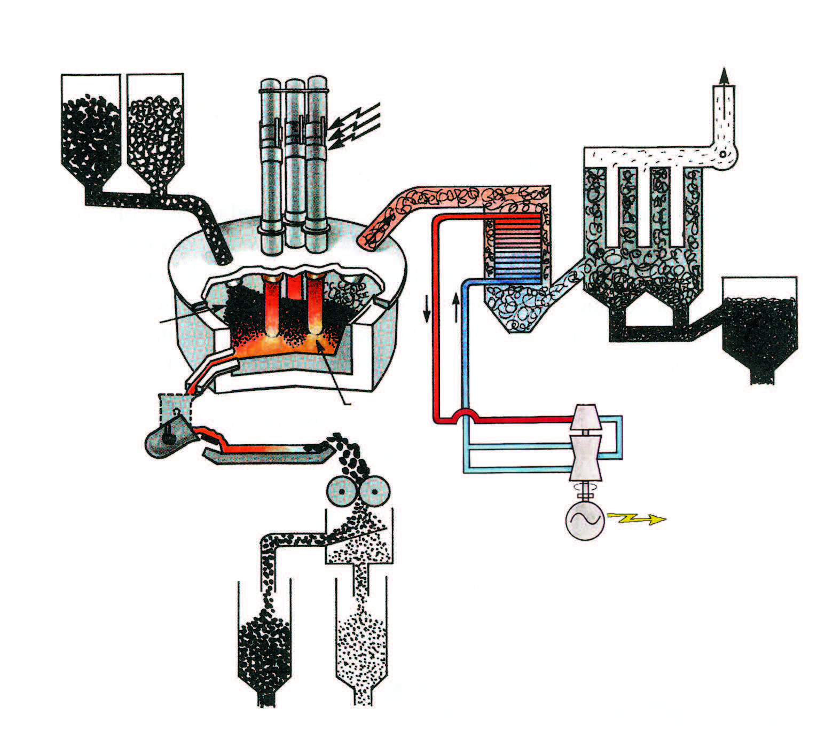
Raw material
C SiO₂
Consumable electrodes
Cleaned gas
Electric energy
Filter
Heat exchanger
Arc
furnace
Silica
Charge material
Liquid metal
Crater
Solidification
Crushing
Sizing
Turbine energy recovery
Silicon products

