Slide 1
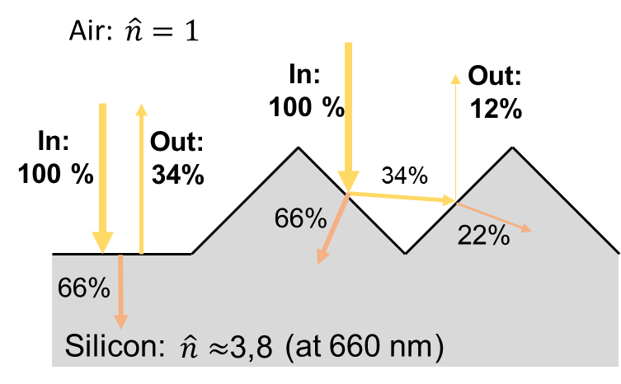
a
b
fast etching
(001) plane
slow etching
(111) plane

