Slide 1
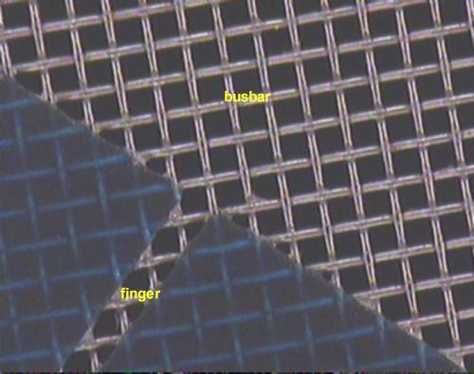
squeegee
busbar
paste
screen
solar cell
front grid pattern
finger

