Slide 1



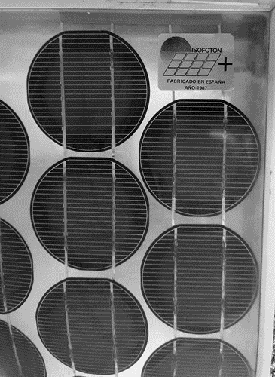
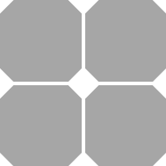


1980
2006
2018
2019
2021
2022
M0
M2
G1
M6-M10
G12
106 mm
156 mm
156.75 mm
158.75 mm
166-182 mm
pseudo-square
(less corner loss)
Monocrystalline
half-cut
pseudo-square
Monocrystalline
210 mm
pseudo-square
Monocrystalline
full-square
Monocrystalline
Very large area losses
Corner losses reduced

