Slide 1
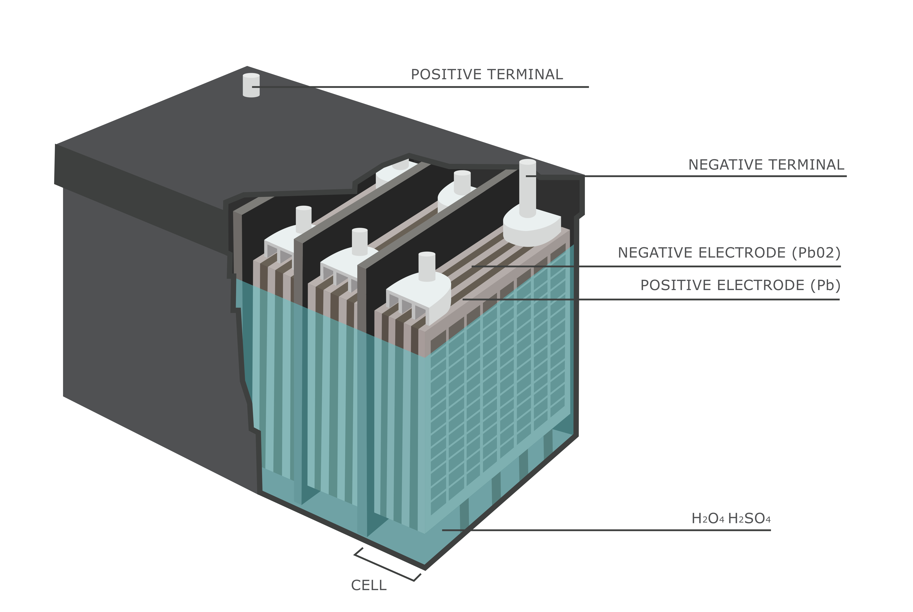
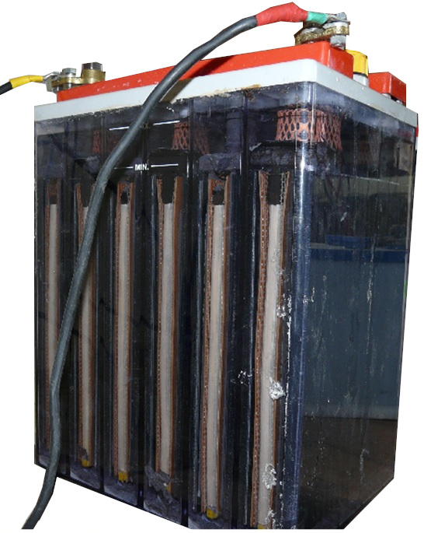
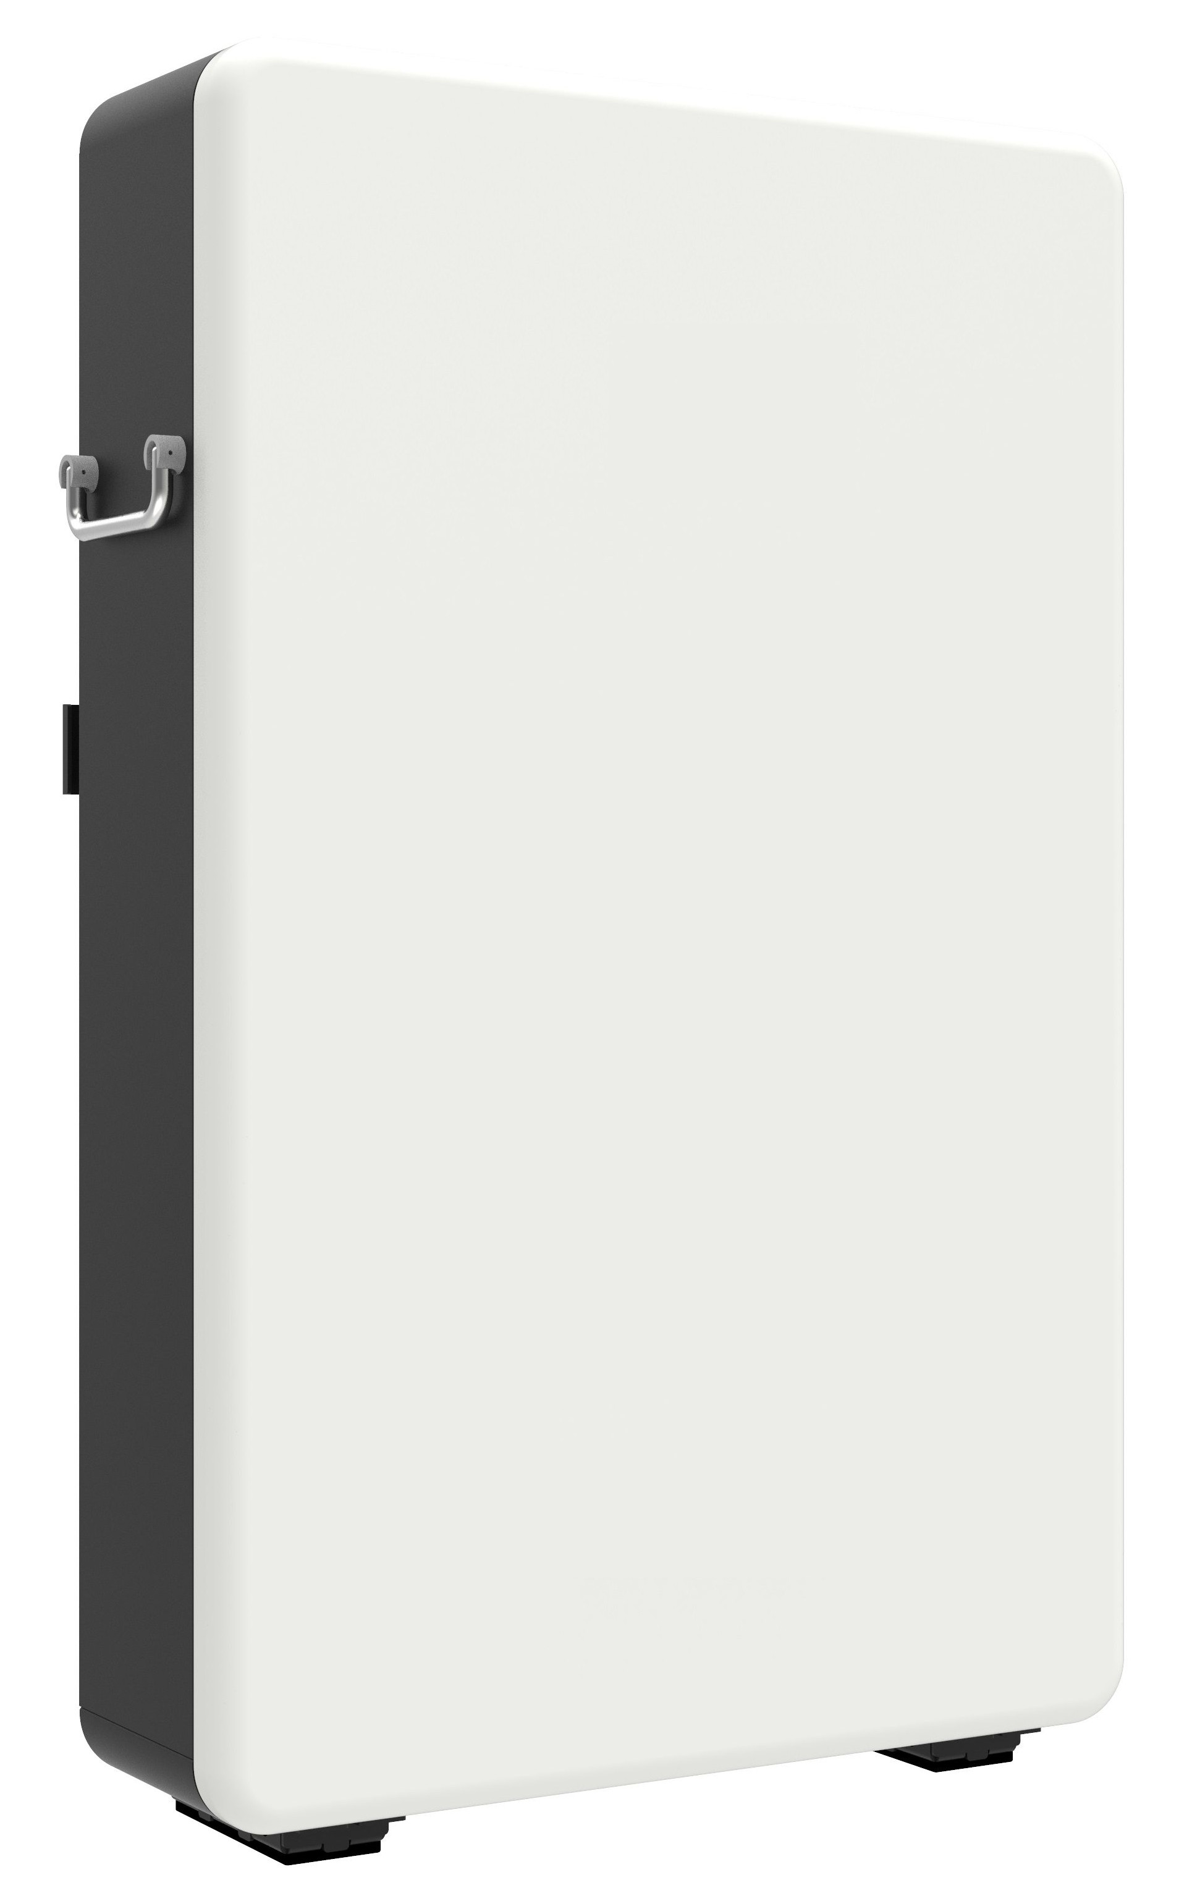

a
b
d
positive terminal
negative terminal
negative electrode
positive electrode
c
H₂O + H₂SO₄
cell

