Slide 1

Storage power (mismatch)
$$\text{Δ}=sin(\frac{2π}{T}t)$$
storage power capacity
charging
t
discharging
Storage energy level
filling level
storage energy capacity
t
t
T/2

Slide 2

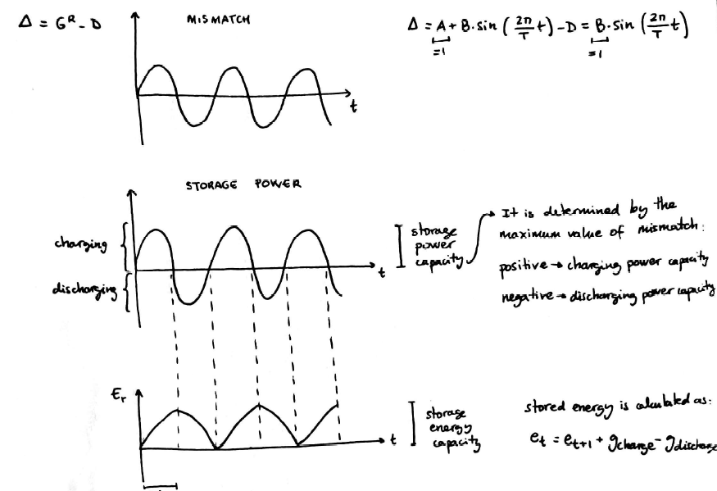
Δ$=G−L=sin(\frac{2π}{T}t)$

