Slide 1

CSE 583
Software Engineering for Data Scientists
Software Design
David Beck^{1,2}, Joseph Hellerstein^{1,3},
Bernease Herman¹, Daniel Jones³
¹eScience Institute
²Chemical Engineering
³Computer Science Engineering
University of Washington
October 30, 2018

Slide 2
Co-Locate With Your Project Team
Choose one member who has a word processor running on their computer
  MS Word, Libre Office, Google Docs

Slide 3


Slide 4
Software Design
"...specification of a software artifact, intended to accomplish goals, using a set of primitive components ..." [wikipedia]
Notes:
Question: From the perspective of evolutionary biology, are organisms designed? Why or why not?

Slide 5
Class Timeline
30 min: Lecture
  Design: why & how
  Use cases
  Component specification
10 min: Team component specification (4 members)
5 min: Team reports
Remainder: Work in teams

Slide 6
Design: Why & How

Slide 7
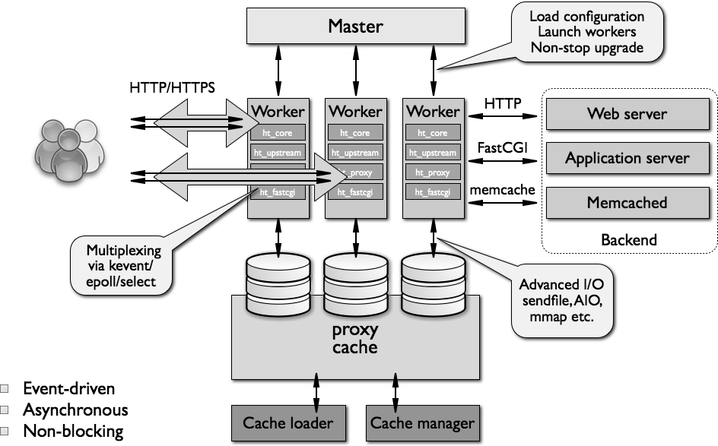
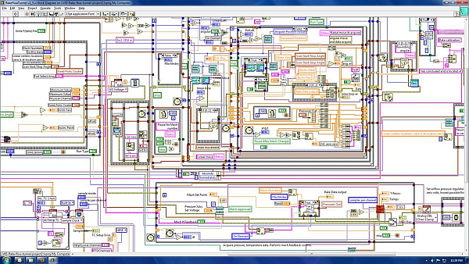
What Makes A Design Understandable?
Few components with clear roles
  Use abstraction hierarchies
Few interactions between components
  Carefully choose the features and interfaces
Similarity with other designs
  Use design patterns

Slide 8
Benefits of a Software Design
Provides a systematic approach to a complex problem
Finds bugs before you code
Enables many people to work in parallel
Promotes testability

Slide 9
Steps in Design
Functional design:
  Describe what the system does (use cases)
Component design: Specify the components
  Each use case has a "Top level" component.
  Sub-components implements portions of the use case
    Ideally want many components that are common across use cases
Iterate. Iterate. Iterate.

Slide 10
Functional Design

Slide 11
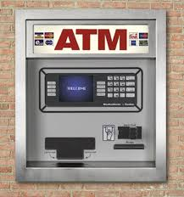
Running Example: Design of ATM

Slide 12
What Do We Do With ATMs?
Get cash
Deposit checks
Check balances
These are examples of Use Cases.
Implied use case – User authentication.

Slide 13
Describing a Use Case
What information the user provides
  E.g., command entered with its options
What responses the system provides
  E.g., prompts, plots, error messages
Authenticate User Use Case
User: Put ATM card in reader
ATM: Display 'Enter PIN'
User: Enters PIN on keyboard
ATM: [if correct] Show main menu
[if incorrect] Display 'Enter PIN'

Slide 14
Organization of Functional Specification
Background. The problem being addressed.
User profile. Who uses the system. What they know about the domain and computing (e.g., can browse the web, can program in Python)
Data sources. What data you will use and how it is structured.
Use cases. Describing at least two use cases
  Objective (e.g., withdraw money from an ATM)
  Expected interactions between the user and your system

Slide 15
Component Design

Slide 16
Specification of Components
Describe components with sufficient detail so that someone with modest knowledge of the project can implement the code for the component.
  Name
  What it does
  Inputs (with type information)
  Outputs (with type information)
  Interactions - how use other components

Slide 17
Developing Component Specifications
What are the components in the use cases?
What components are already available?
What are the sub-components needed to implement those components that aren't already available?
  Do 1-2 for each such component

Slide 18
Example Component Specification
Find Primes < N
Name
  FindPrimes
What it does:
  Finds the primes that are less than N
Inputs (with type information)
  N, an integer
Outputs (with type information)
  List of integers

Slide 19
Describing Interactions With Pseudo Code
Pseudo code for finding the primes < N if the one component is divides
  For n < N
    is_prime = True
    For d < n
      If divides(n, d)
      Then is_prime = False
    If is_prime, add n to list_of_primes
"Rules" for pseudo code
  Consistent use of flow control & variable names
  Readable English where details are sparse
Notes:
Not executeable statements
Some logic is implied (e.g., initializing list_of_primes)

Slide 20
ATM Components by Use Case
Authenticate user
  Database with user PIN
  User interface that reads ATM card
  User interface that reads user PIN
  Control logic
Get cash
  Database with users cash balance
  User interface that reads user cash requested
  Cash drawer interface that dispenses cash
  Control logic

Slide 21
The Next 20 Minutes
Your charter: Design for Authenticate User
  List of components of their interactions
    Who calls whom for each step in the use case
  Component(s) design using the design template
What you'll report: Very brief
  Summary of design
  Issues, open questions

Slide 22
Team Component Specifications
10 min

Slide 23
Team Results
5 min

Slide 24
Report
What we designed
  Which components
  What detail
What issues encountered
What do differently

Slide 25
Technology Review Presentations
Making decisions about the choice of a python library to address a technology need
Ex: choose map visualizations
  Bokeh, Dash, and googlemaps.
  choose a library that: (a) addresses your requirements; (b) compatible (e.g., runs on python 3); (c) easy to use; (d) computationally efficient; (e) doesn’t have software bugs that will impair your use cases.

Slide 26
Technology Reviews Start on Monday
10 minute group presentation
Brief description of your problem and technology needs (e.g., interactive maps).
A use case in which the technology is required.
One slide that describes at least two python libraries that address your requirements.
One slide side-by-side comparisons of the technologies.

Slide 27
Begin Project Functional Specification

Slide 28
Project Standups
What you’ve accomplished to date
Next steps
Blockers

